Slide 1
Unsolicited RSS for SLS in DTI
Date: 2017-7-13
Authors:
1

Slide 2
Introduction
In 11ad, a pair of STAs always perform both ISS and RSS in single TXOP/SP during DTI, which is not flexible and inefficient.
In 11ay D0.3, the NoRSS capability field indicates an EDMG STA supports SLS without RSS in a TXOP.
This contribution proposes unsolicited RSS instead of NoRSS, which needs less modifications to the SSW frame.
  The main difference is the term NoRSS is changed to Unsolicited RSS.
2

Slide 3
Proposed Unsolicited RSS (1/2)
In 11ay, the ISS and RSS can be performed in two different TXOPs.
Initiating Phase: ISS in TXOP1/SP1
  STA B that does not match the RA field of SSW frames can process the received SSW frames from the ISS or RSS of STA A.
Accomplishment phase: (unsolicited RSS + SSW Feedback + SSW Ack) w/o ISS in TXOP2/SP2
  Following TXOP1/SP1, the STA B initiates a new TXOP to perform unsolicited RSS including the Sector Select (Best Sector ID) for STA A.
3

Slide 4
Proposed Unsolicited RSS (2/2)
Unsolicited RSS may be used to respond to an earlier ISS or RSS .
  In TXOP1/SP1, STA A may set Direction = 0 (ISS) or Direction = 1 (RSS) .
  In TXOP2/SP2, the Direction field in SSW field is used to indicate the unsolicited RSS by the TXOP holder/SP source.
4

Slide 5
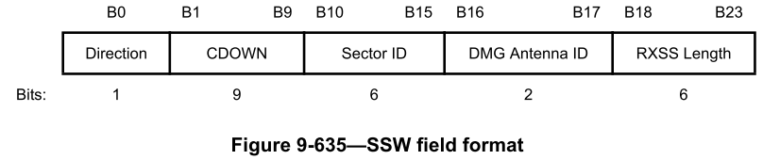
Signaling (1/3)
July 2017
Allow an EDMG STA to set the Direction field to 1 when operates as a TXOP holder/SP source STA.
  In 11ad, the TXOP holder/SP source shall set the Direction = 0 for ISS.
  But for the unsolicited RSS, the TXOP holder/SP source sets the Direction = 1.
5
Dejian Li (Huawei) et al

Slide 6
Signaling (2/3)
July 2017
Insert the Unsolicited RSS Enabled field to SSW Feedback field using one reserved bit.
  To indicate the SSW frame transmitter is capable to get an unsolicited RSS.
6
Dejian Li (Huawei) et al

Slide 7
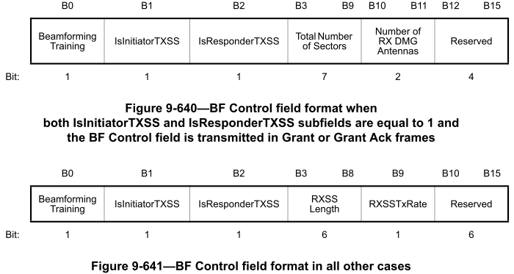
Signaling (3/3)
July 2017
Insert the Unsolicited RSS bit into the BF Control field
  IsInitiatorTXSS and IsResponderTXSS indicate that ISS and RSS are both always present in SLS, which cannot indicate the unsolicited RSS
Unsolicited RSS (B12)
7
Dejian Li (Huawei), et al

Slide 8
Conclusion
Using unsolicited RSS, BF time can be saved significantly due to skipping the already performed “ISS”.
Standard impact
  Use the Direction subfield in SSW field to indicate the unsolicited RSS or a normal ISS.
  Insert the Unsolicited RSS Enabled field to indicate the whether the trasnmitter of Unsolicited RSS Enabled field is ready to receive an unsolicited RSS.
  Insert Unsolicited RSS field to the BF Control field
8

Slide 9
Straw poll 1
Do you agree that the text in contribution 17/1085r0 (Proposed resolution to NoRSS related CIDs) shall be incorporated in the 11ay draft?
  Y /N /A
9

