Slide 1
UL transmission behavior of WUR STA
Date: 2017-09-13
Authors:

Slide 2
Abstract
In this contribution,
  We discuss general uplink transmission behaviors of non-AP STA using WUR mode
  We propose to define a guard time to avoid status mismatch problem when a WUR STA returns to the doze state from the awake state

Slide 3
UL behavior of PS STA
General UL transmission behavior of WUR STA can be readily understood by the SFD and baseline PS STA’s behavior
When a STA is using the power save mode,
  The STA enters the awake state to receive or transmit frames. The STA remains in the doze state otherwise
When a PS STA receives data from the upper layer,
  The PS STA may enter the awake state anytime it wants
    Since the STA does not retrieve buffered BUs, the PS STA doesn’t have to report the AP that it enters the awake state
  After the successful UL transmissions, the PS STA returns to the doze state automatically
  No additional signaling is required for UL transmission

Slide 4
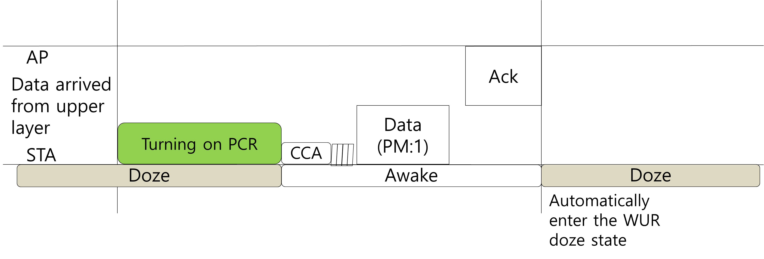
UL behavior of WUR STA
A WUR STA uses WURx when it is in the doze state
When a WUR STA receives data from the upper layer, it may enter the awake state
  Waking up its PCR
  Once a NAV is set or by the expiration of NAVSyncDelay, it may access the channel using EDCA
After successful UL transmission, the WUR STA returns to the doze state automatically
  Turn off the PCR and turn on the WURx
No additional behavior needs to be defined for WUR STA

Slide 5
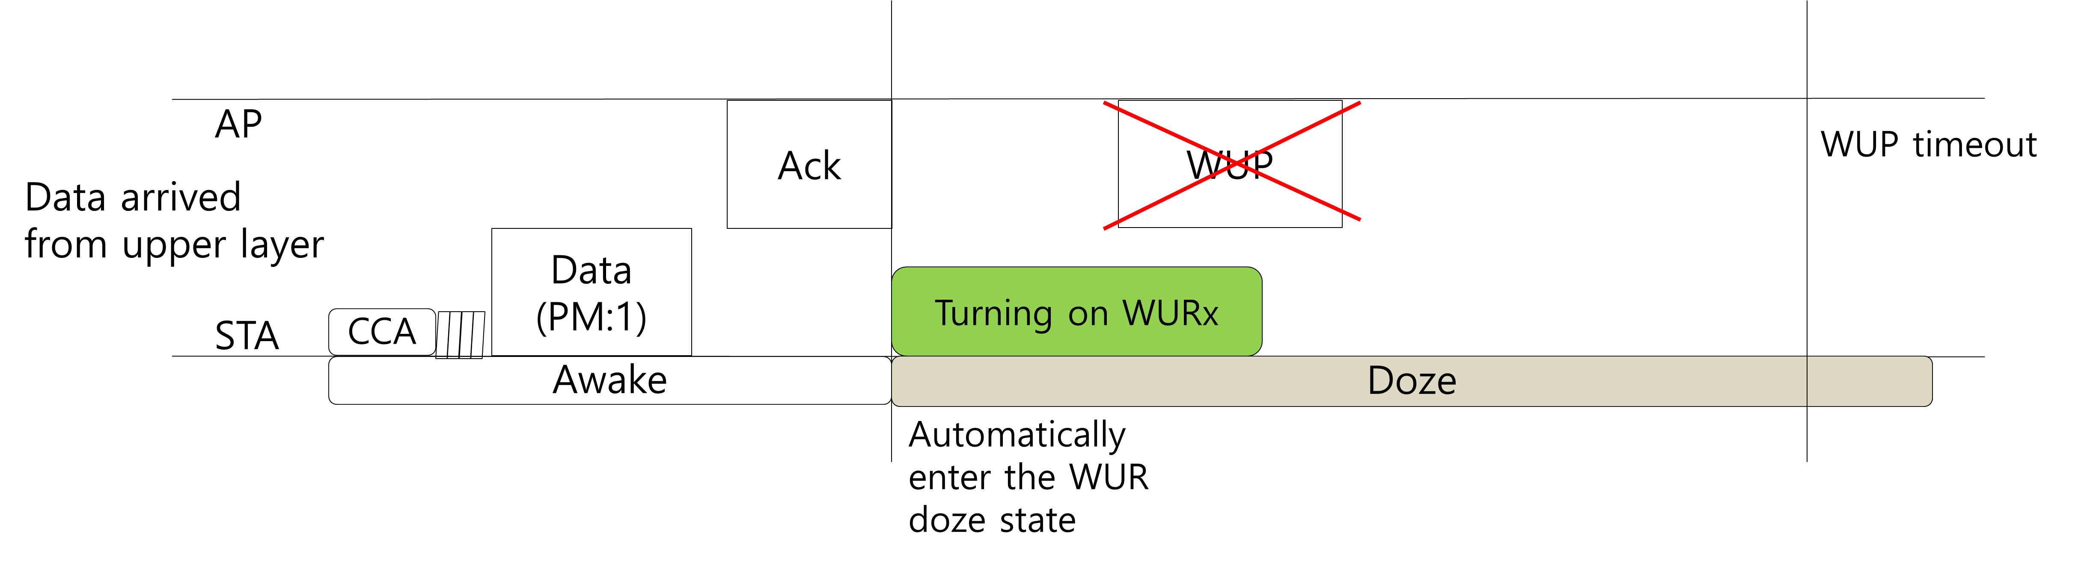
Following behaviors after UL transmission
After a successful UL transmission of a WUR STA, the AP expects that the STA returns to the doze state
However, the AP may not know when the STA is ready to receive WUP
  The STA might have turned off its wake-up receiver during the awake state
  The STA may require some time to set its WURx ready
Any unicast WUPs transmission to the STA during the turn-on latency of WURx will fail
  Resulting in WUP timeout
    Expected overhead caused by a failed WUP is very high

Slide 6
Turn-on latency of WURx
The problem in the previous slide could happen whenever a WUR STA changes the power state from the awake to the doze state
When a WUR STA enters the awake state, the AP considers the wake-up delay of the STA
  After transmitting a unicast WUP, the AP does not transmit a frame until the STA indicates that the STA’s PCR is ready to receive
  The AP may set the WUP timeout based on the wake-up delay of the STA
On the other hand, the turn-on latency of WURx hasn’t been discussed
  The AP may transmit WUP without considering the readiness of WURx
    WURx has no capability to indicate its readiness
The turn-on latency of WURx needs to be considered as well when a WUR STA enters the doze state

Slide 7
Possible approaches
Two possible approaches can be considered
  Option 1) STA side, reducing or eliminating the latency of turning on WURx:
    Turning on WURx before it returns to the doze state
    Not turning off WURx during the awake state
    Or, requiring very small turn-on latency for all WURx implementations
  Option 2) AP side, AP considers the latency before it transmits WUP
    Not sending WUP during an expected time of turning on STA’s WURx
We prefer option 2)
  Option 1) may increase power consumption and implementation complexity of WURx
  Option 2) requires less restrictions on the behaviors of both AP and STA

Slide 8
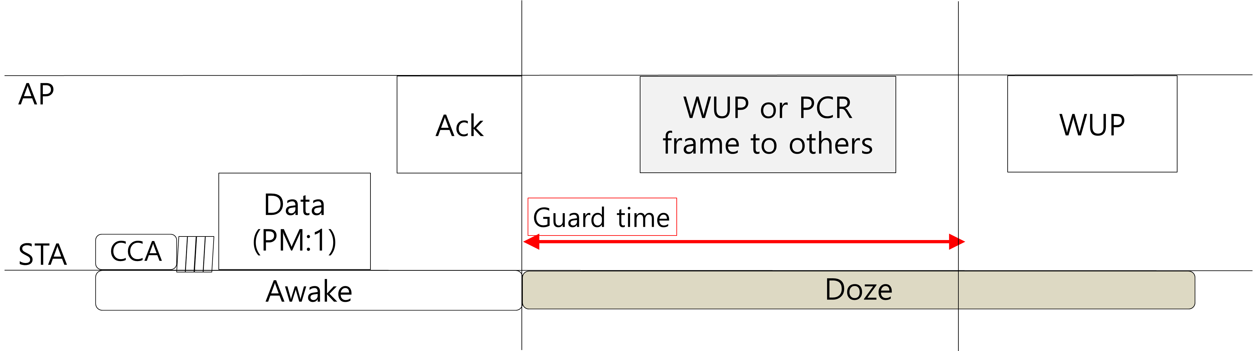
Guard time for WUR STA
A guard time can be considered when a WUR STA enters the doze state
  For example, the guard time starts at the end of WUR STA’s UL transmission sequence
Within the guard time,
  The AP should not send a WUP to the STA entering the doze state
    Otherwise, AP can do anything
  The STA should turn on its WURx within the guard time if it enters the doze state
The guard time may be negotiated
  Using PCR WUR management element

Slide 9
Conclusions
We have discussed the uplink transmission behaviors of WUR STA
We have proposed to use a guard time when a WUR STA enters doze state from awake state to prevent AP to transmit a unicast WUP to a WUR STA within the turn-on latency of WURx

Slide 10
Strawpoll
Do you agree with the following?
  If a non-AP STA is in WUR mode, the AP does not send a unicast wake-up packet to the STA for a guard time after the STA enters the doze state

