Slide 1
WLAN-IOT: Low Complexity & Constrained Peak Power Consumption WLAN
Date: 2017-07-11
Authors:
Chittabrata Ghosh, Intel

Slide 2
Abstract
July 2017
This presentation introduces a new 802.11 WLAN paradigm focusing on enhancing the well established WLAN ecosystem to support the upcoming massive number of small form-factor smart devices for Internet of Things (IOT) applications
WLAN-IOT brings a new set of requirements focusing on small form-factor, and constrained peak power consumption rather than on performance
Chittabrata Ghosh, Intel

Slide 3
Content of this Contribution
Need for WLAN-IOT
Use Cases and Requirements
Advantages of WLAN-IOT over other low power WLAN technologies
  Comparison with respect to existing 802.11 technologies
Solution gap and why focus on low complexity and peak power constrained applications
Scope for WLAN-IOT
Timeline
Chittabrata Ghosh, Intel

Slide 4

Target IOT Verticals for WLAN-IOT
Asset Tracking and Monitoring
Predictive Maintenance
Environment Monitoring
Connected Workers
Flow Control
Asset Tracking and Monitoring
Smart Lighting and
HVAC
Security and safety systems
Elevator Control
Smart Lighting
Home Assistants
Security and Safety Systems
Remote patient care
Health tracking
Sleep monitoring
Wellness tracking
Asset Tracking and Monitoring
Predictive Maintenance
Environment Monitoring
Connected Workers
Flow Control
Asset Tracking and Monitoring
Smart Lighting and
HVAC
Security and safety systems
Elevator Control
Smart Lighting
Home Assistants
Security and Safety Systems
Remote patient care
Health tracking
Sleep monitoring
Wellness tracking
Chittabrata Ghosh, Intel

Slide 5
Estimated Home Automation Proliferation by 2020
Source: 16-05-27 IHST iot-connectivity-market-tracker-q1-2016
No single leading technology: Most popular 802.15.4, Thread, Z-Wave, and BLE
Chittabrata Ghosh, Intel

Slide 6
Estimated Total Available Market (TAM) of Wireless Technologies in 2020
TAM 2020 in other IOT Sectors
TAM: 55763Ku
TAM: 44309Ku
TAM: 48901Ku
Source: 16-05-27 IHST iot-connectivity-market-tracker-q1-2016
WLAN-IOT has potential to compliment 802.11n, 802.15.4, and BLE in 2.4GHz
Chittabrata Ghosh, Intel

Slide 7
Use Cases for WLAN-IOT
Smart Environmental Sensors
  Sensors such as temperature variation sensor, carbon monoxide sensor etc. typically asleep for long-periods of time
    Extended home coverage [1]
  Sensor wakes up on events and/or pre-defined schedule to transmit a small amount of data
  Key requirements
    Small device size, long sleep time and long battery life, easy provisioning
    Peak data rate less of an issue
Intelligent Automation
  Actuators (e.g. irrigation systems), Smart appliances (where one wants ease of placement, regardless of proximity to AC power), Voice Assistant “range extenders”
  Devices wake on either remote control or non wireless event
  Key requirements
    Long battery life, small form-factor, predictable low latency (< 200ms)
[1] IEEE 802.11-17/0784r0 “Wi-Fi Enhancement for Full Coverage at Smart Home : Part-I (Coverage Investigation),” May 2017
Chittabrata Ghosh, Intel

Slide 8





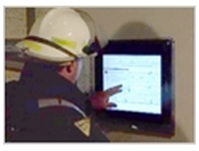




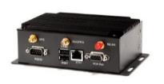
Use Case 1: Connected Portable Devices
WLAN-IOT
Portal
(actionable intelligence)
WLAN-IOT
Smartphone
Cloud
Cellular
Helmet with camera
Cellular
802.11ax
Coat with embedded Wi-Fi sensors
WLAN-IOT
Data transmission rate:
  Sensors to Smartphone: Ranging between 2Mb/s to 10Mb/s
  Smartphone to IOT Gateway: > 20Mb/s
Transmission range:
  Sensors to IOT Gateway: Ranging between 10m-200m
IoT Gateway / AP
Chittabrata Ghosh, Intel

Slide 9
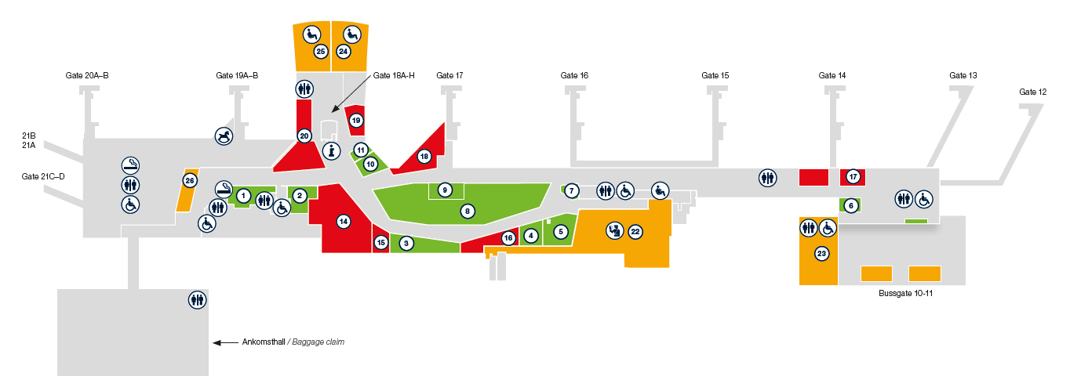

Use Case 2: Gothenburg Airport
July 2017
        doc.: IEEE 802.11-17/1036r0
What is the most suitable radio technology to maintain restrooms in a large deployment?
  Sensors counting number of restroom visitors
  Hand towel, toilet paper, and soap dispensers monitoring their filling status
Selection criteria
  Installation
  Number of Gateways/Relays
  Radio Performance
    Coverage
    Capacity
  Reliability
  Battery Life
  Cost
Technologies under analysis
  802.15.4, ZigBee
  Bluetooth 5
  Bluetooth Low Energy Mesh
  LoRa
Opportunities for WLAN-IOT
  WLAN ecosystem
  Proven security
  Leverage on seamless integration with existing airport WLAN
Data transmission rate: 10B reports every 5 mins
Battery: Coin cell
Battery lifetime: Minimum 2 years, 5 years desirable
Chittabrata Ghosh, Intel

Slide 10
Advantages of WLAN-IOT over other Low Power WLAN Technologies
New WLAN vs 11b | New WLAN vs 11ah | New WLAN vs 11n low power
Higher device density Reduced peak power consumption Better integration with 11ax network | Spectrum Uses existing world harmonized band No need to develop new radio ecosystem Support for higher device density Better integration with 11ax network | Reduced active power consumption (for similar operation range) Higher device density Better integration with 11ax networks
WLAN-IOT to evolve from existing WLAN ecosystem with the unique features of:
  Enabling coin cell powered STAs
  Maintain high density efficiency of 11ax
Chittabrata Ghosh, Intel

Slide 11
Relationship of Peak Transmit Power and Internal Resistance of Battery
Maximum current delivered by a battery is directly proportional to the internal series resistance (ESR) of the battery
Power dissipation within battery is the ESR multiplied by square of the current delivered
With current discharge of 500 uA (~200 uA for CR2032) , battery capacity = 230mAh to 240 mAh
With increasing current discharge, effective battery capacity drops
  With 2.5mA current discharge, capacity drops to 175mAh (prior to reaching Functional End Point)
Inherent limitation of coin cell operation is max Tx power consumption
Chittabrata Ghosh, Intel

Slide 12
Solution Gap in Existing Low Power WLAN Technologies
None of the baseline low power WLAN technologies can operate on coin cell operated devices; hence, smaller form factors targeted for embedded IOT applications are infeasible for WLAN
WLAN-IOT will target exclusively on reduced active power consumption and support of higher device density
  Allows smaller form-factor, enhanced battery life, and better network capacity in the presence of multiple WLAN-IOT devices
  Allow reduce complexity to compete with other existing technologies predominant in the IOT vertical markets
Chittabrata Ghosh, Intel

Slide 13
Why Peak Transmit Power is Critical?
With channel BW is 20 MHz, peak transmit power consumption is affected by the following factors:
  Required Tx power is a linear function of BW and power consumption directly related to Tx power
  Sampling rate is at least 40MHz and can have a ADC whose resolution is 8 to 10 bits depending on MCSs employed
  The noise power, expressed as kTB, also increases for 20MHz BW
  Besides this OFDMA also has high PAPR in 20MHz with 256 QAM and 1024 QAM
  The RF for 20MHz 802.11ax has to be improved to counter spectral regrowth
Possible solution to reduce peak transmit power consumption is considering channel bandwidth narrower than 20MHz
  802.11ax has defined a wideband device operation and a low cost low power option of 20MHz-only STA operation
  Narrower BW over 20MHz channel width will reduce peak transmit power consumption allowing coin-cell operation
    For example, 2MHz channel BW has 10x benefit over 20MHz for the power amplifier
Power consumption critical for battery-powered applications
  Example: Home thermostats, security systems, key finder, wearables
Chittabrata Ghosh, Intel

Slide 14
Battery Capacity with Cell Size
  An AA cell measures 49.2 mm to 50.5 mm (1.94 in to 1.99 in) in length, including the button terminal—and 13.5 mm to 14.5 mm (0.53in to 0.57 in) in diameter
  A triple-A battery is a single cell and measures 10.5 mm in diameter and 44.5 mm in length
  The AAAA battery (usually read as quadruple-A) is 42.5 mm long and 8.3 mm in diameter.
  CR2032 is 20 mm diameter and 3.2 mm length
Battery Characteristics
Battery Capacity (mAh)
AA Battery - NiMH (mAH) @1.5V
3900.00000
AAA Battery - Alkaline (mAH) @1.5V
1200.00000
AAAA Battery - Alkaline (mAH) @1.5V
500.00000
CR 2032 Button Cell - Li Ion (mAH) @3V
210.00000
Reference: http://batteryuniversity.com/learn/article/discharge_characteristics_li
Chittabrata Ghosh, Intel

Slide 15
Scope for WLAN-IOT
The amendment defines a physical (PHY) layer specification and defines modifications to the medium access control (MAC) layer specification that enables operation of a low complexity and constrained peak power consumption STA.
This amendment shall define at least one mode of reduced functionality of a non-AP low complexity and constrained peak power consumption STA with reduced complexity in connectivity module over a 20MHz 11n STA.
The peak transmit power consumption of a low complexity and constrained peak power consumption non-AP STA is at least 50% less than that of an IEEE 20MHz 802.11n STA operating in low power mode including coin cell operation.
The low complexity and constrained peak power consumption non-AP STA coexists with legacy IEEE 802.11 devices in the same band. This amendment defines operations for 2.4GHz and 5GHz bands.
  The coexistence is provided by the AP operating with transmit power higher than the low complexity and constrained peak power consumption STA and able to quiet the network of legacy STAs for frame exchange.
Striping major PHY and MAC components of 11ax protocol
Tweak the 11ax PHY to support WLAN-IOT
Chittabrata Ghosh, Intel

Slide 16
Proposed Projected Timeline for WLAN-IOT
Feasible target for WLAN-IOT launch
WLAN-IOT TG formation
Draft 1.0
Initiate WFA program
Draft 2.0
Initial Sponsor
Ballot
WLAN-IOT in WNG
WLAN-IOT Draft 0.1
WLAN-IOT SG
July 2017
(plenary)
Sept 2017
(interim)
Jan 2018
Jan 2019
May 2019
Nov 2019
July 2020
17 months
9 months
6 months
WNG: IEEE 802.11 session on Wireless Next Generation
SG: Study Group that develops the PAR
TG: task Group that develops the amendment
WFA: Wi-Fi Alliance that certifies interoperability of products
Optimistic target for WLAN-IOT launch
(Jan2019 – May 2020)
Chittabrata Ghosh, Intel

Slide 17
Straw Poll
Would you support a Study Group on WLAN-IOT?
Chittabrata Ghosh, Intel

