Slide 1
Changes to IEEE 802.11ay in support of mmW Distribution Network Use Cases
Date: 2017-07-10
Authors:

Slide 2
Abstract
This presentation proposes initial set of changes to IEEE 802.11ay [1] in support of mmW Distribution Network Use Cases [2]
Ability to latch state of TSF counter to external PPS (e.g. over GPIO) in distribution nodes to enable network wide timing synchronization
Maximum 1usec timing drift over 100msec
Implicit Block-ACK delayed to next SP allocated in opposite direction
Golay code index selection per link
Indication in the Beacon Transmission to indicate subsequent DTI pertains to the mmW Scheduled Access

Slide 3
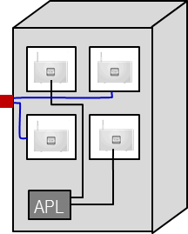
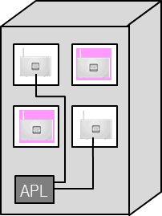
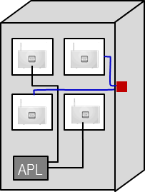
mmWave Distribution Network Use Cases [2]
Provider
Network
Small cell
WTTB
Wi-Fi AP
Fiber PoP (cabinet)
Mesh WBH
Fiber PoP (to Provider Network)
fiber
Focus on use case specific Mesh WBH requirements
mmWave AP
mmWave link
mmW Distribution NW
LOS 60 GHz narrow beam system
Own management and control per mmWave mesh access area
Route control protocol supports re-routing over radio links
Auto-alignment installations via adaptive beamforming
Redundancy of active equipment at “first” pole next to fiber PoP or via connections to 2 or more fiber PoPs
Radio link degradation and outage recognition w/ failure localisation
WTTH
Small cell
Use case c) WiFi AP / SC
Use case a) WTTH
WTTB
Use case b) WTTB
WTTB
WTTH
Wi-Fi-AP
Alternative: Wireless inhouse
RGW

Slide 4
Main Challenges to Achieve Full Potential for the mmW Distribution NW Use Cases
Relatively large density with few hundred AP radio sectors per sqkm deployed in multi-hop multi-point topology
Despite DMG PHY, the co-channel interference remains the main impediment
Random nature of co-channel interference prevents any meaningful interference management and mitigation on L2
False locks
mmW Distribution NW use case specifics
Centralized controller for NW management
Nodes are static (however, adaptive BF still needed)
Upgrades for deployed topology are infrequent planned events
Different set of constrains from typical nomadic use cases with handheld devices

Slide 5
Co-channel Interference
Typical issues with random nature of co-channel interference, exposed and hidden node problems carry over to the new mmW Distribution NW Use cases
In example bellow, each lamppost installation has 4 collocated APs (aka radio sectors)
Hidden node
Exposed node

Slide 6
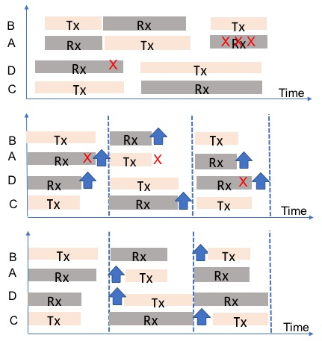
Interference Between SPs Across Network
Current spec enables data to be organized into CBAPs and SPs
Uncoordinated SPs across APs
Uncontrolled interference across NW
Coordinated SPs across APs
Interference still present from immediate BACK
Coordinated SPs across APs with BACK delayed to next slot in opposite direction
Interference can be mitigated

Slide 7
Network Wide Node Synchronization and Modified delayed BACK
Since nodes (APs) in mmW Mesh Network are static, random nature of intra-network interference can be minimized by semi-static coordination of transmissions (SPs) across links
Provision for ability to latch the state of TSF counter to external PPS (ie, over GPIO) in each mesh node to enable network wide timing synchronization
Maximum 1usec timing drift over 100msec
Implicit Block-ACK delayed to next SP allocated in opposite direction
For sake of this presentation, we denote this mode as the Centralized Coordination Function (CCF), as opposed to Distributed Coordination Function (DCF)

Slide 8
CCF and DCF
More than 6.5dB higher SIR for CCF vs DCF
Extra 2dB gain in SIR at 100m link distance for P region rain assumption

Slide 9
Field Data
DCF
CCF
* max achievable (MCS12 and MCS9)

Slide 10
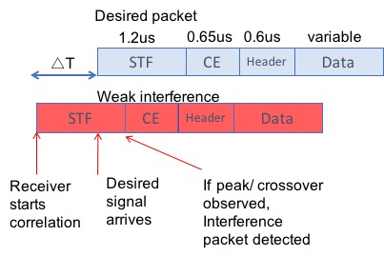
Blocking Effect
In typical wireless distribution system, co-channel interference mainly limits the operating SINR on the link
In WiFi based systems, there is an additional blocking effect
Packet detection is based on Preamble with STF and CE training sequences which are common to all links in the system
Segregation of desired and undesired link signals is based on MAC address
Receiver locks onto an early weak interference packet when △T ∈ [1.2usec-𝛼, 2.45us]
Desired packet may be blocked from being detected
Exact value of 𝛼 depends on CRS thresholds, and details of AGC and packet detection implementation
Unduly limits the spectral efficiency in fixed wireless distribution system

Slide 11
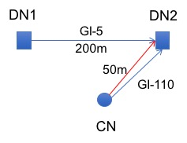
Golay Code Index Selection
Define subset of 3-4 Golay Code Indexes (GIs) with best cross-correlation properties to be assigned to individual links upon association
Default Golay sequence for “onboarding” mmW Distribution NW nodes can be predefined in spec, or receiver can sweep through predefined set (blind detection)
Table 1: Peak suppression as function of GI pair [dB]: Third order set
Example: One radio sector on each side of square, Red arrow denotes early weak interference
Table 2: Peak suppression as function of GI pair [dB]: Forth order set

Slide 12
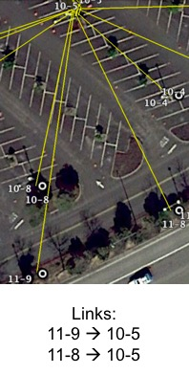
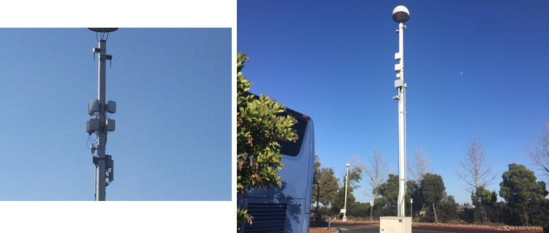
Blocking Effect Field Scenario
11-9
10-5
11-8

Slide 13
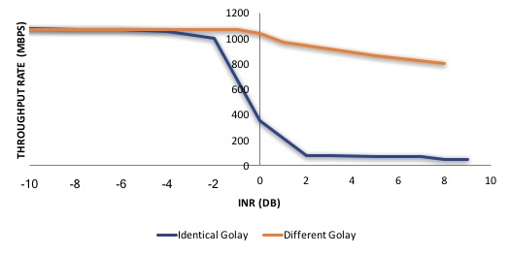
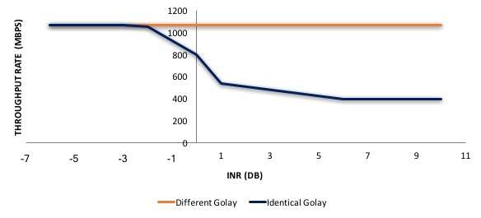
Golay Code Index Selection: Field data
CSR default
MSC9 50% duty cycle (TDD) on both links transmitting simultaneously , max Tput per link 1.05Gbs
CSR optimized

Slide 14
Summary of Proposal
Adopt initial set of changes to Draft 1.0 of 802.11ay to support requirements for the new mmW Distribution Network use cases
Enable centralized co-channel interference management and mitigation
Ability to latch state of TSF counter to external PPS (e.g. over GPIO) in distribution nodes to enable network wide timing synchronization
Maximum 1usec timing drift over 100msec. Recommended implementation, does not require spec change.
Implicit Block-ACK delayed to next SP allocated in opposite direction
The rest of MSDU to AMPDU data path unmodified
Alleviate the blocking problem
Golay code index selection per link
Assure co-existence with other use cases in the spec
Indication in the Beacon Transmission to indicate subsequent DTI pertains to the mmW Scheduled Access

Slide 15
References
[1] IEEE P802.11ayTM/D0.3, March 2017
[2] IEEE 802.11-17/1019r0 “mmWave Mesh Network Usage Model”

