Slide 1
ETSI Software Reconfiguration Overview
Date: 2017-07-11
Authors:
Name | Affiliations | Address | Phone | email
Markus Mueck | INTEL | Am Campeon 10-12, 85579 Neubiberg, Germany | +49-89-99885363149 | Markus.Dominik.Mueck@intel.com
Bahareh Sadeghi | INTEL | 2111 NE 25th Ave Hillsboro, OR 97124 USA | +1-503-803-2471 | Bahareh.Sadeghi@intel.com

Slide 2
Overview
Motivation
ETSI Software Reconfiguration Solution
Conclusion

Slide 3
Motivation
Softwarization and Virtualization are currently a network topic
  Virtualization such as Network Function Virtualization
  Software Defined Networking
  Mobile Edge Computing
  Etc.
Observation: A similar discussion is not (yet) ongoing for the client (terminal) side
Questions:
  Are there client-centric use cases for which Software Reconfigurability may provide added value?
  Why did it not work out in the past? Which are critical design requirements and existing solutions?

Slide 4
Use Cases
ETSI is issuing a “Software Reconfiguration White Paper” focusing on three Use Cases:
Automotive applications
  Challenge: Lifetime of communication components is substantially longer (> 10 yrs) compared to Smartphones (~ 2 yrs), etc.
  Requirement: How to resolve vulnerabilities which may come up over the lifetime of a vehicle (>10 years)
IoT
  Challenge: A substantial number of different IoT applications exist, it is challenging to provide a dedicated chipset solution for each case.
  Requirement: How to enable a generic chipset platform to be tailored to a specific IoT application through SW Reconfiguration?

Slide 5
Use Cases
Mass Market „Smartphones“ and similar
  Challenge: Smartphone Apps are not able to alter radio characteristics of a client device due to certification issues, etc.
  Requirement: To define an ecosystem (comprising technical, security and regulation solutions) to extend the existing „App“ eco-system to „Radio-Apps“ which are apple to (selectively) alter radio parameters.

Slide 6
Why did Software Reconfiguration fail in the past for commercial mass-market devices?
Efficiency
  Past approaches were mainly building on a “middle-ware” approach
  In commercial mass market products, however, the main source for efficiency lies in the joint optimization of HW/SW. A middle-ware limiting designers with respect to power efficient solutions.
  Conclusion: The ETSI approach allows for code portability while maintaining joint HW/SW optimization through a „Radio Virtual Machine (RVM)“ approach.
Gradual transition towards SW Reconfiguration
  Past approaches were requiring a „too big step“ from manufacturers, moving from ASIC solutions to full SW implementations
  Conclusion: The ETSI approach allows for a gradual approach, e.g. replacing ASIC component in case of vulnerabilities being identified.

Slide 7
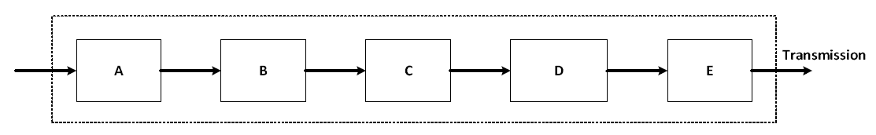
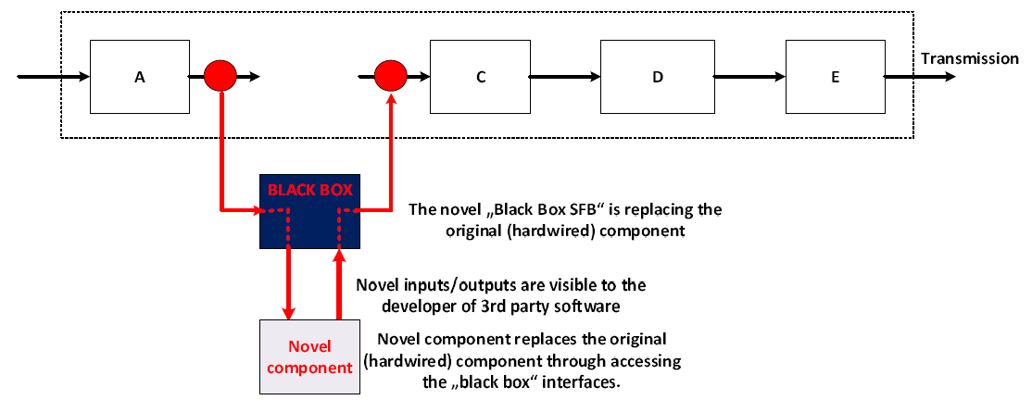
Gradual Reconfiguration Approach
EN 303 146-4: Radio Programming Interface

Slide 8
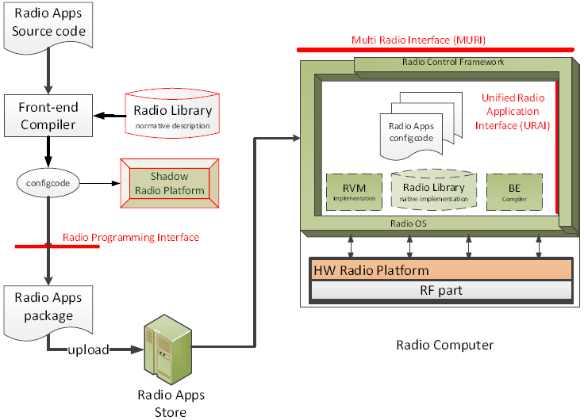
The ETSI SW Reconfiguration Eco-System
EN 303 095: Software Reconfiguration Architecture

Slide 9
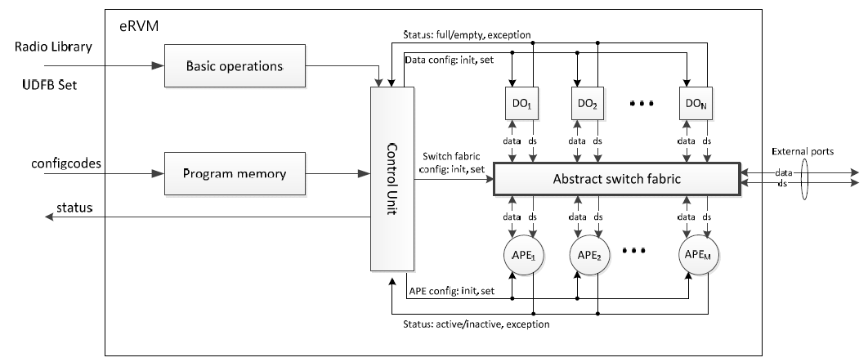
SW Reconfiguration – Efficiency through Radio Virtual Machine approach, EN 303 146-1/2/3/4
Radio Virtual Machine Approach

Slide 10
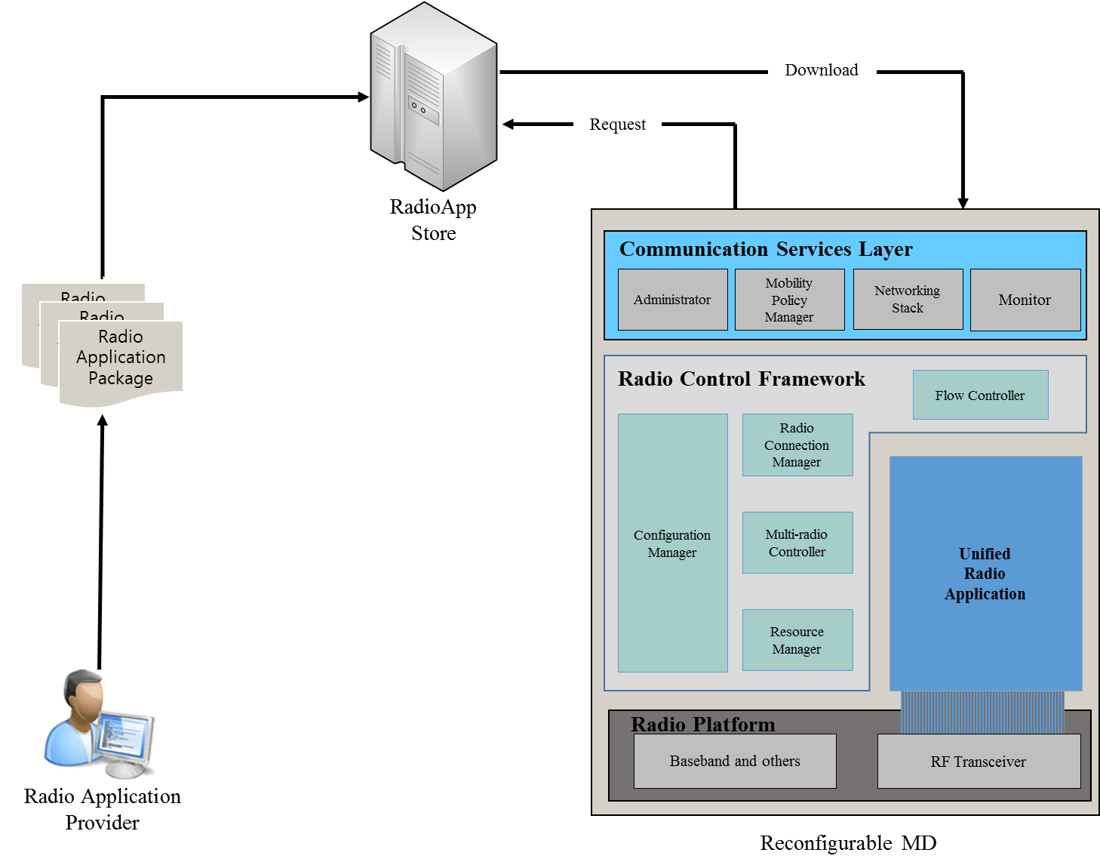

Interfaces defined by ETSI
Interfaces are defined in EN 303 146-1/2/3/4
Multiradio Interface (MURI)
Administrative Services
Access Control Services
Data Flow Services
Unified Radio Application Interface (URAI)
Radio Application Management Services
User Data Flow Services
Multiradio Control Services
Radio Programming Interface (RPI)
Reconfigurable RF Interface (RRFI)
Spectrum Control Services
Power Control Services
Antenna Management Services
Tx/Rx Chain Control Services
RVM Protection Services

Slide 11
Certification Approach
ETSI TR 102 967: Following discussions with regulation administrations, the approach is to have a single responsible entity (“Conformity Contact Entity”) for the combination of HW and SW

Slide 12
Security Solutions
Security mechanisms defined in ETSI TR103 087, TS103 487
  Proof of the integrity of the Radio Applications, RE Configuration Policy and Declaration of Conformity;
  Proof of the identity of the developer of Radio Applications, the issuer of the RE Configuration Policy, and the issuer of the Declaration of Conformity;
  Prevention of an asset installation when the asset is not provided by a legitimate actor;
  Use of the reconfiguration feature as a security update mechanism;
  Proof of conformance of the radio platform and radio application to the regulatory Declaration of Conformity, considering that the set of installed radio applications can change over time;
  Prevention of illegitimate use of the Declaration of Conformity (in particular against counterfeit);

Slide 13
Security Solutions
Security mechanisms defined in ETSI TR103 087, TS103 487
  Audit functionalities including a non-repudiation framework and remote attestation;
  Long-term management framework (e.g., transition of equipment responsibility from one manufacturer to another);
  Prevention of masquerade of stakeholders in the RRS value chain;
  Prevention of code theft; and,
  Supply chain integrity and assurance (which underpins all of the above measures).

Slide 14
Conclusion
ETSI EN 303 095 and EN 303 146-1/2/3/4 provide a framework for Software Reconfiguration including technical, security and regulation solutions
New Working Items have been agreed at last ETSI RRS meeting to extend the solution to Wireless Equipment in general
In Europe, the European Commission is in the process of setting up an „Expert Group“ for implementing articles 3(3)(i) and 4 of the Radio Equipment Directive (RED) related to Software Reconfiguration
The ETSI SW Reconfiguration Framework may be applied to any type of wireless technology client devices and client technology – it may thus support IEEE 802.11 equipment over its lifetime.

Slide 15
References
[1] ETSI EN 302 969 V1.2.1 (2014-11), Reconfigurable Radio Systems (RRS); Radio Reconfiguration related Requirements for Mobile Devices
[2] ETSI EN 303 095 V1.2.1 (2015-06), Reconfigurable Radio Systems (RRS); Radio Reconfiguration related Architecture for Mobile Devices
[3] ETSI EN 303 146-1 V1.2.1 (2015-11), Reconfigurable Radio Systems (RRS); Mobile Device Information Models and Protocols; Part 1: Multiradio Interface (MURI)
[4] ETSI EN 303 146-2 V1.2.1 (2016-06), Reconfigurable Radio Systems (RRS); Mobile Device (MD) information models and protocols; Part 2: Reconfigurable Radio Frequency Interface (RRFI)
[5] ETSI EN 303 146-3 V1.2.1 (2016-08), Reconfigurable Radio Systems (RRS); Mobile Device (MD) information models and protocols; Part 3: Unified Radio Application Interface (URAI)

Slide 16
References
[6] ETSI EN 303 146-4, to appear, Reconfigurable Radio Systems (RRS); Mobile Device (MD) information models and protocols; Part 4: Radio Programming Interface (RPI)
[7] ETSI TR 103 087 V1.1.1 (2016-06); Reconfigurable Radio Systems (RRS); Security related use cases and threats in Reconfigurable Radio Systems
[8] ETSI TS 103 436 V1.1.1 (2016-08); Reconfigurable Radio Systems (RRS); Security requirements for reconfigurable radios
[9] ETSI TR 102 967: Reconfigurable Radio Systems (RRS); Use cases for dynamic equipment reconfiguration, V1.2.1, 2015

