Slide 1
Broadcasting on WLAN
Date: 2017-09-11
Authors:

Slide 2
Abstract
This presentation describes a proposal of broadcasting on WLAN.

Slide 3
Motivation
Many people need common information at specific locations, such as
  Live comments at a stadium,
  Explanation at a tourist attraction,
  Timetable at a train station,
  Floor plan at a shopping mall, or
  Emergency information.
We call them “local information” in this presentation.
Currently people need to do the following actions.
  Search web site.
  Get the local information by unicast traffic.
These actions waste channel time/bandwidth.
Broadcasting local information on WLAN can reduce per user bandwidth.

Slide 4
Broadcasting Service on WLAN
WLAN is a suitable medium for local broadcasting service, but it is not used.
  Radio wave is suitable for broadcasting based on its nature.
    Anyone can listen in the range.
  Frequently changed information, such as vacant space at a parking lot, can be reflected in real time.
  IEEE802.11 WLAN has broadcast mechanism (group address)
  Unlicensed
  Locality
  Low cost
Currently used broadcasting services on WLAN, such as YouTube Live, Facebook Live
  Application layer broadcasting
  It is composed of many independent unicast streams in a single BSS.
    The occupied bandwidth is proportional to the number of participating users.
  The current model suffices if users are distributed world-wide, but works highly inefficiently when they are located in a small area.

Slide 5
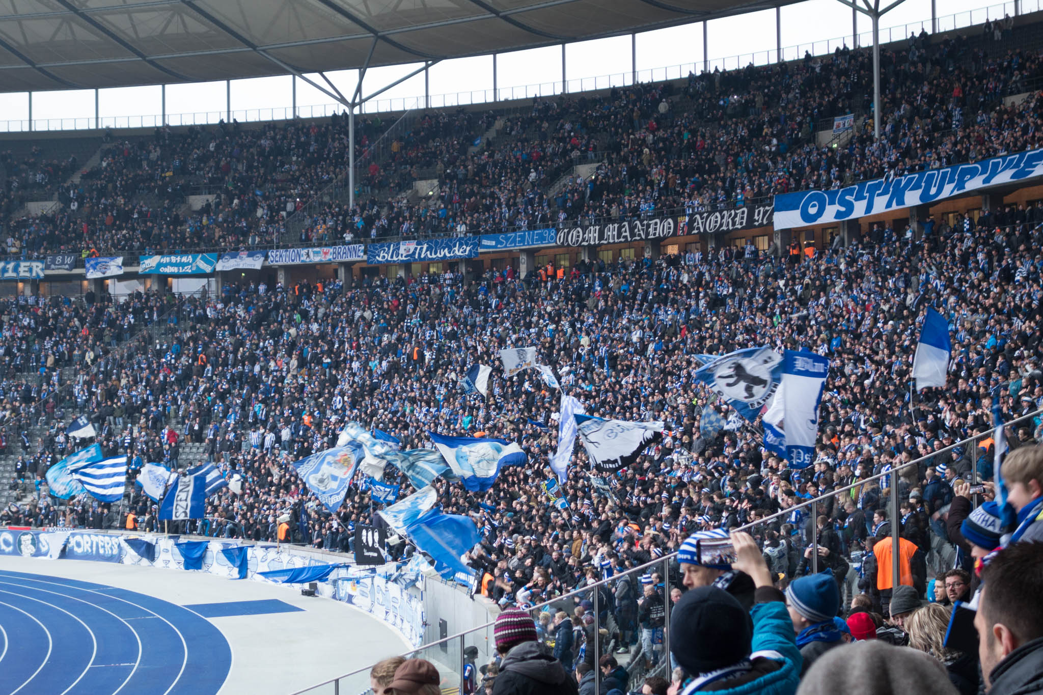
Use Case 1 (Audio Guidance)
AP
Train
STA
Anyone in stadium, museum or zoo who has a smartphone can listen audio guidance/comments without additional hardware.
Multiple logical channels can be used. Multilingual broadcasting can be supported on a single radio channel.
Of course, any type of data can be broadcast, such as video, text, HTML…

Slide 6
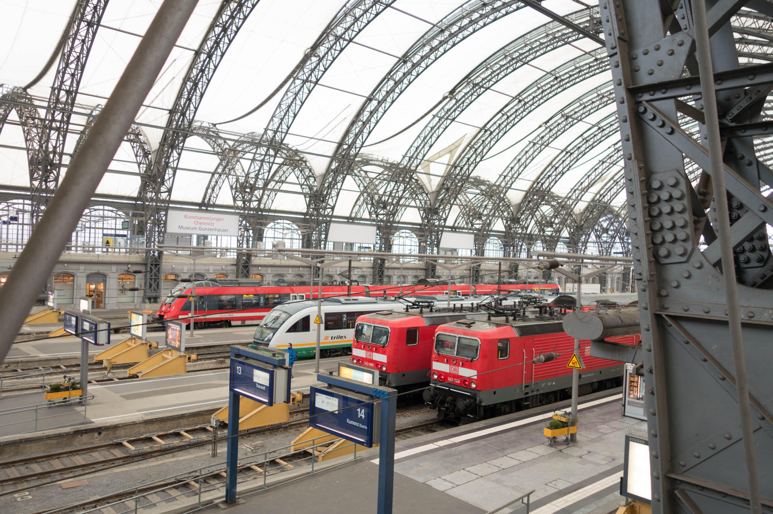
Use Case 2
(Floor Guide, Timetable, Advertisement)
AP
Train
STA
Smartphone
Digital Signage Device
Anyone in a shopping mall, conference venue like here, who has a smartphone can see the floor guide on their device.
Anyone in a train station who has a smartphone can see the timetable on their device.
Digital signage device in the area can show the same information.

Slide 7
Use Case 3
(Emergency Information)
Broadcasting infrastructure can be used for distributing emergency information such as:
  Evacuation guidance in case of fire.
  Earthquake warning.
  Food information in a shelter.

Slide 8
Security Requirements
To prevent fake information distribution, the source of information shall be identified.
  Because of dense deployment in the assumed use cases, the fake AP causes a disruption of the services.
  Every broadcast frame shall be authenticated by the receivers.
Encryption may be optional.
  Most broadcasting contents are considered as public and preferred to be widely distributed.

Slide 9
Current Broadcast Security on WLAN
Required to join GTKSA.
  GTK and Key RSC are shared by EAPOL-key or, in case of 802.11ai, Key Delivery element in Association Response.
Current GTKSA uses AES, a kind of “Symmetric-key algorithm”.
  An AP and non-AP STAs in a GTKSA shares the same GTK and Key RSC/TSC.
  The AP encrypts broadcast frames by using the GTK and the Key TSC.
  The non-AP STA decrypts broadcast frames by using the GTK and the Key RSC.
  This means “Any STAs which can decrypt broadcast frames can produce encrypted broadcast frames”.
  So a malicious user can produce fake broadcast frames.
  The receivers can NOT check the integrity of broadcast frames.
AP
Encrypt
(GTK, TSC)
AP
Mac address spoofing
STA
STA
STA
malicious
STA
Decrypt
(GTK, RSC)
STA
Decrypt
(GTK, RSC)
Decrypt
(GTK, RSC)
STA
Encrypt
(GTK, RSC)
Decrypt
(GTK, RSC)
Decrypt
(GTK, RSC)

Slide 10
QoS Considerations
QoS for broadcast frames
  In general, the loss rate of broadcast frame is higher than unicast frame.
  Broadcast does not have ACK mechanism.
  Existing 802.11 uses BCC/LDPC.
  Is required stronger FEC/Interleaving algorithm?
  Consider to apply 802.11aa GCR mechanism.
    In this case, association to AP is required.
QoS for other .11 frames
  How much bandwidth can be used for broadcasting?
  Define limit of bandwidth?
  Adaptive control?
  Consider to apply 802.11aa OBSS management.

Slide 11
Amendment Proposal to the Existing Standards
AP
STA
Add new broadcast mechanism.
  Each frame can be authenticated without any transmissions of non-AP STAs.
    Without existing Authentication/Association.
  Define new class 1 broadcast data frame.
Limit the receivers by the existing GTKSA mechanism
  Encrypt the key and data.
Key
Data + Authenticator
Data + Authenticator
Data + Authenticator
Data + Authenticator
Data + Authenticator
AP
STA
encrypt(Key)
encrypt(Data + Authenticator)
encrypt(Data + Authenticator)
encrypt(Data + Authenticator)
encrypt(Data + Authenticator)
encrypt(Data + Authenticator)

Slide 12
Conclusion
Broadcasting on WLAN can improve user experience.
For broadcasting on WLAN:
  Define Class 1 broadcast data frame
  Consider QoS mechanism.
  Define frame authentication mechanism
It’s time to start work for broadcasting
  Because we can assign “IEEE802.11bc” for broadcasting!

Slide 13
Comments & Questions

Slide 14
Straw poll
Do you support to form study group for “broadcasting on WLAN”?
  Yes:
  No:
  Don’t care:
  Need more info:

