Slide 1
Preamble Options
Date: 2017-07-10
Authors:

Slide 2
Introduction
In this presentation, two options of WUR Preamble are discussed
  Common preamble for all rates
  Use of different preamble sequences to indicate different rates

Slide 3
Option 1: Common Preamble
Use of a common preamble for all rates. In [1], PN sequences was given as an example
  Each bit is OOK modulated
  Discussion Points
  Simple implementation
  Use the lowest rate for transmission of Rate Field
  Use the lowest rate for transmission of WUR beacons
  Mandatory support of the lowest rate
    Inefficient use of spectrum because WUR beacons always have to be transmitted at the lower rate
  Examples:
    two repetition of 15-bit PN sequence: [1000 1111 0101 100]
    One 31-bit PN sequence

Slide 4
Packet Structure: Common Preamble
For example: repetition of PN sequences can be used
Detection:
  Has the ability of providing three peaks when Cross correlated using a sliding window of the received samples
    The peaks should be preamble-length apart to indicate preamble detection and to give the start of the packet
Packet structure:
802.11 preamble
WUR Mark
Wake-up preamble
Rate Field
MAC header
Payload
FCS
0
15-bit PN seq.
15-bit PN seq.
0

Slide 5
Simulations: Miss detection rate
Miss detection =0 | When the LP-WUR receiver detects the start of LP-WUR packet and bit error rate of the payload is smaller than certain value, e.g., 40%
Miss detection = 1 | (1) When the LP-WUR receiver doesn’t detect the start of LP-WUR packet (2) When the LP-WUR receiver detects the start of LP-WUR packet but the bit error rate of the payload is larger than certain value, e.g., 40%

Slide 6
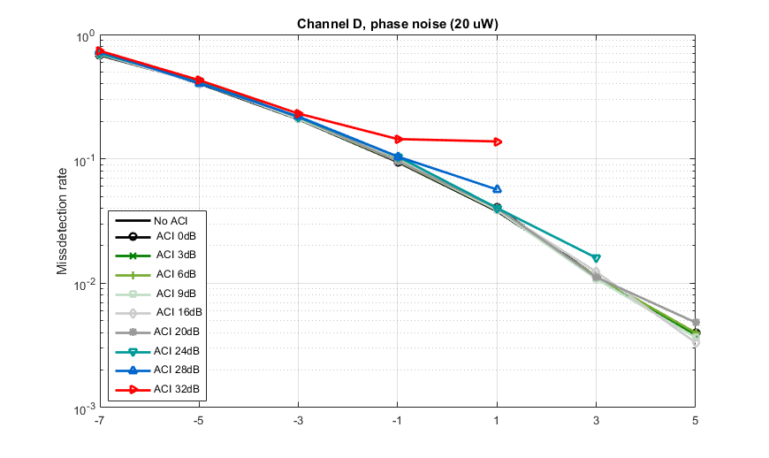
Miss detection rate with and without ACI
Simulation parameters are the same as in [3] with the phase noise model given in [4]

Slide 7
Option 2: Rate Indication
Different preamble sequences are used for different rates, also discussed in [2]
  Discussion Points
  Eliminates the use of Rate field (and potentially overhead bits – CRC)
  Provides flexibility in defining mandatory vs. optional rates, i.e., the lowest rate does not have to be mandatory
    When the extended range/lowest rate is not needed, network will operate more efficiently
  Parallel correlator will be needed

Slide 8
Packet Structure: Rate Dependent Preambles
Short preamble
Long preamble for the lower rate
802.11 preamble
WUR Mark
Wake-up preamble 1
MAC header
Payload
FCS
802.11 preamble
WUR Mark
Wake-up preamble 2
MAC header
Payload
FCS

Slide 9
Straw Poll
Do you support
  Option 1: Common preamble
    Y
    N
    A
  Option 2: Different preambles to indicate different rates
    Y
    N
    A

Slide 10
References
[1] 16/0341r0 Low power wake-up receiver follow-up, IEEE 802.11 TIG LRLP, March 2016
[2] 17/0681r1 Preamble Design for WUR WLAN, IEEE 802.11 TGba, May 2017
[3] 17/0656r0 WUR PHY Performance Study with Phase Noise and ACI, IEEE 802.11 TGba, May 2017
[4] 17/0026r0 WUR phase noise model study, IEEE 802.11 TGba

