Slide 1
P802.11ax PAR Modification
Date: 2017-07-10
Authors:

Slide 2
Overview
This submission proposes a modification for the IEEE P802.11ax High Efficiency WLAN PAR, to raise the top end of the frequency band from 6 GHz to 7.125 GHz, and indicate that new Operating Classes will be required to support the new channels.

Slide 3
Introduction
Why is a PAR modification needed?
Why now?
What do we want to accomplish?
What impact will this have on the current TGax schedule?
Next steps
Questions?

Slide 4
Why is a PAR modification needed?
Recent spectrum needs studies indicate that by 2020 the Wi-Fi industry will require an additional 600-800 MHz of spectrum to support the current growth curve; 1.2-1.6 GHz by 2025
The U-NII-2b band we expected to open is now off the table
  160 MHz in the middle of the 5 GHz band is no longer possible
Opening the 6 GHz band will provide as much as 1.2 GHz of spectrum
The current scope of the PAR includes this statement: “This amendment defines operations in frequency bands between 1 GHz and 6 GHz.”
  The statement must be changed to include the 6 GHz band (i.e., 1-7.125)
  New Operating Classes will be needed to delineate the channel plan for the 6 GHz band

Slide 5
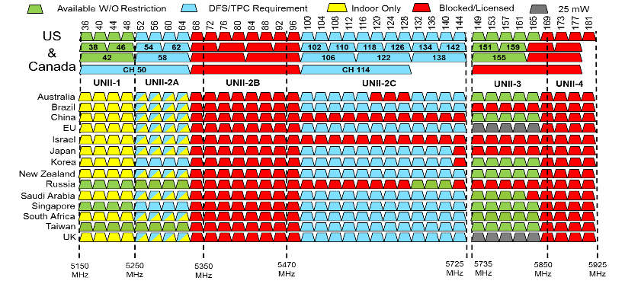
The 5 GHz Band
?

Slide 6
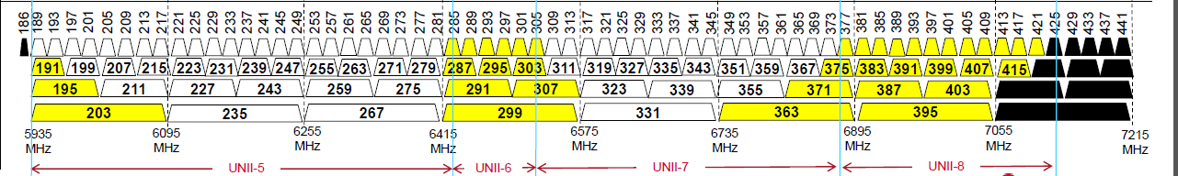
The Proposed 6 GHz Band
Yellow = may required reduced power for incumbent protection
Black = not available in some locations

Slide 7
Why now?
The wheels of regulatory change are slow, but have already begun moving
  The FCC is looking at 6GHz for unlicensed designation, process is expected to take ~2 years once started
  The ETSI process has started, but begins with a study of the band that will officially start in September, and run though December 2018
An 802.11 technology capable of operating in the target band in the time period that the spectrum will likely become available demonstrates that market need aligns with technical capability
  the only thing standing in the way of user benefit is the regulatory designation
802.11ax positioned to use this spectrum once the channels are defined

Slide 8
What do we want to accomplish?
This PAR modification effects what can be done with 802.11ax; does not force any changes to the current project
Shows the regulators the importance of keeping the regulatory process moving in a timely manner
  Actual market impact if process bogs down
Industry has given this effort a head start; we need to be ready with standards and product changes for the late 2019 timeframe
  As this is effectively an extension of the 5 GHz band, the changes are straightforward
This is the future of 802.11ax; more 80 MHz channels and support for wider bandwidth applications
  Without the designation we will soon be limited in what we can accomplish

Slide 9
What impact will this have on the current TGax schedule?
None

Slide 10
Next steps
We will continue to discuss as necessary in TGax
The 802.11 WG will vote to approve the PAR modification this week
The actual submittal will take place at the November Plenary
The 802 EC will approve the modification and place it on the December NESCOM agenda

Slide 11
Questions?

