Slide 1
MCS Set for OFDM PHY in 11ay
Date: 2017-07-10
Authors:

Slide 2
Introduction
This presentation overviews the design of MCS set for OFDM PHY in 11ad and proposes MCS set for 11ay.

Slide 3
OFDM Modulation Types in 11ad
The IEEE 802.11ad standard defines 4 modulation types including SQPSK, QPSK, 16QAM and 64QAM, [1].
These modulations can be divided into two subtypes:
  Dual carrier modulations:
    Spread (S)QPSK and QPSK - utilize two subcarriers in the OFDM signal spectrum;
    SQPSK is in fact a repetition x2 of QPSK point with data rate equivalent to BPSK, it extracts frequency diversity gain;
    QPSK is a repetition x2 of 16QAM point with the additional coding, it extracts both frequency diversity and coding gain; it provides data rate equivalent to regular QPSK modulation;
  Regular modulations:
    16QAM and 64QAM – normal mapping, there is no repetition in the signal spectrum;
    To extract frequency diversity, the interleaver spreads out the LDPC CW over the entire signal bandwidth;

Slide 4
OFDM Modulation Types in 11ad (Cont’d)
SQPSK modulation mapping is shown in figure below:
  Two coded bits (c_{2k}, c_{2k+1}) are modulated to two subcarriers (d_{k}, d_{P(k)});
  The modulation is performed in 2 steps:
    First, two BPSK points are modulated as x_{2k} = (2*c_{2k}-1), x_{2k+1} = (2*c_{2k+1}-1);
    Second, two QPSK points are modulated by multiplication on matrix Q;
  P(k) = 168 + k for Static Tone Pairing (STP) mode and can be permutation of indexes for Dynamic Tone Pairing (DTP) mode in the range [168, 335];

Slide 5
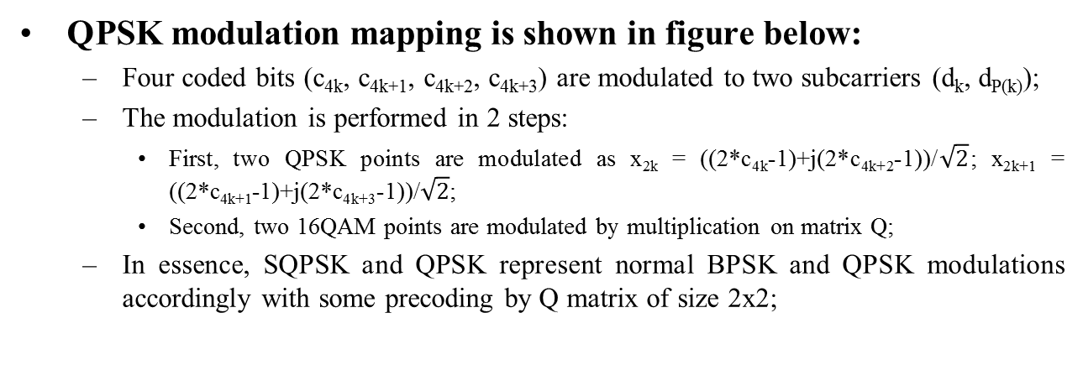
OFDM Modulation Types in 11ad (Cont’d)
QPSK modulation mapping is shown in figure below:
  Four coded bits (c_{4k}, c_{4k+1}, c_{4k+2}, c_{4k+3}) are modulated to two subcarriers (d_{k}, d_{P(k)});
  The modulation is performed in 2 steps:
    First, two QPSK points are modulated as x_{2k} = ((2*c_{4k}-1)+j(2*c_{4k+2}-1))/$\sqrt{2}$; x_{2k+1} = ((2*c_{4k+1}-1)+j(2*c_{4k+3}-1))/$\sqrt{2}$;
    Second, two 16QAM points are modulated by multiplication on matrix Q;
  In essence, SQPSK and QPSK represent normal BPSK and QPSK modulations accordingly with some precoding by Q matrix of size 2x2;

Slide 6
OFDM Modulation Types in 11ad (Cont’d)
16QAM uses regular Gray coded constellation and maps single QAM point to single OFDM subcarrier:
  336*4 = 672*2 – two CWs belong to OFDM symbol;
  Interleaver spreads out single LDPC CW over the entire OFDM signal bandwidth as shown in figure below;

Slide 7
OFDM Modulation Types in 11ad (Cont’d)
64QAM uses regular Gray coded constellation and maps single QAM point to single OFDM subcarrier:
  336*6 = 672*3 – three CWs belong to OFDM symbol;
  Interleaver scheme is shown below;

Slide 8
MCS Set Defined in 11ad
MCS set defined for OFDM in 11ad is provided in Table 1 below.
Table 1: MCS set defined for OFDM in 11ad.
MCS | Modulation | Code rate | Data rate, Mbps
13 | SQPSK | ½ | 693.00
14 | SQPSK | 5/8 | 866.25
15 | QPSK | ½ | 1386.00
16 | QPSK | 5/8 | 1732.50
17 | QPSK | ¾ | 2079.00
18 | 16QAM | ½ | 2772.00
19 | 16QAM | 5/8 | 3465.00
20 | 16QAM | ¾ | 4158.00
21 | 16QAM | 13/16 | 4504.50
22 | 64QAM | 5/8 | 5197.50
23 | 64QAM | ¾ | 6237.00
24 | 64QAM | 13/16 | 6756.75

Slide 9
Simulation Results
Channel models:
  Frequency flat channel (AWGN), IEEE 802.11ad #3;
  AWGN: ~2 dB gap between SQPSK and QPSK, ~3.0 dB gap between QPSK and 16QAM, ~2.5 dB gap between 16QAM and 64QAM;
  MCSs are defined in the legacy 11ad grid;

Slide 10
Proposed MCS Set for OFDM
Table 2: Proposed MCS set for OFDM, red color highlights new MCSs.
MCS | Modulation | Code rate | N_{CB} = 1, Data rate, Mbps
1 | SQPSK | ½ | 729.47
2 | SQPSK | 5/8 | 911.84
3 | SQPSK | ¾ | 1094.20
4 | SQPSK | 13/16 | 1185.40
5 | SQPSK | 7/8 | 1276.60
6 | QPSK | ½ | 1458.90
7 | QPSK | 5/8 | 1823.70
8 | QPSK | ¾ | 2188.40
9 | QPSK | 13/16 | 2370.80
10 | QPSK | 7/8 | 2553.20
11 | 16QAM | ½ | 2917.90
12 | 16QAM | 5/8 | 3647.40
13 | 16QAM | ¾ | 4376.80
14 | 16QAM | 13/16 | 4741.60
15 | 16QAM | 7/8 | 5106.30
16 | 64QAM | 5/8 | 5471.10
17 | 64QAM | ¾ | 6565.30
18 | 64QAM | 13/16 | 7112.40
19 | 64QAM | 7/8 | 7659.50

Slide 11
Simulation Results
Figures below show results for augmented MCS grid:
  Frequency flat channel (AWGN), IEEE 802.11ad #3;

Slide 12
Straw Poll
Do you agree:
  to define the MCS set for EDMG OFDM PHY as described in (11-17-908-00-00ay 30 6 6 Modulation and Coding Scheme for OFDM Mode)?

Slide 13
References
IEEE802.11-2016
Draft P802.11ay_D0.35

