Slide 1
MCS 1 LDPC Encoding Method Modification in 11ay
Date: 2017-06-13
Authors:

Slide 2
Introduction
This presentation raises the issue on scrambling with Pseudo Noise (PN) sequence applied for MCS1 encoding and proposes the solution.

Slide 3
MCS 1 LDPC Encoding in 11ad/mc
MCS 1 LDPC encoding:
  Input data bits:
    b = (b₁, b₂, …, b_{L});
  First scrambling sequence, seed defined in header:
    s1 = (s1₁, s1₂, …, s1_{L});
  First scrambled information sequence:
    bs1 = mod(b+s1, 2);
  Parity computation, R = 1/2:
    Codeword: c = (bs1₁, bs1₂, …, bs1_{L}, 0₁, 0₂, …, 0_{L}, p₁, p₂, …, p_{2L});
    Parity: p = (p₁, p₂, …, p_{2L});
  where: L = 168 for CW 672 bits, L = 336 for CW 1344 bits;

Slide 4
MCS 1 LDPC Encoding in 11ad/mc (Cont’d)
  Second scrambling sequence, seed is equal to all ones:
    s2 = (s2₁, s2₂, …, s2_{L});
  Second scrambled information sequence:
    bs2 = mod(b+s1+s2, 2), s = mod(s1+s2, 2);
  Codeword to transmit:
    c = (bs1, bs2, p);
  s1 and s2 are generated using the same Linear Feedback Shift Register (LFSR);

Slide 5
PN Compensation Effect
PN Compensation effect:
  For some LDPC codewords, s1 = s2, i.e. s = 0, this cancels out the effect of scrambling applied to the original data block b;
  The issue comes from the fact that s1 and s2 are generated using the same LFSR;
  b may contain long sequences of 0s and 1s, this leads to bursts of 0s or 1s in the PPDU and unequal probabilities for -1 and +1 in BPSK modulation and in turn causes spurs in frequency domain;
  The potential burst length can be up to N = L (L = 168 or 336) symbols;

Slide 6
Scrambler Definition in 11ad/mc
Scrambler LFSR definition:
  Modulo 2 linear recurrence is used, starts from initial seed (X₁, X₂, …, X₇);
  Defined by primitive polynomial:
    F(x) = x⁷ + x⁴ + 1;
  Sequence period:
    P = 2⁷ – 1 = 127;
    64 1s and 63 0s per period;

Slide 7
PN Compensation Effect Periodicity
PN compensation effect periodicity:
  The unscrambled block bs2 = b appears with period equal to 127 codewords;
  The first unscrambled block number in the PPDU depends on the initial seed value (left figure);
  Probability of unscrambled block vs PPDU length M (in CWs) grows linearly with M (right figure), P(M > 127) = 1;

Slide 8
Consequences of PN Compensation Effect
Consequences of PN compensation effect:
  Only short PPDUs with the limited number of CWs less than 127 can be used to avoid the PN compensation effect;
  It degrades the seed randomness, because the number of seed values that can be used reduces linearly with growth of CWs number M in the PPDU;
  It complicates the seed selection procedure, because the set of seed values depends on the number of CWs M;
  Conclusion: new solution in 11ay standard is needed to avoid this effect and simplify seed selection procedure;

Slide 9
Proposed Solution
Proposed solution:
  To generate s2 applying LFSR #2 as shown in figure below;
  Defined by primitive polynomial:
    F(x) = x⁷ + x + 1;
  Sequence period:
    P = 2⁷ – 1 = 127;
    64 1s and 63 0s per period;

Slide 10
PN Properties
Probability of 1s and 0s per period, independent on initial seed value:
  LFSR #1: 64 1s and 63 0s per period;
  LFSR #2: 64 1s and 63 0s per period;
Burst statistics:
  Burst definition of length N:
    Burst of 1s: B_{N} = {0, 1₁, 1₂, …, 1_{N}, 0};
    Burst probability;
Correlation properties:
  Mean value, autocorrelation function;

Slide 11
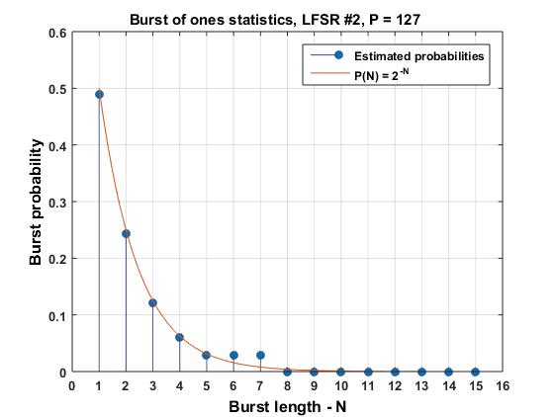
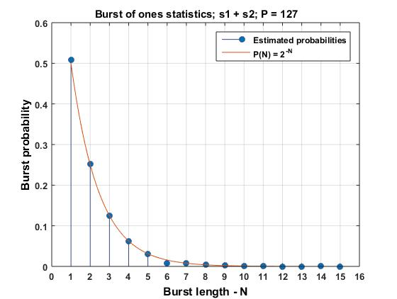
Burst Statistics
  Figures below compare burst statistics for LFSR #1, new LFSR #2 and s1+s2;
  Probability for burst of length N, P(N) ~2^{-N};
  Conclusion: both generators have similar burst statistics;
  For unscrambled block we can have high probability of burst of length N = L, after application of scrambler P(L) ~2^{-L}, which is negligible for L = 168 or 336;

Slide 12
Correlation Properties
Mean value – LFSR #1, #2:
  Estimations are performed for ±1, (0, 1) are converted to w_{k} BPSK values (-1, +1);
  Mean value estimation for LFSR #1, P = 127:
  where n defines highest degree in generator polynomial, L defines the observation period;
  LFSR #1: n = 7, L = 127, E(w_{k}) = 0.0079;
  LFSR #2: n = 7, L = 127, E(w_{k}) = 0.0079;
  Conclusion: mean values are the same and near to zero in both cases;

Slide 13
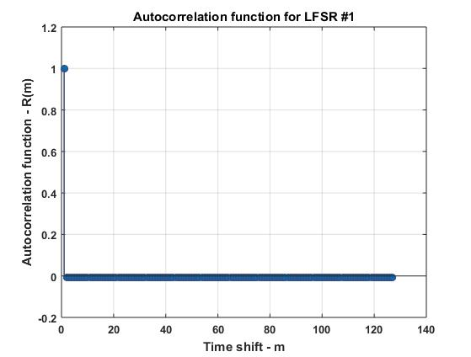

Correlation Properties (Cont’d)
Autocorrelation:
  Autocorrelation function R(m) definition for period P:
  Figures below show autocorrelation functions for LFSR #1 and #2;
  Conclusion: near to delta function shape, i.e. “white” PN in both cases;

Slide 14
Conclusions
This presentation raises the issue with MCS1 bits scrambling.
It was shown that unscrambled blocks can appear in the PPDU due to PN sequence compensation effect.
The proposed solution uses other random sequence to avoid this effect.

Slide 15
Straw Poll
Do you agree:
  to define the scrambling for MCS 1 as described in (11-17-0904-00-00ay 30 5 7 3 3 Scrambler for MCS1 Encoding)?

Slide 16
References
Draft P802.11ay_D0.35

