Slide 1
802.11 July 2017 Closing Reports
Date: 2017-07-13
Authors:

Slide 2
Abstract
This document is a digest of the closing reports of all 802.11 sub-groups for presentation at the July 2017 closing plenary meeting. Attendance information and liaison reports (including liaison reports from the mid-week plenary) are also included.

Slide 3
Attendance
Data as of 2017-07-13
17:00

Slide 4
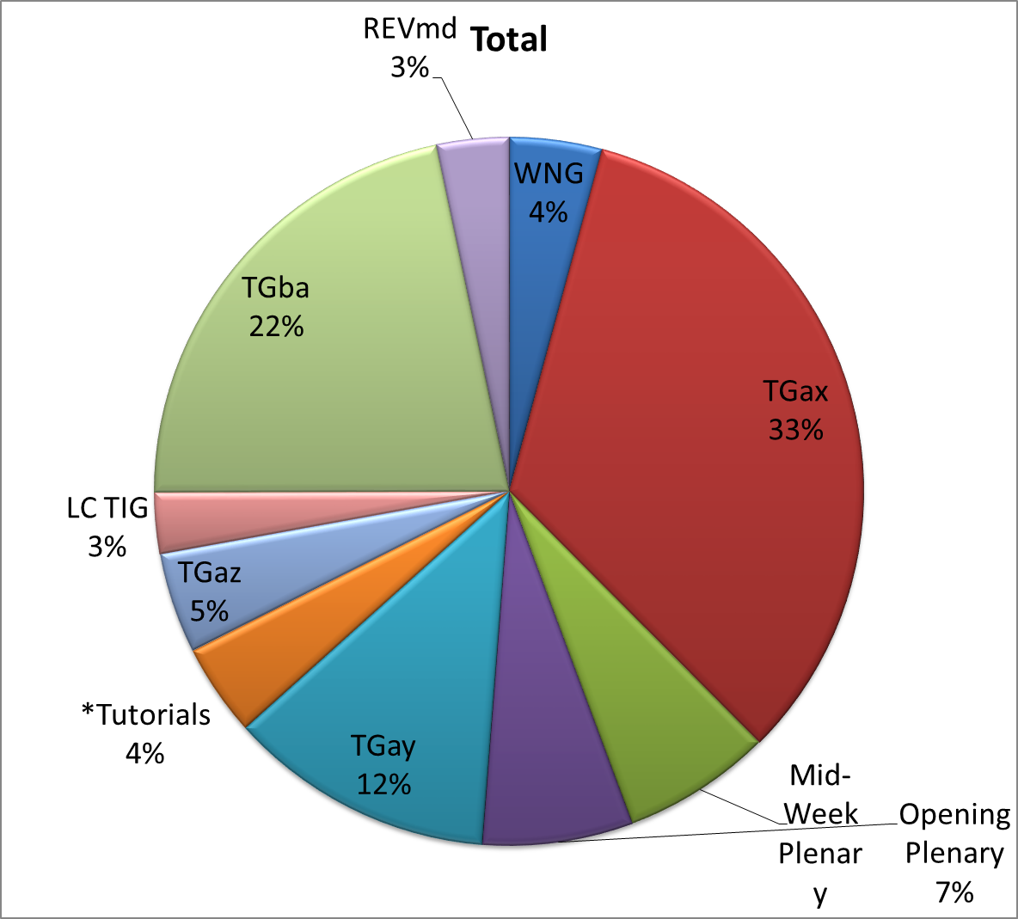
Attendance Total

Slide 5
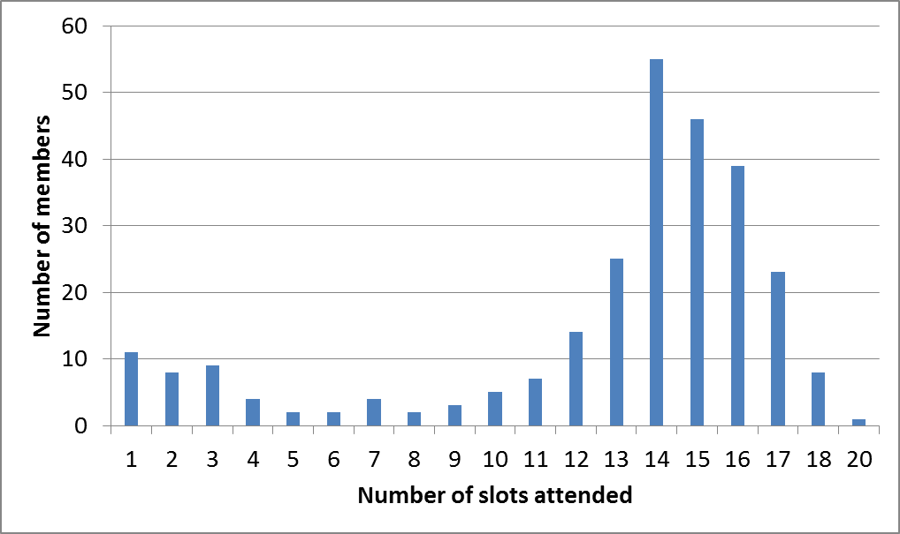
Attendance Histogram

Slide 6
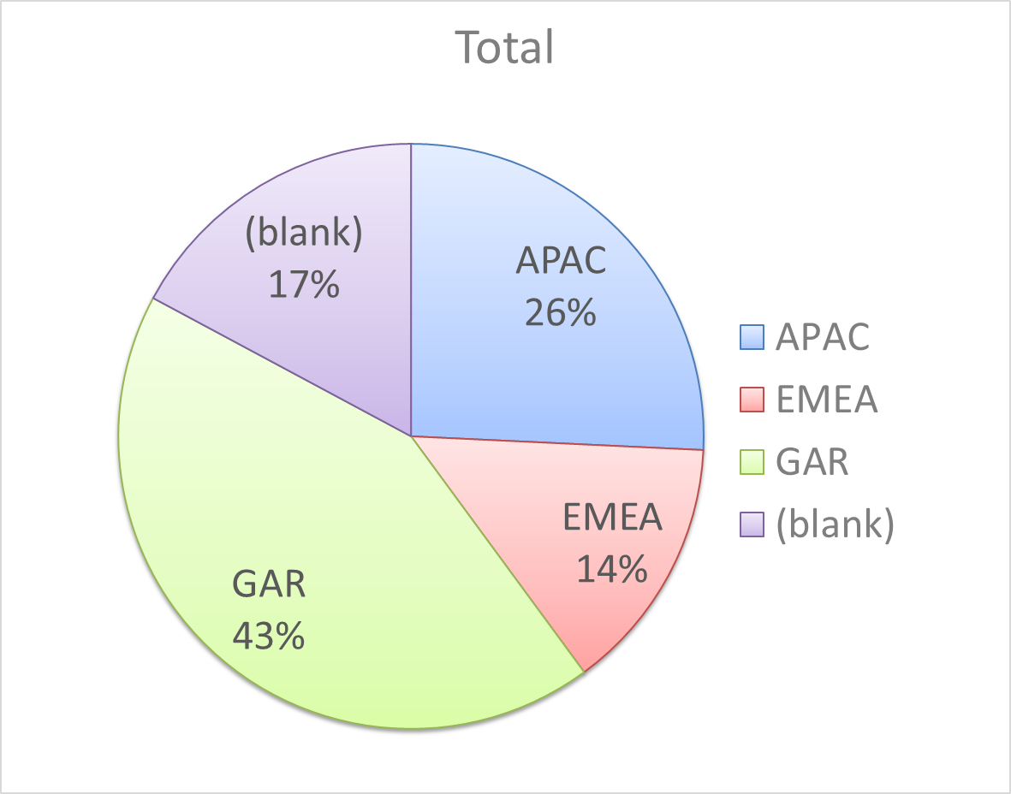
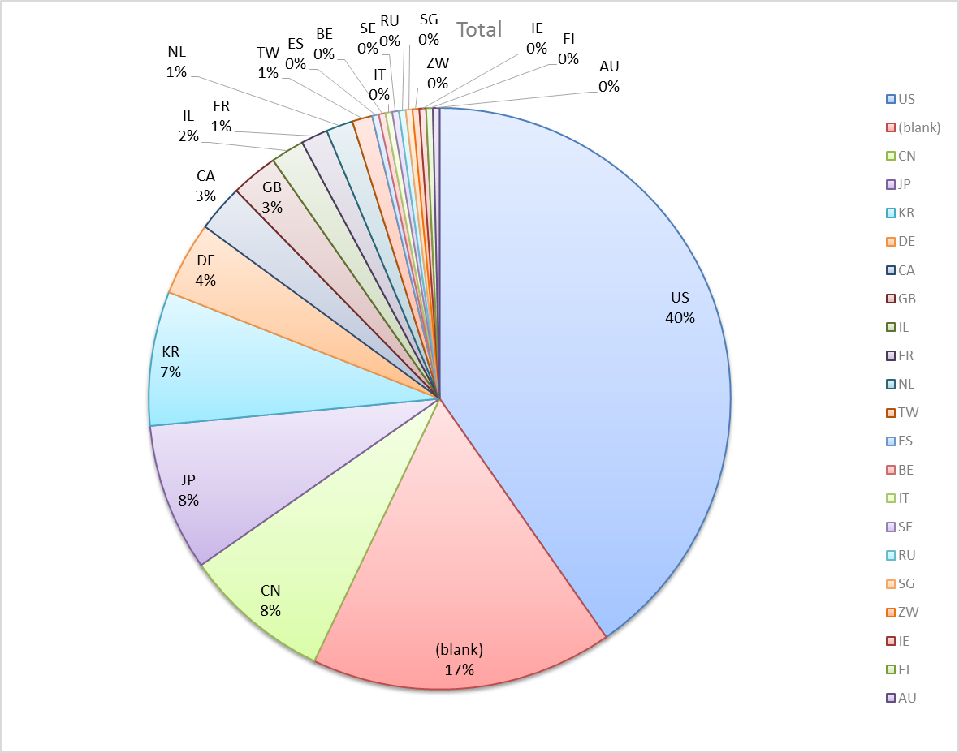
Attendance by Country

Slide 7
Doc Revision uploads by meeting (month #)

Slide 8
802.11 WG Editor’s Meeting (July 2017)
Date: 2017-06-27
Authors:
from slide 1/6 of 11-17-0890 by Peter Ecclesine (Cisco Systems)
Notes:
July 2007

Slide 9
Volunteer Editor Contacts
TGaj – Jiamin CHEN – jiamin.chen@mail01.huawei.com , Shiwen He – shiwenhe@seu.edu.cn
TGak – Donald Eastlake – d3e3e3@gmail.com
TGaq – Lee Armstrong – LRA@tiac.net
  TGax – Robert Stacey – robert.stacey@intel.com
  TGay – Carlos Cordeiro – carlos.cordeiro@intel.com
  TGaz – Chao Chun Wang – chaochun.wang@mediatek.com
  TGba – Po-kai Huang – po-kai.huang@intel.com
REVmd –Emily Qi – emily.h.qi@intel.com, Edward Au – edward.ks.au@huawei.com,
  Editors Emeritus:
  TGaa – Alex Ashley – alex.ashley@hotmail.co.uk
  TGac – Robert Stacey – robert.stacey@intel.com
  TGad – Carlos Cordeiro – carlos.cordeiro@intel.com
  TGae – Henry Ptasinski – henry@LOGOUT.COM
  TGaf – Peter Ecclesine – petere@ieee.org
  REVmc – Adrian Stephens – adrian.p.stephens@ieee.org , Edward Au – edward.ks.au@huawei.com, Emily Qi – emily.h.qi@intel.com
  TGai - LRA@tiac.net, Ping FANG Ping.FANG@huawei.com
  TGah – Yongho Seok yongho.seok@gmail.com, Alfred Asterjadhi – aasterja@qti.qualcomm.com
  TGaq – Dan Gal – ddrgal@gmail.com
from slide 2/6 of 11-17-0890 by Peter Ecclesine (Cisco Systems)
Notes:
July 2007

Slide 10
802.11 Style Guide
See 11-09-1034-11-0000-wg11-style-guide.doc
  We updated 802.11 WG Style Guide based on 2012 IEEE Standards Style Manual and consistency changes in final publication of the 802.11 standard
Editor’s responsibility includes checking the 2014 IEEE Standards Style Manual when creating or updating drafts. https://development.standards.ieee.org/myproject/Public/mytools/draft/styleman.pdf
Submissions with draft text should conform to both the WG11 Style Guide and IEEE Standards Style Manual
Note that the Style Guide evolves with our practice, expect a revision in March
from slide 3/6 of 11-17-0890 by Peter Ecclesine (Cisco Systems)

Slide 11
MIB style, Visio and Frame practices
I’m going to suggest going forward we use a single style with appropriately set tabs, and use leading Tabs to distinguish the syntax and description parts. (Adrian Stephens Feb 9, 2010)
Two ways to format a figure & its caption in frame:
  Insert a table. Insert anchored frame inside table cell to hold graphics. Use table caption as figure caption.
  Insert an anchored frame. Insert caption inside a text frame inside the anchored frame. Insert graphics inside the anchored frame.
Keep embedded figures using visio as long as possible
  Near the end of sponsor ballot, turn these all into .emf (windows meta file) format files (you can do this from visio using “save as”). Keep separate files for the .vsd source and the .emf file that is linked to from frame. There is likelihood we should use .emf
Frame templates for 11aa, 11ac, 11af
from slide 4/6 of 11-17-0890 by Peter Ecclesine (Cisco Systems)

Slide 12
Editor Amendment Ordering
Data as of July 2017
See http://grouper.ieee.org/groups/802/11/Reports/802.11_Timelines.htm
In July 2017, Editors discussed REVmd schedule and possible completion in 2020, and expect only amendments 1 to 5 in REVmd. We will revisit the running order in November.
Amendment Number | Task Group | Projected REVCOM Date
802.11-2016 Amendment 1 | TGai | Dec 2016
802.11-2016 Amendment 2 | TGah | Dec 2016
802.11-2016 Amendment 3 | TGaq - 81 | Aug 2017
802.11-2016 Amendment 4 | TGaj - 291 | Dec 2017
802.11-2016 Amendment 5 | TGak - 95 | Dec 2017
802.11-2016 Amendment 6 | TGax – 521 | Jul 2019
802.11-2016 Amendment 7 | TGay - 242 | Nov 2019
802.11-2016 Amendment 8 | TGaz | Mar 2021
802.11-2016 Amendment 9 | TGba – 500? | Jul 2020
Amendment numbering is editorial! No need to make ballot comments on these dynamic numbers!
from slide 5/6 of 11-17-0890 by Peter Ecclesine (Cisco Systems)
Notes:
July 2007

Slide 13
Draft Development Snapshot
July 2017
Changes from last report shown in red.
Most current doc shaded green.
TG | Published or Draft Baseline Documents |  |  |  |  |  |  |  |  |  | Source | MDR | Style Guide | Editor | Snapshot Date
 | Published | mc | aq | ak | aj | md | ax | ay | az | ba
mc | Y | Y |  |  |  |  |  |  |  |  | Frame 12.0 | Yes | 2012 | Adrian Stephens Edward Au, Emily Qi | 17-Jan
aq | Y | Y | 9.0 |  |  |  |  |  |  |  | Frame 12.0 | Yes | 2012 | Lee Armstrong | 9-Jul
ak | Y | Y | 9.0 | 4.1 |  |  |  |  |  |  | Word | Yes | 2012 | Donald Eastlake Norm Finn | 11-Jul
aj | Y | Y | 7.2 | 3.0 | 6.0 |  |  |  |  |  | Frame 10.0 | Yes | 2012 | Jiamin Chen Shiwen He | 9-Jul
md |  |  |  |  |  | 0.1 |  |  |  |  |  |  |  | Emily Qi Edward Au | 11-Jul
ax | Y | Y | 9.0 | 3.0 | 4.0 |  | 1.3 |  |  |  | Frame 12.0 | No | 2012 | Robert Stacey | 11-Jul
ay | Y | Y | 3.0 | 2.0 | 3.0 |  | 1.2 | 6.0 |  |  | Word | No | 2012 | Carlos Cordeiro | 9-Jul
az |  |  |  |  |  |  |  |  |  |  |  |  |  | Chao Chun Wang | 11-Jul
ba |  |  |  |  |  |  |  |  |  |  |  |  |  | Po-Kai Huang | 11-Jul
from slide 6/6 of 11-17-0890 by Peter Ecclesine (Cisco Systems)
Notes:
July 2009
July 2007
Peter Ecclesine (Cisco Systems)
Page 13

Slide 14
AANI SC Closing Report July 2017
Date: 2017-07-13
Authors:
from slide 1/4 of 11-17-1153 by Joseph Levy (Interdigital)

Slide 15
Abstract
Abstract
This Document is the closing report for AANI SC,
November 2016 Meeting in San Antonio, TX
This Document is the closing report for AANI SC,
July 2017 Meeting in Berlin, Germany
from slide 2/4 of 11-17-1153 by Joseph Levy (Interdigital)

Slide 16
802.11 AANI SC – July 2017
Meeting Goals:
  Discuss incoming LS statement from 3GPP SA (11-17/0903r0)
  Discuss contributions on SA/802.11 interworking and other related topics
  Review 802.1 IC activity and actions
Agenda: See 11-17/0889r3, met for 3 hours (2 on Monday, 1 on Thursday)
Meeting Activity:
  Discussed LS statement from 3GPP SA (11-17/0903r0) – see Agenda
  Discussed 11-17/1064r0: “Overview of 3GPP SA Next Generation System Documents Related to Non-3GPP Access to the 5G Core Network”
  Discussed 802.1 NEND ICA and future ICA possible actions – see Agenda
  Called for:
  802.1 NAND ICA related contributions/participation
  Contributions for teleconferences and the next meeting
  Participation
from slide 3/4 of 11-17-1153 by Joseph Levy (Interdigital)

Slide 17
Future Sessions Planning
Teleconference: July 27, August 3, 10, 17, 24, 31, September 7, 9am - TBC
  Topics for discussion/contribution:
  802.1 NEND IC activity
  3GPP Interworking
  If there are no contributions the teleconference will be canceled.
10-15 September 2017 F2F, Waikoloa Village, Kona, HI, USA:
Goals:
  Contributions on SA/802.11 interworking: 2G/3G/4G
  Contributions on SA/802.11 or RAN/802.11 interworking or related 5G/nextGen
  Continue discussions on NEND IC and report of NEND IC activity.
  Generate a 802.11 contribution(s) for NEND IC activity
Meeting time: 2 sessions - Monday PM1 and Thursday AM2 - TBC
from slide 4/4 of 11-17-1153 by Joseph Levy (Interdigital)

Slide 18
ARC Closing Report
Date: 2017-07-13
Authors:
from slide 1/7 of 11-17-1149 by Mark Hamilton, Ruckus/Brocade

Slide 19
Abstract
This document is the closing report for ARC SC,
July 2017 Meeting in Berlin, Germany
from slide 2/7 of 11-17-1149 by Mark Hamilton, Ruckus/Brocade

Slide 20
Work Completed
Agenda is here: 11-17/0886r4
Noted status of IEEE 1588 mapping to IEEE 802.11
  No changes. Ongoing balloting. No action needed.
  Related activity: 802.1AS REVision use of FTM (next slide)
Noted IEEE 802 activities relevant to 802.11/ARC
  No change: 802.1AC is now published, 802.1Q revision underway.
IETF/802 coordination
  No report
from slide 3/7 of 11-17-1149 by Mark Hamilton, Ruckus/Brocade

Slide 21
Work Completed (cont)
11ba architecture implications
  ARC individuals attended TGba‘s ad-hoc, Monday AM1
  TGba is very early in architecture discussions
  A number of questions raised – considered to be interesting/important discussions to have
  ARC discussed off-line on Wednesday
  Will continue to ask guiding questions and hopefully start to provide proposals next session
802.1AS-rev use of Fine Timing Measurement
  Attended 802.1 TSN during their discussion of 802.1AS-rev
  Provided guidance on options for their usage of FTM
  This is likely to continue; 802.1 will update their draft and bring back for more review/discussion
from slide 4/7 of 11-17-1149 by Mark Hamilton, Ruckus/Brocade

Slide 22
Work Completed (cont)
MIB Design Pattern work item
  No progress this session.
  Off-line work on document capturing patterns envisioned, to date:
    11-15/035r5
AP/DS/Portal architecture, 802/802.1 mappings
  No progress this session.
  Need to consolidate agreements, and provide input to REVmd.
YANG/NETCONF
  No progress this session.
  Hope to consider input received and review reference materials in preparation, and make a recommendation in July.
  Anybody with experience on these, please come help us out!
from slide 5/7 of 11-17-1149 by Mark Hamilton, Ruckus/Brocade

Slide 23
Teleconference(s)
Two planned: Tuesdays, August 1 and August 15, 9am ET, 1 hour
from slide 6/7 of 11-17-1149 by Mark Hamilton, Ruckus/Brocade

Slide 24
September 2017 Plans
Three standalone meeting slots planned:
Continue off-line discussion of 11ba architecture implications, prepare proposal to TGba
Consider other “split” PHYs (?) – perhaps LC, 28 GHz
Finish Design Patterns for MIB attribute use
Continue discussion of 802.1ASrev use of FTM, if needed
Recommendation on 802.11’s use of YANG/NETCONF
DS/AP/Portal architecture discussions, and “what is an ESS?”
Status updates on IETF work, IEEE 1588 work
One joint meeting slot with TGba:
Continue discussion of 11ba architecture implications, present proposal if ready
from slide 7/7 of 11-17-1149 by Mark Hamilton, Ruckus/Brocade

Slide 25
PAR Review - Meeting Agenda and Comment slides - July 2017 -Berlin
Date: 2017-07-14
Authors:
from slide 1/35 of 11-17-0858 by Jon Rosdahl (Qualcomm)

Slide 26
Abstract-Snapshot
Jul 9-14, 2017, Berlin, Germany
PARs under consideration:
  802.1ABcu - Amendment: LLDP YANG Data Model PAR and CSD
  802.1ACct - Amendment: Support for IEEE Std 802.15.3 PAR and CSD
  802.1AS-Rev - Timing and Synchronization for Time-Sensitive Applications PAR Modification Request
  802.1CBcv - Amendment: Information Model, YANG Data Model and Management Information Base Module PAR and CSD
  802.1Qcc - Stream Reservation Protocol (SRP) Enhancements and Performance Improvements PAR extension
  802.1Qcw - Amendment: YANG Data Models for Scheduled Traffic, Frame Preemption, and Per-Stream Filtering and Policing PAR and CSD
  802.1Qcx - Amendment: YANG Data Model for Connectivity Fault Management PAR and CSD
  802.1AE - Standard for Local and Metropolitan Area Networks: Media Access Control (MAC) Security Maintenance PAR
  802.3bt - Amendment: DTE Power via MDI over 4-Pair PAR Extension Unmodified CSD
Meeting times: Monday PM2, Tuesday AM2, Thursday AM2
from slide 2/35 of 11-17-0858 by Jon Rosdahl (Qualcomm)

Slide 27
Responses From 802 WGs
from slide 15/35 of 11-17-0858 by Jon Rosdahl (Qualcomm)

Slide 28
P802.1Qcw PAR & CSD with 802.1 comment responses
Comments on the PAR for P802.1Qcw - Amendment: YANG Data Models for Scheduled Traffic,
Frame Preemption, and Per-Stream Filtering and Policing were received from 802.11 and 802.3.
The responses to the comment are here:
http://ieee802.org/1/files/public/docs2017/cw-PAR-CSD-comments-0717-v01.pdf
The PAR has been updated:
http://ieee802.org/1/files/public/docs2017/cw-draft-PAR-0517-v02.pdf
The CSD has been updated:
http://ieee802.org/1/files/public/docs2017/cw-draft-CSD-0517-v02.pdf
from slide 16/35 of 11-17-0858 by Jon Rosdahl (Qualcomm)

Slide 29
Rebuttal to 802.1Qcw
PAR 5.2.b (project scope)
  – the addition of the “Additionally, this amendment will address errors or omissions to existing features related to the aforementioned clauses as approved by the 802.1 maintenance process.”
  The “IEEE 802.1 maintenance process” does not have a PAR, so it is not an authorized Activity. The purpose each of the 802.1 maintenance PARs should authorize the specific activity that is proposed.
  Delete the “as approved by the 802.1 maintenance process”.
2. PAR 5.3
– “If yes, please explain” – listing the title of another amendment does not seem to “explain”.
  How is the proposed standard dependent on IEEE P802.1Q-Rev and IEEE P802.1Qcp?
  What is the schedule impact due to the dependency on IEEE P802.1Q-Rev and IEEE P802.1Qcp?
from slide 17/35 of 11-17-0858 by Jon Rosdahl (Qualcomm)

Slide 30
Rebuttal to 802.1Qcw
3 PAR – 6.1b – “The YANG Data Model will be assigned a URN based on the RA URN tutorial and IEEE Std 802d.”
  The acronyms need to be expanded “URN”, “RA”
  The RA URN tutorial should include a reference.
  IEEE Std 802d should be fully cited in 8.1
from slide 18/35 of 11-17-0858 by Jon Rosdahl (Qualcomm)

Slide 31
P802.1Qcx PAR & CSD with 802.1 comment responses
Comments on the PAR for P802.1Qcx - Amendment: YANG Data Model for Connectivity
Fault Management were received from 802.11 and 802.3.
The responses to the comment are here:
http://ieee802.org/1/files/public/docs2017/cx-PAR-CSD-comments-0717-v01.pdf
The PAR has been updated:
http://ieee802.org/1/files/public/docs2017/cx-draft-PAR-0517-v02.pdf
The CSD has been updated:
http://ieee802.org/1/files/public/docs2017/cx-draft-CSD-0517-v02.pdf
from slide 19/35 of 11-17-0858 by Jon Rosdahl (Qualcomm)

Slide 32
Rebuttal to 802.1Qcx
1. PAR 5.3
– “If yes, please explain” – listing the title of another amendment does not seem to “explain”.
  How is the proposed standard dependent on IEEE P802.1Q-Rev and IEEE P802.1Qcp?
  What is the schedule impact due to the dependency on IEEE P802.1Q-Rev and IEEE P802.1Qcp?
2. PAR – 6.1b – “The YANG Data Model will be assigned a URN based on the RA URN tutorial and IEEE Std 802d.”
  The acronyms need to be expanded “URN”, “RA”
  The RA URN tutorial should include a reference.
  IEEE Std 802d should be fully cited in 8.1
from slide 20/35 of 11-17-0858 by Jon Rosdahl (Qualcomm)

Slide 33
Updated P802.1Qcc PAR with 802.1 comment responses
Comments on the PAR for P802.1Qcc - Stream Reservation Protocol (SRP) Enhancements
and Performance Improvements were received from 802.11 and 802.3.
The responses to the comment are here:
http://ieee802.org/1/files/public/docs2017/cc-PAR-extension-comments-0717-v1.pdf
The PAR extension has been updated:
http://www.ieee802.org/1/files/public/docs2017/cc-PAR-extension-0517-v01.pdf
No Rebuttal comment.
from slide 21/35 of 11-17-0858 by Jon Rosdahl (Qualcomm)

Slide 34
P802.1CBcv PAR & CSD with 802.1 comment responses
Comments on the PAR for P802.1CBcv - Amendment: Information Model, YANG Data Model
and Management Information Base Module were received from 802.11 and 802.3.
The responses to the comment are here:
http://www.ieee802.org/1/files/public/docs2017/cv-PAR-CSD-comments-0717-v01.pdf
The PAR has been updated:
http://www.ieee802.org/1/files/public/docs2017/cv-draft-PAR-0517-v02.pdf
The CSD has been updated:
http://www.ieee802.org/1/files/public/docs2017/cv-draft-CSD-0517-v02.pdf
from slide 22/35 of 11-17-0858 by Jon Rosdahl (Qualcomm)

Slide 35
Rebuttal to 802.1CBcv response
5 – PAR 6.1b – The citing of IEEE 802d requires that the full standard be listed in 8.1, as well as IEEE std. 802. Also “RA” , “OID” and “URN” acronyms need to be spelled out on first usage as well.
6 – CSD 1.2.5 – In the beginning of the CSD, there is discussion of MIB and YANG models, but in the new text in 1.2.5, there seems to be a change to YANG and SNMP (transport of the MIB), should this section be referring to the impact of the MIB. If Not, then you should also include a reference for SNMP.
from slide 23/35 of 11-17-0858 by Jon Rosdahl (Qualcomm)

Slide 36
P802.1AS-rev PAR with 802.1 comment responses
Comments on the PAR for P802.1AS-Rev - Timing and Synchronization for Time-Sensitive
Applications were received from 802.11 and 802.3.
The responses to the comment are here:
http://ieee802.org/1/files/public/docs2017/as-rev-PAR-modification-comments-0717-v01.pdf
The PAR Modification Request has been updated:
http://ieee802.org/1/files/public/docs2017/as-rev-PAR-modification-0517-v02.pdf
from slide 24/35 of 11-17-0858 by Jon Rosdahl (Qualcomm)

Slide 37
Rebuttal to 802.1ASrev response
2. PAR 6.1b – The explanation text seems to imply a review is not necessary.
Suggested Explanation Text:
  “RAC should review the use of registry terms that appear in the document (e.g., OUI, Ethertype, EUI-64, EUI-48 and text suggesting using a mapping from EUI-48 to EUI-64 that is now deprecated because it potentially creates duplicate EUI-64 addresses).”
  Also include the acronym expansion for “EUI”, “OUI”.
from slide 25/35 of 11-17-0858 by Jon Rosdahl (Qualcomm)

Slide 38
P802.1ABcu PAR & CSD with 802.1 comment responses
Comments on the PAR for P802.1ABcu - Amendment: LLDP YANG Data Model were
received from 802.11 and 802.3.
The responses to the comment are here:
http://ieee802.org/1/files/public/docs2017/cu-PAR-CSD-comments-0717-v01.pdf
The PAR has been updated:
http://ieee802.org/1/files/public/docs2017/cu-draft-PAR-0517-v02.pdf
The updated CSD:
http://ieee802.org/1/files/public/docs2017/cu-draft-CSD-0517-v02.pdf
from slide 26/35 of 11-17-0858 by Jon Rosdahl (Qualcomm)

Slide 39
Rebuttal to 802.1ABcu
PAR 5.2.b (project scope)
  – the addition of the “Additionally, this amendment will address errors or omissions to existing features related to the aforementioned clauses as approved by the 802.1 maintenance process.”
  The “IEEE 802.1 maintenance process” does not have a PAR, so it is not an authorized Activity. The purpose each of the 802.1 maintenance PARs should authorize the specific activity that is proposed.
  Delete the “as approved by the 802.1 maintenance process”.
2. PAR – 6.1b – “The YANG Data Model will be assigned a URN based on the RA URN tutorial and IEEE Std 802d.”
  The acronyms need to be expanded “URN”, “RA”
  The RA URN tutorial should include a reference.
  IEEE Std 802d should be fully cited in 8.1
from slide 27/35 of 11-17-0858 by Jon Rosdahl (Qualcomm)

Slide 40
P802.1ACct PAR & CSD with 802.1 comment responses
Comments on the P802.1ACct PAR were received from 802.11 and 802.3.
The responses to the comment are here:
https://mentor.ieee.org/802.15/dcn/17/15-17-0411-01-003d-responses-to-par-802-1acct-amendment-review-comments.pptx
The PAR has been updated:
http://www.ieee802.org/1/files/public/docs2017/ACct-draft-PAR-0517-v02.pdf
The updated CSD:
http://www.ieee802.org/1/files/public/docs2017/ACct-draft-CSD-0517-v02.pdf
No Rebuttal Comments
from slide 28/35 of 11-17-0858 by Jon Rosdahl (Qualcomm)

Slide 41
P802.1AE PAR & CSD with 802.1 comment responses
Comments on the P802.1AE PAR were received from 802.11 and 802.3.
The responses to the comment are here:
http://www.ieee802.org/1/files/public/docs2017/ae-rev-par-response-to-comments-0717-v01.txt
The PAR has been updated:
http://www.ieee802.org/1/files/public/docs2017/ae-seaman-rev-draft-par0717-v04.pdf
from slide 29/35 of 11-17-0858 by Jon Rosdahl (Qualcomm)

Slide 42
Rebuttal to P802.1AE
PAR 6.1.b. Explanation: “RAC review of previously reviewed text is appropriate to assure terminology and descriptions of usage are correct.”
  Suggested replacement: “RAC should review the use of registry terms that appear in the document.”
from slide 30/35 of 11-17-0858 by Jon Rosdahl (Qualcomm)

Slide 43
802.3
Dear EC members,
Please find below the comments and responses in respect to the draft IEEE P802.3bt PAR extension request. The updated draft PAR extension request can be accessed as follows. In addition, as the result of our own review of the IEEE P802.3bt CSD (grandfathered 5C), a change has been made with respect to existing 2-pair PoE being specified in Clause 33 and the new 4-pair PoE in Clause 145.
The updated CSD (grandfathered 5C), with change marks, can be accessed at the as follows.
Best regards,
David
Updated IEEE P802.3bt draft PAR extension request: <https://mentor.ieee.org/802-ec/dcn/17/ec-17-0087-02-00EC-ieee-p802-3bt-dte-power-via-mdi-over-4-pair-par-extension-request.pdf>
IEEE P802.3bt draft modified CSD (grandfathered 5C): <https://mentor.ieee.org/802-ec/dcn/17/ec-17-0132-01-00EC-ieee-p802-3bt-draft-modified-csd.pdf>
from slide 31/35 of 11-17-0858 by Jon Rosdahl (Qualcomm)

Slide 44
802.3 comment response to 802.11 comments
Why two years? If the expected completion date is May 2018, that leaves 6 months cushion. Providing an explanation for the need for the extra year may be warranted.
ACCEPTED: The number of years that the extension is being requested for has been changed to one.
-----
Does this group really not meet via Teleconference?
ACCEPTED: While the IEEE P802.3bt Task Force itself only meets in person, there are a number of IEEE P802.3bt Task Force Ad Hocs that meet by teleconference 10 times a year. Based on this the response to item 3.3 in respect to teleconferences has been updated to 10.
from slide 32/35 of 11-17-0858 by Jon Rosdahl (Qualcomm)

Slide 45
References:
IEEE 802 PARs Under consideration Webpage:
  http://grouper.ieee.org/groups/802/PARs.shtml
Minutes:
  Previous Plenary: 11-17/461r0:
    https://mentor.ieee.org/802.11/dcn/17/11-17-0461-00-0PAR-minutes-march-2017-session.docx
  Current Meeting: 11-17/1092r0
    https://mentor.ieee.org/802.11/dcn/17/11-17-1092-00-0PAR-minutes-july-2017-session.docx >
from slide 35/35 of 11-17-0858 by Jon Rosdahl (Qualcomm)

Slide 46
WNG SC Closing Report
Date: 2017-07-14
Authors:
from slide 1/4 of 11-17-1150 by Jim Lansford, Chair (Qualcomm)

Slide 47
Abstract
Closing report for WNG SC for July 2017 in Berlin (Germany)
from slide 2/4 of 11-17-1150 by Jim Lansford, Chair (Qualcomm)

Slide 48
Final Agenda
https://mentor.ieee.org/802.11/dcn/17/11-17-0878-03-0wng-agenda-for-wng-2017-july.ppt
Presentations at July 2017 meeting (two sessions)
  “Overview of the ETSI SDR project” – Bahareh Sadeghi (Intel)
    https://mentor.ieee.org/802.11/dcn/17/11-17-1005-00-0wng-etsi-software-reconfiguration-overview.pptx
    No straw polls, no motions
  “Low Complexity and Constrained Peak Power Consumption WLAN” – Chitto Chittabrata (Intel)
    https://mentor.ieee.org/802.11/dcn/17/11-17-1036-00-0wng-wlan-iot-low-complexity-constrained-peak-power-consumption-wlan.pptx
    One straw poll, no motions
  “Orchestrator pilot signal” – Hiroshi Mano (Koden Techno Info, K.K.)
    https://mentor.ieee.org/802.11/dcn/17/11-17-1110-01-0wng-orchestrator-pilot-signal.pptx
    Two straw polls, no motions
  “Broadcasting on WLAN” - Hitoshi Morioka (SRC Software)
    https://mentor.ieee.org/802.11/dcn/17/11-17-0999-01-0wng-broadcasting-on-wlan.pptx
    One straw poll, no motions
  “Student projects at University of Colorado – Boulder: Measurements of temporal occupancy and a comparison of indoor performance of OFDM vs CCK/DSSS” – Jim Lansford (Qualcomm)
    https://mentor.ieee.org/802.11/dcn/17/11-17-1104-01-0wng-wlan-temporal-occupancy-and-indoor-ofdm-vs-dsss.ppt
    No straw polls, no motions
from slide 3/4 of 11-17-1150 by Jim Lansford, Chair (Qualcomm)

Slide 49
Minutes
  https://mentor.ieee.org/802.11/dcn/17/11-17-1123-00-0wng-wireless-next-generation-wng-standing-committee-meeting-minutes-for-july-2017-berlin-meeting.docx
Plans for September 2017
  TBD
No motions, no conference calls
from slide 4/4 of 11-17-1150 by Jim Lansford, Chair (Qualcomm)

Slide 50
IEEE 802.11 Coexistence SC closing report in Berlin in July 2017
14 July 2017
Authors:
Name | Company | Phone | email
Andrew Myles | Cisco | +61 2 84461010 +61 418 656587 | amyles@cisco.com
from slide 1/3 of 11-17-1159 by Andrew Myles, Cisco

Slide 51
IEEE 802.11 Coexistence SC achieved its goals in Berlin in July 2017
IEEE 802.11 Coex SC achievements in Berlin in July 2017 (agenda)
  Agreed no further LS exchanges with RAN1 are necessary at this stage on PDED issues, despite there being unresolved issues
  Noted that responsibility for non-PDED issues will transition from 802.19, and agreed no further LS exchanges with RAN1 are necessary
  Noted that most requests in LS to RAN4 in May 2017 wrt testing were fulfilled, and no further LS is required
  Agreed that the SC will develop & deliver a short (15 min?) briefing for TGax, so that the TG can confirm the goal of the SC
    Short draft version of goal: an environment in which 802 .11ax can be at least as good as 802.11ac and can share with other technologies!
  Noted that ETSI BRAN is starting work on revising EN 301 893, and they are willing to work with us on adaptivity issues
  Discussed possible success metrics for the SC
from slide 2/3 of 11-17-1159 by Andrew Myles, Cisco

Slide 52
IEEE 802.11 Coexistence SC will continue its work in in Hawaii in September 2017
Tentative tasks for Hawaii
  Refine materials for presentation to TGax, with aim of confirming goals
  Review ETSI BRAN progress
  Review any relevant 3GPP activities
  Discuss options for achieving goals, inc
    Interactions with 6GHz plans
    Possibility of neutral preambles
  Discuss potential outreach opportunities
  Refine SC success metrics
Call for contributions
  Contributions are solicited from anyone with a view
Plan to request time in TGax on Thursday in Hawaii
from slide 3/3 of 11-17-1159 by Andrew Myles, Cisco

Slide 53
IEEE 802 JTC1 Standing Committee
July 2017 (Berlin) closing report
12 July 2017
Authors:
Name | Company | Phone | email
Andrew Myles (Chair) | Cisco | +61 2 84461010 +61 418 656587 | amyles@cisco.com
Peter Yee (Vice Chair) | AKAYLA | +1 415 215 7733 | peter@akayla.com
from slide 1/3 of 11-17-1136 by Andrew Myles, Cisco

Slide 54
The IEEE 802 JTC1 SC focused on executing the PSDO process in Berlin in July 2017
IEEE 802 JTC1 SC achievements in Berlin in July 2017
  Processed PSDO submissions
    Noted status of 45standards in the PSDO pipeline
    It is expected that multiple 60-day and FDIS comment responses will be proposed for approval at the EC meeting by 802.1 WG & 802.21 WG
    The ballot on 802.11ai is being re-run after IEEE-SA reissued the standard
    The main issue addressed in all of these responses is the allegation by China NB that 802.1X based security is flawed
  Reviewed activities at SC6 activities
    The proposals for a Security ad hoc passed, but with 4 negative votes that required a CRM
    The China NB protested about the IEEE 802 LS relating to the proposed Security ad hoc
    A LS has been approved for transmission in relation to the protest, subject to an attempt by IEEE-SA staff to resolve the issue with ISO staff
from slide 2/3 of 11-17-1136 by Andrew Myles, Cisco

Slide 55
The IEEE 802 JTC1 SC will focus on executing the PSDO process in Hawaii in Sept 2017
July 2017
IEEE 802 JTC1 plans for Hawaii in Sept 2017
  Execute PSDO process
  Prepare for SC6 meeting in Oct
from slide 3/3 of 11-17-1136 by Andrew Myles, Cisco

Slide 56
TGmd July 2017 Closing Report
Date: 2017-07-13
Authors:
from slide 1/6 of 11-17-1160 by Dorothy Stanley, HP Enterprise

Slide 57
Abstract
This presentation contains the IEEE 802.11 TGmd closing report for the July 2017 session.
from slide 2/6 of 11-17-1160 by Dorothy Stanley, HP Enterprise

Slide 58
Work completed this week
Continued Comment resolution (368 total)
  Approximately 90 CIDs resolved
Established TGmd schedule
Agenda, includes motions
  https://mentor.ieee.org/802.11/dcn/17/11-17-0872-07-000m-july-2017-tgmd-agenda.pptx
Reminder: Call for contributions response to 3GPP Liaison 11-17-0315
  Call will be open through November 2017
  Approved contribution criteria in 11-17-806r1
from slide 3/6 of 11-17-1160 by Dorothy Stanley, HP Enterprise

Slide 59
TGmd schedule
January 2018 – Initial WGLB
September 2018 –D2.0 WGLB Recirculation LB
February 2019 – Form SB Pool
March 2019 – MEC/MDR done
April 2019 – Initial SB
October 2019 – Recirculation SB
July 2020 – Final WG/EC approval
September 2020 – Revcom/SASB approval
from slide 4/6 of 11-17-1160 by Dorothy Stanley, HP Enterprise

Slide 60
Plans for July - Sept
Teleconferences planned for Friday July 28, Aug 4, 11, 18, 25, 10am Eastern 2 hour
Continued comment resolution
Begin TGah roll-in, target completion prior to September 2017 meeting
from slide 5/6 of 11-17-1160 by Dorothy Stanley, HP Enterprise

Slide 61
References
https://mentor.ieee.org/802.11/dcn/17/11-17-0004-03-0000-revision-par-proposal-tgmd.doc
Approved PARs: https://standards.ieee.org/about/sba/index.html
from slide 6/6 of 11-17-1160 by Dorothy Stanley, HP Enterprise

Slide 62
IEEE 802.11aj July Closing Report
Date: 2017-07-13
Author:
from slide 1/6 of 11-17-1143 by Haiming Wang (SEU), Jiamin Chen (Huawei)

Slide 63
Abstract
This document is the TGaj closing report for the July 2017 session.
from slide 2/6 of 11-17-1143 by Haiming Wang (SEU), Jiamin Chen (Huawei)

Slide 64
Work Completed
  Approved May 2017 meeting minutes (11-17/0841r1) and June conference call meeting minutes (11-17/0975r0)
Approved the resolutions for all of CIDs received from 1st Recirculation SB in Document IEEE 802.11-17/0937r2
Instruct the editor to prepare Draft 7.0 incorporating those approved resolutions
Approved a 10-day Sponsor Recirculation Ballot asking the question “Should P802.11aj D7.0 be forwarded to RevCom?”
Updated TG timeline
from slide 3/6 of 11-17-1143 by Haiming Wang (SEU), Jiamin Chen (Huawei)

Slide 65
Plan for September meeting
Complete comment resolution for TGaj Recirculation Sponsor Ballot
Obtain 802.11 WG approval
  Proceed to RevCom
  Report to EC
Review and approve press release
Timeline update
from slide 4/6 of 11-17-1143 by Haiming Wang (SEU), Jiamin Chen (Huawei)

Slide 66
Conference Call Time
  3rd Aug, 2017, 10 pm ET for 2 hours
  (4th Aug, 2017, 10 am Beijing Time)
  10th Aug, 2017, 10 pm ET for 2 hours
  (11th Aug, 2017, 10 am Beijing Time)
  24th Aug, 2017, 10 pm ET for 2 hours
  (25th Aug, 2017, 10 am Beijing Time)
  31st Aug, 2017, 10 pm ET for 2 hours
  (1st Sept, 2017, 10 am Beijing Time)
from slide 5/6 of 11-17-1143 by Haiming Wang (SEU), Jiamin Chen (Huawei)

Slide 67
July 2017
Thank you！
from slide 6/6 of 11-17-1143 by Haiming Wang (SEU), Jiamin Chen (Huawei)

Slide 68
TGak July Closing Report
Date: 2017-07-13
Authors:
Abstract
Closing Report of the 802.11 TGak meeting July 2017 in Berlin, Germany.
from slide 1/3 of 11-17-1133 by Donald Eastlake, Huawei Technologies

Slide 69
TGak Closing Report
Accomplishments
  Entered this meeting with 66 of 11ak’s 165 Sponsor Ballot comments resolved. Resolved an additional 21 comments.
  Due to changes in the 802.11ak draft, 11ak decided to trade in its legacy Information Element in exchange for 2 Extended Capability bits.
  TGak annotated agenda is in 11-17/0859.
  TGak minutes are in 11-17/1106.
from slide 2/3 of 11-17-1133 by Donald Eastlake, Huawei Technologies

Slide 70
TGak Closing Report
Teleconferences
  Decided to hold 1 hour teleconferences until the September 2017 802.11 meeting on Mondays Monday July 31st, August 7th, and August 28th at 9am Eastern US Time.
September 2017 Plans
  Resolve remaining Sponsor Ballot comments.
  Go to Sponsor Ballot recirculation.
from slide 3/3 of 11-17-1133 by Donald Eastlake, Huawei Technologies

Slide 71
TGaq Closing Report
Date: 2017-07-13
Authors:
from slide 1/3 of 11-17-1146 by Stephen McCann, BlackBerry

Slide 72
Abstract
Closing report for TGaq (Pre-Association Discovery) for July 2017, Berlin, Germany.
from slide 2/3 of 11-17-1146 by Stephen McCann, BlackBerry

Slide 73
Summary
  5 meeting slots this week
  2nd re-circulation sponsor ballot comment resolution
  All comments resolved
  Will start 3rd re-circulation sponsor ballot with D10.0 when it has been prepared by the technical editor
  Small change to the timeline
Plans for September 2017
  3rd re-circulation sponsor ballot comment resolution
  Conditional/unconditional request to forward draft to RevCom for the 3rd October 2017 EC teleconference.
from slide 3/3 of 11-17-1146 by Stephen McCann, BlackBerry

Slide 74
TGax July 2017 Closing Report
Date: 2017-07-13
Authors:
from slide 1/5 of 11-17-1158 by Osama Aboul-Magd (Huawei Technologies)

Slide 75
Abstract
This document is the closing report for the TGax for the July 2017 session.
from slide 2/5 of 11-17-1158 by Osama Aboul-Magd (Huawei Technologies)

Slide 76
Work Completed
Continued with the comment resolution on draft D1.0.
  Resolutions of about 480 comments were approved.
  The TG Editor is planning to produce draft D1.4 based on resolved comments.
Discussed options and need for volunteers for the Waveform generation activity.
Motion passed to extend 802.11ax scope to include bands up to 7.125 GHz
Ad hoc meeting is planned for September in the Bay area.
The agenda is available at: https://mentor.ieee.org/802.11/dcn/17/11-17-0887-05-00ax-tgax-july-2017-meeting-agenda.pptx
from slide 3/5 of 11-17-1158 by Osama Aboul-Magd (Huawei Technologies)

Slide 77
September 2017 Goals
Continue and complete the resolution of comments on draft D1.0
Prepare draft D2.0 and plan for WG letter ballot.
from slide 4/5 of 11-17-1158 by Osama Aboul-Magd (Huawei Technologies)

Slide 78
Conference Call Times
Already Approved
  July 20 10:00 – 12:00 ET
New Set of Telecons:
  August 3, August 17, August 31, September 28 10:00 – 12:00 ET
  July 27, August 10, August 24, September 21 20:00 – 22:00 ET
from slide 5/5 of 11-17-1158 by Osama Aboul-Magd (Huawei Technologies)

Slide 79
Task Group AY
July 2017 Closing Report
Date: 2017-07-13
Authors:
from slide 1/6 of 11-17-0869 by Edward Au (Huawei Technologies)

Slide 80
Abstract
This document is the closing report for Task Group AY for the July 2017 session.
from slide 2/6 of 11-17-0869 by Edward Au (Huawei Technologies)

Slide 81
Work Completed
32 submissions were covered during the meeting covering areas related to:
  Draft amendment
  Comment resolution for CC24
  New usage model
Significant progress was made in the development of draft amendment
Comment resolution started
  91 CIDs are resolved this week
  There are 243 remaining CIDs to resolve
from slide 3/6 of 11-17-0869 by Edward Au (Huawei Technologies)

Slide 82
Timeline Update
2017/11: Draft 1.0
2018/03: Draft 2.0
2019/09: Final 802.11 WG Approval
2019/11: Final EC Approval
2019/12: RevCom & Standards Board Final
from slide 4/6 of 11-17-0869 by Edward Au (Huawei Technologies)

Slide 83
Goals for September 2017 interim
Advance on draft amendment
Comment resolution for Draft 0.3
Technical presentation
from slide 5/6 of 11-17-0869 by Edward Au (Huawei Technologies)

Slide 84
Teleconference Schedule
July 26 (Wednesday), 10:00am ET – 11:00am ET
August 2 (Wednesday), 10:00am ET – 11:00am ET
August 9 (Wednesday), 10:00am ET – 11:00am ET
August 16 (Wednesday), 10:00am ET – 11:00am ET
August 23 (Wednesday), 10:00am ET – 11:00am ET
August 30 (Wednesday), 10:00am ET – 11:00am ET
September 6 (Wednesday), 10:00am ET – 11:00am ET
from slide 6/6 of 11-17-0869 by Edward Au (Huawei Technologies)

Slide 85
TGaz Next Generation Positioning
July Closing Report
Date: 2017-07-13
Authors:
from slide 1/5 of 11-17-0862 by Jonathan Segev, Intel Corporation

Slide 86
Abstract
This document is the TGaz Next Generation Positioning closing report for the Berlin meeting, July 2017.
from slide 2/5 of 11-17-0862 by Jonathan Segev, Intel Corporation

Slide 87
TG Status And Work Completed
Group received 18 submissions and met for 4 meeting slots.
Reviewed and resolved comments resulting from 45 day comment collection:
  14 resolved comments, 2 outstanding comments remain.
  Group approved FRD freeze coming out of the Sep. meeting.
Project timelines slippage reviewed:
  Increased scope (MAC and PHY security not in original PAR)
  Group discussed options going forward – reduced scope, updated timelines.
  Group to consider updating its timelines.
from slide 3/5 of 11-17-0862 by Jonathan Segev, Intel Corporation

Slide 88
Goals For The Sep. Meeting
Continue SFD development.
Resolved remaining comments.
Consider technical proposals.
from slide 4/5 of 11-17-0862 by Jonathan Segev, Intel Corporation

Slide 89
Teleconference Schedule
Aug. 30th (Wed.) 11:00AM ET for 1hr.
from slide 5/5 of 11-17-0862 by Jonathan Segev, Intel Corporation

Slide 90
TGba
July 2017 Closing Report
Date: 2017-07-13
Authors:
from slide 1/5 of 11-17-1155 by Minyoung Park (Samsung)

Slide 91
Abstract
This document is the TGba closing report for July 2017
from slide 2/5 of 11-17-1155 by Minyoung Park (Samsung)

Slide 92
Work Completed
Discussed MAC architecture implications of TGba
Reviewed technical presentations
  14 PHY / 11 MAC presentations
Approved TGba Spec Framework Document (SFD)
  IEEE 802.11-17/575r1
Reviewed TGba task group documents
  Usage model document
  Simulation Scenarios and Evaluation Methodology Document
Reviewed the TG timeline
Set goals for the September 2017 meeting and teleconference schedule
Agenda: see doc.: IEEE 802.11-17/883r8
from slide 3/5 of 11-17-1155 by Minyoung Park (Samsung)

Slide 93
Goal for September 2017
Review technical presentations
  Strictly limit the presentation to the basic operation of WUR
Prepare for TGba Draft 0.1 in November 2017
Work on TGba task group documents
  Use case document (editor: RossYu)
  Functional requirement document (editor:Ming Gan)
  Evaluation methodology and simulation scenario document (editor: Shahrnaz Azizi)
  Spec framework document (editor: Po-Kai Huang)
Review TG timeline
from slide 4/5 of 11-17-1155 by Minyoung Park (Samsung)

Slide 94
Teleconference Call Schedule
  2 teleconference calls (each 2 hours)
    August 14th (Monday), 10:00 ET
    August 28th (Monday), 17:00 ET
from slide 5/5 of 11-17-1155 by Minyoung Park (Samsung)

Slide 95
Light Communications Topic Interest Group July 2017 Closing Report
Date: 2017-07-13
Author:
from slide 1/3 of 11-17-1151 by Nikola Serafimovski (pureLiFi)

Slide 96
Abstract
This presentation contains the IEEE 802.11 Light Communications Topic Interest Group closing report for the July 2017 session.
from slide 2/3 of 11-17-1151 by Nikola Serafimovski (pureLiFi)

Slide 97
The LC TIG achieved its objective in the Berlin Meeting
  Content
  The final report of the TIG (doc. 11-17/0023r9) was approved
  The general activities of the IEEE 802 on optical wireless communications (OWC) were presented to the group along with the comparative uniqueness of the potentially three different efforts from the 802.15.7r1, the 802.15.13 and the potential 802.11 effort on LC (doc. 11-17/0962r2).
  A presentation of the summary findings of the LC TIG was discussed during the WG mid-week plenary (doc. 11-17/1048r4)
  Motion
  The LC TIG recommended the continuation of the work with the formation of a LC Study Group (Yes: 18, No: 0, Abstain: 5).
  Straw Poll
  There was a straw poll during the 802.11 WG mid-week plenary asking for the creation of a Study Group passed indicated a favorable outcome
  (Yes: 75, No: 31, Abstain: 49)
  Minutes of the meeting are available as doc. 11-17/1157r0.
  The LC TIG has concluded its work at the July 2017 meeting.
from slide 3/3 of 11-17-1151 by Nikola Serafimovski (pureLiFi)

Slide 98
802.24 Vertical Applications
Technical Advisory Group
Liaison Report
Date: 2017-07-13
Author:
from slide 1/3 of 11-17-1152 by Tim Godfrey, EPRI

Slide 99
802.24 Overview
802.24 Vertical Applications TAG
802.24.1 Smart Grid TG
802.24.2 IoT TG
802.24.1 Smart Grid Task Group
  Internal / external coordination in matters related application of IEEE 802 standards for Smart Grid
  802.24.1 TG meets at Plenaries and Wireless Interims
802.24.2 IoT Task Group
  Internal / external coordination in matters related application of IEEE 802 standards for Internet of Things (IoT)
  802.24.2 TG meets at Plenaries and all-802 Interims
July Agenda: 24-17-0016r1
Closing Report 24-17-0021r0
Minutes 24-17-0018r0
from slide 2/3 of 11-17-1152 by Tim Godfrey, EPRI

Slide 100
802.24 Activities – July 2017
24.1 SGIP PAP2 Wireless Matrix
  Latest version 24-17-0004r6
  Remaining question on 802.11 spectral efficiency
24.1 TSN for utilities white paper
  Held joint meeting with 802.1 TSN – several content contributions
  Latest version 24-17-0006r7
24.2 IoT White Paper
  Latest Version 25-15-0036r1
  Planning review of P2413 IoT Architecture Draft
from slide 3/3 of 11-17-1152 by Tim Godfrey, EPRI

Slide 101
OmniRAN Jul 2017 report to IEEE 802 WGs
Date: 2017-07-13
Authors:
from slide 1/4 of 11-17-1161 by Max Riegel, Nokia

Slide 102
IEEE 802.1 OmniRAN TG Resources
OmniRAN TG maintains a Wiki page on mentor to reflect its status and achievements
  https://mentor.ieee.org/omniran/bp/StartPage
  Also showing meeting announcements and conference call dial-in information
OmniRAN filespace on mentor is used for contributions and meeting documents
  https://mentor.ieee.org/omniran/documents
Recent P802.1CF D0.5 draft is available by
  http://www.ieee802.org/1/files/private/cf-drafts/d0/802-1cf-d0-5.pdf
FYI: OmniRAN P802.1 PAR
  https://development.standards.ieee.org/get-file/P802.1CF.pdf?t=81644900003
from slide 2/4 of 11-17-1161 by Max Riegel, Nokia

Slide 103
OmniRAN TG Achievements
Berlin meeting, July 10th – 13th
Completion of comment resolution of TG ballot on draft P802.1CF-D0.5
  Resolution of the comments
  Agreement on revision of text for 7.1 Network Setup
Going forward to draft D0.6
  Agreed to do another TG ballot with D0.6 to establish sound base for adding new content in St. John’s interim.
    Commenting period until end of August
Planned new content for D0.7
  Information Model
  Time Sensitive Networking
Estimated timeline for P802.1CF with extended scope:
  Starting WG ballot after Sept 2017, Sponsor Ballot Mar 2018
Preparation of contributions to IC NEND
  Wireless Communications in the Manufacturing Fields
  Layer 2 network virtualization
from slide 3/4 of 11-17-1161 by Max Riegel, Nokia

Slide 104
Looking forward to next session in
St. John’s, NFL, September 3rd- 5th , 2017
Envisioned topics:
  Comment resolution on D0.6
  Editorial clean-up of whole document
  Add section 7.9 on Information Model
  Incorporate TSN functionality into sections 7.5 and 7.6
  Prepare for WG ballot
  Potentially discuss contributions to the IC NEND
Conference calls:
  Upcoming conference calls
    July 25th, 09:30am ET
      Editorial review of D0.6 to finalize for recirculation
      Discuss structure of Information Model
from slide 4/4 of 11-17-1161 by Max Riegel, Nokia

Slide 105
IEEE 802.11-IETF Liaison Report
Date: 2017-07-13
Authors:
from slide 1/16 of 11-17-0877 by Dorothy Stanley, HPE

Slide 106
Abstract
This presentation contains the IEEE 802.11 – IETF liaison report for July 2017.
from slide 2/16 of 11-17-0877 by Dorothy Stanley, HPE

Slide 107
IETF Meetings
Upcoming Meetings:
  July 16-21, 2017 – Prague
  November 12-17, 2017 – Singapore
  March 18-23, 2018 – London
  July 22-27, 2018 – San Francisco
http://www.ietf.org
  Newcomer training: https://www.ietf.org/edu/process-oriented-tutorials.html#newcomers
  April 2016: Wireless Tutorial (Donald Eastlake), 802.11 & 802.15 tutorials (Dorothy Stanley, Charlie Perkins), see 11-16/500, July 2016: Pat Thaler & Juan Carlos – 802.1E (Privacy Considerations) and 802.c (Local MAC address usage) https://www.ietf.org/edu/tutorials.html
  http://tools.ietf.org/dailydose/
from slide 3/16 of 11-17-0877 by Dorothy Stanley, HPE

Slide 108
IETF- IEEE 802 Liaison Activity
Joint meetings, agenda and presentations
  http://www.iab.org/activities/joint-activities/iab-ieee-coordination/
  Next meeting: 15 July 2017, Prague
  Agenda topics include: YANG Models, Low Latency, Time Sensitive Networking/DETNET, FlexE, Networking Slicing, 48-bit and 64-bit MAC addresses interworking, 5G
802.11 related items being discussion/tracked
  CAPWAP, one remaining draft: https://datatracker.ietf.org/doc/draft-ietf-opsawg-capwap-alt-tunnel/
  Intelligent Transportation Systems (ITS)- IETF IP Wireless Access in Vehicular Environments ipwave
Also note
  March 2017 IETF presentation on 5G Security, see https://www.youtube.com/watch?v=SMh_vggVgrg&index=43&list=PLC86T-6ZTP5jo6kIuqdyeYYhsKv9sUwG1
  Individual submission draft: Secure Wake on Radio Nudging (SWORN), https://tools.ietf.org/html/draft-bormann-t2trg-sworn-00
from slide 4/16 of 11-17-0877 by Dorothy Stanley, HPE

Slide 109
IoT related work – feedback requested
IETF last call ongoing for IPv6 over Networks of Resource-constrained Nodes (6LO) draft: “An update to 6LO ND”, see “https://tools.ietf.org/html/draft-ietf-6lo-rfc6775-update-06
  6LoWPAN Neighbor Discovery for LoWPANs was initially used only for duplicate address detection.
  Now being extended as a Layer-3 association process that enables IPv6 ND proxy operations.
  Nothing prevents its use in higher power environments such as 802.11
Invitation/request for review and feedback from 802.11 members, send to any comments to 6lo@ietf.org
from slide 5/16 of 11-17-0877 by Dorothy Stanley, HPE

Slide 110
IETF BOFs IETF July 16-21, 2017
See https://datatracker.ietf.org/wg/bofs/ and new work summary
netslicing | Network Slicing
banana | BANdwidth Aggregation for interNet Access: bandwidth aggregation across multiple Internet access links in single-provider and multi-provider scenarios
Iasa2.0 | IETF Administrative Support Activity 2.0 (IASA 2.0) Virtual Workshops; The IASA 2.0 process seeks to address which administrative arrangements will best support the IETF going forward.
ideas | Identity Enabled Networks
from slide 6/16 of 11-17-0877 by Dorothy Stanley, HPE

Slide 111
YANG Model Catalog
YANG catalog development
  A YANG model catalog and registry that allows users to find models relevant to their use cases from the large and growing number of YANG modules being published.
  YANG Catalog was developed through a collaboration between the IETF and the Broadband Forum, and contains many data models, including from other Standards Development Organizations (SDOs) such as the IEEE, as well as some vendor-specific data models. Interest and participation from other SDOs, equipment vendors, open source projects and network operators is encouraged.
See https://www.ietf.org/blog/2017/04/yang-catalog-latest-development-ietf-98-hackathon/Insights
See https://yangcatalog.org/
from slide 7/16 of 11-17-0877 by Dorothy Stanley, HPE

Slide 112
Multicast Topics
Multicast issues were discussed at the IETF-IEEE 802 meeting Sept 29th 2015 and a presentation given at the November 2015 IETF meeting
  See https://mentor.ieee.org/802.11/dcn/15/11-15-1261-02-0arc-mulicast-performance-optimization-features-overview-for-ietf-nov-2015.ppt
  Further actions: ietf mailing list has been established for ongoing discussion, will include additional 802. wireless groups, see http://www.ieee802.org/11/email/stds-802-11/msg01838.html
  Multicast considerations Internet draft describing use cases, issues, etc. under development, see https://tools.ietf.org/html/draft-perkins-intarea-multicast-ieee802-02
See https://www.ietf.org/proceedings/98/slides/slides-98-intarea-80211-multicast-testbed-and-results-00.pdf ;
  TGmd teleconference held with the authors 2017-05-30
from slide 8/16 of 11-17-0877 by Dorothy Stanley, HPE

Slide 113
Of Interest to Smart Grid
6LO
  Working Group website: http://datatracker.ietf.org/wg/6lo/charter/
  Focus: IPv6 over Networks of Resource-constrained Nodes
  See WNG presentation: https://mentor.ieee.org/802.11/dcn/15/11-15-1085-00-0wng-6lowpan-over-802-11.pptx and
  http://datatracker.ietf.org/doc/draft-delcarpio-6lo-wlanah/
  https://tools.ietf.org/html/draft-thubert-6lo-routing-dispatch-06
  https://tools.ietf.org/html/draft-thubert-6lo-backbone-router-02
  Unique IPv6 Prefix Per Host, https://tools.ietf.org/html/draft-jjmb-v6ops-unique-ipv6-prefix-per-host-00
    The concepts in this document were originally developed as part of a large scale, production deployment of IPv6 support for a community Wi-Fi service.
ROLL: Working Group website: http://datatracker.ietf.org/wg/roll/
  Focus: Routing over Low Power and Lossy Networks
  Of interest: https://tools.ietf.org/html/draft-ietf-6lo-ethertype-request-01
CORE : (Constrained RESTful Environments) Working Group website: http://datatracker.ietf.org/wg/core/
  Focus: framework for resource-oriented applications intended to run on constrained IP networks.
from slide 9/16 of 11-17-0877 by Dorothy Stanley, HPE

Slide 114
CAPPORT WG
CAPtive PORTal: https://datatracker.ietf.org/wg/capport/charter/
The CAPPORT Working Group will define secure mechanisms and protocols to
  allow endpoints to discover that they are in this sort of limited environment,
  provide a URL to interact with the Captive Portal, - allow endpoints to learn about the parameters of their confinement,
  interact with the Captive Portal to obtain information such as status and remaining access time, and
  optionally, advertise a service whereby devices can enable or disable access to the Internet without human interaction. (RFC 7710 may be a full or partial solution to the first two bullets)
Updates [July 2017]
  Updated: CAPPORT architecture: https://datatracker.ietf.org/doc/draft-larose-capport-architecture/
  Updated: Captive Portal API: https://datatracker.ietf.org/doc/draft-donnelly-capport-detection/
from slide 10/16 of 11-17-0877 by Dorothy Stanley, HPE

Slide 115
RADEXT WG
See http://datatracker.ietf.org/wg/radext/
RADIUS Extensions
  The RADIUS Extensions Working Group will focus on extensions to the
  RADIUS protocol required to define extensions to the standard attribute space as well as to address cryptographic algorithm agility and use over new transports.
  In addition, RADEXT will work on RADIUS Design Guidelines and define new attributes for particular applications of authentication, authorization and
  accounting such as NAS management and local area network (LAN) usage.
Updates [July 2017]
  Updated: LoRaWAN Authentication in RADIUS, see https://datatracker.ietf.org/doc/draft-garcia-radext-radius-lorawan/
  Published: RFC 8146: Adding Support for Salted Password Databases to EAP-pwd, see https://tools.ietf.org/html/rfc8146
from slide 11/16 of 11-17-0877 by Dorothy Stanley, HPE

Slide 116
Home Networking (homenet) WG
See https://datatracker.ietf.org/wg/homenet/
This working group focuses on the evolving networking technology
within and among relatively small "residential home" networks
  The task of the group is to produce an architecture document that outlines how to construct home networks involving multiple routers and subnets.
  Home Networking Architecture for IPv6, Published as IPv6 Home Networking Architecture Principle: http://datatracker.ietf.org/doc/rfc7368/
  Home Networking Control Protocol, published as RFC 7788, see https://datatracker.ietf.org/doc/rfc7788/
Updates [July 2017] Documents of interest:
  Updated and in WG Last call: Special Use Top Level Domain '.homenet‘, see https://datatracker.ietf.org/doc/draft-ietf-homenet-dot/
  Of Interest (no longer active): Home Network Wi-Fi Roaming, see https://datatracker.ietf.org/doc/draft-barth-homenet-wifi-roaming/
from slide 12/16 of 11-17-0877 by Dorothy Stanley, HPE

Slide 117
Operations Area Working Group
http://datatracker.ietf.org/wg/opsawg/
Responded to requests from OPSAWG chairs for IEEE 802.11 review
  “Alternate Tunnel Encapsulation for Data Frames in CAPWAP” http://www.ietf.org/id/draft-zhang-opsawg-capwap-cds-02.txt , see Slide 5 in11-14-0368-01
  “IEEE 802.11 MAC Profile for CAPWAP” https://datatracker.ietf.org/doc/draft-ietf-opsawg-capwap-hybridmac/ , see 11-14-0684-01
  CAPWAP Hybrid MAC published as RFC7494, http://datatracker.ietf.org/doc/rfc7494/
  “CAPWAP extension for 802.11n and Power/channel Autoconfiguration” http://datatracker.ietf.org/doc/draft-ietf-opsawg-capwap-extension/ , see 11-14-0913-01
Updates [July 2017] Operations Area Working Group work group items
  Still active: Alternate Tunnel Encapsulation for Data Frames in CAPWAP, see https://datatracker.ietf.org/doc/draft-ietf-opsawg-capwap-alt-tunnel/
  Of interest: The TACACS+ Protocol, see https://datatracker.ietf.org/doc/draft-ietf-opsawg-tacacs/
  Of interest: Requirements and Architecture of Carrier IP Service Models https://datatracker.ietf.org/doc/draft-li-opsawg-carrier-ip-service-model-req-arch/
  Carrier Wi-Fi Calling Deployment Considerations: https://datatracker.ietf.org/doc/draft-pularikkal-opsawg-wifi-calling/
  Of interest: RFC6632, An Overview of the IETF Network Management Protocols, see https://tools.ietf.org/html/rfc6632
  Of Interest: RFC7548, Management of Networks with Constrained Devices: Use Cases, see https://datatracker.ietf.org/doc/rfc7548/
from slide 13/16 of 11-17-0877 by Dorothy Stanley, HPE

Slide 118
Transport Layer Security (TLS)
Transport Layer Security Working Group website: http://datatracker.ietf.org/wg/tls/charter/
Work underway on a new version of TLS (used in EAP methods): Transport Layer Security Protocol Version 1.3
Updates [July 2017]
  New WG document: Datagram Transport Layer Security (DTLS) Protocol Version 1.3,see https://datatracker.ietf.org/doc/draft-ietf-tls-dtls13/
  Updated and in WG Last Call: TLS version 1.3 https://datatracker.ietf.org/doc/draft-ietf-tls-tls13/
  Of interest: Example Handshake Traces for TLS 1.3, see https://datatracker.ietf.org/doc/draft-ietf-tls-tls13-vectors/
  Submitted for publication: Elliptic Curve Cryptography (ECC) Cipher Suites for Transport Layer Security (TLS) Versions 1.2 and Earlier, see http://datatracker.ietf.org/doc/draft-ietf-tls-rfc4492bis/
from slide 14/16 of 11-17-0877 by Dorothy Stanley, HPE

Slide 119
Deterministic Networking (DETNET)
DETNET: https://datatracker.ietf.org/wg/detnet/charter/
  The Deterministic Networking (DetNet) Working Group focuses on deterministic data paths that operate over Layer 2 bridged and Layer 3 routed segments, where such paths can provide bounds on latency, loss, and packet delay variation (jitter), and high reliability.
  Addresses Layer 3 aspects in support of applications requiring deterministic networking.
  The Working Group collaborates with IEEE802.1 Time Sensitive Networking (TSN), which is responsible for Layer 2 operations, to define a common architecture for both Layer 2 and Layer 3.
  Example applications for deterministic networks include professional and home audio/video, multimedia in transportation, engine control systems, and other general industrial and vehicular applications being considered by the IEEE 802.1 TSN Task Group.
Of interest:
  DetNet Data Plane Protocol and Solution Alternatives, see https://datatracker.ietf.org/doc/draft-ietf-detnet-dp-alt/
  Deterministic Networking Architecture, see https://datatracker.ietf.org/doc/draft-ietf-detnet-architecture/
  Deterministic Networking Use Cases, see https://datatracker.ietf.org/doc/draft-ietf-detnet-use-cases/ (note 5.1.1, reference to WiFi)
  Deterministic Networking Problem Statement, see https://datatracker.ietf.org/doc/draft-ietf-detnet-problem-statement/
  Integrated Mobile Fronthaul and Backhaul, see https://datatracker.ietf.org/doc/draft-huang-detnet-xhaul/
from slide 15/16 of 11-17-0877 by Dorothy Stanley, HPE

Slide 120
References
RFC 7241, “The IEEE 802/IETF Relationship” (RFC4441 update)
  https://datatracker.ietf.org/doc/rfc7241/
IEEE 802 Liaisons list is available
  http://ieee-sa.centraldesktop.com/802liaisondb/FrontPage
from slide 16/16 of 11-17-0877 by Dorothy Stanley, HPE

