Slide 1
July 2017 802.11ak Agenda
Date: 2016-07-13
Authors:
Name | Affiliations | Address | Phone | Email
Donald Eastlake | Huawei Technologies | 155 Beaver Street, Milford, MA 01757 USA | +1-508-333-2270 | d3e3e3@gmail.com

Slide 2
IEEE 802.11ak/GLK:
Enhancements For Transit Links Within Bridged Networks
Berlin, Germany
10-13 July 2017
Chair & Editor: Donald E. Eastlake 3rd (Huawei)
d3e3e3@gmail.com +1-508-333-2270
Vice Chair: Mark Hamilton (Ruckus Wireless)
Vice Editor: Norm Finn (Huawei)
Secretary: Vacant
Mailing list: STDS-802-11-TGAK@listserv.ieee.org

Slide 3
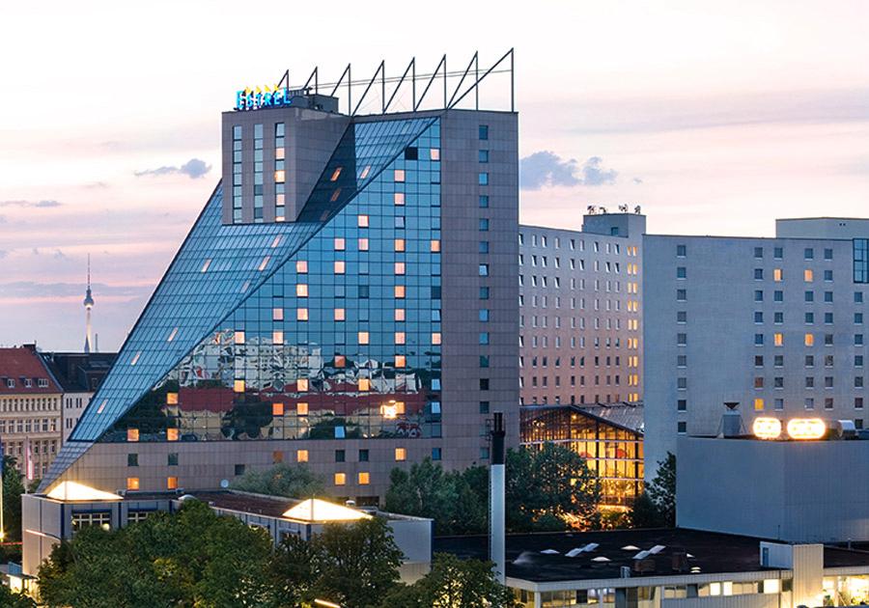
Venue
Estrel Hotel, Berlin, Germany

Slide 4
TGak Timeline
  March 2015 – Initial WG Letter Ballot
  February 2016 – WG Recirculation
  January 2017 – Sponsor Ballot Pool Formation Start
  January 2017 – MEC/MDR Initiated
  (March 2017 – Sponsor Ballot Pool Formation and MEC/MDR Completed)
  May 2017 – Initial Sponsor Ballot
  September 2017 – Sponsor Recirculation
  December 2017– Final WG & ExecComm & RevCom Approval

Slide 5
Sessions
Day | Time | Room
Monday | PM2 | Room 30441
Tuesday | EVE | Room 30441
Wednesday | PM2 | Room 30441
Thursday | AM1 | Room 30412

Slide 6
Monday, 10 July 2017
16:00 – 18:00, Room 30441
Call TGak meeting to order
Appointment of Secretary
  Mark Hamilton took notes
Review of IEEE 802 and 802.11 Policies and Procedures on Intellectual Property, Inappropriate Topics, Etc. Call for essential patents
  No response.
Attendance Recording Reminder
Approval of Agenda

Slide 7
Monday, 10 July 2017
16:00 – 18:00, Room 30441
Moved, to approve 11-17/0513r0 as the minutes of the Daejeon TGak meeting in May.
  Approved by unanimous consent
Moved, to approve the following minutes of TGak teleconferences held since the May TGak meeting:
  22 May & 12 June & 26 June: 11-17/0860r4
  “[Motion 52]” added to motion producing r5
  Amendment and Minutes Approved by unanimous consent

Slide 8
Monday, 10 July 2017
16:00 – 18:00, Room 30441
The Editor announced that D4.1 should be posted later today and will reflect 11-17/0898r1.
Presentations, motions, and discussion to resolve comments and improve the TGak Draft
Recess until 19:30 Tuesday evening.

Slide 9
Participants, Patents, and Duty to Inform
All participants in this meeting have certain obligations under the IEEE-SA Patent Policy.
Participants [Note: Quoted text excerpted from IEEE-SA Standards Board Bylaws subclause 6.2]:
  “Shall inform the IEEE (or cause the IEEE to be informed)” of the identity of each “holder of any potential Essential Patent Claims of which they are personally aware” if the claims are owned or controlled by the participant or the entity the participant is from, employed by, or otherwise represent.
  “Should inform the IEEE (or cause the IEEE to be informed)” of the identity of “any other holders of potential Essential Patent Claims” (that is, third parties that are not affiliated with the participant, with the participant’s employer, or with anyone else that the participant is from or otherwise represents)
The above does not apply if the patent claim is already the subject of an Accepted Letter of Assurance that applies to the proposed standard(s) under consideration by this group
Early identification of holders of potential Essential Patent Claims is strongly encouraged
No duty to perform a patent search

Slide 10
Patent Related Links
  All participants should be familiar with their obligations under the IEEE-SA Policies & Procedures for standards development.
  Patent Policy is stated in these sources:
  IEEE-SA Standards Boards Bylaws
  http://standards.ieee.org/develop/policies/bylaws/sect6-7.html#6
  IEEE-SA Standards Board Operations Manual
  http://standards.ieee.org/develop/policies/opman/sect6.html#6.3
  Material about the patent policy is available at
  http://standards.ieee.org/about/sasb/patcom/materials.html
If you have questions, contact the IEEE-SA Standards Board Patent Committee Administrator at patcom@ieee.org or visit http://standards.ieee.org/about/sasb/patcom/index.html
This slide set is available at https://development.standards.ieee.org/myproject/Public/mytools/mob/slideset.ppt

Slide 11
Call for Potentially Essential Patents
If anyone in this meeting is personally aware of the holder of any patent claims that are potentially essential to implementation of the proposed standard(s) under consideration by this group and that are not already the subject of an Accepted Letter of Assurance:
  Either speak up now or
  Provide the chair of this group with the identity of the holder(s) of any and all such claims as soon as possible or
  Cause an LOA to be submitted

Slide 12
Participation in IEEE 802 Meetings
All participation in IEEE 802 Working Group meetings is on an individual basis
• Participants in the IEEE standards development individual process shall act based on their qualifications and experience. (https://standards.ieee.org/develop/policies/bylaws/sb_bylaws.pdf section 5.2.1)
• IEEE 802 Working Group membership is by individual; “Working Group members shall participate in the consensus process in a manner consistent with their professional expert opinion as individuals, and not as organizational representatives”. (subclause 4.2.1 “Establishment”, of the IEEE 802 LMSC Working Group Policies and Procedures)
Participants have an obligation to act and vote as an individual and not under the direction of any other individual or group. A Participant’s obligation to act and vote as an individual applies in all cases, regardless of any external commitments, agreements, contracts, or orders.
Participants shall not direct the actions or votes of any other member of an IEEE 802 Working Group or retaliate against any other member for their actions or votes within IEEE 802 Working Group meetings, see https://standards.ieee.org/develop/policies/bylaws/sb_bylaws.pdf section 5.2.1.3 and the IEEE 802 LMSC Working Group Policies and Procedures, subclause 3.4.1 “Chair”, list item x.
By participating in IEEE 802 meetings, you accept these requirements. If you do not agree to these policies then you shall not participate.
(Latest revision of IEEE 802 LMSC Working Group Policies and Procedures: http://www.ieee802.org/devdocs.shtml)

Slide 13
Other Guidelines for IEEE WG Meetings
All IEEE-SA standards meetings shall be conducted in compliance with all applicable laws, including antitrust and competition laws.
  Don’t discuss the interpretation, validity, or essentiality of patents/patent claims.
  Don’t discuss specific license rates, terms, or conditions.
    Relative costs, including licensing costs of essential patent claims, of different technical approaches may be discussed in standards development meetings.
      Technical considerations remain primary focus
  Don’t discuss or engage in the fixing of product prices, allocation of customers, or division of sales markets.
  Don’t discuss the status or substance of ongoing or threatened litigation.
  Don’t be silent if inappropriate topics are discussed … do formally object.
---------------------------------------------------------------
See IEEE-SA Standards Board Operations Manual, clause 5.3.10 and “Promoting Competition and Innovation: What You Need to Know about the IEEE Standards Association's Antitrust and Competition Policy” for more details.

Slide 14
Tuesday, 11 July 2017
19:30–21:30, Room 30441
Call meeting to order
Appointment of Secretary
  Mark Hamilton
Call for essential patents
  No IPR declarations
Attendance Recording Reminder
Approval of Agenda
Presentations, motions, and discussion to resolve comments and improve the TGak Draft
  11-17/1117r1 -> r2
  Work on comment resolution.
Recess until 16:00 Wednesday

Slide 15
Wednesday, 12 July 2017
16:00–18:00, Room 30441
Call meeting to order
Appointment of Secretary
  Mark Hamilton took notes.
Call for essential patents
  No response.
Attendance Recording Reminder
Approval of Agenda
[53] Moved, to approve the comment resolutions in 11-17/0898r2 marked “Ready for motion”.
  Mover: Joe Levy Seconder: Ganesh Venkatesan
  Approved by unanimous consent
Presentations, motions, and discussion to resolve comments and improve the TGak Draft

Slide 16
Wednesday, 12 July 2017
16:00–18:00, Room 30441
  Look at revised Figures 4-13a, 4-13b, and 4-13c (11-17/1140r0). Suggested changes:
    Splitting to one EISS per port as at top of 4-13b is best. Change the bottom left of 4-13a, bottom center of 4-14b, and top center and left of 4-13c to also show multiple EISSes.
    Change “802.1Q MAC Relay Function” to “802.1Q MAC Relay Entity”
    In 4-13c, show a bridge spanning two STAs by moving the LLC end station on the central AP to the right a bit (swap with adjacent .1Q port stack) and then have one 802.1Q MAC Relay Entity across the right bridge port on the leftmost AP and the left bridge port on the center AP.
    A minor point: where data is being muxed/demuxed to bridge ports, this is clearer by having jogs in the lines to the ISSes. The figures are currently inconsistent on this point. In 4-13a, bottom right is good, bottom left needs jogs. In 4-13b, bottom left and top center are good, bottom center needs jogs. In 4-13c, top center is good, top left needs jogs.
    Extend 802.1Q Media Access Independent Fucntion at bottom left of 4-13c so MAC-SAP corresponds with bottom of 802.1Q MAC Relay Entity. (Bottom left of 4-13b is good.)
    Change stuff above DS-SAP in 4-13c top right to just be one box saying “Portal”.
    “802.1Q Media Access Independent Function” -> “802.1Q Media Independent Function.

Slide 17
Wednesday, 12 July 2017
16:00–18:00, Room 30441
Recess until 08:00 Thursday

Slide 18
Thursday, 13 July 2017
08:00–10:00, Room 30412
Call meeting to order 08:10
Appointment of Secretary
  Mark Hamilton
Call for essential patents
  No response
Attendance Recording Reminder
Approval of Agenda
Presentations, motions, and discussion to resolve comments and improve the TGak Draft
  11-17/1134r0 Ganesh Venkatesan
    -> r1
  11-17/1140r1 Joseph Levy

Slide 19
Thursday, 13 July 2017
08:00–10:00, Room 30412
Teleconferences discussion
Moved, to hold 802.11ak Teleconferences:
  1 hour teleconferences through the September 2017 802.11 meeting on Monday July 31st, August 7th, and August 28th at 9am Eastern US Time.
  Approved by unanimous consent.
Adjourn TGak

Slide 20
[Reference Information]
802.11ak PAR and Five Criterion
  https://development.standards.ieee.org/get-file/P802.11ak.pdf?t=77398400003
    11-12/1207r1, “802.11 GLK Draft PAR”
    11-12/1208r0, “802.11 GLK Draft 5C”
Draft 4.0 of 802.11ak (now in Sponsor Ballot):
  http://www.ieee802.org/11/private/Draft_Standards/11ak/Draft P802.11ak_D4.0.pdf
802.1Qbz and 802.1AC-REV are published as IEEE Std 802.1Qbz-2016 and IEEE Std 802.1AC-2016
  Last Drafts:
    http://www.ieee802.org/1/files/private/bz-drafts/d2/802-1Qbz-d2-4.pdf
    http://www.ieee802.org/1/files/private/ac-rev-drafts/d4/802-1ac-rev-d4-0.pdf
(Note: you can use 802.1 or 802.11 credential to access either members site.)

