Slide 1
Wi-Fi Enhancement for Full Coverage at Smart Home : Part-I (Coverage Investigation)
Date: 2017-05-08
Authors:
Name | Affiliation | Address | Phone | Email
Dongguk Lim | LG Electronics | 19, Yangjae-daero 11gil, Seocho-gu, Seoul 137-130, Korea |  | dongguk.lim@lge.com
Eunsung Park |  |  |  | esung.park@lge.com
Jinsoo Choi |  |  |  | js.choi@lge.com
HanGyu Cho |  |  |  | hg.cho@lge.com

Slide 2
Abstract
This presentation :
investigates coverage issue of current IEEE 802.11 wirelessLAN when the WLAN is used for Smart home,
introduces the Narrow band transmission to improve the SNR and to support the full coverage of home.

Slide 3
Introduction
The Wi-Fi has been used as a key connectivity technology at home. And, the usage of Wi-Fi for home appliance has been increasing year by year.
  E.g. LG Electronics announced to use Wi-Fi in all of home appliances in 2017.
So, it is required for Wi-Fi to support various devices and services at home.
  E.g. streaming, audio and smart home services described in appendix.
But, it is hard to secure link connection and quality everywhere at home.
  If device is far from the AP and/or many obstacles like wall or floor are located between AP and the device, the received signal is very poor.
=> We need to investigate that the current Wi-Fi can support various devices and services everywhere at home

Slide 4
Assumption for analysis (1/2)
: Topology
To investigate the raised issue of home Wi-Fi, we assume the WLAN system which operates on 2.4GHz band or 5GHz band for our analysis.
  The 11ax system which has been designed for dense environment including the residential use case is assumed.
  And, to confirm the impact of the frequency characteristic, both 2.4GHz and 5GHz band are assumed for investigation.
  We investigate the performance of the WLAN system in realistic home environment where we use the modified scenario from the simulation scenario-1[1] for the simulation.
    One Apartment is constructed with four rooms
      Single AP, Single STA per room
Number of wall traversed for each STA
  One wall : STA 1, STA2
  Two wall : STA3
Distance of each STA
  STA1 : 7m
  STA2&STA3 : 10m
5m
AP
STA1
10m
STA2
STA3

Slide 5
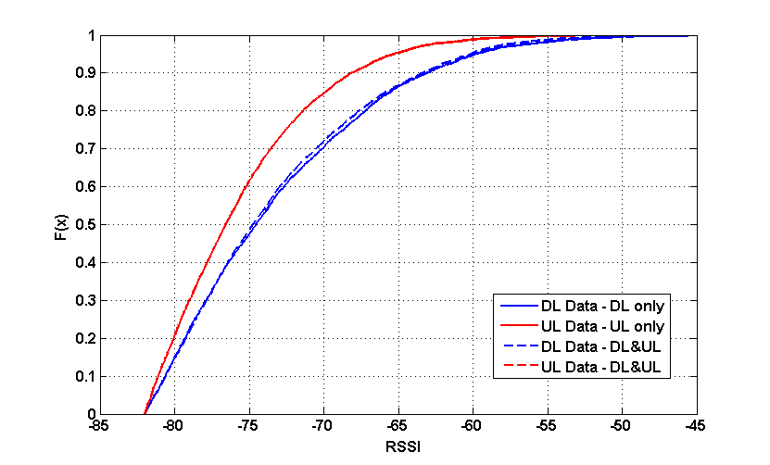
Assumption for analysis (2/2)
: OBSS interference
For the consideration of the influence of interference in home, the following interference measurement is assumed.
  To measure the interference, we considered the RSSI of OBSS PPDU in residential environment as provided in [2].
  In the downlink, we can observe that the 10% of STAs are affected by interference larger than -62dBm and the 40% of STAs are influenced by interference larger than -72dBm.
  => The environment used in the reference is a bit different from what we assumed in this presentation, but we simply assumed these two RSSI values as OBSS interference in our analysis.
RSSI of detected OBSS PPDU ( 80MHz )

Slide 6
Required SNR per MCS for analysis
FER Performance at 10% FER on 20MHz
  Based on the frame formats which are defined in 11ax, we check the performance and further consider the beamforming case in the simulation.
  Required SNR of each MCS level at 10% FER (dB) – Simulation assumption is in Appendix
1) 5GHz band
2) 2.4GHz band
MCS level | SNR¹⁾ (dB) | SNR²⁾ (dB) | SNR³⁾ (dB)
0 | 8 | 3.3 | 0.8
1 | 11 | 6.2 | 2.3
2 | 15.8 | 10 | 3.5
3 | 16.6 | 11.5 | 5.6
4 | 21.6 | 16 | 8.4
5 | 24.5 | 19.5 | 12.6
6 | 26.6 | 21.3 | 14.2
7 | 28.8 | 23.6 | 15.5
8 | 31.4 | 26.8 | 20
9 | 33.8 | 28.6 | 21.8
MCS level | SNR¹⁾ (dB) | SNR²⁾ (dB) | SNR³⁾ (dB)
0 | 8.5 | 4.4 | 1.9
1 | 11.2 | 6.9 | 4
2 | 15.1 | 10.5 | 5.7
3 | 16.7 | 12.1 | 9.5
4 | 21.1 | 16.5 | 11.9
5 | 25 | 20.3 | 13.7
6 | 27.3 | 22 | 15.6
7 | 29.1 | 24.1 | 17.2
8 | 33.8 | 28.1 | 21.6
9 | 36 | 29.5 | 23.6
1) SU PPDU, 2) Extended Range PPDU w/ 106-tone RU, 3) SU-PPDU w/ 3x2 beamfomring

Slide 7
Received SINR per distance for analysis (1/2)
We used the Link budget described in appendix to find out how much SINR the STA can get according to environment in home.
In 5GHz band
Received SINR according to Distance
Received SINR according to Distance
Distance from AP / Interference | -72 dBm | -62 dBm
7m | 16.45 | 6.478
10m | 11.03 | 1.057
Distance from AP / Interference | -72 dBm | -62 dBm
7m | 5.454 | -4.522
10m | 0.032 | -9.943

Slide 8
Received SINR per distance for analysis (2/2)
In 2.4GHz band
Received SINR according to Distance
Received SINR according to Distance
Interference /Distance from AP | -72 dBm | -62 dBm
7m | 21.69 | 11.84
10m | 16.26 | 6.417
Interference /Distance from AP | -72 dBm | -62 dBm
7m | 10.69 | 0.8388
10m | 5.268 | -4.583

Slide 9
Analysis: Required additional SNR (1/5)
Comparing received SINR with required SNR at 10% FER of MCS0
  Based on the received SINR of previous slides, we check how much SNR improvement is required for Wi-Fi transmission depending on STA’s condition.
  5GHz band
    STA w/ -62dBm interference
  As shown in results, it is difficult to support the full coverage without enhancement of SNR and even though the transmit scheme such as beamforming (e.g. 3x2 BF) is used for transmission, the SNR larger than 10dB is required in worst case (18dB is required with the SU PPDU)
    Required additional SNR = required SNR at 10% FER of MCS0 – received SINR
 |  | STA1 (7m, w/ 1wall) | STA2 (10m, w/ 1wall) | STA3 (10m, w/ 2wall)
Received SINR (dB) |  | 6.478 | 1.057 | -9.943
Required additional SNR (dB) | SU PPDU | 1.5 | 7 | 18
 | ER w/ 106 | 0 | 2.2 | 13.2
 | 3x2 BF | 0 | 0 | 10.7

Slide 10
Analysis: Required additional SNR (2/5)
  2.4GHz band
    STA w/ -62dBm interference
  We observed that even though the 2.4GHz band which has better frequency characteristic is used for transmission, SNR improvement larger than 13dB is required by using the SU PPDU in the worst case (6.5dB is still needed with 3x2 BF)
 |  | STA1 (7m, w/ 1wall) | STA2 (10m, w/ 1wall) | STA3 (10m, w/ 2wall)
Received SINR (dB) |  | 11.84 | 6.417 | -4.583
Required additional SNR (dB) | SU PPDU | 0 | 2.1 | 13
 | ER w/ 106 | 0 | 0 | 9
 | 3x2 BF | 0 | 0 | 6.5

Slide 11
Analysis: Required additional SNR (3/5)
In the previous slides, we showed that significant SNR improvement is required to cover the STA that is under the worst condition at home.
On the other side, we investigate how much SNR improvement is needed to support various home services.
  As shown in appendix, according to type of home service, the required data rate (~500Mbps) is very different.
    For the analysis, we assume the multimedia service such as streaming video.
    For example, if we want to watch a streaming video by using YouTube (e.g. resolution is 720p), then the required data rate can be calculated as following
      Data rate = (1280 * 720) (resolution) * 30(fps) * 0.27(compression) * (100/70) (MAC efficiency) / 1024 / 1024 = 10.1702Mbps
    Here, we assume the mac efficiency as 70%
In next slides, we calculate the required additional SNR to support the data rate addressed above.

Slide 12
Analysis: Required additional SNR (4/5)
Required additional SNR (according to MCS level to satisfy the data rate of service, e.g. streaming video)
  STA w/ -62dBm interference (5GHz band)
  Depending on the transmission scheme, 12 ~ 21dB SNR improvement is required to satisfy the required data rate (10.17Mbps) in worst case.
    The least MCS which can support the target data rate was selected from 11ax MCS table
 |  | STA1 (7m, w/ 1wall) | STA2 (10m, w/ 1wall) | STA3 (10m, w/ 2wall)
Received SNR (dB) |  | 6.478 | 1.057 | -9.943
Required additional SNR (dB) | SU PPDU (MCS1)¹⁾ | 4.5 | 9.9 | 21
 | ER w/ 106 (MCS2)²⁾ | 3.5 | 9 | 20
 | 3x2 BF (MCS1)¹⁾ | 0 | 1.3 | 12.3
1) MCS0 w/ 234 data tones: 8.1Mbps (not satisfied, so MCS1 is required), 2) MCS1 w/ 102 data tones: 7.1Mbps (not satisfied, so MCS2 is required)

Slide 13
Analysis: Required additional SNR (5/5)
  STA w/ -62dBm interference (2.4GHz band)
    We can see a similar trend from 5GHz band with a bit reduced SNR requirement. 8 ~ 15dB SNR improvement is required to cover the target data rate in worst case.
 |  | STA1 (7m, w/ 1 wall) | STA2 (10m, w/ 1 wall) | STA3 (10m, 2wall)
Received SNR (dB) |  | 11.84 | 6.417 | -4.583
Required additional SNR (dB) | SU PPDU (MCS1)¹⁾ | 0 | 4.8 | 15.8
 | ER w/ 106 (MCS2)²⁾ | 0 | 4 | 15
 | 3x2 BF (MCS1)¹⁾ | 0 | 0 | 8.6
1) MCS0 w/ 234 data tones: 8.1Mbps (not satisfied, so MCS1 is required), 2) MCS1 w/ 102 data tones: 7.1Mbps (not satisfied, so MCS2 is required)

Slide 14
Discussion
Based on our analysis, received SINR should be increased by 10 ~ 18dB in 5GHz and 6 ~ 13dB in 2.4GHz to cover users’ Wi-Fi connection in worst condition at home (e.g. w/ multiple walls, strong interference)
If we further consider service requirement (e.g. data rate for streaming), we need to enhance SNR by 12 ~ 21dB in 5GHz and 8 ~ 15dB in 2.4GHz.
  Higher data rate required, more SNR improvement needed.
  So, we think it’s needed to have some solution to cover Wi-Fi connection and better service requirement

Slide 15
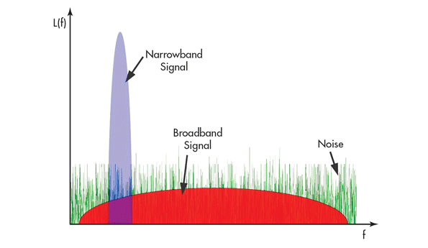
A possible solution
: Narrow band transmission (i.e. NBT)
The narrow band transmission has the following pros and cons.
  Pros.
    Due to concentration of power on narrow bandwidth, it can secure higher SNR as shown in right figure.
    Due to increasing of symbol length, it can also achieve robustness to the delay spread.
  Cons.
    The response with the sharp peak of a narrowband signal requires high-performing filters, which are precisely adjusted to avoid attenuating the active signal
    Due to narrow sub-carrier spacing, it might be vulnerable to carrier frequency offset.

Slide 16



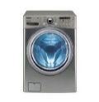




Smart Home Use Case w/ NBT
Without additional equipment or system, users can access to the household appliances with Wi-Fi connectivity and get better services regardless of situation of devices
Second floor
user enjoys the services(e.g. streaming, audio) that require high data rate regardless of location in home
First floor
user manages or controls the all household appliances regardless of location in home

Slide 17
Considerations on NBT (1/2)
In order to use a narrow band in UNII-band (i.e. 2.4GHz, 5GHz), firstly, we should consider the power limitation by the regulation.
=> In terms of regulation, it is expected that the Narrow band transmission on 2.4GHz (e.g. under FCC rule) is potentially able to improve the SNR.
 | Band (GHz) | Power Limit for AP (dBm) | PSD Limit for AP (dBm/MHz)
FCC¹⁾ | 2.4 | 30(1W) | N/A
 | 5.15-5.25 | 30(1W) | 17 (50mw)
 | 5.25-5.35 | 24(250mW) | 11(12mW)
 | 5.47-5.725 | 24(250mW) | 11(12mW)
 | 5.725-5.85 | 30(1W) | 30/500KHz
ETSI | 2.4²⁾ | 20(100mW) | 10(10mW)
 | 5.15-5.25³⁾ | 23(200mW) | 10(10mW)
 | 5.25-5.35 | 23(200mW) | 10(10mW)
 | 5.47-5.725 | 30(1W) | 17(50mW)
 | 5.725-5.85⁴⁾ | 30(1W) | 23(200mW)
1) 47 CFR 15.247, 2) EN 300 328 v2.1.1, 3) EN 301 893 v2.0.7, 4) 302 502 V2.0.8

Slide 18
Considerations on NBT (2/2)
Besides power limit, in order to use the NBT on 2.4GHz or 5GHz, we should consider several issues more.
  DFS channel on 5GHz
    To avoid the false detection as radar signal, using of the NBT may be restricted.
  Interference in 2.4GHz
    Since the channels are usually congested by many devices, the NBT can be influenced by stronger interference (than what we assumed).

Slide 19
SNR improvement by NBT
We observe that as we use smaller bandwidth in 2.4GHz band (e.g. under FCC rule), we can increase the coverage that the WLAN signal can reach.
  E.g. when 2MHz is used for transmission w/ -62dBm interference, the received SINR can be improved by about 10dB and we can get longer coverage by about 8m.
20MHz, SNR at 10% FER
20MHz, SNR at 10% FER
4MHz, SNR at 10% FER
4MHz, SNR at 10% FER
2MHz, SNR at 10% FER
2MHz, SNR at 10% FER

Slide 20
Conclusion
It is shown in this presentation that SNR improvement is required to support Wi-Fi connectivity and various home services everywhere at home.
It is also investigated that narrow band transmission (i.e. NBT) can provide SNR improvement for this purpose.
It is necessary to study issues coming from NBT, e.g.
  Narrow band preamble design
  Narrow band PHY design
  Legacy coexistence

Slide 21
Reference
[1] 11-14-0980-16-00ax-simulation-scenarios
[2] 11-15-0551-01-00ax-obss-preamble-detection

Slide 22
Appendix

Slide 23
Assumption for simulation
Band : 2.4GHz, 5GHz
Bandwidth : 2, 4, 20MHz
Channel : TGnD (indoor)
CP size : 1.6us
Data size : 100 Byte
Ant. Conf : 1x1, 3x2
Number of Spatial Stream : 1
Impairment : CFO + TO
  CFO : 25PPM on 2.4GHz, 20PPM on 5GHz
Channel estimation : LS+SM

Slide 24
Link budget
Transmit power
  Tx_Pwr = 20dBm(2.4GHz), 21dBm(5GHz)
Noise figure : 7dBm
Noise floor : -174dBm + 10log10BW
Bandwidth : 1MHz, 2MHz, 4MHz, 5MHz, 20MHz
Target PER : 10%
Interference : -72dBm, -62dBm
  It is based on 20MHz
Penetration loss
  Wall loss : 11dB per wall (refer the next slide)

Slide 25
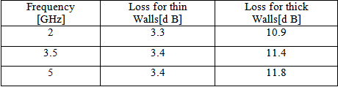
Wall loss
Penetration loss as a function of frequency for two types of walls¹⁾
1) P. Nobles, “A comparison of indoor pathloss measurements at 2 GHz, 5 GHz, 17 GHz and 60 GHz”, COST 259, TD (99)100, Leidschendam, The Netherlands, September 1999

Slide 26
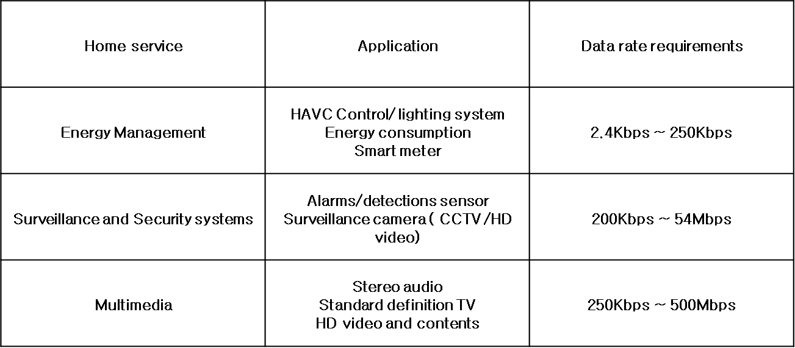
  Smart home services¹⁾
Required data rate for services
1) www.mdpi.com/journal/energies ISSN 1996-1073 Smart Home Communication Technologies and Applications: Wireless Protocol Assessment for Home Area Network Resources

Slide 27
Link budget according to BW (1/3)
5GHz band (FCC, 5.15-5.25GHz)
All curves are overlapped by power limitation under regulation

Slide 28
Link budget according to BW (2/3)
5GHz band (ETSI, 5.15-5.25GHz)
All curves are overlapped by power limitation under regulation

Slide 29
Link budget according to BW (3/3)
2.4GHz band (ETSI)
  The Tx power is still tightly limited, so we can observe small enhancement of SNR by using NBT (about 3dB)

