Slide 1
Improvements to enhanced SLS beamforming
Date: 2017-05-09
Authors:

Slide 2
Introduction
Enhanced SLS beamforming [1] can provide significant gains in dense environments or in asymmetrical beamforming configuration [2]
Use of directive receive patterns in association
Low collision probability, high link budget
Prerequisite: Responders require reciprocity
Responder needs to decide for Tx beam based on Rx beam
This presentation proposes an extension to
allow responders with weak reciprocity to participate in enhanced SLS
Lowered reciprocity requirements
allow for simultaneous Tx and Rx beam improvement for responders with sufficient reciprocity in enhanced SLS

Slide 3
Enhanced SLS beamforming (recap)
Enhanced SLS comprises three steps [1, 2]
TRNs are appended to beacon frames in BTI
Responding STAs can determine best Rx beam
Beamforming SP holds several listen periods, where the initiator (AP) uses directional Rx beams
Responders transmit directionally in a space-time slot
Transmission of a single SSW frame in a slot where the AP receives with appropriate pattern
Tx beam selection based on best Rx beam
Reciprocity required
Feedback phase
Sector ACK to each successfully received responder

Slide 4
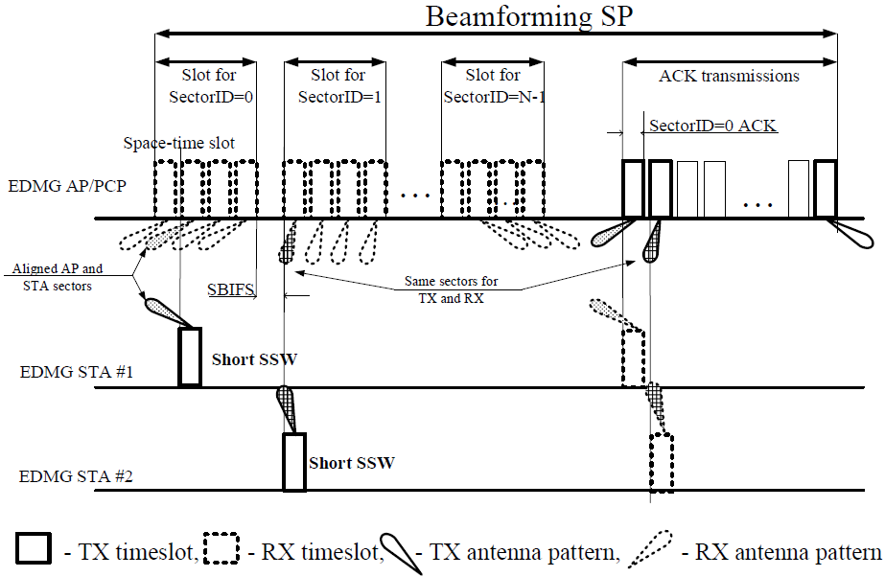
Enhanced SLS beamforming (recap)
Example of enhanced SLS [1]
slot
space-time slot

Slide 5
Properties
Enhanced SLS beamforming implies
Reciprocity at responder
Responder concludes on Tx beam based on Rx beam
Successful beam training with a single SSW frame
Rx and Tx beam granularity of responder is determined by number of TRNs in BTI
Number of TRNs may be selected low in long BTIs for overhead reasons
Improvements target
STAs with weak reciprocity
Remove uncertainty in responder Tx beam by training
STAs with reciprocity
Simultaneous improvement of Tx and Rx beam

Slide 6
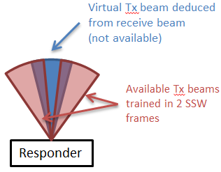
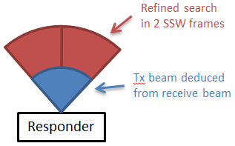
Proposal
We propose to enable responders to transmit in several consecutive space-time slots within in a slot for beamforming SP
The maximum number of space-time slots a responder can use is signaled in the configuration of beamforming SP
Benefits
Responders with weak reciprocity can train several candidate Tx beams
Weak reciprocity comes with uncertainty in Tx beams
Uncertainty can be removed by training
Responders with sufficient reciprocity can improve beam training
Short responder sector sweep can improve transmit and receive beam simultaneously

Slide 7
Signaling Proposal
Signaling for maximum number of consecutive space-time slots which can be occupied by a STA during a slot of beamforming SP
Use two bits in EDMG Extended Schedule Element when ‘asymmetric beamforming training‘ is set
Otherwise bits are reserved

Slide 8
Signaling Proposal (cont)
Exponential encoding of Nmax STS
Covers wide range
„00“: A STA can occupy 1 space-time slot
„11“: A STA can occupy up to 8 space-time slots
Nmax STS value in field | Actual Nmax STS value
00 | 1
01 | 2
10 | 4
11 | 8

Slide 9
Summary
Extension of Enhanced SLS beamforming
Extension of beamforming SP to support responders to train in multiple consecutive space-time slots
Maximum number of occupied space-time slots by a particular responder (Nmax STS) is signaled by the initiator in EDMG Extended Schedule Element
Exponential signaling
Benefits
Responders with weak reciprocity can participate in enhanced SLS
Responders with sufficient reciprocity can improve beam training for transmitter and receiver simultaneously

Slide 10
Straw Poll
Do you agree to add the amendment text of 11-17/0771r0 to D0.3?

Slide 11
References
[1] Candidate Draft P802.11ay D0.3
[2] 11-17/0067r1 Enhanced SLS BF flow for efficient AP-STA access in dense environment

