Slide 1
Trigger Frame Format for 802.11az
Date: 2017-05-09
Authors:
Chittabrata Ghosh

Slide 2
Abstract
May 2017
doc.: IEEE 802.11-17/0758r0
In this presentation, we propose the Trigger frame format for various Trigger frame variants required for 11az-based measurement
Chittabrata Ghosh

Slide 3
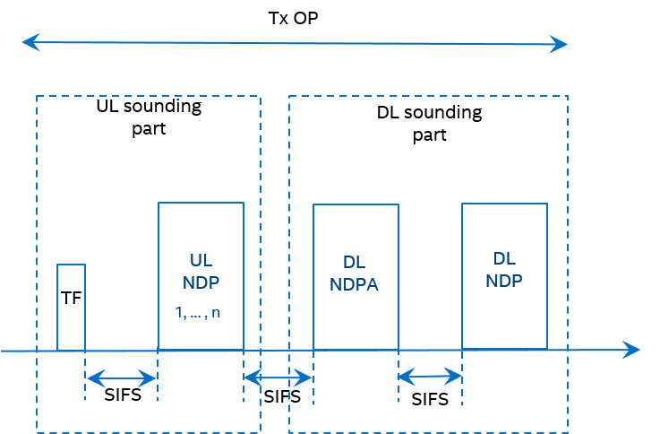
Introduction
May 2017
doc.: IEEE 802.11-17/0758r0
802.11az has agreed on using NDP-based sounding mechanism for measurement in the measurement phase
Within a single TXOP, the UL sounding is followed by the DL sounding
In UL sounding, UL NDPs are solicited from STAs assigned resources identified in the Trigger frame
However, for efficient resource allocation, the AP needs to identify the STAs that intend to perform measurements
Chittabrata Ghosh

Slide 4
Trigger Frames for 11az Functionalities
May 2017
doc.: IEEE 802.11-17/0758r0
4 different Trigger frame variants have been identified for 11ax-based MU ranging
Trigger frame for 11az-based MU ranging negotiation
Trigger frame for 11az-based MU measurement phase
Triggering the UL NDP from multiple STAs
Trigger frame for LMR report from multiple STAs simultaneously
Trigger frame for the polling phase preceding the MU measurement phase
Additional Trigger frame variants might be defined within the 11az amendment
Chittabrata Ghosh

Slide 5
Trigger Frame Format in 802.11ax
May 2017
doc.: IEEE 802.11-17/0758r0
Chittabrata Ghosh

Slide 6
Trigger Type Subfield in Common Info Field
May 2017
doc.: IEEE 802.11-17/0758r0
There are 7 Trigger frame variants already defined in 802.11ax
Only 11 variants remaining to be defined for future amendments
We propose to use 1 value in the Trigger Type subfield to represent all Trigger variants for 11az
Trigger Type field value = 8; description: 11az
We also propose to define a Trigger Sub-type subfield in the Trigger Dependent Common Info field for Trigger frame variants for 11az MU ranging
Chittabrata Ghosh

Slide 7
Trigger Frames for 11az Functionalities
May 2017
doc.: IEEE 802.11-17/0758r0
For illustration, the four different Trigger frame variants have been identified for 11ax-based MU ranging with Trigger Type = 7
Trigger Sub-type 00: Trigger frame for 11az-based MU ranging negotiation
Trigger Sub-type 01: Trigger frame for 11az-based MU measurement phase
Triggering the UL NDP from multiple STAs
Trigger Sub-type 10: Trigger frame for LMR report from multiple STAs simultaneously
Trigger Sub-type 11: Trigger frame for the polling phase preceding the MU measurement phase
Support for additional variants of Trigger frame need to be defined; for example, defining 3 bits for the Trigger Sub-type subfield
Chittabrata Ghosh

Slide 8
Summary
May 2017
doc.: IEEE 802.11-17/0758r0
We reviewed the Trigger frame format defined in 802.11ax
We have proposed a Trigger frame format for MU ranging
A special Trigger Type field value for MU ranging
A newly defined Trigger Sub-type subfield to define the variants of Trigger frame defined in 11az
Chittabrata Ghosh

Slide 9
Straw Poll 1
May 2017
doc.: IEEE 802.11-17/0758r0
Do you support defining a single Trigger Type field value for the 11az amendment and a Trigger Sub-type subfield in Trigger Dependent Common Info field?
Chittabrata Ghosh

