Slide 1
STBC for OFDM PHY in 11ay
Date: 2017-05-07
Authors:

Slide 2
Introduction
This presentation proposes Space-Time Block Coding (STBC) scheme definition for EDMG OFDM PHY in 11ay.

Slide 3
STBC in 11n/ac for OFDM PHY
The IEEE 802.11 n/ac standard defines the STBC schemes with the number of input spatial stream N_{SS} and the number of output space-time streams N_{STS} = 2*N_{SS}.
The signal subcarriers mapping for (N_{SS} = 1, N_{STS} = 2) scheme is shown in figure below, [1].

Slide 4
STBC in 11n/ac for OFDM PHY (Cont’d)
Received signals in frequency domain:
  OFDM symbol n = 1:
    R₁(k) = H₁(k)*X(k) – H₂(k)*Y*(k) + Z₁(k);
  OFDM symbol n = 2:
    R₂(k) = H₂(k)*X*(k) + H₁(k)*Y(k) + Z₂(k);
  where: H₁(k) and H₂(k) – channel coefficients as shown below;
  Z₁(k) and Z₂(k) – AWGN ~CN(0, σ²) noise samples;

Slide 5
STBC in 11n/ac for OFDM PHY (Cont’d)
ZF equalizer solution:
  The estimated X^(k) and Y^(k) signals can be written as follows:
  where H₁^(k) and H₂^(k) estimations of channel coefficients;

Slide 6
SQPSK OFDM Modulation in 11ay
SQPSK modulation mapping is shown in figure below:
  Two coded bits (c_{2k}, c_{2k+1}) are modulated to two subcarriers (X_{k}, X_{P(k)});
  The modulation is performed in 2 steps:
    First, two BPSK points are modulated as x_{2k} = (2*c_{2k}-1), x_{2k+1} = (2*c_{2k+1}-1);
    Second, two QPSK points are modulated by multiplication on matrix Q;
  P(k) = 168 + k for Static Tone Pairing (STP) mode and can be permutation of indexes for Dynamic Tone Pairing (DTP) mode in the range [168, 335];

Slide 7
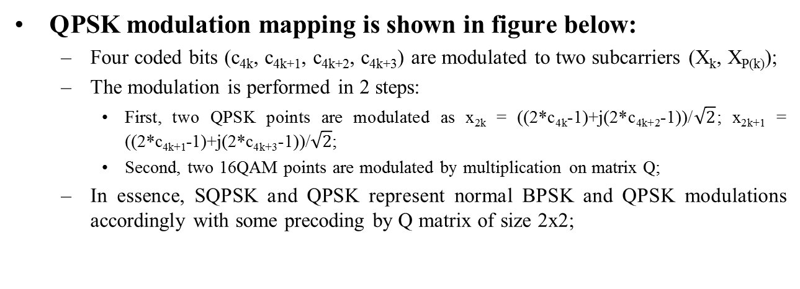
QPSK OFDM Modulation in 11ay
QPSK modulation mapping is shown in figure below:
  Four coded bits (c_{4k}, c_{4k+1}, c_{4k+2}, c_{4k+3}) are modulated to two subcarriers (X_{k}, X_{P(k)});
  The modulation is performed in 2 steps:
    First, two QPSK points are modulated as x_{2k} = ((2*c_{4k}-1)+j(2*c_{4k+2}-1))/$\sqrt{2}$; x_{2k+1} = ((2*c_{4k+1}-1)+j(2*c_{4k+3}-1))/$\sqrt{2}$;
    Second, two 16QAM points are modulated by multiplication on matrix Q;
  In essence, SQPSK and QPSK represent normal BPSK and QPSK modulations accordingly with some precoding by Q matrix of size 2x2;

Slide 8
STBC for SQPSK/QSPK in 11ay
The STBC mapping scheme with SQPSK, QPSK modulation is shown below. P(k) = N_{SD}/2 + k, i.e. Static Tone Paring (STP) is used.
It occupies 8 subcarriers and extracts space-time-frequency diversity gain.

Slide 9
STBC for OFDM in 11ay
For 11ay data transmission it is proposed to keep the same scheme with (N_{SS} = 1, N_{STS} = 2) as defined for 11n/ac.
It is proposed to introduce space-time pilots encoding as shown in figure below.

Slide 10
STBC for OFDM in 11ay (Cont’d)
The sequences P_{NSP}(i_{STS}, :) are composed of ±1 symbols, therefore conj() is not required.
N_{SP} defines the number of pilots per OFDM symbol.
It is proposed to reuse sequences P_{NSP}(i_{STS}, :) defined for regular MIMO transmission.

Slide 11
SP/M
Do you agree:
  To include spec text proposed in (11-17-0753-00-00ay 30 6 6 2 Space Time Block Coding) defining STBC scheme for OFDM PHY into the spec draft?

Slide 12
References
IEEE802.11-2016
Draft P802.11ay_D0.3

