Slide 1
Length Calculation in EDMG PPDU
Date: 2017-05-09
Authors:

Slide 2
Introduction
As the L-Header definition in the current draft, for an EDMG SC mode PPDU and an EDMG OFDM mode PPDU, the requirement of spoofing error shall be smaller than one symbol block.
This presentation proposes the method of length calculation for EDMG SC & OFDM PPDUs to meet the spoofing error requirement.

Slide 3
Spoofing of EDMG TXTIME
The DMG receiver should hold the carrier sense signal busy during actual TXTIME, the actual TXTIME is the same as or shorter than the spoofed duration.
  The spoofing error shall be smaller than one SC symbol block (512×Tc) and non-negative.
EDMG SC & OFDM PPDU
TXTIME
L-STF
L-CEF
L-Header
EDMG-Header-A
E-STF
E-CEF
Data
TRN
DMG SC mode PPDU
L-STF
L-CEF
L-Header
DMG payload
N_{BLKS}
Spoofing error

Slide 4
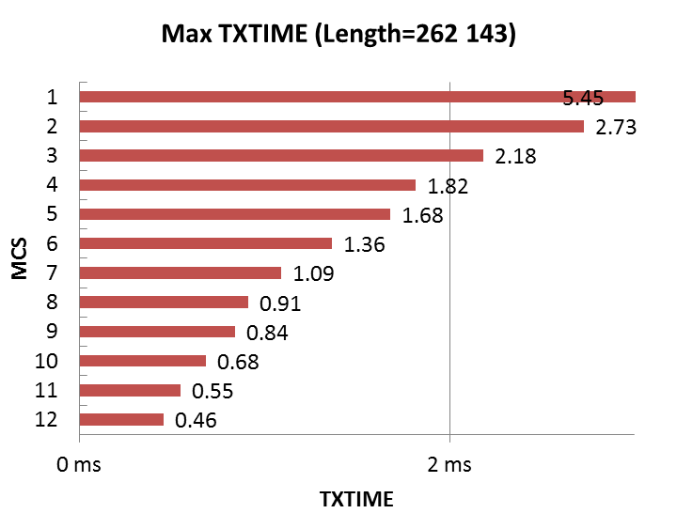
MCS value in L-Header
The number of SC symbol blocks that is used for the calculation of EDMG TXTIME can be different according to MCS.
  QPSK, 16QAM, and 64QAM MCSs provide resolution of one symbol block (512×T_c) and the maximum PPDU duration is smaller than 2 ms (aPPDUMaxTime).
  BPSK MCS provides resolution of one symbol block (512×T_c) or two symbol blocks (1024×T_c) and the maximum PPDU duration reaches 2 ms(aPPDUMaxTime).
  → the spoofing error requirement can be guaranteed by using training length together.

Slide 5
Method of length calculation
If the TXTIME of EDMG PPDU is short, QPSK, 16QAM, and 64QAM MCSs can be used for the calculation. It guarantees a maximum spoofing error by selecting an appropriate value for Length field.
If the TXTIME of EDMG PPDU is long, BPSK MCS should be used with TRN length in order to guarantee a maximum spoofing error by selecting an appropriate value for Length and TRN-LEN fields together.

Slide 6
Conclusion
According to the length of EDMG PPDU, available MCSs are changed.
In the long EDMG packet case, an appropriate training length value should be used to guarantee the spoofing error requirement.
We propose the length calculation should be defined into the specification body as an informative.

Slide 7
SP/M
Do you agree to include the text for the length calculation proposed in (11-17-0788-00-00ay-Length Calculation in EDMG PPDU-Draft text) into the specification body as an informative text?

