Slide 1
Beamforming Training for
Channel Bonding & Channel Aggregation
Date: 2017-05-09
Authors:

Slide 2
Introduction
The EDMG STA can perform the BF training for CB & CA by using BRP packets.
The BRP PPDU can be different depending on the following cases.
  Case1: an initiator has trained BF on a bonded and aggregated channel with a responder.
  Case2: an initiator has not trained BF on a bonded and aggregated channel with a responder.

Slide 3
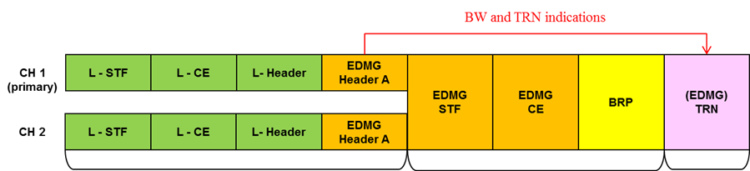
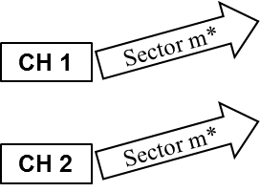
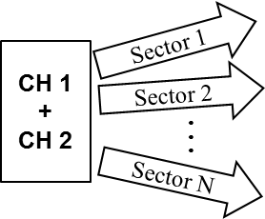
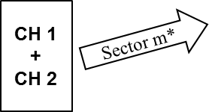
Existing BRP PPDU format
(BF on a bonded channel was trained)
If an initiator has trained BF on a bonded channel with a responder, the initiator and responder can transmit the following PPDU format in order to refine the beam over a bonded channel.
This PPDU format is suitable for beam refinement if the best sector over a bonded channel is already known.
The duplicate part of PPDU can be decoded through the primary channel
The bonded part of PPDU can be decoded through a bonded channel
This training part of PPDU conducts beam refinement for a bonded channel.
*Sector m: the best sector from previous BF results over a bonded channel

Slide 4
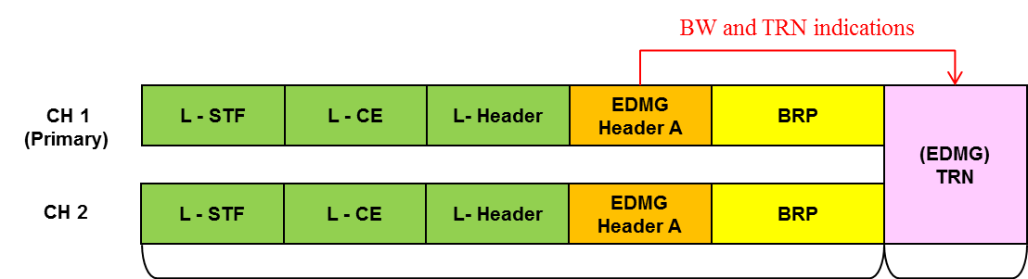
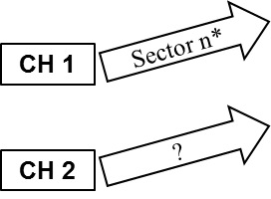
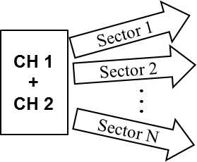
Proposed BRP PPDU format
(BF on a bonded channel was not trained)
If an initiator has not trained BF on a bonded channel with a responder, the following PPDU format is suitable for initiating BF training for CB.
This PPDU format should be allowed in order to achieve BF training for CB.
The duplicate part of PPDU can be decoded through the primary channel
This training part of PPDU conducts BF training for a bonded channel
Until conducting this part, the best sector for a bonded channel cannot be founded.
*Sector n: the best sector from previous SLS results

Slide 5
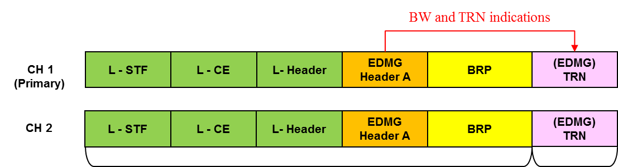
Proposed BRP PPDU format
(BF on a aggregated channel was not trained)
If an initiator has not trained BF on an aggregated channel with a responder, the following PPDU format is suitable for initiating BF training for CA.
This PPDU format should be allowed in order to achieve BF training for CA.
The duplicate part of PPDU can be decoded through the primary channel
This training part of PPDU conducts BF training for an aggregated channel
Until conducting this part, the best sector for an aggregated channel cannot be founded.
*Sector n: the best sector from previous SLS results

Slide 6
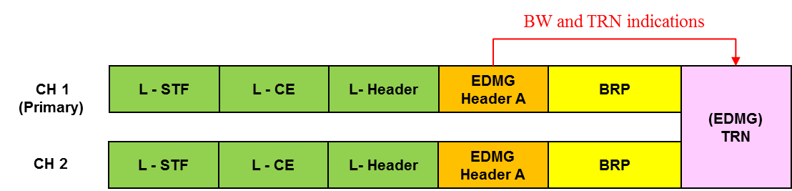
Proposed Aggregation field in EDMG control mode
In EDMG control mode, the Aggregation field is not defined in EDMG Header-A.
To indicate whether TRN format in EDMG control mode PPDU is bonded or aggregated, we propose Aggregation field in EDMG Header-A.
Table 15 - EDMG Header-A2 subfield definition
Field | Number of bits | Start bit | Description
Aggregation | 1 | 0 | If this field set to 0, the BW field specifies that the TRN field of the PPDU is appended on a 2.16 GHz, 4.32 GHz, 6.48 GHz or 8.64 GHz channel. If this field set to 1, the BW field specifies a 2.16+2.16 GHz or 4.32+4.32 GHz channel. This field is reserved if the value of the EDMG TRN Length field is 0.
Reserved | 7 | 1 | Set to 0 by the transmitter and ignored by the receiver.
CRC | 16 | 8 | Header Check sequence. Calculation of the header check sequence is defined in 20.3.7.

Slide 7
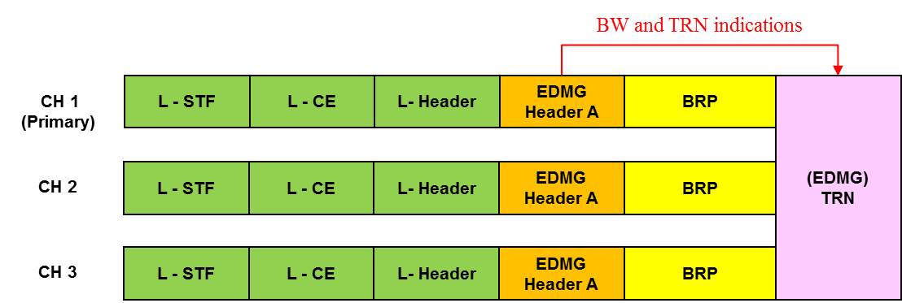
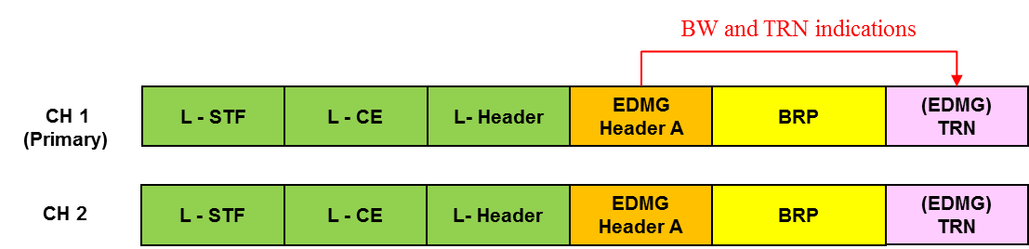
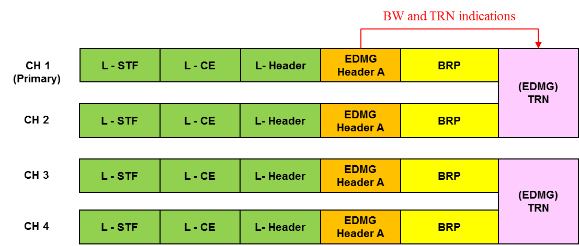
Examples of EDMG control mode PPDUs for BF training for CB & CA
BW field set to 6.48GHz
Aggregation field set to 0
(6.48GHz channel)
BW field set to 4.32GHz
Aggregation field set to 1
(2.16+2.16GHz channel)
BW field set to 8.64GHz
Aggregation field set to 1
(4.32+4.32GHz channel)

Slide 8
Conclusion
We proposed that EDMG BRP packet is transmitted by the EDMG control mode PPDU in order to perform BF for CB & CA.

Slide 9
SP/Motion
Do you agree to include the text for the beamforming training for channel bonding and channel aggregation proposed in (11-17-0743-00-00ay-Beamforming Training for CB & CA) to the draft?

