Slide 1
Multi-Carrier OOK with Bipolar Modulation
Date: 2017-05-03
Authors:
Name | Affiliations | Address | Phone | Email
Shouxing Simon Qu | BlackBerry Ltd | 1001 Farrar Rd, Ottawa, ON, Canada | +1 613-595-4205 | squ@blackberry.com
Stephen McCann | BlackBerry Ltd | The Pearce Building, West Street, Maidenhead, UK | +44 1753 667099 | smccann@blackberry.com
Michael Montemurro | BlackBerry Ltd | 4701 Tahoe Blvd, Mississauga, ON, Canada | +1 289-261-4183 | mmontemurro@blackberry.com
James Lepp | BlackBerry Ltd | 1001 Farrar Road, Ottawa, ON, Canada | +1 613-595-4156 | jlepp@blackberry.com

Slide 2
Abstract
As demonstrated in [1]-[2], the narrow-band bipolar OOK (NBB OOK) and bipolar PPM (BPPM) signals provide higher bandwidth efficiencies than the regular NRZ OOK and PPM signals respectively.
In this submission, we show the potential benefit when NBB OOK or BPPM is applied to multi-carrier OOK.

Slide 3
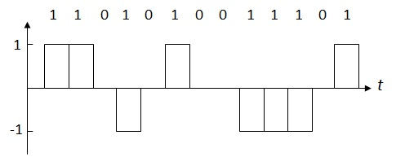
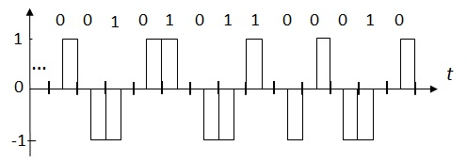
Recap: Unipolar/Bipolar OOK/PPM [1]-[2]
OOK Signal
NBB OOK Signal
PPM Signal
Bipolar PPM Signal

Slide 4
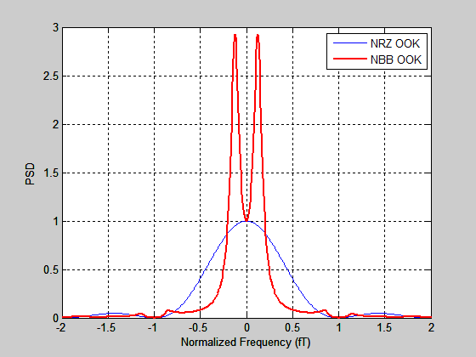
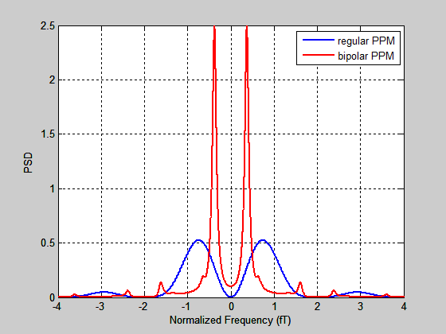
PSDs of OOK and NBB OOK
PSDs of PPM and BPPM

Slide 5
Multi-Carrier OOK and Multi-carrier NBB-OOK
Multi-carrier OOK:
Each subcarrier is modulated by a baseband OOK signal. The baseband OOK signal has two levels: {0, 1}.
Multi-carrier NBB OOK:
Each subcarrier is modulated by a baseband NBB OOK signal. The baseband NBB OOK signal has three levels: {+1, 0, -1}.
Benefit vs Single-Carrier OOK:
providing freq. diversity to cope with freq. selective fading.

Slide 6
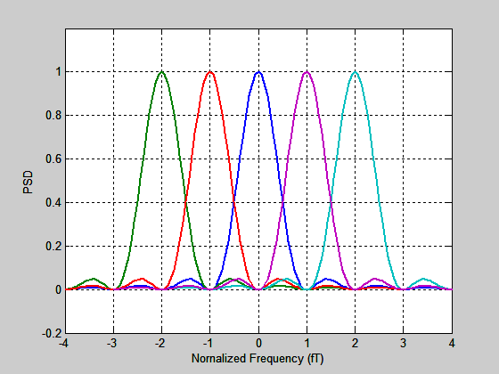
PSD of Multi-Carrier OOK
PSDs of neighboring
sub-carriers are
overlapped.
Freq. diversity is reduced.
Error rate performance in freq. selective fading channel is affected.

Slide 7
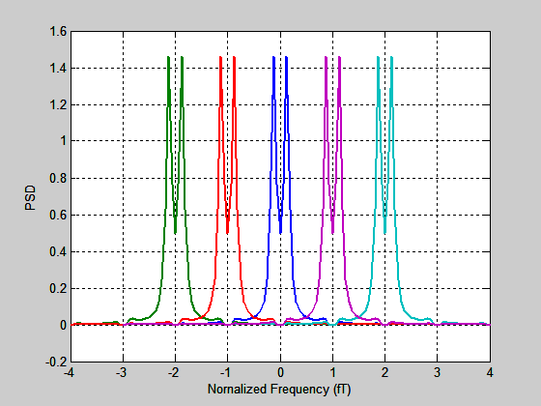
PSD of Multi-Carrier NBB-OOK
PSD overlapping of neighboring
sub-carriers is
greatly reduced.
Freq. diversity is improved.
Error rate performance in F-S fading channel may be improved.

Slide 8
Multi-Carrier PPM & Multi-Carrier BPPM
Multi-carrier PPM:
Each subcarrier is modulated by a baseband PPM signal. The baseband PPM signal has two levels: {0, 1}.
Multi-carrier BPPM:
Each subcarrier is modulated by a baseband BPPM signal. The baseband BPPM signal has three levels: {+1, 0, -1}.

Slide 9
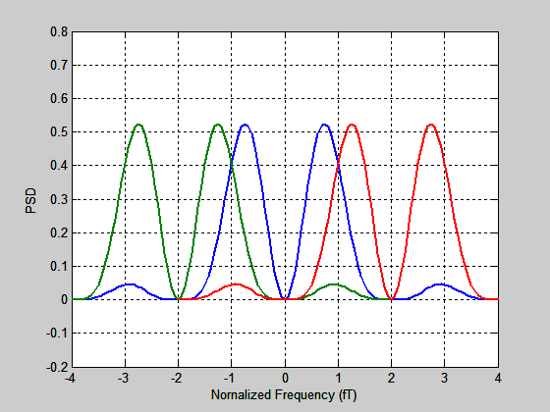
PSD of Multi-Carrier PPM
Subcarrier space is 2/T.
PSDs of neighboring
sub-carriers are
overlapped.
Freq. diversity is reduced.
Error rate performance in freq. selective fading channel is affected.

Slide 10
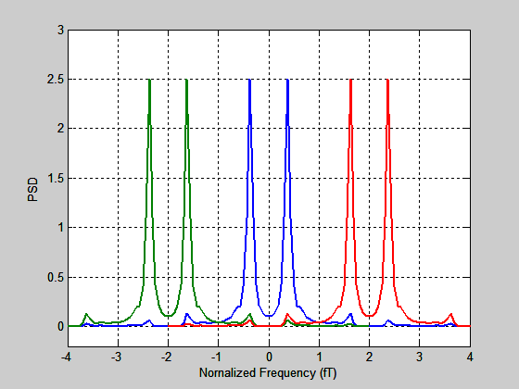
PSD of Multi-Carrier BPPM-OOK (1)
Subcarrier space is 2/T.
PSD overlapping of neighboring
sub-carriers is
greatly reduced.
Freq. diversity is improved.
Error rate performance in F-S fading channel may be improved.

Slide 11
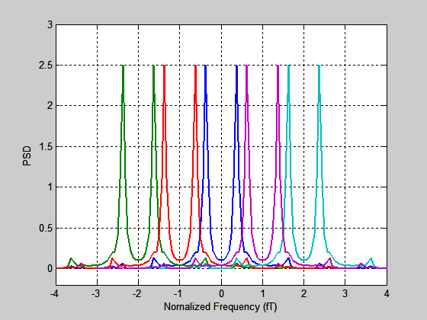
PSD of Multi-Carrier BPPM-OOK (2)
Subcarrier space is 1/T
Number of subcarriers increase.
Improved frequency resolution.

Slide 12
Conclusions
When the subcarriers of multi-carrier OOK are modulated by the regular OOK or PPM, the PSDs of neighboring sub-channels are overlapped. This reduces the frequency diversity.
When the subcarriers of multi-carrier OOK are modulated by the NBB OOK or BPPM, the PSD overlapping of neighboring sub-channels is greatly reduced. This improves the frequency diversity and may improve error rate performance in frequency selective fading channels.
Suggestion: Using NBB OOK or BPPM for either multi-carrier or single carrier OOK in WUR.

Slide 13
Strawpoll
Should Multi-Carrier OOK with Bipolar Modulation be considered for the Specification Framework document?
Yes
No
Abstain

Slide 14
REFERENCES
:
[1] Simon Qu, Stephen McCann and James Lepp, “Narrow-Band Bipolar OOK Signal”, IEEE 802.11-17/0357r3, March 2017.
[2] Simon Qu, Stephen McCann and James Lepp, “Bipolar Pulse Position Modulation”, IEEE 802.11-17/0703r0, May 2017.

