Slide 1
Bipolar Pulse Position Modulation
Date: 2017-05-03
Authors:
Name | Affiliations | Address | Phone | Email
Shouxing Simon Qu | BlackBerry Ltd | 1001 Farrar Rd, Ottawa, ON, Canada | +1 613-595-4205 | squ@blackberry.com
Stephen McCann | BlackBerry Ltd | The Pearce Building, West Street, Maidenhead, UK | +44 1753 667099 | smccann@blackberry.com
Michael Montemurro | BlackBerry Ltd | 4701 Tahoe Blvd, Mississauga, ON, Canada | +1 289-261-4183 | mmontemurro@blackberry.com
James Lepp | BlackBerry Ltd | 1001 Farrar Road, Ottawa, ON, Canada | +1 613-595-4156 | jlepp@blackberry.com

Slide 2
Abstract
As demonstrated in [1], the narrow-band bipolar OOK (NBB OOK) signal provides higher bandwidth efficiency than the regular NRZ OOK signal.
It is indicated in [1] that “The principle is applicable to other unipolar binary signals”.
In this submission, we demonstrate how to apply the approach to the pulse-position modulation (PPM) (i.e. Manchester-code-like OOK).

Slide 3
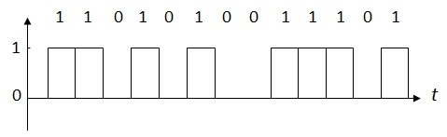
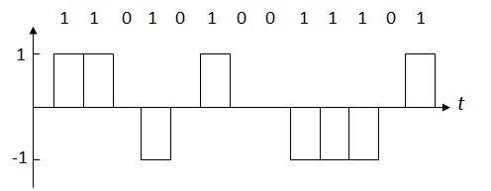
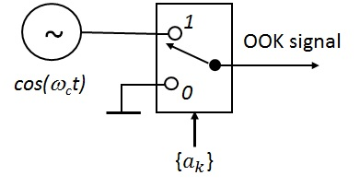
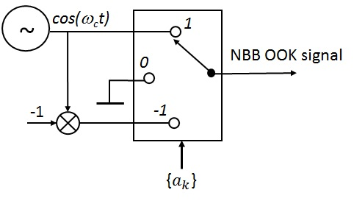
Recap: OOK & NBB OOK [1]
OOK Signal
NBB OOK Signal

Slide 4
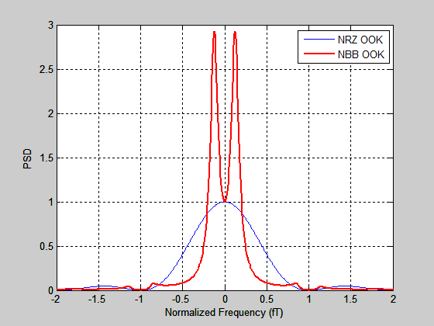
PSDs of OOK & NBB OOK Signals

Slide 5
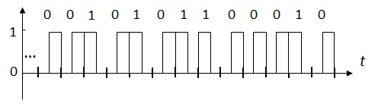
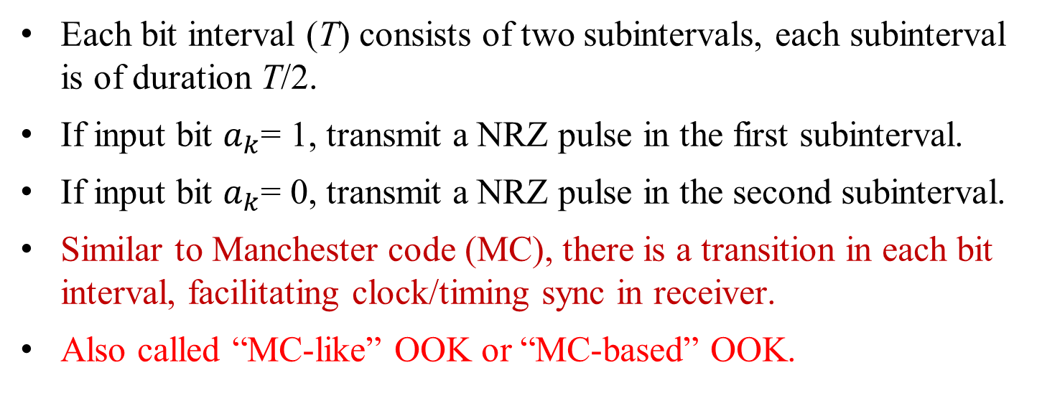
Baseband Pulse-Position Modulation (PPM)
Each bit interval (T) consists of two subintervals, each subinterval is of duration T/2.
If input bit $a_{k}$= 1, transmit a NRZ pulse in the first subinterval.
If input bit $a_{k}$= 0, transmit a NRZ pulse in the second subinterval.
Similar to Manchester code (MC), there is a transition in each bit interval, facilitating clock/timing sync in receiver.
Also called “MC-like” OOK or “MC-based” OOK.

Slide 6
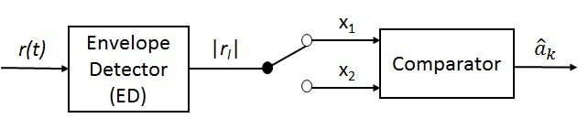
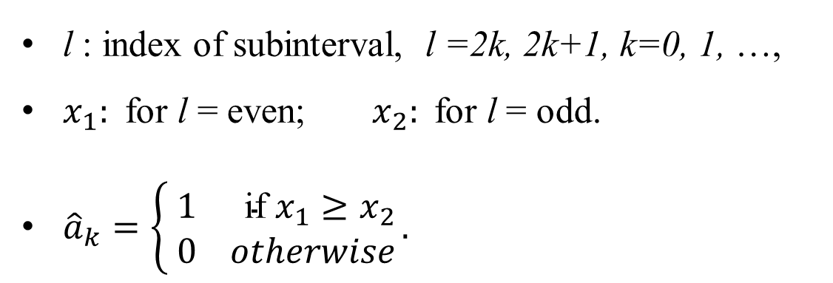
Non-Coherent Demodulation of PPM Signal
l : index of subinterval, l =2k, 2k+1, k=0, 1, …,
$x_{1}:$ for l = even; $x_{2}:$for l = odd.
${\hat{a}}_{k}=\left\{\begin{aligned} 1 \text{if} x_{1}≥x_{2} \\ 0 otherwise\end{aligned}\right..$.

Slide 7
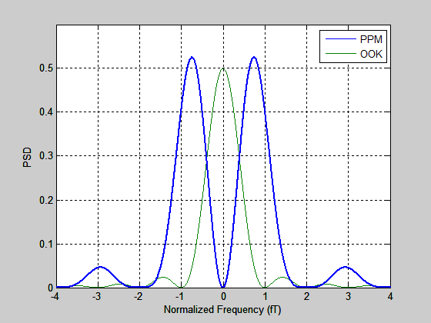
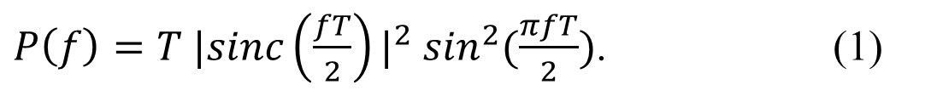
Normalized PSD of PPM Signal [2]
$P\left(f\right)=T {|sinc\left(\frac{fT}{2}\right)|}^{2} \sin^{2}(\frac{πfT}{2})$. (1)
  null-to-null bandwidth: W = 4/T.
  has non-zero discrete DC component (not shown).

Slide 8
Motivation for Bipolar PPM
Proposing a new PPM signal suitable for WUR.
Providing higher spectrum efficiency.
Do not increase receiver complexity:
  The new signal can be demodulated with the same non-coherent demodulator used as for the regular PPM.
  Same error rate performance in AWGN channel.
Slightly increasing transmitter complexity.

Slide 9
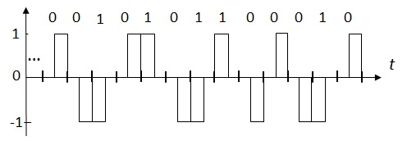
Bipolar PPM (BPPM) Baseband Signal
Bipolar: have three levels: {+1, 0 -1}.
Adjacent pulses have same polarity.
Non-adjacent pulses have alternate polarities.
Level varies cyclically: +1 → 0 → -1 → 0 → +1…

Slide 10
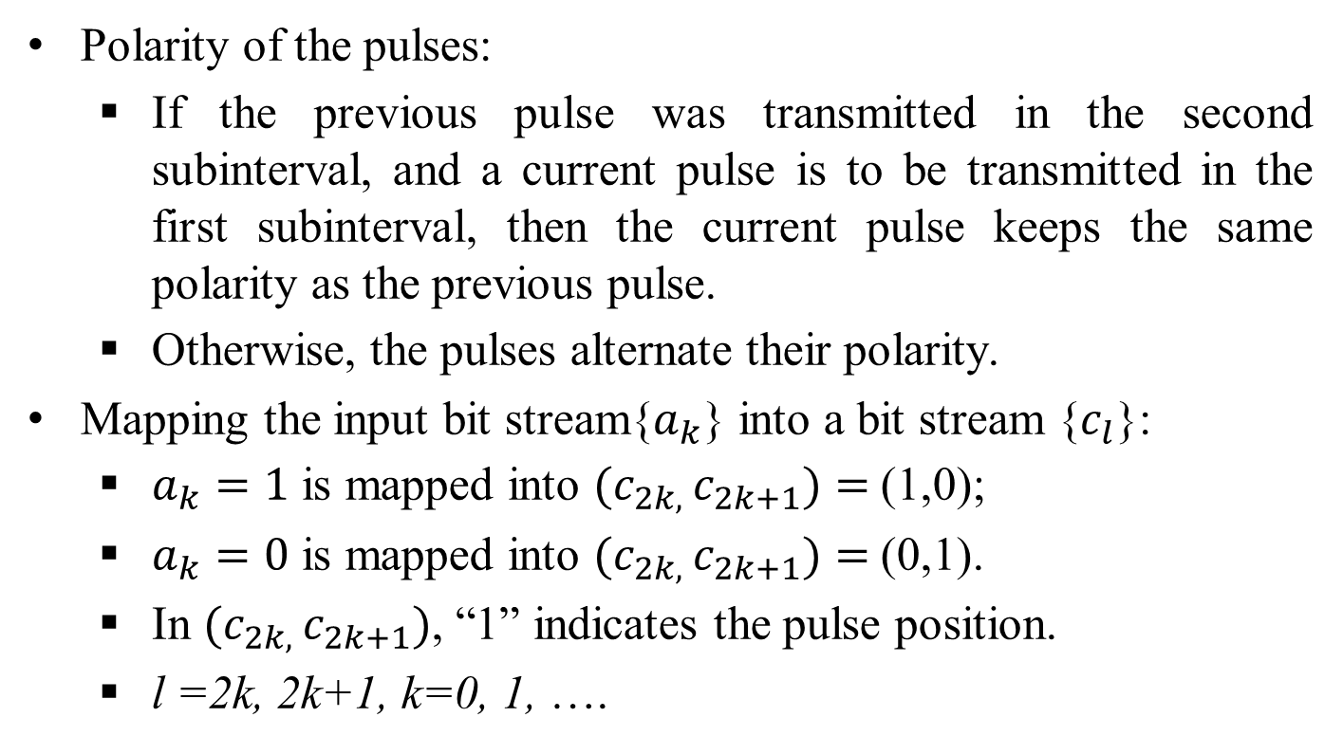
Bipolar PPM Signal (2)
Polarity of the pulses:
  If the previous pulse was transmitted in the second subinterval, and a current pulse is to be transmitted in the first subinterval, then the current pulse keeps the same polarity as the previous pulse.
  Otherwise, the pulses alternate their polarity.
Mapping the input bit stream{$a_{k}$} into a bit stream {$c_{l}$}:
  $a_{k}=1$ is mapped into ${(c}_{2k, }c_{2k+1})=$(1,0);
  $a_{k}=0$ is mapped into ${(c}_{2k, }c_{2k+1})=$(0,1).
  In ${(c}_{2k, }c_{2k+1})$, “1” indicates the pulse position.
  l =2k, 2k+1, k=0, 1, ….

Slide 11
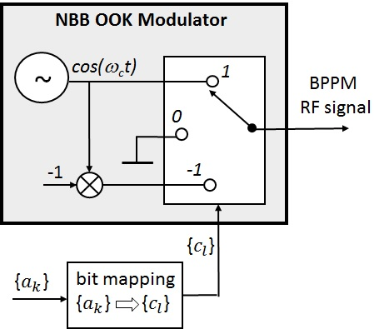
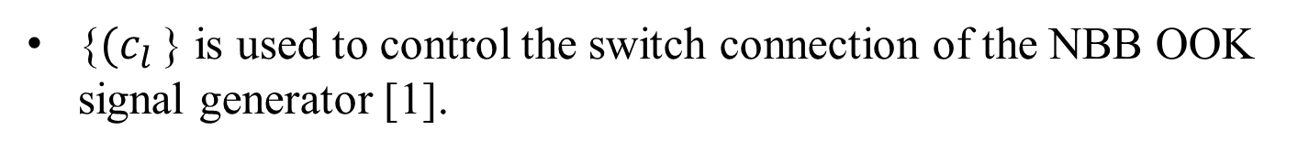
Bipolar PPM Signal Generator
{${(c}_{l }$} is used to control the switch connection of the NBB OOK signal generator [1].

Slide 12
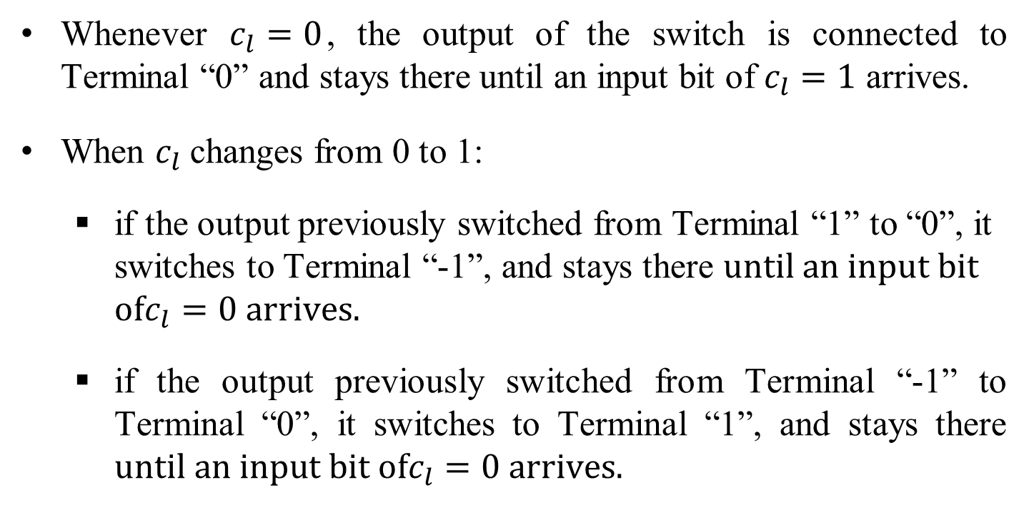
Switch Connection
Whenever $c_{l}=0$, the output of the switch is connected to Terminal “0” and stays there until an input bit of $c_{l}=1$ arrives.
When $c_{l}$changes from 0 to 1:
  if the output previously switched from Terminal “1” to “0”, it switches to Terminal “-1”, and stays there $until an input bit$ $ofc_{l}=0 arrives.$
  if the output previously switched from Terminal “-1” to Terminal “0”, it switches to Terminal “1”, and stays there $until an input bit ofc_{l}=0 arrives.$

Slide 13
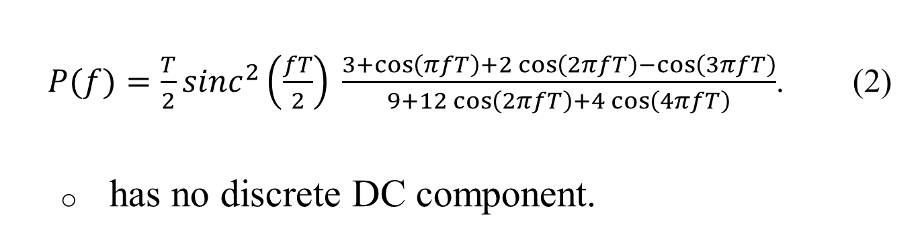
Normalized PSD of BPPM Signal
$P(f)=\frac{T}{2}{sinc}^{2}\left(\frac{fT}{2}\right) \frac{3+\cos\left(πfT\right)+2\cos\left(2πfT\right)−\cos\left(3πfT\right)}{9+12\cos\left(2πfT\right)+4\cos\left(4πfT\right)}$. (2)
  has no discrete DC component.
Non-coherent detection:
  with the same detector as for the regular PPM signal.

Slide 14
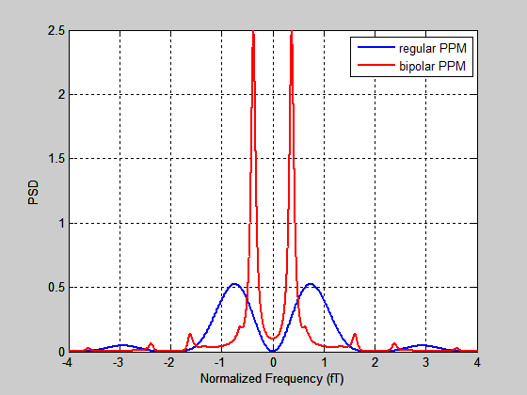
PSD of BPPM Signal (theoretical)

Slide 15
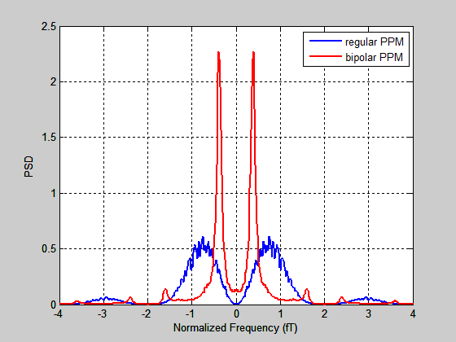
PSD of BPPM Signal (Simulation Results)

Slide 16
Bandwidth Efficiency Comparison
Double-Sided Bandwidth (fT) | Power Ratio within the Bandwidth (%)
 | Regular PPM | Bipolar PPM
2.0 | 64.4 | 85.2
2.2 | 71.7 | 86.0
2.4 | 77.2 | 86.7
2.6 | 81.0 | 87.4
2.8 | 83.3 | 88.2
3.0 | 84.7 | 88.9
3.2 | 85.3 | 90.5
3.4 | 85.5 | 92.3
3.6 | 85.6 | 92.5
3.8 | 85.6 | 92.5
4.0 | 85.6 | 92.5

Slide 17
Conclusions
By introducing proper correlation among symbols, the bipolar PPM provides improved spectrum efficiency compared to the regular PPM.
The required bandwidth for BPPM is significantly narrower than the regular PPM.
The out-of-band energy leakage is reduced.
No increase of Rx complexity:
  Demodulation with the same ED for the regular PPM; yielding same error rate performance in AWGN channel.
Transmitter complexity increases slightly.

Slide 18
Strawpoll
Should Bipolar Pulse Position Modulation (BPPM) be considered for the Specification Framework document?
Yes
No
Abstain

Slide 19
REFERENCES
:
[1] Simon Qu, Stephen McCann and James Lepp, “Narrow-Band Bipolar OOK Signal”, IEEE 802.11-17/0357r3, Mar. 2017.
[2] S. Benedetto, E. Biglieri and V. Castellani, Digital Transmission
Theory, Prentice-Hall, 1988.

