Slide 1
WUR Link Budget Analysis Follow-up:
Data Rates and SIG Bits Protection
Date: 2017-05-07
Authors:

Slide 2
Introduction
[1] Recap: WUR Link budge analysis shows, for 250kbps On-Off Keying (OOK),
  There is ~30dB link margin at close distance for indoor channels
  The coverage is shorter than 30m in UMi-NLOS channels @2.4G
  Multiple data rates can be beneficial to achieve either better efficiency or coverage
In this contribution, we address two issues:
  Provide simulation results for multiple data rate with and without Manchester Coding (MC).
  Signaling (SIG) bits are needed for each WUR packets to indicate the data rate and packet length options [2]. How many protection bits are needed for the SIG bits?

Slide 3
Modulation and Coding
OOK and Manchester Coding (MC) are favorable modulation and coding scheme for WUR [3][4]
In this contribution, we adopt similar waveform design (Appendix) and compare the performance with different rates
  125Kbps OOK, the “ON”/“OFF” symbol duration is 8μs
  250Kbps OOK, the “ON”/“OFF” symbol duration is 4μs
  500Kbps OOK, the “ON”/“OFF” symbol duration is 2μs
  1Mbps OOK, the “ON”/“OFF” symbol duration is 1μs

Slide 4
Simulation Settings
Device BW: 20MHz
Signal BW: ~4MHz, center 12 tones (without DC)
Waveform: 12 tone sequence
  [-1 -1 -1 1 1 -1 -1 -1 -1 1 -1 1]
  Good property: ave. CP power is similar to ave. signal power for all data rates
Number of information bits: 100
No impairments: phase noise, CFO, IQ imbalance

Slide 5
Ch: AWGN
Manchester Coding (MC) is beneficial for all data rates

Slide 6
Ch: DNLos
Manchester Coding (MC) is beneficial for all data rates

Slide 7
Ch: UMi-Los
Manchester Coding (MC) is beneficial for all data rates
1Mbps rate has error floor above 1% for UMi-Los

Slide 8
Data Rate Discussion
Confirmed with prior contributions[3][4], Manchester Coding has advantages in WUR OOK waveform design
  2~3dB SNR gain for all channel types
  Simple OOK detection with SNR-based threshold setting
Number of data rates
  125Kbps, 250Kbps, 500Kbps, 1Mbps can cover large range of channels and sensitivity
  2 bits signaling for the data rates

Slide 9
SIG Bits Protection
The signaling bits need protection for WUR receiver to save power
Assume total 4 bits of WUR-SIG: 2 bits to signal data rate, 2 bits to signal packet lengths
Cyclic redundancy check (CRC) is a popular technique for error detection

Slide 10
Ch: AWGN
P-false = (Num. of pkts with correct SIG bits but wrong CRC)/Num. of pkts
P-miss = (Num. of pkts with wrong SIG bits but correct CRC)/Num. of pkts
P-false is much higher for 2bit and 3bit CRC, though P-miss is lower

Slide 11
Ch: DNLos
P-false is much higher for 2bit and 3bit CRC

Slide 12
Ch: UMi-Los
P-false is much higher for 2bit and 3bit CRC

Slide 13
Number of CRC Bits
Since there are only 4 SIG bits, 2 or 3 CRC bits are relatively large. The error of CRC bits causes large P-false.
1-bit parity has good balance between P-false and P-miss, and P-miss is roughly one order lower than SIG bits error

Slide 14
Straw Poll 1
Do you agree to have two SIG bits to signal data rates?
  Yes
  No
  Abstain

Slide 15
Straw Poll 2
Do you agree to have one bit parity for the SIG bits protection in one WUR packet?
  Yes
  No
  Abstain

Slide 16
References
[1] Rui Cao et al., “WRU Link Budget Analysis”, IEEE 802.11-17/0339r1, March, 2017
[2] Liwen Chu et al. “WUR MAC and Wakeup Frame”, IEEE 802.11-17/0124r4, March 2017
[3] Eunsung Park and et al., , “Further Investigation on WUR
Performance”, IEEE 802.11-16/1144r0, Sept. 12, 2016.
[4] Steve Shellhammer and et al., “WUR Modulation and Coding”, IEEE 802.11-17/0366r0, Mar., 2017

Slide 17
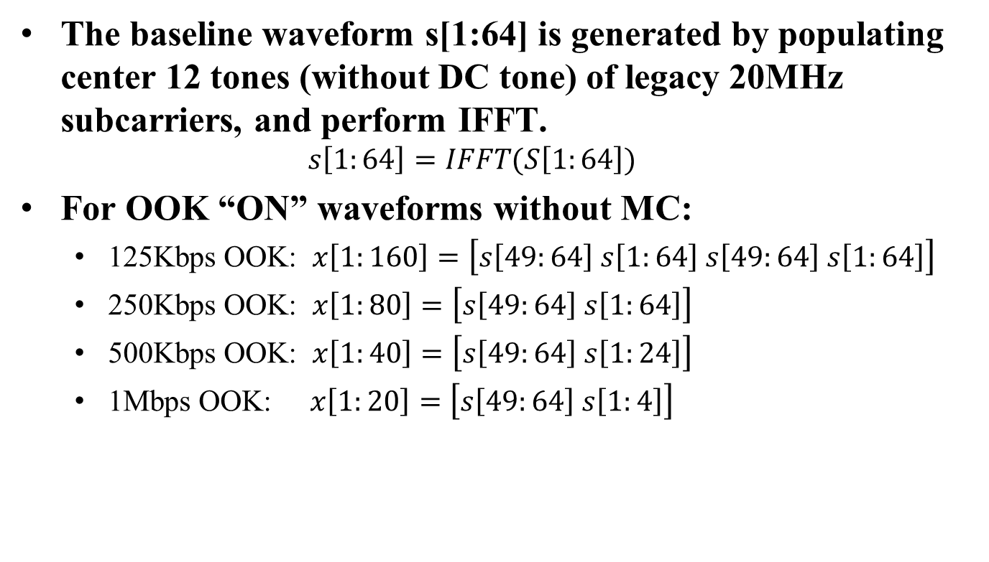
Appendix: OOK waveform (1)
The baseline waveform s[1:64] is generated by populating center 12 tones (without DC tone) of legacy 20MHz subcarriers, and perform IFFT.
  $$s\left[1:64\right]=IFFT(S\left[1:64\right])$$
For OOK “ON” waveforms without MC:
  125Kbps OOK: $x\left[1:160\right]=\left[s\left[49:64\right] s\left[1:64\right] s\left[49:64\right] s\left[1:64\right]\right]$
  250Kbps OOK: $x\left[1:80\right]=\left[s\left[49:64\right] s\left[1:64\right]\right]$
  500Kbps OOK: $x\left[1:40\right]=\left[s\left[49:64\right] s\left[1:24\right]\right]$
  1Mbps OOK: $x\left[1:20\right]=\left[s\left[49:64\right] s\left[1:4\right]\right]$

Slide 18
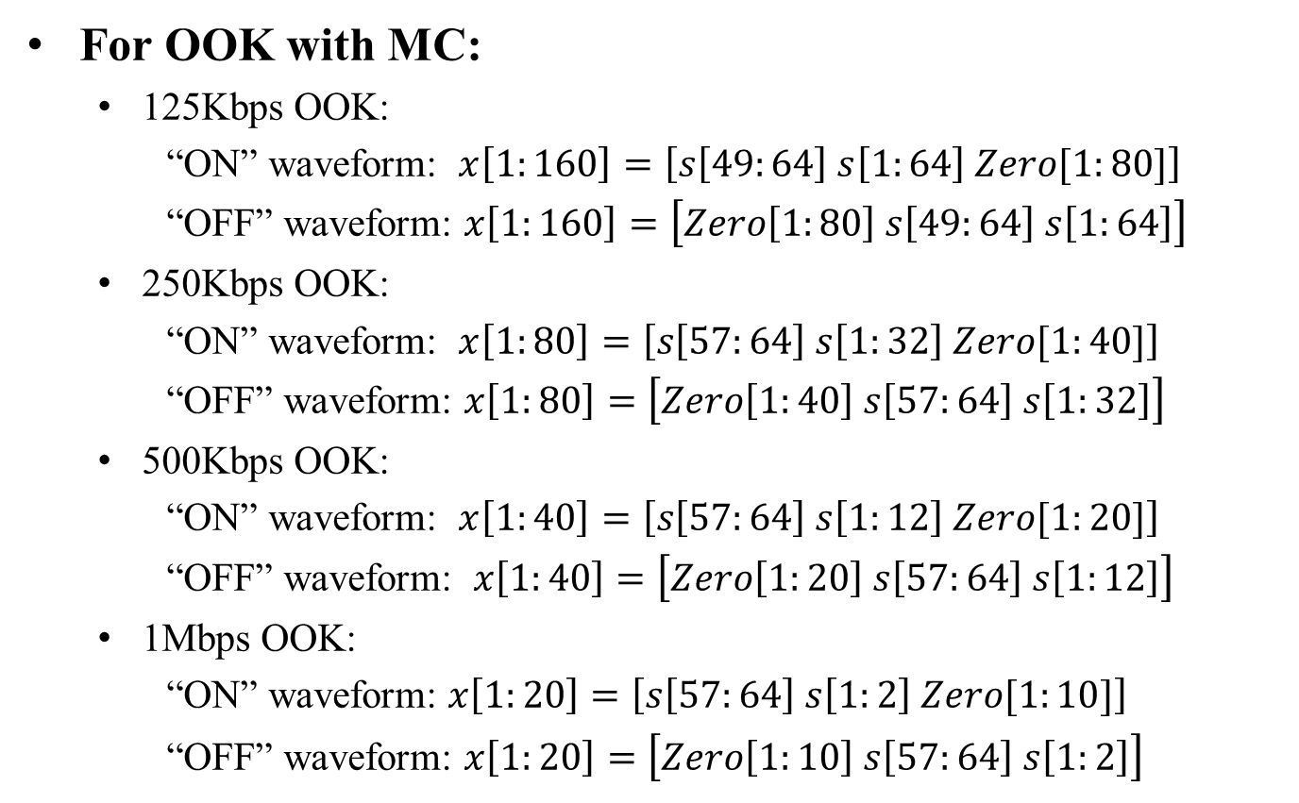
Appendix: OOK waveform (2)
For OOK with MC:
  125Kbps OOK:
  “ON” waveform: $x\left[1:160\right]=\left[s\left[49:64\right] s\left[1:64\right] Zero[1:80]\right]$
  “OFF” waveform: $x\left[1:160\right]=\left[Zero\left[1:80\right] s\left[49:64\right] s\left[1:64\right]\right]$
  250Kbps OOK:
  “ON” waveform: $x\left[1:80\right]=\left[s\left[57:64\right] s\left[1:32\right] Zero[1:40]\right]$
  “OFF” waveform: $x\left[1:80\right]=\left[Zero\left[1:40\right] s\left[57:64\right] s\left[1:32\right]\right]$
  500Kbps OOK:
  “ON” waveform: $x\left[1:40\right]=\left[s\left[57:64\right] s\left[1:12\right] Zero[1:20]\right]$
  “OFF” waveform: $x\left[1:40\right]=\left[Zero\left[1:20\right] s\left[57:64\right] s\left[1:12\right]\right]$
  1Mbps OOK:
  “ON” waveform: $x\left[1:20\right]=\left[s\left[57:64\right] s\left[1:2\right] Zero[1:10]\right]$
“OFF” waveform: $x\left[1:20\right]=\left[Zero\left[1:10\right] s\left[57:64\right] s\left[1:2\right]\right]$

