Slide 1
Considerations on WUR Synchronization
Date: 2017-05-08
Authors:
Authors:

Slide 2
Background
Prior presentations [1] [2] have discussed how to provide synchronization for WUR via WUR beacons
  [1] suggests carrying partial TSF information (e.g. 3 octets)
  Pros: able to handle contention delay
  Cons: overhead to carry the partial TSF
  [2] suggested to use the arrival time of WUR beacon
  Pros: 0 octet timing info
  Cons: susceptible to contention delay
Objective: get the best of both approaches
[1] Po-Kai Huang, “WUR Beacon,” 802.11-17/0343r2, March 2017
[2] Tianyu Wu, “WUR duty cycle mode and timing synchronization,” 802.11-17/0371r4, March 2017

Slide 3
Feasibility Study: Use 1 Octet for SYNC
STA operations with SYNC message transmitted at TSF1
Replace TSF1'[7,14] with received PTSF and get a new value BASE
Handle the carry-over bit: choose a value from set [BASE +/- n * 16384 us] that is closest to TSF1' and set local clock to the value
  Range of time covered by the 1 octet should be greater than 2 * maximum_clock_drift
  Assume a 200ppm clock drift and 10 seconds beacon interval, difference between TSF1 and TSF1' is less than 2000 us.

Slide 4
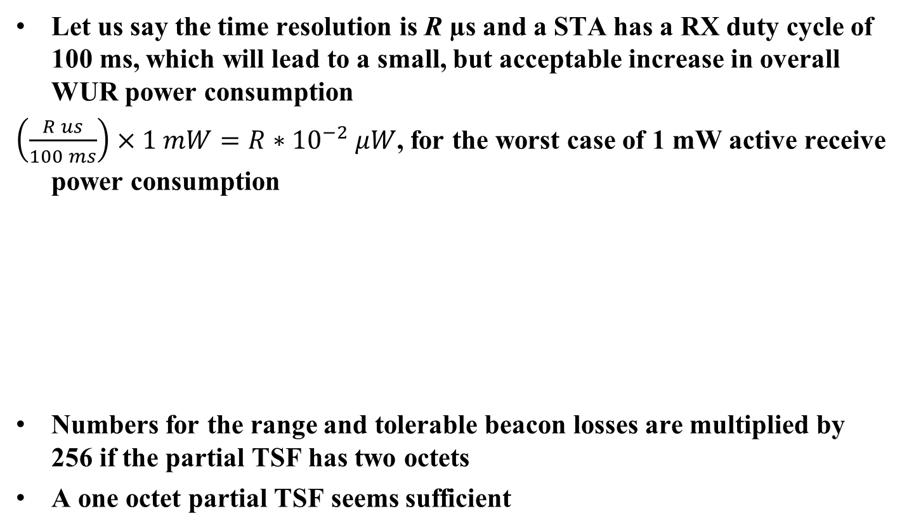
Tradeoff for Different Time Resolutions
Let us say the time resolution is R µs and a STA has a RX duty cycle of 100 ms, which will lead to a small, but acceptable increase in overall WUR power consumption
$\left(\frac{R us}{100 ms}\right)×1 mW=R∗{10}^{−2} μW$, for the worst case of 1 mW active receive power consumption
Numbers for the range and tolerable beacon losses are multiplied by 256 if the partial TSF has two octets
A one octet partial TSF seems sufficient
Time resolution (µs) | Delay range covered by 1 octet (ms) | Extra power consumption (µW) | Tolerable beacon losses (assuming 10s interval, 200ppm drift)
32 | 8.192 | 0.32 | 2
64 | 16.384 | 0.64 | 4
128 | 32.768 | 1.28 | 8
256 | 65.536 | 2.56 | 16
512 | 131.072 | 5.12 | 32

Slide 5
Straw Poll
Do you support the following?
  WUR beacon frame can carry partial TSF for synchronization
Yes
Now
Abstain

