Slide 1
Data Rates and Coding
Date: 2017-05-07
Authors:

Slide 2
Outline
Discussion on Link Budget
Simulations
Number of Data Rates
Straw Poll

Slide 3
Link Budget
PAR Scope States
  “The WUR is a companion radio to the primary connectivity radio and meets the same range requirement as the primary connectivity radio.”
In [1] it was explained that there are several factors that impact the link budget, in comparison to the Main Radio (MR)
  In a number of Regulatory Domains the transmit power of the WUR will be lower than the MR. Typically 4 dB lower in 2.4 GHz band and 7 dB lower in 5 GHz band
  The noise figure of the WUR will be around 8 dB higher than that of the MR, due to lower power consumption
This leads to the WUR needing 12 to 15 dB more link budget than the Main Radio

Slide 4
Link Budget
Others have looked at the link budget. For example, [2] indicates that even without correcting for the TX power limits, it may be challenging to meet the link budget

Slide 5
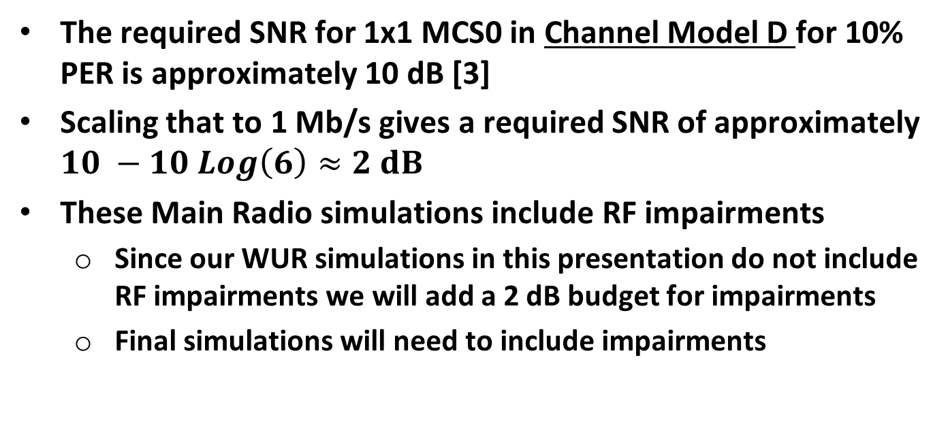
Link Budget
The required SNR for 1x1 MCS0 in Channel Model D for 10% PER is approximately 10 dB [3]
Scaling that to 1 Mb/s gives a required SNR of approximately $10 −10 Log\left(6\right)≈2 dB$
These Main Radio simulations include RF impairments
  Since our WUR simulations in this presentation do not include RF impairments we will add a 2 dB budget for impairments
  Final simulations will need to include impairments

Slide 6
Link Budget (Channel Model D)
MR Data Rate (Mb/s) | Frequency Band (GHz) | MR SNR (dB) | TX Power Delta (dB) | Noise Figure Delta (dB) | Impairment Budget (dB) | WUR SNR (dB)
6 | 2.4 | 10 | 4 | 8 | 2 | -4
6 | 5 | 10 | 7 | 8 | 2 | -7
1 | 2.4 | 2 | 4 | 8 | 2 | -12
$$SNR_{WUR}=SNR_{MR}−Δ_{TX}−Δ_{NF}−Loss_{Impair}$$
Wake-up Radio SNR
Budget for Impairment Loss
Difference in TX power due to Regulations
Difference Receiver Noise Figure
Main Radio SNR
Note: SNR is defined with a 20 MHz noise bandwidth for easy comparison. It can be converted to a 4 MHz bandwidth (for example) by $SNR_{4MHz}={SNR}_{20MHz}+10 Log\left(\frac{20}{4}\right)={SNR}_{20MHz}+7 dB$

Slide 7
Simulations
Considered four different designs
Baseline – Multicarrier OOK (250 kb/s)
Manchester Coding (125 kb/s)
Repetition Coding & Manchester Coding (62.5 kb/s)
BCC & Manchester Coding (62.5 kb/s)
BCC, Repetition Coding & Manchester Coding (31.25 kb/s)

Slide 8
Simulations

Slide 9
AWGN

Slide 10
Channel Model D

Slide 11
SNR
Design | Data Rate (kb/s) | 10%-PER SNR (dB) AWGN | 10%-PER SNR (dB) Model D
Baseline | 250 | -3.8 | 2.1
Manchester Code | 125 | -7.3 | -1.1
Repetition Code & Manchester Code | 62.5 | -9.3 | -2.9
BCC & Manchester Code | 62.5 | -12.3 | -5.3
BCC & Repetition & Manchester | 31.25 | -13.9 | -7.4
Previous SNR Calculations
MR Data Rate (Mb/s) | Frequency Band (GHz) | WUR SNR (dB)
6 | 2.4 | -4
6 | 5 | -7
1 | 2.4 | -12

Slide 12
Observations
MR Data Rate (Mb/s) | Frequency Band (GHz) | Regulatory PSD Limit | WUR SNR (dB) | WUR Data Rate (kb/s)
6 | 2.4 | No | 0 | 125
6 | 2.4 | Yes | -4 | 62.5
6 | 5 | No | 0 | 125
6 | 5 | Yes | -7 | 31.25
1 | 2.4 | No | -8 | ≈ 31.25
1 | 2.4 | Yes | -12 | < 31.25
BCC & Manchester Code is 2.4 to 3 dB better than Repetition Code & Manchester Code

Slide 13
Benefits of BCC
Improved sensitivity versus repetition codes (2.4 to 3 dB better) at the same data rate
For short packets, full packet interleaving can be employed, leading to improved robustness in an interference environment
Power consumption for BCC small compared to RF power consumption
BCC only runs after packet detection (e.g. every 10 seconds) not every listening interval (e.g. every 100 ms)

Slide 14
Number of Data Rates
Link Budget Challenge
  To match the range of the primary connected radio could lead to a low data rate, which is not spectrally efficient
  There may be a number of cases where a higher data rate will meet the range requirements depending on the STA locations
Possible Solution
  Support more than one data rate
  This has been recently been suggested in 802.11ba [2]
  More than two rates adds significant complexity

Slide 15
Number of Data Rates
Option #1
  A single WUR data rate to match the range of the primary connectivity radio
Option #2
  Two WUR data rates
  Low Rate, to match range of the primary connected radio
  High Rate, for improved spectral efficiency

Slide 16
Straw Poll
Do you support having two WUR data rates?
Yes
No
Abstain

Slide 17
References
Steve Shellhammer and Bin Tian, “Regulations and Noise Figure – Impact on SNR,” IEEE 802.11-17/365r0, March 2017
Rui Cao, et. al., “WUR Link Budget Analysis,” IEEE 802.11-17/399r1, March 2017
Eldad Perahia and Robert Stacey, “Next Generation Wireless LANs,” Cambridge University Press, 2008 (Figure 5.14)

