Slide 1
OFDM Pilot Sequences in 11ay
Date: 2017-05-10
Authors:

Slide 2
Introduction
This presentation proposes frequency domain pilot sequences for EDMG OFDM PHY

Slide 3
Considerations of Pilot sequences in 11ay(1/2)
Considering channel bonding, frequency domain pilot sequence for EDMG OFDM PHY should be newly defined for each channel bonding case (NCB=2/NCB=3/NCB=4)
Since the maximum number of spatial streams per STA is eight as defined in draft, pilot sequences up to 8 streams should be defined
We assume that
For single channel transmission, the number of pilot subcarriers is 16 as same as 11ad
For channel bonding transmission(CB>1), the number of pilot subcarriers is proposed in [1] as follows
2CB : 16*2 + 4 = 36
3CB : 16*3 + 4*2 = 56
4CB : 16*4 + 4*3 = 76

Slide 4
Considerations of Pilot sequences in 11ay(2/2)
In [2], they show simulation results that mutual orthogonal pilot sequence between spatial streams may give more robust performance(i.e. residual CFO estimation) for correlated channels
Orthogonal pilot sequence design makes pilot tracking more robust against various scenario

Slide 5
How to design the pilot sequence(1/3)
We consider criteria on how to design the pilot sequence
1. Simple extension property
Considering HW complexity, extension method is more desirable than independent sequence for each CB
2. Mutual orthogonality
For 8 mutual orthogonal sequences, at least sequence of 8 length(i.e. $P_{8}(i_{STS}, :)$ ) is needed
3. Low PAPR
When we consider above,
We propose to define only $P_{12}\left(i_{STS}, :\right) \& P_{16}(i_{STS}, :)$ to make pilot sequence for all CB factor
With $P_{16}(i_{STS}, :)$ and $P_{12}(i_{STS}, :)$ , it is possible to make mutual orthogonal sequences by simple way as described in next slide

Slide 6
How to design the pilot sequence(2/3)
The pilot sequence for each channel bonding cases is defined in Table1 below
The pilot sequences $P_{16}(i_{STS}, :)$ and $P_{12}\left(i_{STS}, :\right)$ are defined at the next slide
$$N_{CB}$$ | Pilot sequences for each channel bonding
1 | $P_{16}(i_{STS}, :)$
2 | $P_{36}(i_{STS}, :)$ = [$P_{12}(i_{STS}, :)$ $P_{12}(i_{STS}, :)$ $P_{12}(i_{STS}, :)$]
3 | $P_{56}(i_{STS}, :)$ = [$P_{16}(i_{STS}, :)$ $P_{12}(i_{STS}, :)$ $P_{12}(i_{STS}, :)$ $P_{16}(i_{STS}, :)$]
4 | $P_{76}(i_{STS}, :)$ = [$P_{16}(i_{STS}, :)$ ${P_{16}\left(i_{STS}, :\right) P}_{12}(i_{STS}, :)$ $P_{16}(i_{STS}, :)$ $P_{16}(i_{STS}, :)$]
Table1. Definition of pilot sequence for each CB

Slide 7
How to design the pilot sequence(3/3)
The pilot sequences $P_{16}(i_{STS}, :)$ and $P_{12}\left(i_{STS}, :\right)$ are defined in table 2 below
$P_{16}(i_{STS}, :)$ is proposed in [3]
$$i_{sts}$$ | $$P_{16}(i_{STS}, :)$$ | $$P_{12}(i_{STS}, :)$$
1 | [ 1 1 1 -1 1 1 -1 1 1 1 1 -1 -1 -1 1 -1] | [-1 +1 -1 +1 +1 -1 -1 -1 -1 -1 +1 +1]
2 | [-1 -1 -1 1 -1 -1 1 -1 1 1 1 -1 -1 -1 1 -1] | [+1 -1 +1 +1 -1 -1 -1 -1 -1 +1 +1 -1]
3 | [-1 -1 -1 1 1 1 -1 1 -1 -1 -1 1 -1 -1 1 -1] | [-1 +1 +1 -1 -1 -1 -1 -1 +1 +1 -1 +1]
4 | [1 1 1 -1 -1 -1 1 -1 -1 -1 -1 1 -1 -1 1 -1] | [+1 +1 -1 -1 -1 -1 -1 +1 +1 -1 +1 -1]
5 | [-1 -1 1 -1 -1 -1 -1 1 -1 -1 1 -1 1 1 1 -1] | [+1 -1 -1 -1 +1 -1 -1 +1 -1 +1 -1 +1]
6 | [1 1 -1 1 1 1 1 -1 -1 -1 1 -1 1 1 1 -1] | [-1 -1 +1 -1 -1 -1 +1 +1 -1 -1 +1 +1]
7 | [1 1 -1 1 -1 -1 -1 1 1 1 -1 1 1 1 1 -1] | [-1 -1 -1 +1 -1 +1 -1 +1 +1 +1 +1 +1]
8 | [-1 -1 1 -1 1 1 1 -1 1 1 -1 1 1 1 1 -1] | [-1 -1 -1 -1 +1 -1 +1 -1 +1 +1 +1 -1]
Table2. Definition of $P_{16}\left(i_{STS}, :\right)$ and $P_{12}(i_{STS}, :)$

Slide 8
Simulation Results :PAPR(1/5)
We checked PAPR to verify that proposed OFDM pilot sequences have low PAPR property
The number and location of data, DC and pilot subcarriers are based on [1]
Data : Random data with 64QAM modulation
4 times up-sampling

Slide 9
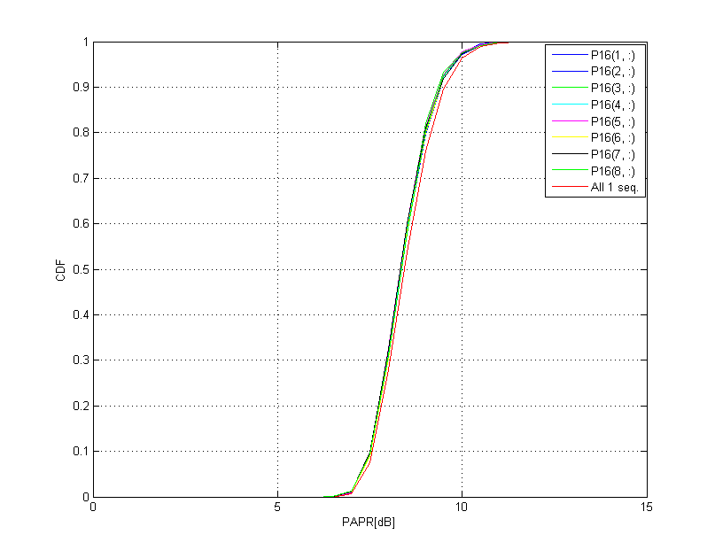
Simulation Results :PAPR(2/5)
Data part PAPR with each stream’s pilot sequences for 1CB

Slide 10
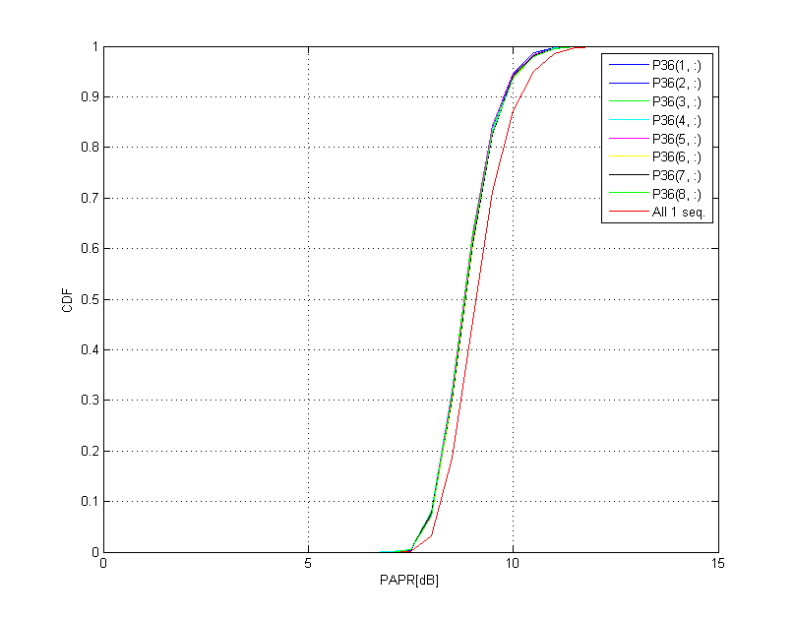
Simulation Results :PAPR(3/5)
Data part PAPR with each stream’s pilot sequences for 2CB

Slide 11
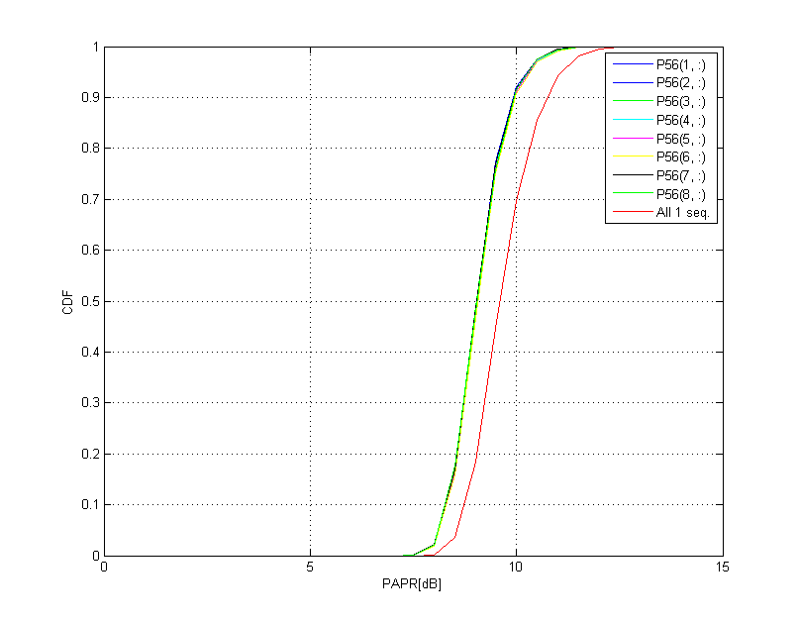
Simulation Results :PAPR(4/5)
Data part PAPR with each stream’s pilot sequences for 3CB

Slide 12
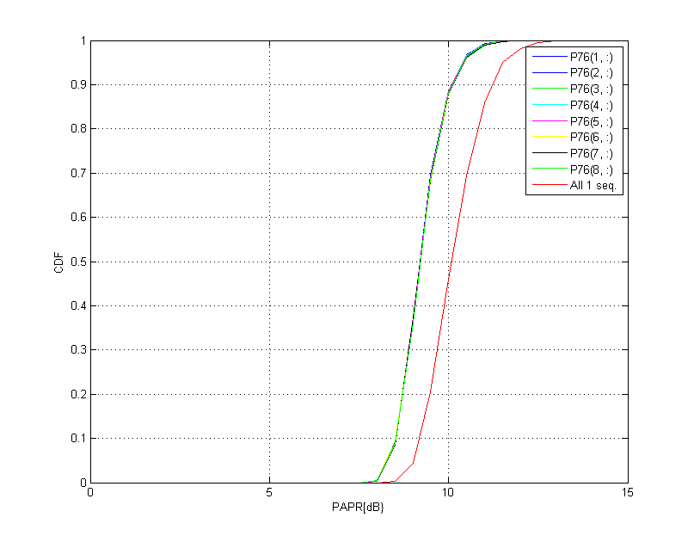
Simulation Results :PAPR(5/5)
Data part PAPR with each stream’s pilot sequences for 4CB

Slide 13
Conclusion
Since the maximum number of spatial streams per STA is eight in 802.11ay, 8 pilot sequences should be defined for 8 streams
Mutual orthogonality between streams should be considered
We propose that pilot sequences for 2CB, 3CB, 4CB with $P_{16}(i_{STS}, :)$ and $P_{12}\left(i_{STS}, :\right)$
2CB : $P_{36}(i_{STS}, :)$ = [$P_{12}(i_{STS}, :)$ $P_{12}(i_{STS}, :)$ $P_{12}(i_{STS}, :)$]
3CB : $P_{56}(i_{STS}, :)$ = [$P_{16}(i_{STS}, :)$ $P_{12}(i_{STS}, :)$ $P_{12}(i_{STS}, :)$ $P_{16}(i_{STS}, :)$]
4CB : $P_{76}(i_{STS}, :)$ = [$P_{16}(i_{STS}, :)$ ${P_{16}\left(i_{STS}, :\right) P}_{12}(i_{STS}, :)$ $P_{16}(i_{STS}, :)$ $P_{16}(i_{STS}, :)$]

Slide 14
SP/M
Do you agree :
to define OFDM pilot sequences for NCB>1 as described in (11-17-0712-00-00ay-30 6 1 OFDM Pilot sequences)?

Slide 15
Reference
[1] 11-17-0597-00-00ay 30 6 1 OFDM Signal Parameters
[2]Aoki, T.; Sandell, M.; , "Analysis of pilots for residual frequency offset estimation in MIMO OFDM systems," Wireless Communications, IEEE Transactions on , vol.8, no.3, pp.1128-1132, March 2009.
[3] 11-17-0627-01-00ay OFDM Pilot Definition in 11ay

