Slide 1
On the Coexistence of 802.11ax and 802.11ba Signals
Date: 2017-05-08
Authors:

Slide 2
Abstract
In this contribution, we introduce a narrow band sequence-based on-off keying (OOK) scheme with waveform coding (WFC) which allows coexistence with 802.11ax transmissions without interference between the two signals and increases the WUR coverage range

Slide 3
Introduction
TGba has agreed to use OOK symbols for WUR payload [1]
  On-off keying (OOK) with waveform coding (WFC) is one of the candidate schemes for 802.11ba WUR [2-5]
The existing WLAN OFDM transmitter may be employed to generate the wake-up signal (WUS).
It is also possible to transmit WUS and 802.11ax signals concurrently by allocating some of resource units (RU)s, defined in 802.11ax, for WUS [6]
The compatibility between 802.11ba OOK and 802.11ax OFDMA signals need to be studied
  To avoid any degradation on both radios due to the interference during the concurrent transmissions

Slide 4

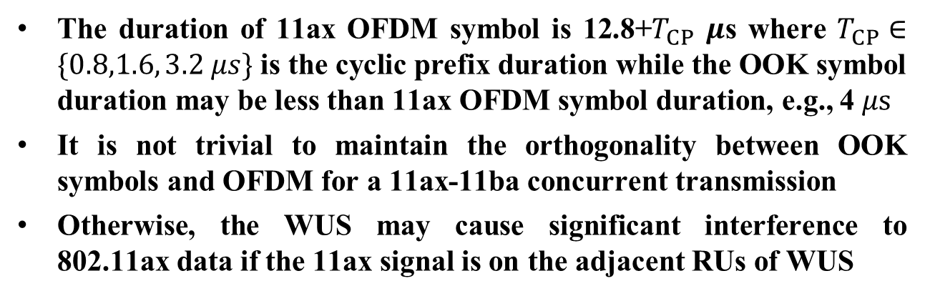







Problem: Incompatible Numerologies
The duration of 11ax OFDM symbol is 12.8+$T_{CP}$ $μ$s where $T_{CP}∈\{0.8,1.6, 3.2 μs\}$ is the cyclic prefix duration while the OOK symbol duration may be less than 11ax OFDM symbol duration, e.g., 4 $μs$
It is not trivial to maintain the orthogonality between OOK symbols and OFDM for a 11ax-11ba concurrent transmission
Otherwise, the WUS may cause significant interference to 802.11ax data if the 11ax signal is on the adjacent RUs of WUS
802.11ba
WUS
802.11ax
OFDM
11ax RUs
$$t$$
(e.g., 5 MHz)
Orthogonality?
$T_{ook}$ (e.g., 4 $μ$s)
802.11ax
OFDM
$$f_{c}$$
$$f$$
$$t$$
Interference?
WUS
$$T_{CP}$$
$12.8$ $μ$s
$$T_{OFDM}$$
a) Representation of problem in time
b) Representation of problem in frequency

Slide 5



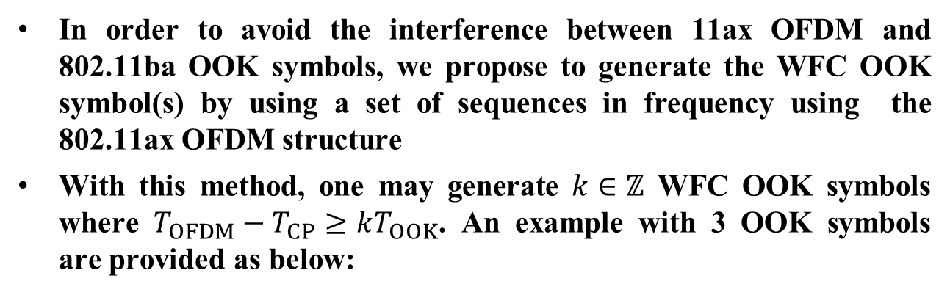






Proposed Solution: Sequence-based WFC-OOK Symbols (1/2)
In order to avoid the interference between 11ax OFDM and 802.11ba OOK symbols, we propose to generate the WFC OOK symbol(s) by using a set of sequences in frequency using the 802.11ax OFDM structure
With this method, one may generate $k∈ℤ$ WFC OOK symbols where $T_{OFDM}−T_{CP}≥kT_{OOK}$. An example with 3 OOK symbols are provided as below:
WFC OOK
sequence 1a (Logic 1)
Sequence 1a/1b affects the first 4 $μs$
WFC OOK
sequence 1b (Logic 0)
Sequence 2a/2b affects the second 4 $μs$
64
Sequence 3a/3b affects the third 4 $μs$
WFC OOK
sequence 2a (Logic 1)
Mapping
Amplitude
WFC OOK
sequence 2b (Logic 0)
802.11ba
64
64
IDFT
(256)
CP+
DAC
RF
$$0$$
$$T_{CP}$$
$$T_{OFDM}$$
time
WFC OOK
sequence 3a (Logic 1)
$T_{ook}$ (e.g., 4 $μs$)
WFC OOK
sequence 3b (Logic 0)
802.11ax
$f_{s}=20$ MHz
$12.8$ $μ$s
64
IDFT output

Slide 6
Proposed Solution: Sequence-based WFC-OOK Symbols (2/2)
This method has three main benefits:
  Orthogonality: Perfect orthogonality between 802.11ax data and 802.11ba is achieved. This means that WUS does not interfere 802.11ax signal during concurrent transmission
  Confined OOK symbols: The proposed method controls the spectrum of OOK symbols as the sequence is mapped to certain subcarriers. Hence, WUR can benefit from the localized energy in the spectrum
  Flexibility: The sequence based WFC OOK design allows both envelope detector based WURs and correlator-based WURs

Slide 7














Sequence Design Principle: DFT-s-OFDM
DFT-spread OFDM is a block single carrier waveform where the pulse shape is a Dirichlet sinc function and the convolution operation is circular
Since the symbol order at the input of DFT-spread is the same for the corresponding pulse locations in time domain, the WFC OOK symbols can be generated by changing the location of active inputs of DFT-spread.
  For example, the diagram below generates the first Manchester coded OOK symbol by only activating [2:10] (Bit 1) or [11:20] (Bit 9) inputs of DFT-spread OFDM.
Offline calculation
Corresponding time domain signals for seq.1a and seq.1b
Mapping
Logic 0
$$0$$
1
DFT ($64$)
WFC OOK
sequence 1a
(Logic 0)
$$s$$
9
$$0$$
1
$$0$$
9
IDFT
(256)
time
$$0$$
44
Logic 1
$$0$$
1
DFT ($64$)
WFC OOK
sequence 1b
(Logic 1)
$$0$$
9
$$s$$
$$0$$
1
$$0$$
9
time
44
$T_{ook}$ = 4 $μs$
$12.8$ $μ$s (256 samples, IDFT output)

Slide 8






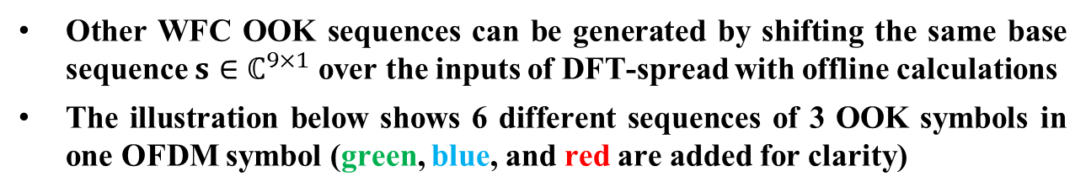









Sequences for WFC OOK Symbols
Other WFC OOK sequences can be generated by shifting the same base sequence $s∈ℂ^{9×1}$ over the inputs of DFT-spread with offline calculations
  The illustration below shows 6 different sequences of 3 OOK symbols in one OFDM symbol (green, blue, and red are added for clarity)
Corresponding time domain signal of each sequence
Logic 0
Logic 1
time
Offline calculations
$$0$$
time
WFC OOK
sequence 1a (Logic 0)
1
DFT ($64$)
Logic 0
$$s$$
9
$$0$$
54
time
$$0$$
Logic 1
WFC OOK
sequence 1b (Logic 1)
11
DFT ($64$)
$$s$$
9
$$0$$
44
time
$$0$$
Mapping
Logic 0
WFC OOK
sequence 2a (Logic 0)
21
DFT ($64$)
$$s$$
9
$$0$$
34
+
Logic 1
time
$$0$$
+
+
IDFT
(256)
WFC OOK
sequence 2b (Logic 1)
31
DFT ($64$)
$$s$$
9
time
$$0$$
24
$T_{ook}$ = 4 $μs$
$$0$$
WFC OOK
sequence 3a (Logic 0)
41
DFT ($64$)
$$s$$
9
$12.8$ $μ$s (256 samples, IDFT output)
$$0$$
14
$$0$$
Logic 0
Logic 1
Logic 0
WFC OOK
sequence 3b (Logic 1)
51
DFT ($64$)
$$s$$
9
$$0$$
time
4

Slide 9



Improving OOK symbols with Frequency Domain Shaping
The Dirichlet sinc kernel of DFT-s-OFDM can be replaced with another kernel to improve the WUR performance
To change the kernel, frequency domain shaping can be considered at the expense of more number of subcarriers for WUS
Offline calculation
Cyclic Extension
Windowing
Mapping
IDFT
(256)
$$0$$
Dirichlet
sinc
kernel
$$s$$
1
DFT ($64$)
$$0$$
9
54
(a)
(b)
(c)
Output of DFT (64)
Modified
kernel
(a)➔
$$f$$
(b)➔
$$f$$
(c)➔
$$f$$

Slide 10

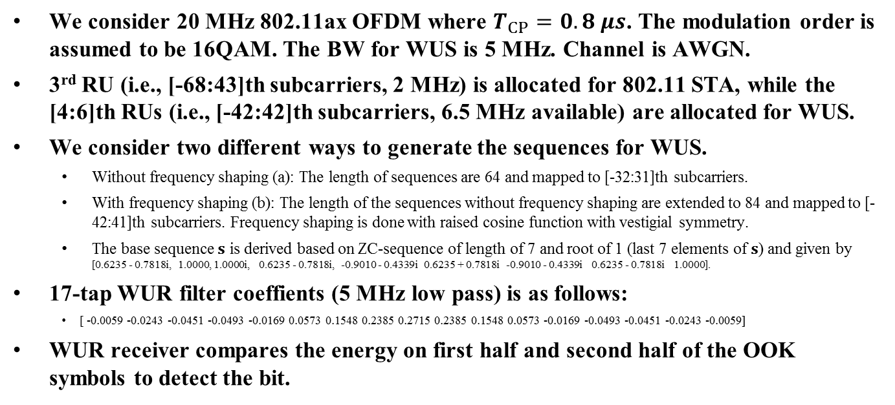
Simulation Assumptions
We consider 20 MHz 802.11ax OFDM where $T_{CP}=0.8 μs$. The modulation order is assumed to be 16QAM. The BW for WUS is 5 MHz. Channel is AWGN.
3rd RU (i.e., [-68:43]th subcarriers, 2 MHz) is allocated for 802.11 STA, while the [4:6]th RUs (i.e., [-42:42]th subcarriers, 6.5 MHz available) are allocated for WUS.
We consider two different ways to generate the sequences for WUS.
  Without frequency shaping (a): The length of sequences are 64 and mapped to [-32:31]th subcarriers.
  With frequency shaping (b): The length of the sequences without frequency shaping are extended to 84 and mapped to [-42:41]th subcarriers. Frequency shaping is done with raised cosine function with vestigial symmetry.
  The base sequence $s$ is derived based on ZC-sequence of length of 7 and root of 1 (last 7 elements of $s$) and given by [0.6235 - 0.7818i, 1.0000, 1.0000i, 0.6235 - 0.7818i, -0.9010 - 0.4339i 0.6235 + 0.7818i -0.9010 - 0.4339i 0.6235 - 0.7818i 1.0000].
17-tap WUR filter coeffients (5 MHz low pass) is as follows:
  [ -0.0059 -0.0243 -0.0451 -0.0493 -0.0169 0.0573 0.1548 0.2385 0.2715 0.2385 0.1548 0.0573 -0.0169 -0.0493 -0.0451 -0.0243 -0.0059]
WUR receiver compares the energy on first half and second half of the OOK symbols to detect the bit.
a) Without shaping
a) With shaping
802.11ax
802.11ba
$$f$$
802.11ax
802.11ba
$$f$$

Slide 11
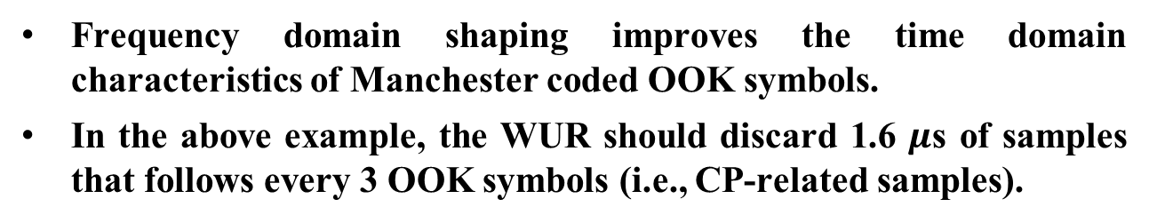



Temporal Characteristics
CP
IDFT output
CP
IDFT output
CP
IDFT output
$T_{ook}$ = 4 $μs$
$T_{ook}$ = 4 $μs$
$T_{ook}$ = 4 $μs$
$T_{ook}$ = 4 $μs$
$T_{ook}$ = 4 $μs$
$T_{ook}$ = 4 $μs$
$T_{ook}$ = 4 $μs$
$T_{ook}$ = 4 $μs$
$T_{ook}$ = 4 $μs$
Logic 1
Logic 1
Logic 0
Logic 1
Logic 1
Logic 0
Logic 0
Logic 1
Logic 1
1.6 $μs$
WUR discards
these samples
Frequency domain shaping improves the time domain characteristics of Manchester coded OOK symbols.
In the above example, the WUR should discard 1.6 $μ$s of samples that follows every 3 OOK symbols (i.e., CP-related samples).

Slide 12
Spectral Characteristics
5 MHz
Localized OOK symbol energy
The energy of the sequence-based Manchester coded OOK symbols are confined in the center of the bandwidth for both proposed approaches
This is beneficial for narrow band WUR to capture the localized OOK symbol energy in frequency, which also means higher coverage range for WUR

Slide 13

802.11ba BER Performance
11ax
11ba
11ax
11ba
$$f$$
$$f$$
a) Standalone
b) Under Coexistence
Frequency domain spectral shaping enhances the WUR performance.
The impact of interference from 802.11ax to 802.11ba (due to the WUR filter) is negligible in this simulation

Slide 14

802.11ax BER Performance
11ax
11ba
$$f$$
11ax
$$f$$
a) Standalone
b) Under Coexistence
The proposed OOK symbol design does not change 11ax performance as OOK signals are orthogonal to OFDM symbols

Slide 15
Conclusions
We propose an OOK scheme which is orthogonal to 11ax OFDM symbols
Numerical analysis shows that the proposed scheme enables concurrent WUS and 802.11ax data transmission without adjacent interference
WFC OOK symbols are generated based on sequences in frequency domain
  We show that the sequences for WFC OOK symbols can be obtained by using the structure of DFT with proper input design
  The sequence can be generated with offline calculations
  The temporal characteristics of sequence-based Manchester-coded OOK symbols can be improved via frequency domain spectral shaping
With the proposed method, the OOK symbol energy is localized in frequency, enabling WUR to capture more OOK symbol energy. This provides higher coverage range for WUR.

Slide 16
Straw Poll 1
Do you agree that TG11ba should consider the concurrent 11ax signal and WUS transmission?

Slide 17
Straw Poll 2
Do you agree that TGba should investigate on WUR waveform designs as a part of 11ax OFDMA transmissions ?

Slide 18
Straw Poll 3
Do you agree that the TGba should further study sequence-based OOK symbols as a 11ba PHY design?
  to allow concurrent transmission of 11ax signal and WUS
  to have increased WUR coverage range

Slide 19
Motion
Do you agree to insert the following to the 802.11ba SFD:
“802.11ba should enable the concurrent transmission of 11ax signal and wake up signal.”
Move: Rui Yang
Second:
Y:
N:
A:

Slide 20
References
[1] Shahrnaz Azizi et al., Intel, “Motion for the High Level PHY Design”, IEEE 802.11-17/0368r1, Mar. 2017
[2] Justin Jia Jia et al., Huawei, “Performance Investigations on Single-carrier and Multiple-carrier-based WUR”, IEEE 802.11-17/0373r1, Mar. 2017
[3] Junghoon Suh et al., Huawei, “Waveform Generation for Waveform Coding”, IEEE 802.11-17/0376r0, Mar. 2017
[4] Eunsung Park et al,. LG, “Various Symbol Types for WUR”, IEEE 802.11-17/0350r0, Mar. 2017
[5] Steve Shellhammer, Qualcomm, “WUR Modulation and Coding”, IEEE 802.11-17/0366r0, Mar. 2017
[6] Leif Wilhelmsson et al., Ericsson, “Concurrent transmission of data and a wake-up signal in 802.11ax – Follow-up”, IEEE 802.11-2017/385r0, Mar. 2017
[7] Shahrnaz Azizi et al., “A PAR Proposal for Wake-up Radio”, IEEE 802.11-16/1045r9 Jul. 2015

Slide 21
Appendix - DFT Input Mapping for OOK Symbol with Manchester Coding
DFT Input Index
1
2
10
11
12
20
21
22
30
31
32
40
41
42
50
51
52
60
61
64
Symbol 1 = 0
0
S
0
0
0
0
0
0
0
0
0
0
0
Symbol 1 = 1
0
0
0
S
0
0
0
0
0
0
0
0
0
Symbol 2 = 0
0
0
0
0
0
S
0
0
0
0
0
0
0
Symbol 2 = 1
0
0
0
0
0
0
0
S
0
0
0
0
0
Symbol 3 = 0
0
0
0
0
0
0
0
0
0
S
0
0
0
Symbol 3 = 1
0
0
0
0
0
0
0
0
0
0
0
S
0

