Slide 1
OFDM Signal Parameters Definition in 11ay
Date: 2017-04-17
Authors:

Slide 2
Introduction
This presentation proposes OFDM signal parameters definition in 11ay.

Slide 3
Common Frequency Grid
Channel and subcarrier spacing:
  Channel spacing: ∆F = 2160 MHz;
  Subcarriers spacing: ∆_{F} = 5.1563 MHz;
Problem:
  ∆F / ∆_{F} ~= 418.9091;
  There is no common subcarriers grid over the channels;
Solution:
  The closest integer number which provides minimal error is 419;
  F_{DC} – DC frequency for OFDM signal spectrum;
  Fc – carrier frequency or center channel frequency;
  F_{DC}(4) = Fc(4), F_{DC}(i) ≠ Fc(i), for channels i = 1, 2, 3, 5, 6, 7, 8;
  F_{shift} = F_{DC} – Fc, | F_{shift} | < ∆_{F}/2;

Slide 4
Common Frequency Grid (Cont’d)
Table 1 below provides a summary of DC (F_{DC}) and carrier (Fc) frequencies for frequency channels #1 - #8.
The relative shift (F_{shift}) does not exceed ∆_{F}/2 ~= 2.5781 MHz.
Table 1: DC and carrier frequencies for frequency channels #1 - #8.
Channel # | #1 | #2 | #3 | #4 | #5 | #6 | #7 | #8
Fc, GHz | 58.32 | 60.48 | 62.64 | 64.8 | 66.96 | 69.12 | 71.28 | 73.44
F_{DC}, GHz | 64.8 - ∆_{F}*3*419 | 64.8 - ∆_{F}*2*419 | 64.8 - ∆_{F}*419 | 64.8 | 64.8 + ∆_{F}*419 | 64.8 + ∆_{F}*2*419 | 64.8 + ∆_{F}*3*419 | 64.8 + ∆_{F}*4*419
F_{shift}, MHz | -1.4063 | -0.9375 | -0.4688 | 0 | 0.4688 | 0.9375 | 1.4063 | 1.8750

Slide 5
Pilots Grid for Single Channel
11ad pilots grid:
  Pilot indexes: p_idx = [-150:20:150];
  Issue: large zones at the spectrum edges without pilots;
Proposed solution for 11ay grid:
  Pilot indexes: p_idx = [-165:22:165];
Legacy 11ad pilots grid
Proposed pilots grid for 11ay

Slide 6
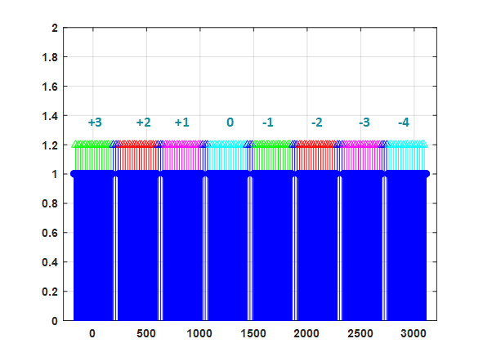
Common Pilots Grid
Common pilots grid:
  Different channels and channel bonding should have a common pilots grid with equidistant step equal to 22;
  Issue: channel spacing by 419 subcarriers complicates the alignment of pilots grid over the channels;
Proposed solution:
  Different channels have different
  pilot indexes:
    CH#1: p_idx = [-165:22:165] + 3;
    CH#2: p_idx = [-165:22:165] + 2;
    CH#3: p_idx = [-165:22:165] + 1;
    CH#4: p_idx = [-165:22:165];
    CH#5: p_idx = [-165:22:165] - 1;
    CH#6: p_idx = [-165:22:165] - 2;
    CH#7: p_idx = [-165:22:165] - 3;
    CH#8: p_idx = [-165:22:165] - 4;

Slide 7
Common Pilots Grid (Cont’d)
Extra pilots:
  In case of channel bonding, additionally to 16 pilots per channel, extra pilots filling the gaps between the channels are inserted;
Issue with middle pilot for N_{CB} = 2 and 4:
  For N_{CB} = 2 and 4, the middle pilot can fall into the DC bin, which is undesired;
Proposed solution:
  Instead of single middle pilot, it is proposed to introduce two pilots with indexes [-5, +5] relative to the middle pilot tone index;
  Based on channel estimation from these pilots one can interpolate the channel for the middle point;
  This allows to keep the total number of pilots equal to even number;

Slide 8
Number of Pilots
Number of pilots for different NCB:
  N_{CB} = 1: N_{SP} = 16, like in the legacy case;
  N_{CB} = 2: N_{SP} = 2*16 + 4 = 36;
  N_{CB} = 3: N_{SP} = 3*16 + 4*2 = 56;
  N_{CB} = 4: N_{SP} = 4*16 + 4*3 = 76;
  General formula:
    N_{SP} = N_{CB}*16 + (N_{CB}-1)*4 = N_{CB}*20 – 4;
    Linear dependence on N_{CB} factor;

Slide 9
Data & DC Subcarriers
Data subcarriers indexes for different NCB:
  N_{CB} = 1: d_idx = [-177:-2, 2:177], excluding p_idx;
  N_{CB} = 2: d_idx = [-386:-2, 2:386], excluding p_idx;
  N_{CB} = 3: d_idx = [-596:-2, 2:596], excluding p_idx;
  N_{CB} = 4: d_idx = [-805:-2, 2:805], excluding p_idx;
DC subcarrier indexes for different NCB:
  N_{CB} = 1: dc_idx = [-1, 0, 1];
  N_{CB} = 2: dc_idx = [-1, 0, 1];
  N_{CB} = 3: dc_idx = [-1, 0, 1];
  N_{CB} = 4: dc_idx = [-1, 0, 1];
  Keeping the number of DC subcarriers the same for different N_{CB} simplifies implementation;

Slide 10
Summary of OFDM Parameters
Table 2 below provides a summary of main OFDM signal spectrum parameters.
Table 2: Summary of main OFDM signal spectrum parameters.
 | N_{CB} = 1 | N_{CB} = 2 | N_{CB} = 3 | N_{CB} = 4
N_{SD} | 336 | 734 | 1134 | 1532
N_{SP} | 16 | 36 | 56 | 76
N_{ST} | 355 | 773 | 1193 | 1611
N_{DC} | 3 | 3 | 3 | 3
∆_{F}, MHz | 5.1563 | 5.1563 | 5.1563 | 5.1563

Slide 11
Pilots Overhead
Pilots overhead example for 11ac:
    N_{CB} = 1: N_{SP} = 4, N_{total} = 56, overhead = 4*100/56 ~= 7.1 %;
    N_{CB} = 2: N_{SP} = 6, N_{total} = 114, overhead ~= 5.3 %;
    N_{CB} = 4: N_{SP} = 8, N_{total} = 242, overhead ~= 3.3 %;
Pilots overhead in the current proposal for 11ay:
    N_{CB} = 1: N_{SP} = 16, N_{total} = 352, overhead ~= 4.5 %;
    N_{CB} = 2: N_{SP} = 36, N_{total} = 770, overhead ~= 4.7 %;
    N_{CB} = 3: N_{SP} = 56, N_{total} = 1190, overhead ~= 4.7 %;
    N_{CB} = 4: N_{SP} = 76, N_{total} = 1608, overhead ~= 4.7 %;
  Proposal keeps constant overhead over different N_{CB} > 1;
  N_{CB} = 1, 2: 11ac has ~0.6 - 2.6 % higher overhead;
  N_{CB} = 4: 11ay has ~1.4 % higher overhead;

Slide 12
Pilot Estimations
Pilots estimations:
  Common Phase Error (CPE) estimation;
  Phase Noise (PN) realization estimation;
  Channel estimation and tracking:
    Channel estimation for pilot subcarriers;
    Channel interpolation;
    NOTE #1: equidistant pilots distribution allows to simplify interpolation;
    NOTE #2: reduction of number of pilots leads to significant errors between actual channel and its interpolated counterpart;

Slide 13
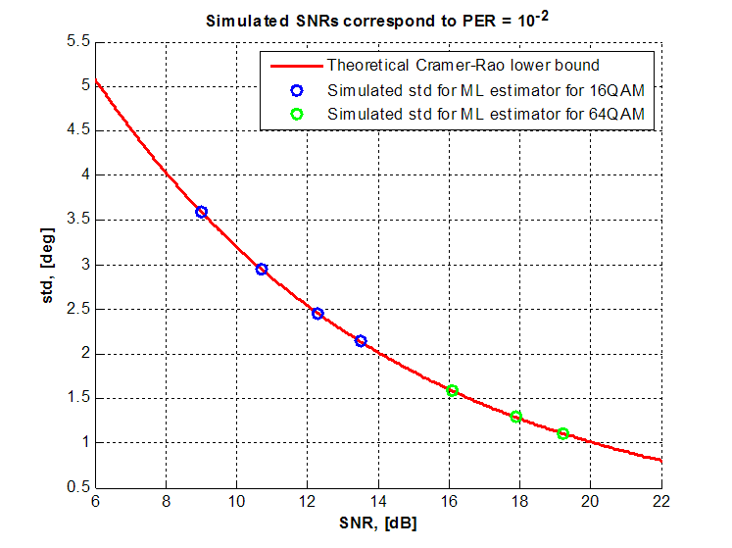
CPE Estimation
Maximum likelihood estimator:
  ML estimation is given by:
  S_{qk} is a known pilot, H_{qk} is a channel estimation, Y_{qk} is a received signal, q_{k} is a pilot subcarrier index;
ML estimator achieves Cramer-Rao Lower Bound (CRLB);
Blue and green points represent the simulated performance of ML estimator for SNRs corresponding to PER = 10⁻² for different MCSs of 16QAM and 64QAM modulations;

Slide 14
CPE Estimation (Cont’d)
Table below summarizes the SNR degradation due to CPE estimation for fixed level of BLER = 10⁻⁴.
ML phase estimator uses N_{SP} = 16 and 32 pilot subcarriers.
CFO + PN model from 11ad evaluation methodology.
Table 3: SNR degradation due to residual phase error for BLER = 10⁻⁴.
 | N_{SP} = 16 | N_{SP} = 32
16QAM 1/2 | 0.6 dB | 0.2 dB
16QAM 5/8 | 0.5 dB | 0.2 dB
16QAM 3/4 | 0.5 dB | 0.1 dB
16QAM 13/16 | 0.3 dB | 0.1 dB

Slide 15
Cyclic Prefix (GI) Length
OFDM cyclic prefix proposal @ 2.64 GHz:
  Short GI: 48 samples, T_{GI short} = 18.18 ns;
  Normal GI: 96 samples, T_{GI normal} = 36.36 ns;
  Long GI: 192 samples, T_{GI long} = 72.72 ns;
CP duration for OFDM is equal to SC PHY GI duration;

Slide 16
SP/M
Do you agree:
  To define OFDM signal parameters as defined in (11-17-0597-00-00ay 30 6 1 OFDM Signal Parameters)?

Slide 17
References
P802.11ay_D0.3

