Slide 1
Light Communication Use-Cases in Retail
Authors:

Slide 2
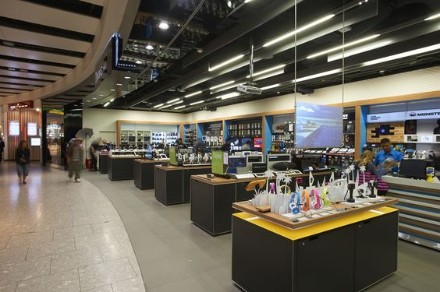
LC in Retail: For the Retailer
Flexible and Adaptive Retail Space
Delivery of high-bandwidth data at particular points in store requires cabled connection. Makes these rather immobile.
Alteration of retail space to enable new customer experiences a key part of retailer strategy.
High-bandwidth flexible retail space through LC enables cost reductions for retailers when modifying or refitting the space.

Slide 3
LC in Retail: For the Customer
Location-based Content Delivery
Real-time delivery of product-relevant content based on the position of the consumer in the store.
No additional infrastructure for RF comm-unications required to deliver content, can be provided directly over LiFi.
Data density of LiFi enables very-high bandwidth content without fear of lack of wireless resources.

Slide 4
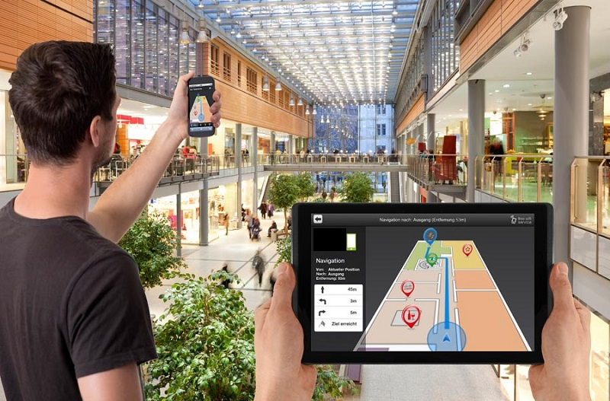
LC in Retail: For the Customer
Indoor Navigation
Density of light fixtures and LiFi APs allows highly precise localisation of users and paths.
This enables the provision of navi-gational directions for users within a store or mall.
Further, continuous tracking of the user can provide up-to-date navigational information.

Slide 5
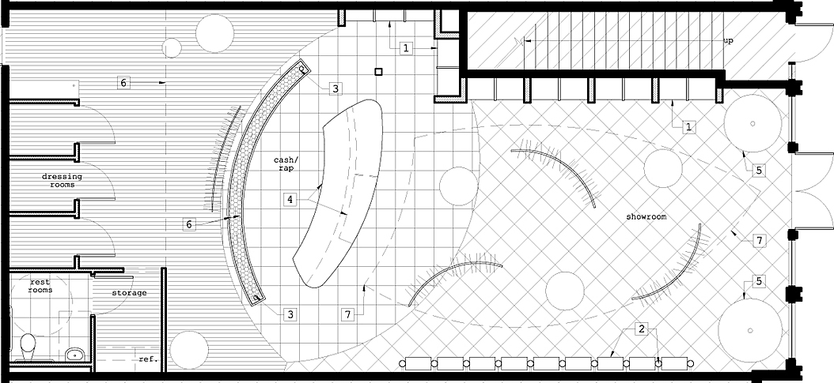
LC in Retail: For the Customer
Asset Tracking and Location Information
Precise location further provides the ability to locate persons/assets of interest, e.g., store staff or even other customers, for enhanced consumer support experience.

Slide 6
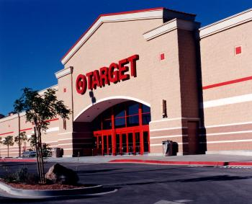
LC in Retail: For the Retailer
Wireless and Network Security
Current information networks are secured pri-
marily over encryption. Where high security is
paramount, wireless communications is avoided.
The fact that light is non-penetrative and highly containable enables the establishment of very
secure wireless signals.
The precise localisation enables the use of a 3rd
factor of authentication to further improve the
security of the network.

