Slide 1
802.11 May 2017 Closing Reports
Date: 2017-05-12
Authors:

Slide 2
Abstract
This document is a digest of the closing reports of all 802.11 sub-groups for presentation at the May 2017 closing plenary meeting. Attendance information and liaison reports (including liaison reports from the mid-week plenary) are also included.

Slide 3
Attendance
Data as of 2017-05-11

Slide 4
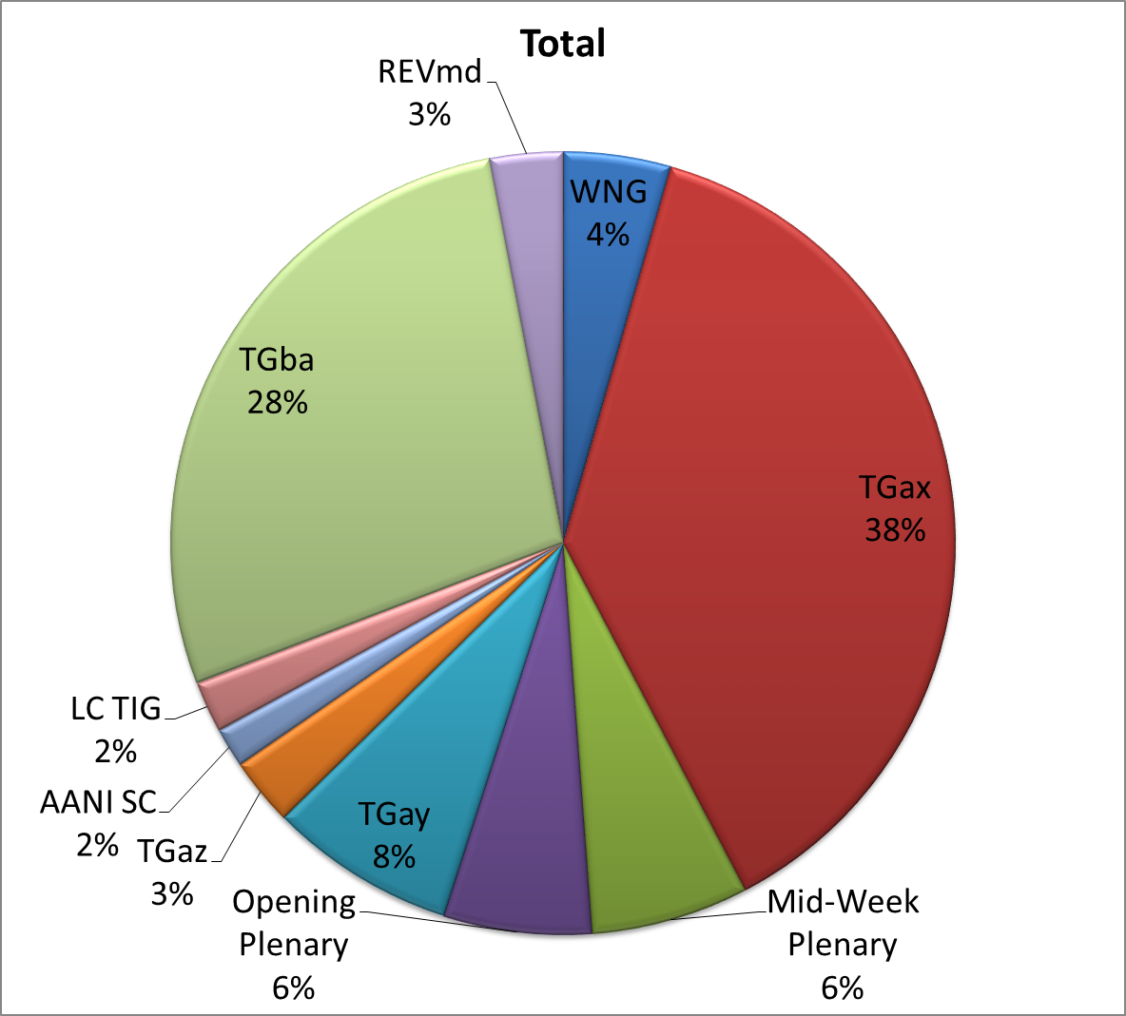
Attendance Total

Slide 5
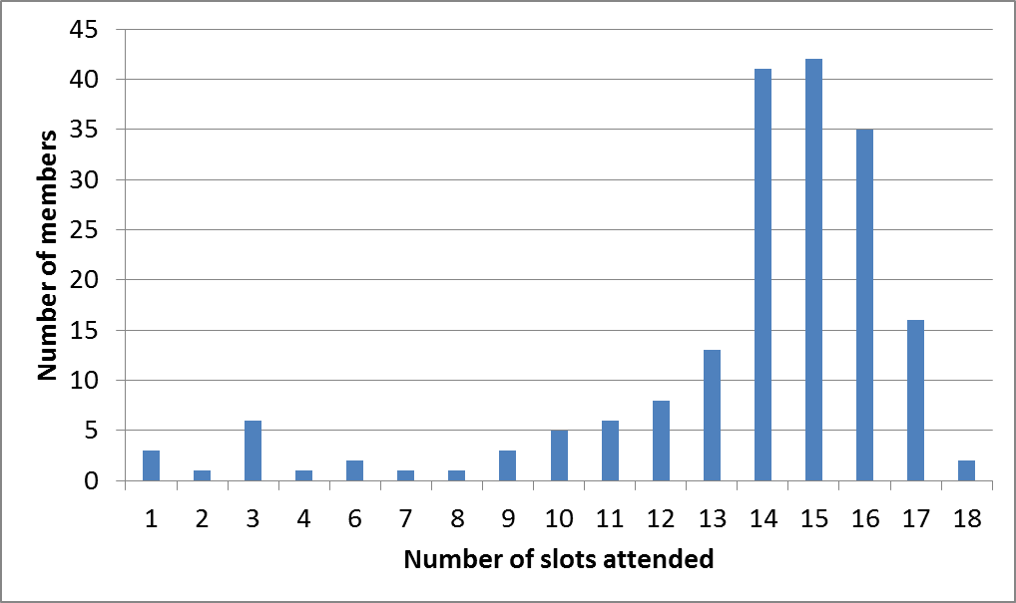
Attendance Histogram

Slide 6
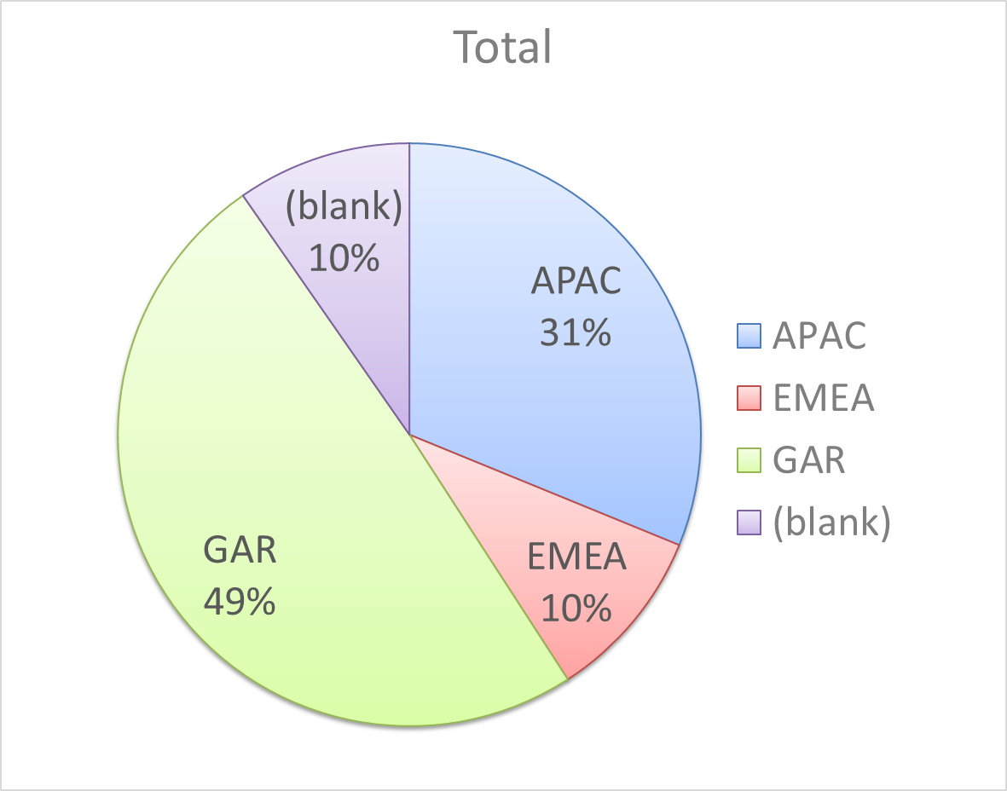
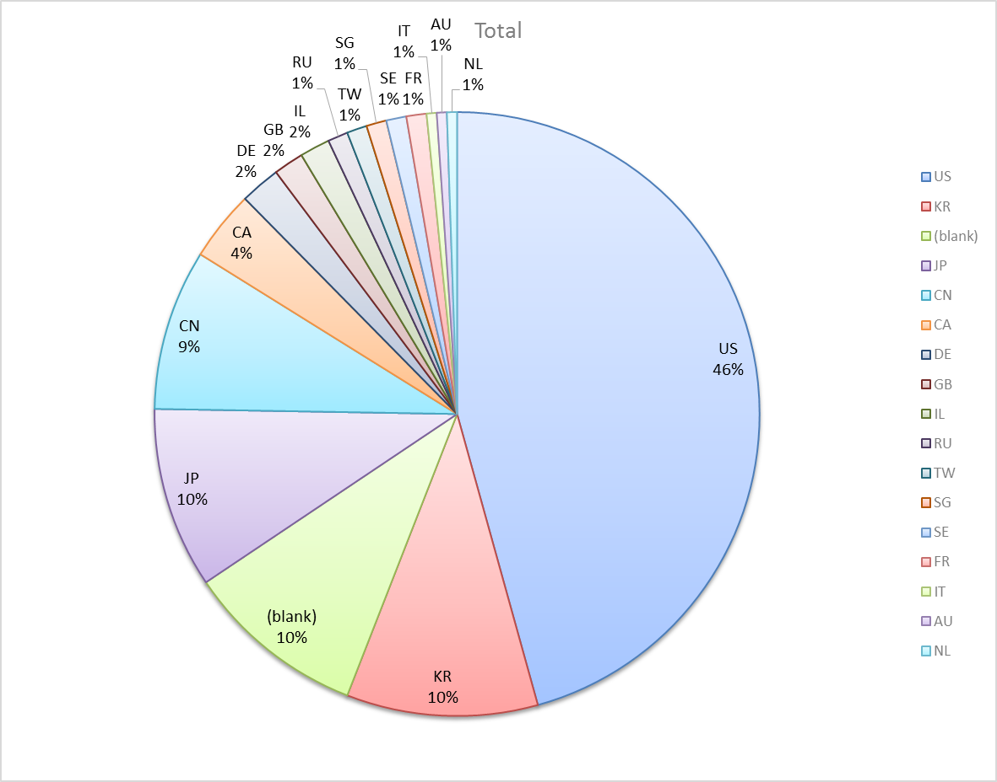
Attendance by Country

Slide 7
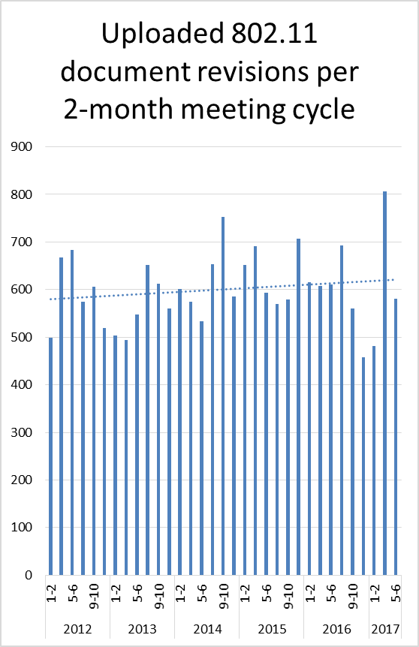
Doc Revision uploads by meeting (month #)

Slide 8
802.11 WG Editor’s Meeting (May ‘17)
Date: 2017-09-15
Authors:
from slide 1/5 of 11-17-0840 by Robert Stacey, Intel
Notes:
July 2007

Slide 9
Publication process discussion
Publication editor creates a marked up PDF with editorial changes highlighted
802.11 technical editor forms a review committee, usual the task group editor and one other person associated with 802.11 editing
Each member of the committee should review each change proposed by the publication editor
Pay particular attention to
  Reconstructed sentences
  Tables with number changes
  ANA assignments
The review process is complete when all publication changes have been reviewed
Action: WG editor to update editor’s guide to include publication process
from slide 2/5 of 11-17-0840 by Robert Stacey, Intel

Slide 10
Volunteer Editor Contacts
TGaj – Jiamin CHEN – jiamin.chen@mail01.huawei.com , Shiwen He – shiwenhe@seu.edu.cn
TGak – Donald Eastlake – d3e3e3@gmail.com
TGaq – Lee Armstrong – LRA@tiac.net
  TGax – Robert Stacey – robert.stacey@intel.com
  TGay – Carlos Cordeiro – carlos.cordeiro@intel.com
  TGaz – Chao Chun Wang – chaochun.wang@mediatek.com
REVmd – Emily Qi – emily.h.qi@intel.com, Edward Au – edward.ks.au@huawei.com,
  Editors Emeritus:
  TGaa – Alex Ashley – alex.ashley@hotmail.co.uk
  TGac – Robert Stacey – robert.stacey@intel.com
  TGad – Carlos Cordeiro – carlos.cordeiro@intel.com
  TGae – Henry Ptasinski – henry@LOGOUT.COM
  TGaf – Peter Ecclesine – petere@ieee.org
  REVmc – Adrian Stephens – adrian.p.stephens@ieee.org , Edward Au – edward.ks.au@huawei.com, Emily Qi – emily.h.qi@intel.com
  TGai - LRA@tiac.net, Ping FANG Ping.FANG@huawei.com
  TGah – Yongho Seok yongho.seok@gmail.com, Alfred Asterjadhi – aasterja@qti.qualcomm.com
  TGaq – Dan Gal – ddrgal@gmail.com
from slide 3/5 of 11-17-0840 by Robert Stacey, Intel
Notes:
July 2007

Slide 11
Editor Amendment Ordering
Amendment numbering is editorial! No need to make ballot comments on these dynamic numbers!
Data as of May 2017
See http://grouper.ieee.org/groups/802/11/Reports/802.11_Timelines.htm
In July 2016, Editors changed the running order and will revisit in Mar 2017, maintaining this order in the interim
Amendment Number | Task Group | Projected REVCOM Date
802.11-2016 |  | Dec 2016
802.11-2016 Amendment 1 | TGai | Dec 2016
802.11-2016 Amendment 2 | TGah | Dec 2016
802.11-2016 Amendment 3 | TGaq - 74 | August 2017
802.11-2016 Amendment 4 | TGaj - 321 | September 2017
802.11-2016 Amendment 5 | TGak - 98 | Dec 2017
802.11-2016 Amendment 6 | TGax – 453 | July 2019
802.11-2016 Amendment 7 | TGay - 193 | Nov 2019
802.11-2016 Amendment 8 | TGaz | Mar 2021
from slide 4/5 of 11-17-0840 by Robert Stacey, Intel
Notes:
July 2007

Slide 12
Draft Development Snapshot
May 2017
Changes from last report shown in red.
Most current doc shaded green.
TG | Published or Draft Baseline Documents |  |  |  |  |  |  |  |  |  | Source | MDR | Style Guide | Editor | Snapshot Date
 | Published | mc | ai | ah | aq | ak | aj | ax | ay | az
mc | Y | Y |  |  |  |  |  |  |  |  | Frame 12.0 | Yes | 2012 | Adrian Stephens Edward Au, Emily Qi | 17-Jan
ai | Y |  | Y |  |  |  |  |  |  |  | Frame 12.0 | Yes | 2012 | Lee Armstrong Ping FANG | 14-Mar
ah | Y |  |  | 10.0 |  |  |  |  |  |  | Frame 11.0 | Yes | 2012 | Yongho Seok Alfred Asterjadhi | 13-Sep
aq | Y |  |  | 10.0 | 8.1 |  |  |  |  |  | Frame 12.0 | No | 2012 | Lee Armstrong | 9-May
ak | Y |  |  | 10.0 | 7.2 | 4.0 |  |  |  |  | Word | No | 2012 | Donald Eastlake Norm Finn | 9-May
aj | N | 8.0 | 11.0 | 10.0 | 7.2 | 3.0 | 5.0 |  |  |  | Frame 10.0 | No | 2012 | Jiamin Chen Shiwen He | 9-May
ax | Y |  | 10.0 | 9.0 | 3.0 | 2.0 | 3.0 | 1.2 |  |  | Frame 12.0 | No | 2012 | Robert Stacey | 9-May
ay | Y |  | 10.0 | 9.0 | 3.0 | 2.0 | 3.0 | 1.2 | 0.3 |  | Word | No | 2012 | Carlos Cordeiro | 9-May
az |  |  |  |  |  |  |  |  |  |  |  |  |  | Chao Chun Wang | 17-Jan
from slide 5/5 of 11-17-0840 by Robert Stacey, Intel
Notes:
July 2009
July 2007
Peter Ecclesine (Cisco Systems)
Page 12

Slide 13
AANI SC Closing Report March 2017
Date: 2017-05-11
Authors:
from slide 1/4 of 11-17-0830 by Joseph Levy (Interdigital)

Slide 14
Abstract
Abstract
This Document is the closing report for AANI SC,
November 2016 Meeting in San Antonio, TX
This Document is the closing report for AANI SC,
May 2017 Meeting in Daejeon, Korea
from slide 2/4 of 11-17-0830 by Joseph Levy (Interdigital)

Slide 15
802.11 AANI SC – May 2017
May Goals:
  Complete the reply LS (11-17/0378r1) Reply to 3GPP RAN WG 2 on Estimated Throughput reply LS 11-17/0315r0
    Complete the LS 3GPP SA (11-16/1574) on suggested technical areas of engagement and requesting guidance on SA planning/timing
Agenda: See 11-17/0550r2
Meeting Activity:
  Completed 11-17/0378r1 Reply to 3GPP RAN WG 2 on Estimated Throughput reply LS 11-17/0315r0
    Agreed to be sent during mid-week plenary
    Discussed with 802.11 TGmd how to progress this work.
  Completed the LS 3GPP SA (11-16/1574) on suggested technical areas of engagement and requesting guidance on SA planning/timing
from slide 3/4 of 11-17-0830 by Joseph Levy (Interdigital)

Slide 16
Future Sessions Planning
Teleconference:
  None
9-14 July 2017 F2F, Berlin, Germany:
  Goals, two meeting sessions:
    Review contributions on current SA/802.11 interworking: 2G/3G/4G
    Discuss any other contributions (5G/nextGen topics)
    Discuss and address and LSs received
    Review: IEEE 802 network enhancements for the next decade Industry Connections activity
from slide 4/4 of 11-17-0830 by Joseph Levy (Interdigital)

Slide 17
ARC Closing Report
Date: 2017-05-11
Authors:
from slide 1/6 of 11-17-0825

Slide 18
Abstract
This document is the closing report for ARC SC,
May 2017 Meeting in Daejeon, South Korea
from slide 2/6 of 11-17-0825

Slide 19
Work Completed
Agenda is here: 11-17/0556r3
Noted status of IEEE 1588 mapping to IEEE 802.11
  No changes. Ongoing balloting. No action needed.
  Related: Noted that 802.1 is undergoing REVision of 802.1AS to use FTM
Noted IEEE 802 activities relevant to 802.11/ARC
  No change: 802.1AC is now published, 802.1Q revision underway.
IETF/802 coordination
  Noted the IETF Chair’s blog article about their YANG catalog
  IPWAVE work may be of interest
Status of joint topics with TGak (General Links)
  All known issues addressed. No further joint work planned.
Status of joint topics with TGaq (PAD)
  All known issues addressed. No further joint work planned.
from slide 3/6 of 11-17-0825

Slide 20
Work Completed (cont)
MIB Design Pattern work item
  Discussed and updated to https://mentor.ieee.org/802.11/dcn/17/11-17-0475-05-0arc-mib-pattern-analysis.xlsx.
  Chair will update https://mentor.ieee.org/802.11/dcn/15/11-15-0355-04-0arc-mib-truthvalue-usage-patterns.docx, per direction, for review in July.
  Off-line volunteers will complete review of existing usages in 11-17/0475, also for review in July.
AP/DS/Portal architecture, 802/802.1 mappings
  No progress this session.
  Need to consolidate agreements, and provide input to REVmd.
YANG/NETCONF
  No progress this session.
  Hope to consider input received and review reference materials in preparation, and make a recommendation in July.
  Anybody with experience on these, please come help us out!
from slide 4/6 of 11-17-0825

Slide 21
Teleconference(s)
Two planned: May 30 and Jun 27, 9am ET, 1 hour
from slide 5/6 of 11-17-0825

Slide 22
July 2017 Plans
Two standalone meeting slots planned:
  Finish Design Patterns for MIB attribute use
  802.1ASrev use of FTM
  Consideration of TGba architecture implications
  Consider other “split” PHYs (?) – perhaps LC, 28 GHz
  Recommendation on 802.11’s use of YANG/NETCONF
  DS/AP/Portal architecture discussions, and “what is an ESS?”
  Status updates on IETF work, IEEE 1588 work
from slide 6/6 of 11-17-0825

Slide 23
WNG SC Closing Report
Date: 2017-05-11
Authors:
from slide 1/3 of 11-17-0798 by Jim Lansford, Chair (Qualcomm)

Slide 24
Abstract
Closing report for WNG SC for May 2017 in Daejeon (S. Korea)
from slide 2/3 of 11-17-0798 by Jim Lansford, Chair (Qualcomm)

Slide 25
Final Agenda
https://mentor.ieee.org/802.11/dcn/17/11-17-0554-03-0wng-agenda-for-wng-2017-05.ppt
Presentations at May 2017 meeting
  “Wi-Fi enhancement for full Coverage at smart home : part-I (coverage investigation)” - Jinsoo Choi (LG Electronics)
  https://mentor.ieee.org/802.11/dcn/17/11-17-0784-00-0wng-wi-fi-enhancement-for-full-coverage-at-smart-home-part-i-coverage-investigation.pptx
  No straw polls or motions
  "Concurrent multi-band transmission in WLAN“ - Julian Webber (Advanced Telecommunications Research Institute International - ATR)
  https://mentor.ieee.org/802.11/dcn/17/11-17-0767-00-0wng-concurrent-multi-band-transmission-in-wlan.pptx
  Two straw polls, no motions
Minutes
  https://mentor.ieee.org/802.11/dcn/17/11-17-0800-00-0wng-wireless-next-generation-wng-standing-committee-meeting-minutes-for-may-2017-daejeon-meeting.docx
Plans for July 2017
  TBD
No motions, no conference calls
from slide 3/3 of 11-17-0798 by Jim Lansford, Chair (Qualcomm)

Slide 26
IEEE 802.11 PDED ad hoc closing report in Daejeon in May 2017
11 May 2017
Authors:
Name | Company | Phone | email
Andrew Myles | Cisco | +61 2 84461010 +61 418 656587 | amyles@cisco.com
Adrian Stephens, Intel Corporation
from slide 1/8 of 11-17-0835 by Andrew Myles, Cisco

Slide 27
The PDED ad hoc achieved all its goals in Daejeon in May 2017 … almost!
IEEE 802.11 PDED achievements in Daejeon in May 2017
(agenda, unapproved minutes from Tue, Wed & Thu)
  Reviewed what has happened so far on the PDED issue
  Reviewed draft response from 3GPP RAN1 on the PDED issue
    Official response expected next week
  Reviewed activities in 3GPP RAN4 related to testing
    LS to RAN4 approved by WG and sent on Wed
    Response possible next week, but may be later
  Considered a LS to ETSI BRAN relating to the revision of EN 301 893
    LS to ETSI BRAN approved by ad hoc; consideration by WG today
    Response possible in July, but may be later
  Discussed future of ad hoc - Did not achieve consensus
Adrian Stephens, Intel Corporation
from slide 2/8 of 11-17-0835 by Andrew Myles, Cisco

Slide 28
The PDED ad hoc approved a LS to ETSI BRAN
PDED motion
  The IEEE 802.11 PDED ad hoc recommends that a LS using the text contained in 11-17-0634-04 be sent to ETSI BRAN after 6 June 2017 and before 17 June 2017
  Moved: Rich Kennedy
  Seconded: Vinko Erceg
  Result: 14/1/3 (approved)
Adrian Stephens, Intel Corporation
from slide 3/8 of 11-17-0835 by Andrew Myles, Cisco

Slide 29
The 802.11 WG will consider a LS to ETSI BRAN
WG motion
  The IEEE 802.11 WG approves a LS using the text contained in 11-17-0634-04 be sent to ETSI BRAN after 6 June 2017 and before 17 June 2017
  Moved:
  Seconded:
  Result:
  Note: this LS needs to be approved by the 802 EC on 6 June, but needs to be submitted to ETSI BRAN by 19 June
Adrian Stephens, Intel Corporation
from slide 4/8 of 11-17-0835 by Andrew Myles, Cisco

Slide 30
The PDED ad hoc still has outstanding work to complete into the future …
  The PDED ad hoc has been the forum for discussions about sharing of 802.11 (using PDED) with other technologies (eg LAA) in the 5GHz band
  The general goal has been to ensure that all technologies operating in and sharing the 5GHz band do so in a “fair” manner
  Unfortunately, It is not yet clear 802.11 will operate in an environment in which the performance of 802.11 equipment does not regress
    New 802.11ac gear may perform worse than old 802.11ac gear
    Next gen 802.11ax gear may perform worse than old/new 802.11ac gear
  To ensure 802.11 can continue to get better, there is important work outstanding for the PDED ad hoc
    A LS response from 3GPP RAN1 on PDED issues
    A LS response from 3GPP RAN4 on testing mechanisms
    A LS from ETSI BRAN related to EN 301 893
    Discussions and future work on topics underlying all of these LS exchanges
Adrian Stephens, Intel Corporation
from slide 5/8 of 11-17-0835 by Andrew Myles, Cisco

Slide 31
… but does not have consensus on the appropriate structure in which to operate
  The PDED ad hoc discussed the request of the WG Chair on whether it should continue as a Standing Committee rather than an ad hoc
  The PDED ad hoc considered a motion to recommend that it become a Standing Committee, but the motion failed 7/4/2
  Discussion after the motion suggest that of the “no” voters
    One wanted the work to occur in IEEE 802.19
      Doubt was expressed by others as to whether it was within the scope of 802.19
    One or two wanted the work to continue in the ad hoc
    The other person did not articulate an opinion
  This suggests broad consensus that there is work to be done, but some disagreement in what structure
  Hopefully a question of the “right structure” will not get in the way of people doing work to the benefit of 802.11
Adrian Stephens, Intel Corporation
from slide 6/8 of 11-17-0835 by Andrew Myles, Cisco

Slide 32
The question of the future of the PDED ad hoc is now up to the 802.11 WG Chair and the 802.11 WG
  Op 1: continue the PDED ad hoc
    This is the status quo
    It might make sense to close the ad hoc by default at the end of the Nov 2017 plenary unless there is a WG decision to do otherwise
    This option is within the authority of the WG Chair
  Op 2: approve the transition of the PDED ad hoc to a SC structure
    This will not change the work …
    … but will change the formalities
    This option requires a WG motion
  Op 3: shut down the PDED ad hoc
    The work would probably end up in IEEE 802.19 WG …
    … despite it being fundamentally an IEEE 802.11 WG issue
    This option is within the authority of the WG Chair
Adrian Stephens, Intel Corporation
from slide 7/8 of 11-17-0835 by Andrew Myles, Cisco

Slide 33
The 802.11 WG could consider a motion to transition the PDED ad hoc to a Coexistence SC
Possible WG motion
  The IEEE 802.11 WG approves transitioning the PDED ad hoc to the Coexistence Standing Committee with scope
    Discuss the use of PD, ED or other coexistence mechanisms with the goal of promoting “fair access” to unlicensed spectrum for all technologies including IEEE 802.11
    Promote an environment that enables IEEE 802.11ax to have “fair access” to global unlicensed spectrum in the 5GHz band
  Moved:
  Seconded:
  Result:
Adrian Stephens, Intel Corporation
from slide 8/8 of 11-17-0835 by Andrew Myles, Cisco

Slide 34
IEEE 802 JTC1 Standing Committee
May 2017 (Daejeon) closing report
11 May 2017
Authors:
Name | Company | Phone | email
Andrew Myles (Chair) | Cisco | +61 2 84461010 +61 418 656587 | amyles@cisco.com
Peter Yee (Vice Chair) | AKAYLA | +1 415 215 7733 | peter@akayla.com
from slide 1/3 of 11-17-0837

Slide 35
The IEEE 802 JTC1 SC focused on executing the PSDO process in Daejeon in May 2017
IEEE 802 JTC1 SC achievements in Daejeon in May 2017
  Processed PSDO submissions
    Noted status of 44 standards in the PSDO pipeline
    It is expected that multiple 60-day and FDIS comment responses will be proposed for approval at the EC meeting by 802.1 WG & 802.3 WG
    802.11 WG approved responses to comments on 802.11 and 802.11ai
    The main issue addressed in all of these responses is the allegation by China NB that 802.1X based security is flawed
  Reviewed activities at SC6 activities
    Noted that China NB declined multiple invitations to explain concerns about 802.1X security to IEEE 802; instead they want to operate solely within SC6
    IEEE 802’s LS from March in relation to proposed SC6 Security ad hoc was finally published yesterday – maybe too late to have much effect
    There is some evidence that WAPI will be proposed again
Adrian Stephens, Intel Corporation
from slide 2/3 of 11-17-0837 by Andrew Myles, Cisco

Slide 36
The IEEE 802 JTC1 SC will focus on executing the PSDO process in Berlin in July 2017
May 2017
IEEE 802 JTC1 plans for Berlin in July 2017
  Execute PSDO process
  Consider result of ballot for SC6 Security ad hoc
Adrian Stephens, Intel Corporation
from slide 3/3 of 11-17-0837 by Andrew Myles, Cisco

Slide 37
TGmd May 2017 Closing Report
Date: 2017-05-10
Authors:
from slide 1/6 of 11-17-0822 by Dorothy Stanley, HP Enterprise

Slide 38
Abstract
This presentation contains the IEEE 802.11 TGmd closing report for the May 2017 session.
from slide 2/6 of 11-17-0822 by Dorothy Stanley, HP Enterprise

Slide 39
Work completed this week - 1
Approved Comment collection on P802.11REVmd D0.1
  D0.1 includes 802.11ai roll-in
  Open now, closes 2017-06-14
Approved Call for contributions response to 3GPP Liaison 11-17-0315
  Call will be open through November 2017
  Approved contribution criteria in 11-17-806r1
Heard presentations
Began schedule discussion
  One option: include 11ai, 11ah, 11ak, 11aq, 11aj (not 11ax, 11ay…)
  Currently an 18 month window between 11aj and 11ax completion
from slide 3/6 of 11-17-0822 by Dorothy Stanley, HP Enterprise

Slide 40
Work completed this week -2
Completed officer elections, appointments and confirmations
  Chair: Dorothy Stanley
  Vice Chair: Mark Hamilton, Michael Montemurro
  Secretary: Jon Rosdahl
  Editor: Emily Qi, Sub-editor: Edward Au
Approved Conference calls
  Tuesday May 30th 11am Eastern to hear presentations, including https://www.ietf.org/proceedings/98/slides/slides-98-intarea-80211-multicast-testbed-and-results-00.pdf
  Friday June 23, 30 10am Eastern 1 hour to begin processing comment collection comments
Agenda, includes motions
  https://mentor.ieee.org/802.11/dcn/17/11-17-0559-04-000m-may-2017-tgmd-agenda.pptx
from slide 4/6 of 11-17-0822 by Dorothy Stanley, HP Enterprise

Slide 41
Plans for May - July
Issue call for contributions in response to 3GPP Liaison 11-17-0315
Complete comment collection
Begin resolution of comments received in comment collection
  Teleconferences
Begin TGah roll-in, target completion prior to September 2017 meeting
from slide 5/6 of 11-17-0822 by Dorothy Stanley, HP Enterprise

Slide 42
References
https://mentor.ieee.org/802.11/dcn/17/11-17-0004-03-0000-revision-par-proposal-tgmd.doc
Approved PARs: https://standards.ieee.org/about/sba/index.html
from slide 6/6 of 11-17-0822 by Dorothy Stanley, HP Enterprise

Slide 43
IEEE 802.11aj May Closing Report
Date: 2017-05-11
Author:
from slide 1/7 of 11-17-0824 by Jiamin Chen (Huawei)

Slide 44
Abstract
This document is the TGaj closing report for the May 2017 session.
from slide 2/7 of 11-17-0824 by Jiamin Chen (Huawei)

Slide 45
Work Completed (1/2)
  Approved March 2017 meeting minutes (11-17/0086r0) and April 27th conference call meeting minutes (11-17/0623r0)
The following comment resolution proposal has been presented and approved
  CID 803, 806-807, 809-810, 811, 813-814, 818-819, 826, 828, 833-836, 846-847, 861-864, 866-868 and 870-875 (from 11-17/0789r2)
  CID 801, 802, 804, 805, 808, 812, 815-817, 820-825, 827, 829-832, 837, and 851 (from 11-17/0622r3)
  CID 856-858 and 860 (from 11-17/0635r2)
  CID 854-855, 865 and 869 (from 11-17/0639r2)
  CID 848-850, 859 (from 11-17/0791r1)
  CID 838-845 (from 11-17/0792r1)
Completed comment resolution for the initial SB on D5.0
from slide 3/7 of 11-17-0824 by Jiamin Chen (Huawei)

Slide 46
Work Completed (2/2)
Instruct the editor to prepare Draft 6.0 incorporating those approved resolutions
Approved a 10-day Sponsor Recirculation Ballot asking the question “Should P802.11aj D6.0 be forwarded to RevCom?”
Updated TG timeline
from slide 4/7 of 11-17-0824 by Jiamin Chen (Huawei)

Slide 47
Plan for July meeting
Complete comment resolution for TGaj Recirculation Sponsor Ballot
Conditional IEEE 802 EC approval
Prepare draft press release for WG approval
Timeline update if needed
from slide 5/7 of 11-17-0824 by Jiamin Chen (Huawei)

Slide 48
Conference Call Time
  8th Jun, 2017, 10 pm ET for 2 hours
  (9th Jun, 2017, 10 am Beijing Time)
  15th Jun, 2017, 10 pm ET for 2 hours
  (16th Jun, 2017, 10 am Beijing Time)
  22nd Jun, 2017, 10 pm ET for 2 hours
  (23rd Jun, 2017, 10 am Beijing Time)
  29th Jun, 2017, 11 pm ET for 2 hours
  (30th Jun, 2017, 11 am Beijing Time)
  6th July, 2017, 10 pm ET for 2 hours
  (7th July, 2017, 10 am Beijing Time)
from slide 6/7 of 11-17-0824 by Jiamin Chen (Huawei)

Slide 49
May 2017
Thank you！
from slide 7/7 of 11-17-0824 by Jiamin Chen (Huawei)

Slide 50
TGak May Closing Report
Date: 2017-05-11
Authors:
Abstract
Closing Report of the 802.11 TGak meeting May 2017 in Daejeon, Korea.
from slide 1/4 of 11-17-0838 by Donald Eastlake, Huawei Technologies

Slide 51
TGak Closing Report
Accomplishments
  The initial Sponsor Ballot on P802.11ak Draft 4.0 ran until 1pm Thursday this week, Daejeon time.
  11ak passed sponsor Ballot and TGak has been working on draft resolutions for some of the 165 comments received.
  TGak annotated agenda is in 11-17/0643r5.
  TGak minutes will be in 11-17/0810.
from slide 2/4 of 11-17-0838 by Donald Eastlake, Huawei Technologies

Slide 52
Motion
Moved, to liaise the following draft to ISO/IEC JTC1/SC6 under the PSDO agreement:
  P802.11ak D4.0
  Moved:
  Seconded:
  Results:
  [In TG Moved: Mark Hamilton Seconded: Jon Rosdahl
  Yes: 3 No: 1 Abstain: 1]
from slide 3/4 of 11-17-0838 by Donald Eastlake, Huawei Technologies

Slide 53
TGak Closing Report
Teleconferences
  Decided to hold 1 hour teleconferences until the July 2017 802.11 meeting on Mondays May 22nd, June 12th, and June 26th at 9am Eastern US Time.
July 2017 Plans
  Resolve Sponsor Ballot comments.
  If resolutions complete, go to Sponsor Ballot recirculation.
from slide 4/4 of 11-17-0838 by Donald Eastlake, Huawei Technologies

Slide 54
TGaq Closing Report
Date: 2017-05-11
Authors:
from slide 1/3 of 11-17-0821 by Stephen McCann, BlackBerry

Slide 55
Abstract
Closing report for TGaq (Pre-Association Discovery) for May 2017, Daejeon, South Korea.
from slide 2/3 of 11-17-0821 by Stephen McCann, BlackBerry

Slide 56
Summary
  6 meeting slots this week
  Re-circulation sponsor ballot comment resolution
  All comments resolved
  Will start 2nd re-circulation sponsor ballot with D9.0 when it has been prepared by the technical editor
Plans for July 2017
  Sponsor ballot comment resolution
  Conditional/unconditional request to forward draft to RevCom at Friday EC meeting.
from slide 3/3 of 11-17-0821 by Stephen McCann, BlackBerry

Slide 57
TGax May 2017 Closing Report
Date: 2017-05-11
Authors:
from slide 1/5 of 11-17-0832 by Osama Aboul-Magd (Huawei Technologies)

Slide 58
Abstract
This document is the closing report for the TGax for the May 2017 session.
from slide 2/5 of 11-17-0832 by Osama Aboul-Magd (Huawei Technologies)

Slide 59
Work Completed
Continued with the comment resolution on draft D1.0.
  Good progress during the ad hoc meeting and this meeting.
  Resolutions of over 900 comments were approved.
  The TG Editor is planning to produce draft D1.3 based on resolved comments
Discussed the need to produce a reference waveform generator similar to that for HT and VHT – looking for volunteers
No ad hoc meeting is planned for June/July.
  Increase the frequency of the TG calls during the week of June 26
The agenda is available at: https://mentor.ieee.org/802.11/dcn/17/11-17-0555-05-00ax-tgax-may-2017-meeting-agenda.pptx
from slide 3/5 of 11-17-0832 by Osama Aboul-Magd (Huawei Technologies)

Slide 60
July 2017 Goals
Continue with the resolution of comments on draft D1.0
from slide 4/5 of 11-17-0832 by Osama Aboul-Magd (Huawei Technologies)

Slide 61
Conference Call Times
Already Approved (please don’t delete)
May 25 10:00 – 12:00 ET
May 18 20:00 – 22:00 ET
New Set of Telecons:
June 1 , June 15, June 26, June 28 20:00 – 22:00 ET
June 8, June 22, June 27, June 29, July 20 10:00 – 12:00 ET
from slide 5/5 of 11-17-0832 by Osama Aboul-Magd (Huawei Technologies)

Slide 62
Task Group AY
May 2017 Closing Report
Date: 2017-05-12
Authors:
from slide 1/5 of 11-17-0737 by Edward Au (Huawei Technologies)

Slide 63
Abstract
This document is the closing report for Task Group AY for the May 2017 session.
from slide 2/5 of 11-17-0737 by Edward Au (Huawei Technologies)

Slide 64
Work Completed
33 submissions were covered during the meeting covering areas related to:
  Draft amendment
  Comment resolution for CC24
Significant progress was made in the development of draft amendment
Comment resolution started
  105 CIDs are resolved and approved
from slide 3/5 of 11-17-0737 by Edward Au (Huawei Technologies)

Slide 65
Goals for July 2017 plenary
Advance on draft amendment
Comment resolution for Draft 0.3
Technical presentation
from slide 4/5 of 11-17-0737 by Edward Au (Huawei Technologies)

Slide 66
Teleconference Schedule
May 24 (Wednesday), 10:00am ET – 11:00am ET
May 31 (Wednesday), 10:00am ET – 11:00am ET
June 7 (Wednesday), 10:00am ET – 11:00am ET
June 14 (Wednesday), 10:00am ET – 11:00am ET
June 21 (Wednesday), 10:00am ET – 11:00am ET
June 28 (Wednesday), 10:00am ET – 11:00am ET
from slide 5/5 of 11-17-0737 by Edward Au (Huawei Technologies)

Slide 67
TGaz Next Generation Positioning
May Closing Report
Date: 2017-05-11
Authors:
from slide 1/6 of 11-17-0535 by Jonathan Segev, Intel Corporation

Slide 68
Abstract
This document is the TGaz Next Generation Positioning closing report for the Daejeon Korea meeting, March 2017.
from slide 2/6 of 11-17-0535 by Jonathan Segev, Intel Corporation

Slide 69
Work Completed This Week
Reviewed and adopted text to Spec. Framework on following topics:
  MU measurement resource allocation in unassociated and associated modes.
  MU Negotiation Resource allocation in the unassociated mode.
  Negotiation and Trigger Frame frame formats.
  Measurement resource multiplexing techniques (OFDMA, P-Matrix, TDMA).
  Scalable Location.
  Secured measurements execution and secured context establishment in the unassociated mode.
Total of 14 submissions considered and discussed.
from slide 3/6 of 11-17-0535 by Jonathan Segev, Intel Corporation

Slide 70
Work Completed This Week
Approve FRD and initiate 45 days FRD comment collection to be resolved till end of the next FtF (July).
from slide 4/6 of 11-17-0535 by Jonathan Segev, Intel Corporation

Slide 71
Goals For The July Meeting
. Complete 45 day comment collection for TG approved FRD.
Complete subsequent comment resolution by the end of the July IEEE 802.11 WG meeting.
Continue SFD development.
Consider technical proposals.
from slide 5/6 of 11-17-0535 by Jonathan Segev, Intel Corporation

Slide 72
Teleconference Schedule
May 31st (Wed.) 11:00AM ET for 1hr.
from slide 6/6 of 11-17-0535 by Jonathan Segev, Intel Corporation

Slide 73
TGba
May 2017 Closing Report
Date: 2017-05-11
Authors:
from slide 1/5 of 11-17-0496 by Minyoung Park (Intel Corp.)

Slide 74
Abstract
This document is the TGba closing report for May 2017
from slide 2/5 of 11-17-0496 by Minyoung Park (Intel Corp.)

Slide 75
Work Completed
Reviewed technical presentations (33 out of 43 submissions)
  PHY and MAC
  Made progress reaching consensus on basic design of PHY/MAC
Approved TGba Spec Framework Document (SFD)
Reviewed TGba task group documents
  Usage model document
  Simulation Scenarios and Evaluation Methodology Document
Reviewed the TG timeline
Set goals for the July 2017 meeting and teleconference schedule
Agenda: see doc.: IEEE 802.11-17/545r11
from slide 3/5 of 11-17-0496 by Minyoung Park (Intel Corp.)

Slide 76
Goal for July 2017
Review technical presentations
  Reach consensus on more details of PHY and MAC designs
  Prioritize submissions: give higher priority to the basic operation of WUR (i.e. a single WUR packet transmission and reception)
Work on TGba task group documents
  Use case document (editor: RossYu)
  Functional requirement document (editor:Ming Gan)
  Evaluation methodology and simulation scenario document (editor: Shahrnaz Azizi)
  Spec framework document (editor: Po-Kai Huang)
Review TG timeline
from slide 4/5 of 11-17-0496 by Minyoung Park (Intel Corp.)

Slide 77
Teleconference Call Schedule
  3 teleconference calls (each 2 hours)
    June 05 (Monday), 10:00 ET
    June 19 (Monday), 17:00 ET
    June 26 (Monday), 23:00 ET
from slide 5/5 of 11-17-0496 by Minyoung Park (Intel Corp.)

Slide 78
Light Communications Topic Interest Group May 2017 Closing Report
Date: 2017-05-11
Author:
from slide 1/4 of 11-17-0505 by Nikola Serafimovski (pureLiFi)

Slide 79
Abstract
This presentation contains the IEEE 802.11 Light Communications Topic Interest Group closing report for the May 2017 session.
from slide 2/4 of 11-17-0505 by Nikola Serafimovski (pureLiFi)

Slide 80
The LC TIG achieved its objective in the Daejeon Meeting
  ITU-R contribution
  The group agreed on the content to be sent to the ITU-R SG1 WP1A as a contribution from the IEEE with support from the 802.11 WG
  Tutorial request
  The TIG requests a tutorial slot at the July plenary to provide an updated on Light Communications to the wider IEEE 802 community.
  Content
  The draft report outline in doc. 11-17/0023r7 was improved
  The contribution from Swiss regulator OFCOM was presented and the relevant text with a recommendation on the license exempt nature of LC was included in doc. 11-17/0023r7
  The economic consideration for LC was presented doc. 11-17/0803r1 and the relevant text was included in doc. 11-17/0023r7.
  Motion
  Doc. 11-17/0023r7 will be sent for comment collection from the 802.11 WG will be issued with a 20 day circulation ballot passed unanimously.
  Minutes of the meeting are available as doc. 11-17/0827r0.
from slide 3/4 of 11-17-0505 by Nikola Serafimovski (pureLiFi)

Slide 81
The LC TIG approved the following calendar for conference calls and meeting
Date | Location | Goal
 | Conference call | With 10 day notice
9 – 14 Jul. 2017 | Plenary – Berlin | Final review and sign-off of TIG report on all sections WG and EC LC Study Group approval Tutorial to wider 802 on Light Communications
from slide 4/4 of 11-17-0505 by Nikola Serafimovski (pureLiFi)

Slide 82
802.24 Vertical Applications
Technical Advisory Group
Liaison Report
Date: 2017-05-11
Author:
from slide 1/2 of 11-17-0831 by Tim Godfrey, EPRI

Slide 83
802.24 Update
802.24 Vertical Applications TAG
802.24.1 Smart Grid TG
802.24.2 IoT TG
802.24.1 Smart Grid Task Group (meeting this week)
  Internal / external coordination in matters related application of IEEE 802 standards for Smart Grid
  802.24.1 TG meets at Plenaries and Wireless Interims
May Agenda 24-17-0011r0
Meeting Report 24-17-0012r1
Minutes 24-17-0013r0
Output Documents
  Wireless Characteristics Matrix update for NISTIR 7761 24-17-0004-r6
  TSN Utility Applications White Paper 24-17-0006r2
from slide 2/2 of 11-17-0831 by Tim Godfrey, EPRI

Slide 84
IEEE 802.11-IETF Liaison Report
Date: 2017-05-10
Authors:
from slide 1/21 of 11-17-0564 by Dorothy Stanley, HPE

Slide 85
Abstract
This presentation contains the IEEE 802.11 – IETF liaison report for May 2017.
from slide 2/21 of 11-17-0564 by Dorothy Stanley, HPE

Slide 86
IETF Meetings
Upcoming Meetings:
  July 16-21, 2017 – Prague
  November 12-17, 2017 – Singapore
  March 18-23, 2018 – London
  July 22-27, 2018 – San Francisco
http://www.ietf.org
  Newcomer training: https://www.ietf.org/edu/process-oriented-tutorials.html#newcomers
  April 2016: Wireless Tutorial (Donald Eastlake), 802.11 & 802.15 tutorials (Dorothy Stanley, Charlie Perkins), see 11-16/500, July 2016: Pat Thaler & Juan Carlos – 802.1E (Privacy Considerations) and 802.c (Local MAC address usage) https://www.ietf.org/edu/tutorials.html
  http://tools.ietf.org/dailydose/
from slide 3/21 of 11-17-0564 by Dorothy Stanley, HPE

Slide 87
IETF- IEEE 802 Liaison Activity
Joint meetings, agenda and presentations
  http://www.iab.org/activities/joint-activities/iab-ieee-coordination/
  Tutorial request: present 802.11/.15 updates in Nov 2016, see https://mentor.ieee.org/802.11/dcn/16/11-16-0500-01-0000-ietf-95-wireless-tutorial-802-11-overview.pptx
  Face to Face meeting held March 31, 2017; IPWAVE added to coordination list
  Next meeting: 15 July 2017, Prague
RFC 7241, “The IEEE 802/IETF Relationship” has been published (RFC4441 update)
  https://datatracker.ietf.org/doc/rfc7241/
IEEE 802 Liaisons list is available
  http://ieee-sa.centraldesktop.com/802liaisondb/FrontPage
802 EC “IETF/IAB/IESG” 802 EC Standing Committee
  Formed March 2014, Pat Thaler as chair
  Next meeting during July 2017 plenary
from slide 4/21 of 11-17-0564 by Dorothy Stanley, HPE

Slide 88
YANG Model Catalog
YANG catalog development
  A YANG model catalog and registry that allows users to find models relevant to their use cases from the large and growing number of YANG modules being published.
  YANG Catalog was developed through a collaboration between the IETF and the Broadband Forum, and contains many data models, including from other Standards Development Organizations (SDOs) such as the IEEE, as well as some vendor-specific data models. Interest and participation from other SDOs, equipment vendors, open source projects and network operators is encouraged.
See https://www.ietf.org/blog/2017/04/yang-catalog-latest-development-ietf-98-hackathon/Insights
See https://yangcatalog.org/
from slide 5/21 of 11-17-0564 by Dorothy Stanley, HPE

Slide 89
Multicast Topics
Multicast issues were discussed at the IETF-IEEE 802 meeting Sept 29th 2015 and a presentation given at the November 2015 IETF meeting
  See https://mentor.ieee.org/802.11/dcn/15/11-15-1261-02-0arc-mulicast-performance-optimization-features-overview-for-ietf-nov-2015.ppt
  Further actions: ietf mailing list has been established for ongoing discussion, will include additional 802. wireless groups, see http://www.ieee802.org/11/email/stds-802-11/msg01838.html
  Multicast considerations Internet draft describing use cases, issues, etc. under development, see https://tools.ietf.org/html/draft-perkins-intarea-multicast-ieee802-02
New: See https://www.ietf.org/proceedings/98/slides/slides-98-intarea-80211-multicast-testbed-and-results-00.pdf ; TGmd teleconference planned with the authors
from slide 6/21 of 11-17-0564 by Dorothy Stanley, HPE

Slide 90
IETF BOFs IETF March 27-31, 2017
See https://datatracker.ietf.org/wg/bofs/
wugh | WGs Using GitHub (wugh)
iasa20 | IETF Administrative Support Activity 2.0 (IASA 2.0) Virtual Workshops; The IASA 2.0 process seeks to address which administrative arrangements will best support the IETF going forward.
casm | Coordinated Address Space Management
teep | A Protocol for Dynamic Trusted Execution Environment Enablement
from slide 7/21 of 11-17-0564 by Dorothy Stanley, HPE

Slide 91
Recently approved IETF Charters
Approved: IPv6 over Low Power Wide-Area Networks (lpwan), see https://datatracker.ietf.org/doc/charter-ietf-lpwan/ and also https://tools.ietf.org/html/draft-farrell-lpwan-overview-04
Approved: IP Wireless Access in Vehicular Environments (ipwave), see https://datatracker.ietf.org/doc/charter-ietf-ipwave/ and also https://datatracker.ietf.org/wg/its/documents/
from slide 8/21 of 11-17-0564 by Dorothy Stanley, HPE

Slide 92
IRTF Drafts of interest
Recall PKEX removed from 11ai, modified protocol review and discussion in IRTF: Password-authenticated protocol to allow two devices to exchange "raw" (uncertified) public keys and establish trust that the keys belong to their respective identities (PKEX) see https://www.ietf.org/id/draft-harkins-pkex-03.txt .
from slide 9/21 of 11-17-0564 by Dorothy Stanley, HPE

Slide 93
BABEL
BABEL: Working Group website: https://tools.ietf.org/wg/babel/charters
  Focus: The Working Group will focus on moving the Babel protocol to IETF Proposed Standard with IETF review. This includes clarifying RFC 6126 and integrating RFC 7557 and feedback provided by independent implementations, and resolving comments.
  Babel [RFC6126] is a loop-avoiding distance-vector routing protocol that aims to be robust in a variety of environments.
Of interest: https://tools.ietf.org/html/draft-ietf-babel-applicability-01 :
  Babel is able to deal with both classical, prefix-based ("Internet- style") routing and flat ("mesh-style") routing over non-transitive link technologies. Because of that, it has seen a number of succesful deployments in medium-sized hybrid networks, networks that combine a wired, aggregated backbone with meshy wireless bits at the edges. No other routing protocol known to us is similarly robust and efficient in this particular type of network.
from slide 10/21 of 11-17-0564 by Dorothy Stanley, HPE

Slide 94
Of Interest to Smart Grid
6LO
  Working Group website: http://datatracker.ietf.org/wg/6lo/charter/
  Focus: IPv6 over Networks of Resource-constrained Nodes
  See WNG presentation: https://mentor.ieee.org/802.11/dcn/15/11-15-1085-00-0wng-6lowpan-over-802-11.pptx and
  http://datatracker.ietf.org/doc/draft-delcarpio-6lo-wlanah/
  https://tools.ietf.org/html/draft-thubert-6lo-routing-dispatch-06
  https://tools.ietf.org/html/draft-thubert-6lo-backbone-router-02
  Unique IPv6 Prefix Per Host, https://tools.ietf.org/html/draft-jjmb-v6ops-unique-ipv6-prefix-per-host-00
    The concepts in this document were originally developed as part of a large scale, production deployment of IPv6 support for a community Wi-Fi service.
ROLL: Working Group website: http://datatracker.ietf.org/wg/roll/
  Focus: Routing over Low Power and Lossy Networks
  Of interest: https://tools.ietf.org/html/draft-ietf-6lo-ethertype-request-01
CORE : (Constrained RESTful Environments) Working Group website: http://datatracker.ietf.org/wg/core/
  Focus: framework for resource-oriented applications intended to run on constrained IP networks.
from slide 11/21 of 11-17-0564 by Dorothy Stanley, HPE

Slide 95
CAPPORT WG
CAPtive PORTal: https://datatracker.ietf.org/wg/capport/charter/
The CAPPORT Working Group will define secure mechanisms and protocols to
  allow endpoints to discover that they are in this sort of limited environment,
  provide a URL to interact with the Captive Portal, - allow endpoints to learn about the parameters of their confinement,
  interact with the Captive Portal to obtain information such as status and remaining access time, and
  optionally, advertise a service whereby devices can enable or disable access to the Internet without human interaction. (RFC 7710 may be a full or partial solution to the first two bullets)
Updates [May 2017]
  Updated: CAPPORT architecture: https://datatracker.ietf.org/doc/draft-larose-capport-architecture/
  Updated: Captive Portal API: https://datatracker.ietf.org/doc/draft-donnelly-capport-detection/
from slide 12/21 of 11-17-0564 by Dorothy Stanley, HPE

Slide 96
RADEXT WG
See http://datatracker.ietf.org/wg/radext/
RADIUS Extensions
  The RADIUS Extensions Working Group will focus on extensions to the
  RADIUS protocol required to define extensions to the standard attribute space as well as to address cryptographic algorithm agility and use over new transports.
  In addition, RADEXT will work on RADIUS Design Guidelines and define new attributes for particular applications of authentication, authorization and
  accounting such as NAS management and local area network (LAN) usage.
Updates [May 2017]
  New: LoRaWAN Authentication in RADIUS, see https://datatracker.ietf.org/doc/draft-garcia-radext-radius-lorawan/
  Updated: In RFC editor queue, will be RFC 8146: https://datatracker.ietf.org/doc/draft-harkins-salted-eap-pwd/
from slide 13/21 of 11-17-0564 by Dorothy Stanley, HPE

Slide 97
Home Networking (homenet) WG
See https://datatracker.ietf.org/wg/homenet/
This working group focuses on the evolving networking technology
within and among relatively small "residential home" networks
  The task of the group is to produce an architecture document that outlines how to construct home networks involving multiple routers and subnets.
  Home Networking Architecture for IPv6, Published as IPv6 Home Networking Architecture Principle: http://datatracker.ietf.org/doc/rfc7368/
  Home Networking Control Protocol, published as RFC 7788, see https://datatracker.ietf.org/doc/rfc7788/
Updates [May 2017] Documents of interest:
  Updated: Special Use Top Level Domain '.homenet‘, see https://datatracker.ietf.org/doc/draft-ietf-homenet-dot/
  Of Interest (no longer active): Home Network Wi-Fi Roaming, see https://datatracker.ietf.org/doc/draft-barth-homenet-wifi-roaming/
from slide 14/21 of 11-17-0564 by Dorothy Stanley, HPE

Slide 98
Operations Area Working Group
http://datatracker.ietf.org/wg/opsawg/
Responded to requests from OPSAWG chairs for IEEE 802.11 review
  “Alternate Tunnel Encapsulation for Data Frames in CAPWAP” http://www.ietf.org/id/draft-zhang-opsawg-capwap-cds-02.txt , see Slide 5 in11-14-0368-01
  “IEEE 802.11 MAC Profile for CAPWAP” https://datatracker.ietf.org/doc/draft-ietf-opsawg-capwap-hybridmac/ , see 11-14-0684-01
  CAPWAP Hybrid MAC published as RFC7494, http://datatracker.ietf.org/doc/rfc7494/
  “CAPWAP extension for 802.11n and Power/channel Autoconfiguration” http://datatracker.ietf.org/doc/draft-ietf-opsawg-capwap-extension/ , see 11-14-0913-01
Updates [May 2017] Operations Area Working Group work group items
  Updated: Alternate Tunnel Encapsulation for Data Frames in CAPWAP, see https://datatracker.ietf.org/doc/draft-ietf-opsawg-capwap-alt-tunnel/
  Of interest: The TACACS+ Protocol, see https://datatracker.ietf.org/doc/draft-ietf-opsawg-tacacs/
  Of interest: Requirements and Architecture of Carrier IP Service Models https://datatracker.ietf.org/doc/draft-li-opsawg-carrier-ip-service-model-req-arch/
  Carrier Wi-Fi Calling Deployment Considerations: https://datatracker.ietf.org/doc/draft-pularikkal-opsawg-wifi-calling/
  Of interest: RFC6632, An Overview of the IETF Network Management Protocols, see https://tools.ietf.org/html/rfc6632
  Of Interest: RFC7548, Management of Networks with Constrained Devices: Use Cases, see https://datatracker.ietf.org/doc/rfc7548/
from slide 15/21 of 11-17-0564 by Dorothy Stanley, HPE

Slide 99
Transport Layer Security (TLS)
Transport Layer Security Working Group website: http://datatracker.ietf.org/wg/tls/charter/
Work underway on a new version of TLS (used in EAP methods): Transport Layer Security Protocol Version 1.3
Updates [May 2017]
  Updated and submitted for IESG approval/publication: TLS version 1.3 https://datatracker.ietf.org/doc/draft-ietf-tls-tls13/
  Of interest: Example Handshake Traces for TLS 1.3, see https://datatracker.ietf.org/doc/draft-ietf-tls-tls13-vectors/
  Updated: Elliptic Curve Cryptography (ECC) Cipher Suites for Transport Layer Security (TLS) Versions 1.2 and Earlier, see http://datatracker.ietf.org/doc/draft-ietf-tls-rfc4492bis/
from slide 16/21 of 11-17-0564 by Dorothy Stanley, HPE

Slide 100
Extensions for Scalable DNS Service Discovery (dnssd)
Working Group website: http://datatracker.ietf.org/wg/dnssd/charter/
Charter: Develop scalable DNS-SD/mDNS Extension requirements and standard solutions to address problematic use of mDNS and DNS-SD in networks today
  mDNS discovery of services on other links is not possible
  Multicast transmissions over wireless are very expensive
  Addressed with different ad hoc technologies
Of interest to: Homenet, Zero configuration, Enterprise-grade vendors of 802.11 infrastructure, Multi-link mesh networking
Updates [May 2017]
  Updated: Hybrid Multicast/Unicast DNS-Based Service Discovery, see https://datatracker.ietf.org/doc/draft-ietf-dnssd-hybrid/
  Of interest: On Interoperation of Labels Among Conventional DNS and Other Resolution Systems, see https://datatracker.ietf.org/doc/draft-ietf-dnssd-mdns-dns-interop/
  Updated: Privacy Extensions for DNS-SD, see https://datatracker.ietf.org/doc/draft-ietf-dnssd-privacy/
from slide 17/21 of 11-17-0564 by Dorothy Stanley, HPE

Slide 101
Of Interest: Network-Based Mobility Extensions (NETEXT)
NETEXT: http://datatracker.ietf.org/wg/netext/charter/
RFC 7561 published: Mapping PMIPv6 QoS Procedures with WLAN QoS Procedures, see http://datatracker.ietf.org/doc/rfc7561/
Abstract: This document provides guidelines for achieving end to end Quality- of-Service (QoS) in a Proxy Mobile IPv6 (PMIPv6) domain where the access network is based on IEEE 802.11. RFC 7222 describes QoS negotiation between a Mobility Access Gateway (MAG) and Local Mobility Anchor (LMA) in a PMIPv6 mobility domain. The negotiated QoS parameters can be used for QoS policing and marking of packets to enforce QoS differentiation on the path between the MAG and LMA. IEEE 802.11, Wi-Fi Multimedia - Admission Control (WMM-AC) describes methods for QoS negotiation between a Wi-Fi Station (MN in PMIPv6 terminology) and an Access Point. This document provides a mapping between the above two sets of QoS procedures and the associated QoS parameters. This document is intended to be used as a companion document to RFC 7222 to enable implementation of end to end QoS.
from slide 18/21 of 11-17-0564 by Dorothy Stanley, HPE

Slide 102
Protocols for IP Multicast (PIM)
PIM: http://datatracker.ietf.org/wg/pim/charter/
  The Working Group charter includes: “Optimization approaches for IGMP and MLD to adapt to link conditions in wireless and mobile networks and be more robust to packet loss.”
  And a work item (April 2016) “submit solutions for IGMP and MLD to adapt to wireless link conditions”
  RFC 7761 published, Protocol Independent Multicast - Sparse Mode (PIM-SM): Protocol Specification (Revised), https://datatracker.ietf.org/doc/rfc7761/
Of interest:
  A YANG data model for Protocol-Independent Multicast (PIM), see https://datatracker.ietf.org/doc/draft-ietf-pim-yang/ and A YANG data model for Internet Group Management Protocol (IGMP) and Multicast Listener Discovery (MLD), see https://datatracker.ietf.org/doc/draft-ietf-pim-igmp-mld-yang/
  RFC 2236: Internet Group Management Protocol, Version 2 (IPv4), https://tools.ietf.org/html/rfc2236
  RFC 2710: Multicast Listener Discovery (MLD) for IPv6, https://www.ietf.org/rfc/rfc2710.txt
from slide 19/21 of 11-17-0564 by Dorothy Stanley, HPE

Slide 103
Deterministic Networking (DETNET)
DETNET: https://datatracker.ietf.org/wg/detnet/charter/
  The Deterministic Networking (DetNet) Working Group focuses on deterministic data paths that operate over Layer 2 bridged and Layer 3 routed segments, where such paths can provide bounds on latency, loss, and packet delay variation (jitter), and high reliability.
  Addresses Layer 3 aspects in support of applications requiring deterministic networking.
  The Working Group collaborates with IEEE802.1 Time Sensitive Networking (TSN), which is responsible for Layer 2 operations, to define a common architecture for both Layer 2 and Layer 3.
  Example applications for deterministic networks include professional and home audio/video, multimedia in transportation, engine control systems, and other general industrial and vehicular applications being considered by the IEEE 802.1 TSN Task Group.
Of interest:
  DetNet Data Plane Protocol and Solution Alternatives, see https://datatracker.ietf.org/doc/draft-ietf-detnet-dp-alt/
  Deterministic Networking Architecture, see https://datatracker.ietf.org/doc/draft-ietf-detnet-architecture/
  Deterministic Networking Use Cases, see https://datatracker.ietf.org/doc/draft-ietf-detnet-use-cases/ (note 5.1.1, reference to WiFi)
  Deterministic Networking Problem Statement, see https://datatracker.ietf.org/doc/draft-ietf-detnet-problem-statement/
  Integrated Mobile Fronthaul and Backhaul, see https://datatracker.ietf.org/doc/draft-huang-detnet-xhaul/
from slide 20/21 of 11-17-0564 by Dorothy Stanley, HPE

Slide 104
Active Queue Management (AQM)
Active Queue Management and Packet Scheduling Working Group website: http://datatracker.ietf.org/wg/aqm/charter/
IETF Recommendations Regarding Active Queue Management to update https://datatracker.ietf.org/doc/rfc2309/
Updates [May 2017]
  Updated: “Guidelines for DiffServ to IEEE 802.11 Mapping”: https://tools.ietf.org/html/draft-ietf-tsvwg-ieee-802-11-01 . It is not intended to make any changes in priority mapping in 802.11 but does mention it extensively in Section 2. Also see https://www.ietf.org/proceedings/96/slides/slides-96-tsvwg-2.pdf .
  Publication requested: Controlled Delay Active Queue Management, see https://datatracker.ietf.org/doc/draft-ietf-aqm-codel/
  Published as RFC 8087: The Benefits and Pitfalls of using Explicit Congestion Notification (ECN), https://datatracker.ietf.org/doc/rfc8087/
  Published as RFC 7928: AQM Characterization Guidelines, see https://datatracker.ietf.org/doc/rfc7928/
  RFC 7567 published: IETF Recommendations Regarding Active Queue Management, see https://tools.ietf.org/html/rfc7567
from slide 21/21 of 11-17-0564 by Dorothy Stanley, HPE

