Slide 1
MIMO Channel Access for 11ay
Date: 2017-03-29
Authors:

Slide 2
Abstract
We propose the MIMO channel access rules for 11ay.

Slide 3
What is currently defined in 11ay draft 0.3
Grant frame
  An EDMG STA shall transmit a Grant frame to a peer EDMG STA to indicate the intent to transmit a MIMO PPDU to the peer STA if the Grant Required field within the peer STA’s EDMG Capabilities element is one. Otherwise if the Grant Required field within the peer STA’s EDMG Capabilities element is zero, the STA may transmit a Grant frame.
RTS/DMG CTS-to-self frame
  An EDMG STA may transmit an RTS frame or a DMG CTS-to-self frame to one or more peer EDMG 43 STAs prior to an SU-MIMO or an MU-MIMO transmission.
The intended receiver of such an RTS frame or a DMG CTS-to-self frame with a control trailer may transmit a frame (e.g., a DMG CTS frame or an ACK frame) in response to the received RTS or DMG CTS-to-self with a control trailer.

Slide 4
What is currently defined in 11ad
A STA can have more than one DMG antenna.
Each DMG antenna has its own quasi-omni antenna pattern.
Within CBAPs a STA that changed to a different DMG antenna in order to transmit should perform CCA on that DMG antenna until a frame is detected by which it can set its NAV, or until a period of time equal to the dot11DMGNavSync has transpired, whichever is earlier.

Slide 5
Assumptions
An EDMG device may not have all the EDMG MIMO antennas on when MIMO transaction is not expected.
MIMO initiator and MIMO responder use RTS and DMG CTS to exchange channel availability and to set NAV on other STAs.

Slide 6
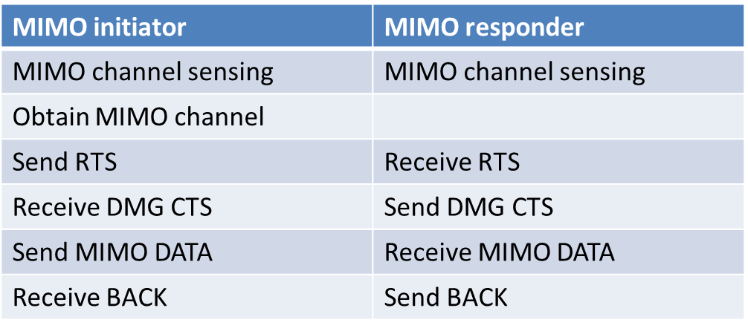
Consideration on SISO Reception
RTS/DMG CTS is in DMG control PHY.
  in order to receive RTS/DMG CTS, SISO reception shall be maintained in an MIMO TXOP
RTS/DMG CTS carries MIMO channel availability information
  MIMO channel sensing (physical and/or virtual) shall be done before sending RTS/DMG CTS
MIMO channel sensing may take long. When MIMO channel sensing is ongoing, STA with SISO reception capability can still receive frames from other STAs.

Slide 7
Solution for MIMO Channel Access (1/3)
In all cases, a device shall be able to receive SISO frames when MIMO channel access is pending.
  current preamble detection, NAV, and backoff timer remains the same
  when backoff timer reaches 0, SISO channel access is allowed

Slide 8
Solution for MIMO Channel Access (2/3)
Option 1
  physical carrier sensing and virtual carrier sensing shall be maintained such that at least all the sectors that are used for MIMO communication are covered
Alternative 1
  create a new MIMO backoff timer
  MIMO backoff timer decreases when all the MIMO sectors have channel clear
  MIMO backoff timer freezes when not all the MIMO sectors have channel clear
  MIMO channel access is allowed when MIMO backoff timer reaches 0
Alternative 2
  one or more backoff timer may be used for MIMO channel access
  each backoff timer decreases when the associated physical carrier sensing and virtual carrier sensing shows channel clear, and remains the same when the channel is busy
  MIMO channel access is allowed when at least one backoff timer reaches 0 and all the rest of the backoff timers are not suspended

Slide 9
Solution for MIMO Channel Access (3/3)
Option 2
  at least CCA of energy detection shall be maintained such that at least all the sectors that are used for MIMO communication are covered
  when backoff timer reaches 0, and all the sectors that are used for MIMO communication have CCA clear for PIFS, MIMO channel access is allowed

Slide 10
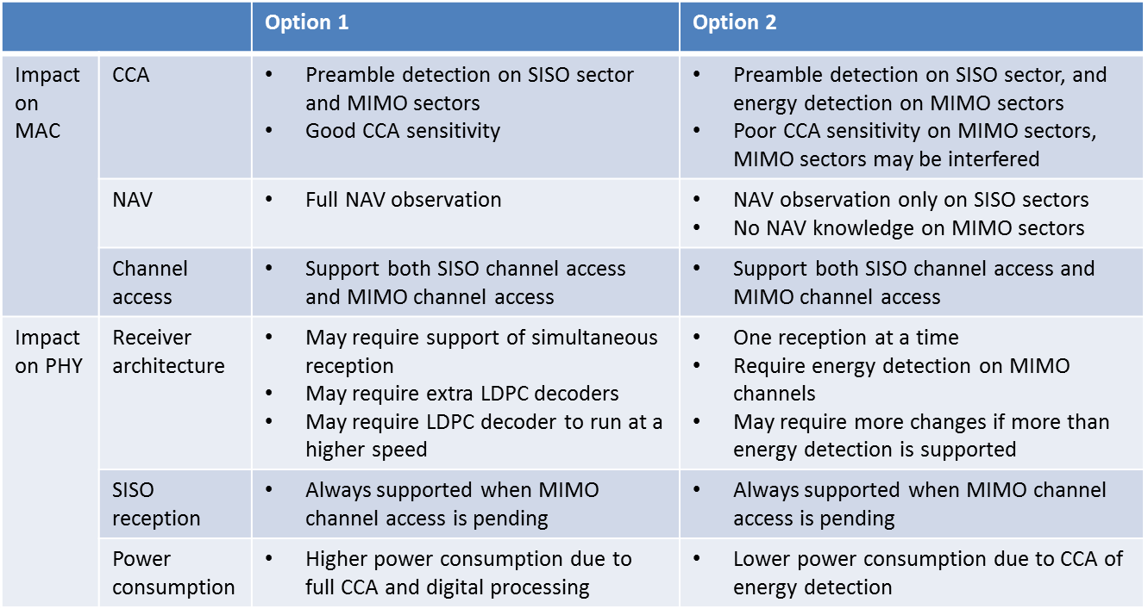
Comparison of Option 1 and Option 2

Slide 11
Conclusions and Recommendation
2 proposals for MIMO channel access are proposed
  both proposal requires support of SISO reception
  option 1 requires full CCA on all MIMO sectors
  option 2 requires CCA of energy detection on all MIMO sectors
We recommend option 2
  less implementation complexity
  lower power consumption

Slide 12
Straw Poll
Do you agree to insert the following text in the SFD: IEEE 802.11-17/0523r0 Draft Text for MIMO Channel Access.docx?

Slide 13
References

