Slide 1
Throughput and Coverage Improvements with DFT-s-OFDM for 802.11ay
Date: 2017-03-16
Authors:

Slide 2
Abstract
In [1-3], we evaluated the DFT-spread OFDM for 802.11ay from different angles (e.g., its benefit in fading, low PAPR, and channel-wise orthogonal multiple access in frequency domain)
In this contribution,
  We quantify the benefit of DFT-spread OFDM by using a majority of 11ay MCSs for two different simulation scenarios
  We show how DFT-spread OFDM can be adopted without major modifications to the existing agreements in 802.11ay

Slide 3



Background
A typical SC TX and RX for 802.11ad/ay may employ up-sampling, filtering, and down-sampling operations to match the sampling rate
In [3], we show that the up-sampling, filtering, down-sampling operation is equivalent to a weighted combination in frequency domain, which is not optimal in 802.11ay channels
448
448
$$↑$$
2
Filter
$$↓$$
3
Data
$$≡$$
Weighted Comb.
Data
S
/
P
DFT
(512)
EQ
IDFT
(512)
DFT
(768)
EQ
IDFT
(512)
768
64
64
RS
RS
SC receiver (time domain representation)
SC receiver (frequency domain representation)

Slide 4






SC versus DFT-spread OFDM
As shown in the appendix, SC transmitter can also be presented in frequency by using a weighted expansion block
DFT-spread OFDM basically removes the expansion and combination operations and achieves better PER and throughput performance
The references [4] and [5] show that DFT-spread OFDM can be implemented with mixed radix (e.g., radix-3 & radix-2) FFT implementation
Single carrier:
$$G_{H}$$
DFT
(512)
Weighted expan.
Weighted comb.
IDFT
(512)
$$G_{H}$$
Data
IDFT
(768)
DFT
(768)
EQ
Data
448
512
512
448
$$G_{T}$$
$$G_{T}$$
Filter coef.
DFT-spread OFDM:
Filter coef.
$$G_{H}$$
DFT
(512)
IDFT
(768)
DFT
(768)
IDFT
(512)
$$G_{H}$$
Data
448
EQ
448
Data
$$G_{T}$$
512
512
$$G_{T}$$

Slide 5








Minor Modification to Existing 11ay SC Frame Structure
DFT-spread OFDM can be adopted in 802.11ay without any major modification to the existing agreements.
For example, the preamble may indicate if the payload is DFT-spread OFDM or not as shown in the figure below:
$$G_{H}$$
Data
DFT
(512)
IDFT
(768)
448
512
$$G_{T}$$
Indicate: EDMG CEF, EDMG Header B and Data Field use DFT-spread OFDM or SC
DFT block 1
DFT block 2
DFT block N
L-STF
L-CEF
L-Header
EDMG Header A
EDMG STF
EDMG CEF
EDMG Header B
64
448
64
448
64
448
…
64
448
64
TRN
$$G_{T}$$
$$G_{H}$$
$$G_{T}$$
$$G_{H}$$
$$G_{T}$$
$$G_{H}$$
$$G_{T}$$
$$G_{H}$$
$$G_{T}$$
$$G_{H}$$
CP
CS
SC
DFT-s-OFDM

Slide 6
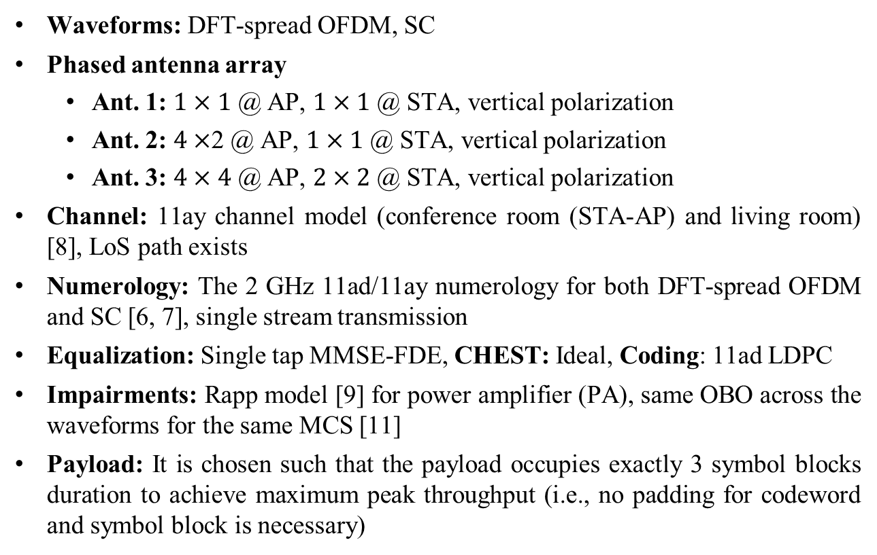
Simulation Assumptions [11]
Waveforms: DFT-spread OFDM, SC
Phased antenna array
    Ant. 1: $1×1$ @ AP, $1×1$ @ STA, vertical polarization
    Ant. 2: $4×$2 @ AP, $1×1$ @ STA, vertical polarization
    Ant. 3: $4×4$ @ AP, $2×2$ @ STA, vertical polarization
Channel: 11ay channel model (conference room (STA-AP) and living room) [8], LoS path exists
Numerology: The 2 GHz 11ad/11ay numerology for both DFT-spread OFDM and SC [6, 7], single stream transmission
Equalization: Single tap MMSE-FDE, CHEST: Ideal, Coding: 11ad LDPC
Impairments: Rapp model [9] for power amplifier (PA), same OBO across the waveforms for the same MCS [11]
Payload: It is chosen such that the payload occupies exactly 3 symbol blocks duration to achieve maximum peak throughput (i.e., no padding for codeword and symbol block is necessary)

Slide 7
Throughput Results (Conference Room, STA-AP, Ant. 3)
DFT-s OFDM provides more than 20% throughput gain in certain SNR ranges
On average, DFT-spread OFDM introduces approximately 15% throughput as compared to SC
The results for the aforementioned scenarios, provided in appendices, show similar improvement

Slide 8
Coverage Range (Conference Room STA-AP, Ant. 3)
Assumptions: TX power: 10 dBm; Noise figure: 5 dB; Path loss: Friis formula; Method: calculate SNR for a given link distance and find the best MCS
DFT-s OFDM improves the coverage range approximately by 10% as compared to SC

Slide 9
Throughput Results (Living Room, Ant. 3)

Slide 10
Coverage Range (Living Room, Ant. 3)

Slide 11
Conclusion
In this contribution, we demonstrate that DFT-spread OFDM brings approximately 15% throughput gain for a given link distance and 10% coverage gain as compared to SC by using the MCS adopted in 802.11ay
We also show how DFT-spread OFDM can be adopted without major modifications to PPDU in 802.11ay

Slide 12
Straw Poll
Should TGay include DFT-spread OFDM as an additional waveform in 802.11ay spec draft to improve the throughput and coverage?
Yes
No
Need more information
No opinion/don’t care

Slide 13
References
[1] “On the Single Carrier Waveforms for 11ay”, IEEE 802.11-16/01455r0
[2] “Performance Evaluation of Multi-DFT-spread OFDM for 802.11ay ”, IEEE 802.11-17/0048r0
[3] "Further Evaluation of Single Carrier Waveforms”, IEEE 802.11-17/0274r0
[4] “Software Optimization of DFTs and IDFTs Using the StarCore SC3850 DSP Core” http://www.nxp.com/assets/documents/data/en/application-notes/AN3680.pdf, 2010
[5] J. Lofgren and P. Nilsson “On Hardware Implementation of Radix 3 and Radix 5 FFT Kernels for LTE systems”, IEEE NORCHIP, Lund, 2011
[6] “Wireless LAN Medium Access Control (MAC) and Physical Layer (PHY) Specifications Amendment 3: Enhancements for Very High Throughput in the 60 GHz Band,” IEEE Std 802.11ad-2012, pp. 1–628, Dec. 2012.
[7] “Specification Framework for TGay,” IEEE 802.11-15/01358r6
[8] “Channel Models for IEEE 802.11ay,” IEEE 802.11-15/1150r7
[9] “11ay evaluation methodology,” IEEE 802.11-16/866r4
[10] K. R. Rao at al., “Fast Fourier Transform - Algorithms and Applications”, Signals and Communication Tech., Springer, 2010
[11] “PHY Simulations and Methodology”, IEEE 802.11-10/0431r3

Slide 14
Appendix - Simulation Results

Slide 15
Throughput Results (STA-AP, Ant. 1)

Slide 16
Throughput Results (STA-AP, Ant. 2)

Slide 17
Throughput Results (STA-AP, Ant. 3)

Slide 18
Coverage Range (STA-AP, Ant. 2)

Slide 19
Coverage Range (STA-AP, Ant. 3)

Slide 20
PER Results (STA-AP, Ant. 1)

Slide 21
PER Results (STA-AP, Ant. 2)

Slide 22
PER Results (STA-AP, Ant. 3)

Slide 23
Throughput Results (Living Room, Ant. 1)

Slide 24
Throughput Results (Living Room, Ant. 2)

Slide 25
Throughput Results (Living Room, Ant. 3)

Slide 26
Coverage Range (Living Room, Ant. 2)

Slide 27
Coverage Range (Living Room, Ant. 3)

Slide 28
PER Results (Living Room, Ant. 1)

Slide 29
PER Results (Living Room, Ant. 2)

Slide 30
PER Results (Living Room, Ant. 3)

Slide 31










Representations of Single Carrier TX and RX in Frequency
+
time
+
time
time
=
$$G_{H}$$
$$↑$$
3
Filter
$$↓$$
2
$$↑$$
2
Filter
$$↓$$
3
DFT
(512)
IDFT
(512)
$$G_{H}$$
Data
Data
448
P
/
S
S
/
P
EQ
448
$$G_{T}$$
768
$$G_{T}$$
[10]
[10]
[10]
[10]
IDFT
($512×3$)
DFT
($768×2$)
IDFT
($768×2$)
DFT
($512×3$)
IDFT
(512)
DFT
(512)
DFT
(512)
IDFT
(768)
DFT
(768)
768
768
Cancels each other
Filter
coef.
Cancels each other
Filter
coef.
Cancels each other
$$≡$$
$$≡$$
$$G_{H}$$
DFT
(512)
Weighted expan.
Weighted comb.
IDFT
(512)
$$G_{H}$$
Data
IDFT
(768)
DFT
(768)
EQ
Data
448
512
512
448
$$G_{T}$$
$$G_{T}$$
Filter coef.
Filter coef.

