Slide 1
Review of existing approaches and use cases of obtaining transmission opportunity from multiple channels
Date: 2017-03-12
Authors:

Slide 2
Abstract
This presentation:
  shows an example of spectrum usage in 2.4 GHz unlicensed band measured at a terminal station in Japan,
  briefly reviews current approaches such as IEEE 802.11aa and 11ai to select a good channel,
  shows the limitation of above approaches,
  also shows some use cases in which the new approach is necessary.

Slide 3
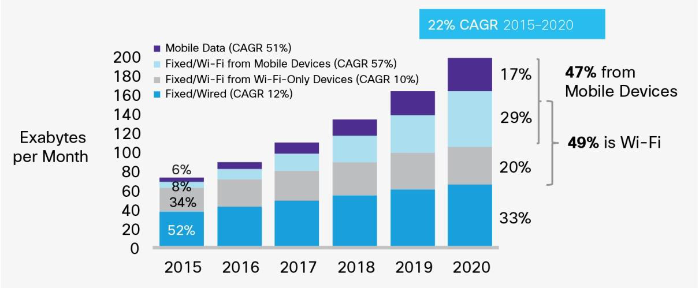
Background (1)
The amount of wireless LAN traffic is still increasing. It is forecasted that the amount of the traffic will become four times larger from 2015 to 2020 [1]. Thus, enhancement of system throughput of the wireless LAN is still necessary.
Growth of IP traffic forecasted by Cisco [1].

Slide 4
Background (2)
In current IEEE 802.11 wireless LAN, a BSS sets one primary channel on which each STA invokes the back-off procedure to transmit its data [2].
If the primary channel is congested, the STA hardly transmits its data even if other channels are vacant [3].
In the previous WNG SC session, we presented a new approach to overcome this issue by instantly obtaining transmission opportunity from vacant channels in the same or another frequency band [4].
A comment that IEEE 802.11aa started with this problem by selecting the channel correctly was given for the previous presentation [5].

Slide 5
Issue of congested primary channel on current IEEE 802.11 wireless LAN [3, 4]
In the current IEEE 802.11 wireless LAN, a BSS sets one primary channel on which each STA invokes the back-off procedure to transmit its data [2].
If the primary channel is congested, the STA hardly transmits its data even if other channels are vacant [3], and such unused resources cannot be available unless changing the primary channel.
Another STA cannot transmit its data if the primary channel is busy.
busy
idle
idle
idle
idle
idle
…
ch. a
ch. b
ch. c
ch. d
ch. e
ch. f
…
primary channel

Slide 6
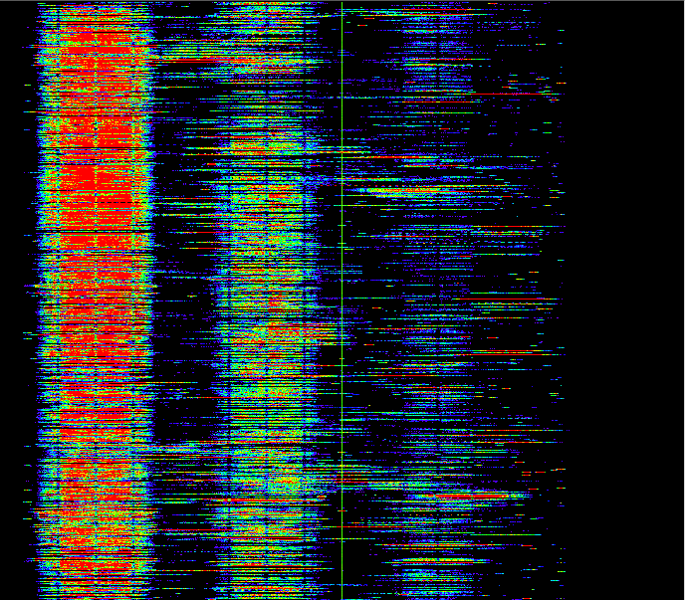
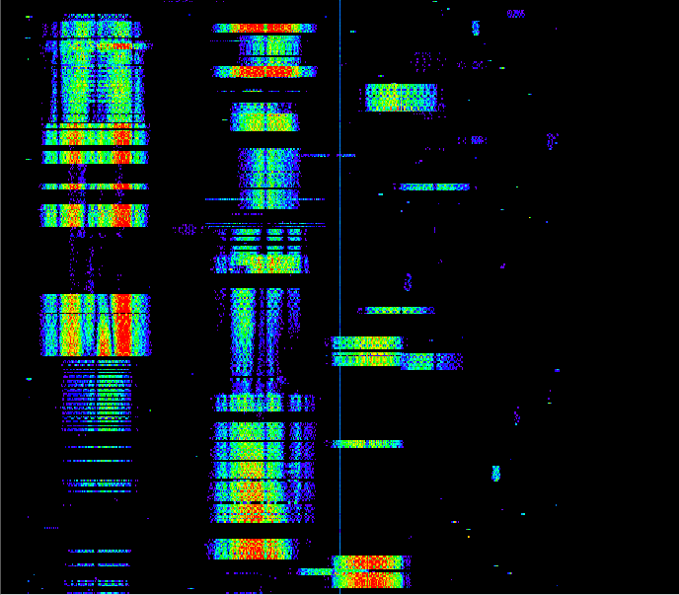
Example of channel usage at a railway terminal station in Japan
In some “busy locations,” radio channels are heavily congested. The congestion will become more severe in future.
time
time
30 min.
500 ms
ch. 1
ch. 6
ch. 11
ch. 1
ch. 6
ch. 11
Spectrogram of 2.4 GHz band measured in a “rush-hour” at a railway terminal station in Japan.

Slide 7
Possible approaches to overcome this issue
An AP selects a channel with enough available resource by using QLoad Report for management of OBSS defined in IEEE 802.11aa [6].
A non-AP STA searches a BSS with enough available resource by channel scanning and quickly sets up a link to the BSS by FILS defined in IEEE 802.11ai [7].
A STA instantly obtains transmission opportunity on another idle channel even when the primary channel is busy by performing CCA in parallel on multiple channels. (new approach)

Slide 8
Using OBSS management in IEEE 802.11aa [6]
IEEE 802.11aa defines a procedure to manage OBSS by using QLoad Report. It includes several information related with channel sharing policy, the number of allocated streams of QoS traffic, amount of peak QoS traffic, and so on.
IEEE 802.11aa also shows some examples of channel selection procedure using the QLoad Report for efficient resource sharing among BSSs.
Resource
Channel selection
own
load
QLoad report element
Total
available
resource
AP in
OBSS
OBSS
load
own
load
OBSS
load
OBSS
load
AP
QLoad report element
ch.
AP in
OBSS
ch. a
ch. b
ch. c

Slide 9

Using FILS in IEEE 802.11ai [7]
IEEE 802.11ai provide FILS to minimize initial link setup time.
If a non-AP STA obtains BSS load information from several BSSs by channel scan and sets up a link to a BSS with a low load, an overload situation might be avoided.
AP (BSS 1)
BSS load information
BSS load information
AP
(BSS 2)
Resource
Total
available
resource
BSS 1
load
Selected
BSS load information
BSS 2
load
AP
(BSS 3)
BSS 3
load
Fast link setup
ch.
ch. a
ch. b
ch. c

Slide 10
Benefit of current approaches
When channel loads are imbalanced among channels, QoS can be improved by switching the primary channel from congested one to idle one by the current approaches.
As many STAs taking these approaches, average channel load will be more balanced among channels.
Channel selection based on measured channel load
Resource
Measurement of average channel load
Total
available
resource
BSS 4
BSS 5
BSS 3
BSS 1
BSS 2
ch. 1
ch. 6
ch. 11
ch. a
ch. b
ch. c

Slide 11
Limitation of current approaches
The current 11aa and 11ai’s approaches will balance channel loads among channels.
On the other hand, the total channel load is getting raised as the amount of traffic and the number of wireless LAN terminals increases.
When the channel load is relatively high, another approach will be necessary to further improve the QoS to meet the user’s demand.

Slide 12
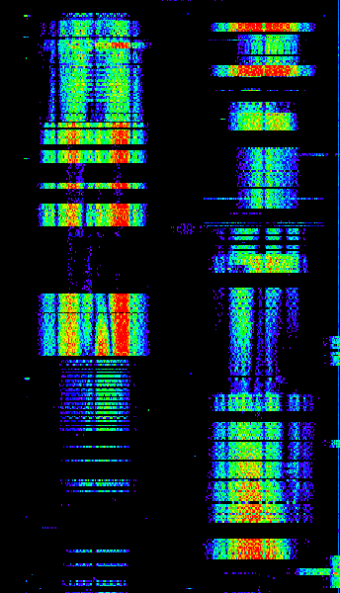
Short-term channel usage
In a short time, there are some unused periods on a channel unless the channel is full-loaded.
These unused periods randomly and independently occur among channels even after the channel load is balanced.
QoS of each traffic will be improved if such unused periods are available.
ch. 1
ch. 6

Slide 13
Another approach [4]
To utilize unused periods which occur randomly and independently in multiple channels, a STA performs CCA and the backoff process on multiple channels in parallel to quickly obtains transmission opportunity on an idle channel.
This approach will be effective whether channel load is balanced or not.
Utilize these idle resources scattered in multiple channels for channel access.
ch. 1
ch. 6

Slide 14
Use case of the new approach (1)
By employing the new approach, a STA can obtain more transmission opportunities, and thus achievable throughput will be increased.
This approach will enhance the robustness of QoS support to QoS traffic in relatively high-load situations whether or not the average channel load is balanced by current approaches.
This new approach would be more effective when there are many unmanaged BSSs, for example, in a condominium building or a public space where many mobile routers are operated.

Slide 15
Use case of the new approach (2)
Transmission delay will be reduced by the new approach. It will help to support QoS traffic with severe requirement on latency.
ch.
ch. a
(primary channel)
Busy
Backoff
Transmission
Reduced
transmission delay
ch. b
(another channel)
Busy
Backoff
Transmission
Time

Slide 16
Summary (1/2)
IEEE 802.11aa defines a procedure to manage OBSS. By using this, efficient resource sharing among BSSs is enabled.
If a STA finds another BSS with enough available resource, and quickly sets up a link to the BSS by FILS defined in IEEE 802.11ai, the overload situation might be avoided.
On the other hand, the total channel load is getting raised as the amount of traffic and the number of wireless LAN terminals increases.
When the channel load is relatively high, another approach will be necessary to further improve the QoS to meet the user’s demand.

Slide 17
Summary (2/2)
The new approach obtains transmission opportunity on a idle channel by performing CCA on multiple channels in parallel.
This approach will enhance the robustness of QoS support to QoS traffic in relatively high-load situations whether or not the average channel load is balanced by current approaches.
This new approach would be more effective when there are many unmanaged BSSs.

Slide 18
Straw Poll #1
Do you agree that there are issues in balanced and relatively high-load situations, and it is hard to overcome only by existing approaches in IEEE 802.11 wireless LAN in some cases?
  Y:
  N:
  Need more information
  Don’t care

Slide 19
Straw Poll #2
Do you think that IEEE 802.11 wireless LAN should have a new way to overcome some relatively high-load situations?
  Yes
  No
  Need further study/information
  Don’t care

Slide 20
References
[1] Cisco, “Cisco Visual Networking Index: Global Mobile Data Traffic Forecast Update, 2016–2021,” Cisco White Paper C11-738429-00, February 2017.
[2] IEEE 802.11-2012.
[3] doc. IEEE 802.11-14/1437r1.
[4] doc. IEEE 802.11-17/0129r3.
[5] doc. IEEE 802.11-17/0146r0.
[6] IEEE 802.11aa-2012.
[7] IEEE 802.11 TGai D10.0.

