Slide 1
Studies of PER Performance
Date: 2017-03-13
Authors:

Slide 2
Introduction
It was proposed in [1,2] to use Manchester Coding (MC) with the OOK modulation
This presentation provides simulation results for different MC schemes

Slide 3
Simulation Cases
Chip rate = OFDM symbol rate | OOK symbol rate = OFDM symbol rate
1010/0101 in 16 usec | 1010/0101 in 4 usec
10/01 in 8 usec | 10/01 in 4 usec
Several cases at the receiver are considered:
(1) only in-phase component
With CP
Removed CP
(2) Both I and Q
A random phase offset is added at the receiver
SNR is the expected SNR (set in the simulations) after the low pass filter
No other impairments

Slide 4
Receiver Block Diagram
Samples after ADC
4 or 8 or 16 MSps
Not considered in the simulation results
Packet detection block
Continue Searching
In Phase
|.|
Packet
detection
No
Detected?
Yes
Detect Boundary
Begin decoding packet
Decode data payload
OOK demodulation block
Yes
Decoded
Bit = 1
Buffer required samples
Cross correlate with the MC code
To packet parser
(includes CRC)
metric-1 > metric-0
Decoded
Bit = 0
No

Slide 5
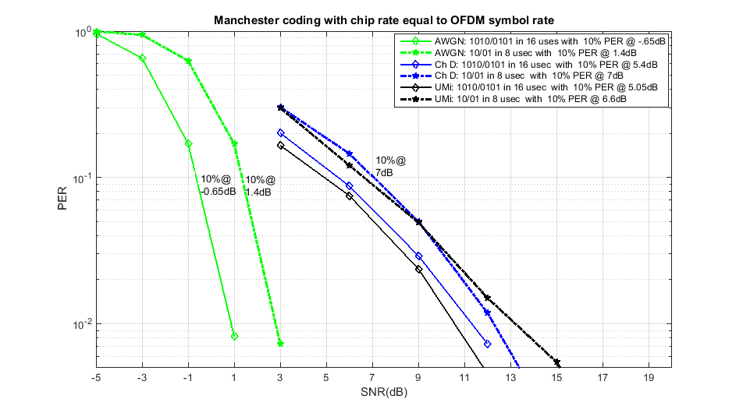
Simulations 1010/0101 in 16 usec compared to 10/01 in 8 usec

Slide 6
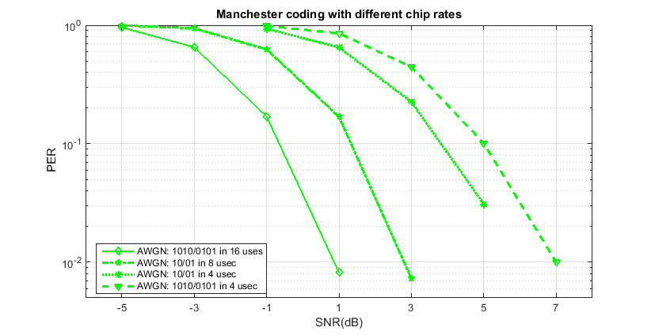
Simulations in 4usec

Slide 7
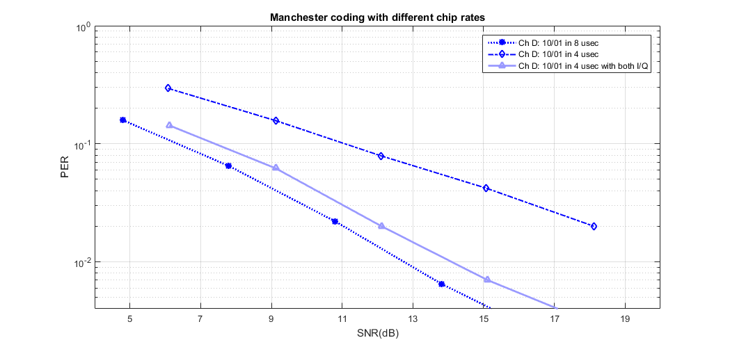
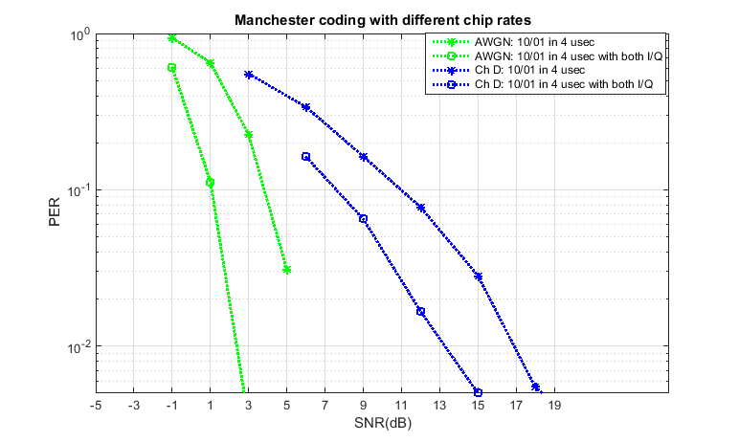
Use of I/Q

Slide 8
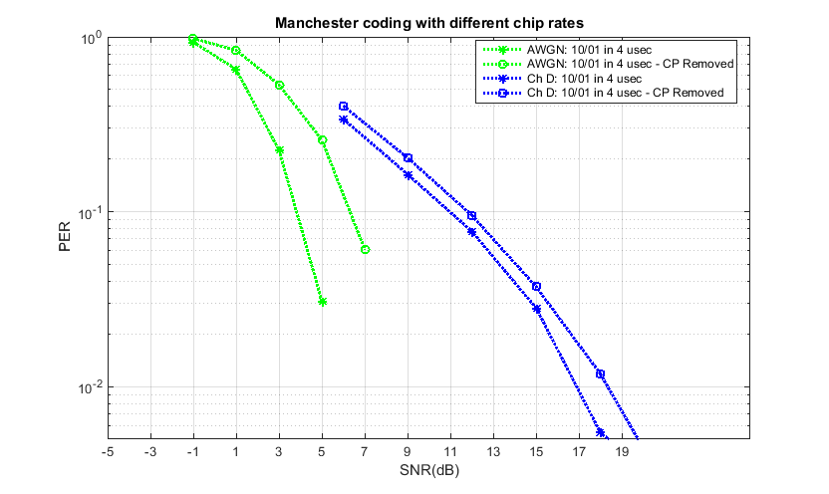
Comparison with CP-Removed

Slide 9
References
[1] “17/0030r0 On the Performance of Timing Synchronization and OOK Pulse Bandwidth”, IEEE 802.11 TGba, Jan 2017
[2] “16/1144r0 Further Investigation on WUR Performance”, IEEE 802.11 WUR-SC, Sep 2016

