Slide 1
Regulations and Noise Figure – Impact on SNR
Date: 2017-03-08
Authors:

Slide 2
Outline
Regulatory Allowed Transmit Power
  WUR (4 MHz)
  Regular 802.11 (20 MHz)
WUR Noise Figure
Impact on WUR operating SNR

Slide 3
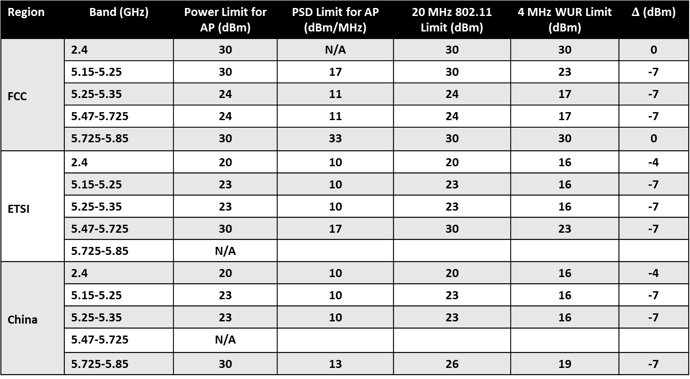
Regulated Maximum Allowed Transmit Power
Region | Band (GHz) | Power Limit for AP (dBm) | PSD Limit for AP (dBm/MHz) | 20 MHz 802.11 Limit (dBm) | 4 MHz WUR Limit (dBm) | $Δ$ (dBm)
FCC | 2.4 | 30 | N/A | 30 | 30 | 0
 | 5.15-5.25 | 30 | 17 | 30 | 23 | -7
 | 5.25-5.35 | 24 | 11 | 24 | 17 | -7
 | 5.47-5.725 | 24 | 11 | 24 | 17 | -7
 | 5.725-5.85 | 30 | 33 | 30 | 30 | 0
ETSI | 2.4 | 20 | 10 | 20 | 16 | -4
 | 5.15-5.25 | 23 | 10 | 23 | 16 | -7
 | 5.25-5.35 | 23 | 10 | 23 | 16 | -7
 | 5.47-5.725 | 30 | 17 | 30 | 23 | -7
 | 5.725-5.85 | N/A
China | 2.4 | 20 | 10 | 20 | 16 | -4
 | 5.15-5.25 | 23 | 10 | 23 | 16 | -7
 | 5.25-5.35 | 23 | 10 | 23 | 16 | -7
 | 5.47-5.725 | N/A
 | 5.725-5.85 | 30 | 13 | 26 | 19 | -7

Slide 4
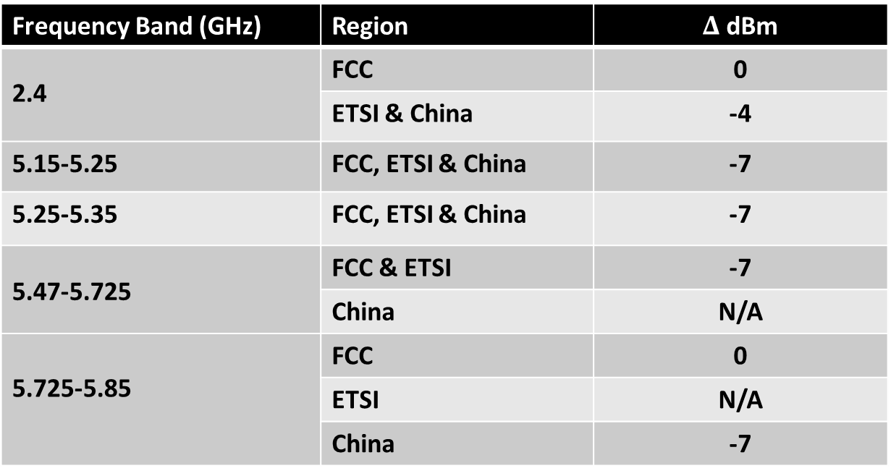
Regulatory Transmit Power Summary
Frequency Band (GHz) | Region | $Δ$ dBm
2.4 | FCC | 0
 | ETSI & China | -4
5.15-5.25 | FCC, ETSI & China | -7
5.25-5.35 | FCC, ETSI & China | -7
5.47-5.725 | FCC & ETSI | -7
 | China | N/A
5.725-5.85 | FCC | 0
 | ETSI | N/A
 | China | -7
In 2.4 GHz the delta is either 0 or -4 dB, depending on region
In 5 GHz the delta is -7 dB, in almost all cases

Slide 5
Impact on WUR Receiver Sensitivity
To compensate for the lower WUR TX Power
  In 2.4 GHz the WUR receiver sensitivity will need to be 4 dB better than regular 20-MHz Wi-Fi
  In 5 GHz the WUR receiver sensitivity will need to be 7 dB better than regular 20-MHz Wi-Fi

Slide 6
Receiver Noise Figure Difference – WUR versus 20 MHz 802.11
The WUR uses ultra lower power RF circuits which leads to a higher receiver noise figure relative to 20-MHz 802.11
The WUR noise figure is approximately 8 dB poorer than regular 802.11
  This is based on input from Qualcomm RFIC design engineers

Slide 7
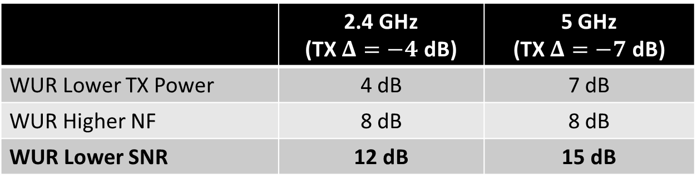
WUR Required to Operate at Lower SNR than Regular Wi-Fi
Combining the effects of lower TX power and higher receiver noise figure, the WUR must operate at a lower SNR than regular W-Fi, to match the range of regular Wi-Fi
As shown in the table below that SNR delta is 12 dB for the 2.4 GHz frequency band and 15 dB for the 5 GHz frequency band
 | 2.4 GHz (TX $Δ=−4$ dB) | 5 GHz (TX $Δ=−7$ dB)
WUR Lower TX Power | 4 dB | 7 dB
WUR Higher NF | 8 dB | 8 dB
WUR Lower SNR | 12 dB | 15 dB
SNR is defined as the ratio of signal to noise power in 20MHz BW for easy comparison with baseline Wi-Fi technologies

Slide 8
Conclusions
Based on Regulatory PSD limits and WUR receiver noise figure the WUR needs to operate at a lower (20 MHz) SNR than regular 802.11
  12 dB lower in 2.4 GHz frequency band
  15 dB lower in 5 GHz frequency band

