Slide 1
Low Latency and Low Medium Utilization
Date: 2017-03-08
Authors:

Slide 2
WUR Requirements
In our opinion, the WUR must support the following requirements
  Low Latency wake-up (e.g. 100 ms)
  Low Medium Utilization for WUR Beacon
    Wake-up messages are expected to be sent less frequently than a beacon, for IoT applications
Initially these look like conflicting requirements, but it is possible to meet both of these requirements with WUR

Slide 3
WUR Beacons
Prior contributions [1,2] proposed to use WUR Beacons to maintain time synchronization for WUR
In regular 802.11 the beacons are transmitted every 100 ms
The STA listens every beacon or every N-th Beacon
If we use this approach in WUR we would need to send a WUR beacon every 100 ms, which could lead to excessive medium utilization
[1] IEEE 802.11-16/1504r0, “Discussion of WUR Packets Design”
[2] IEEE 802.11-17/0029r4, “WUR Usage Model Document”

Slide 4
WUR Proposal
In WUR we propose to “listen frequently” at the STA and “transmit infrequently” at the AP
For example
  WUR receiver listens every 100 ms
  AP sends WUR beacon every 10 seconds

Slide 5
Observations
By listening at the STA every 100 ms, that provides the AP the opportunity to send a Wake-up message within 100 ms of any event
The Medium Utilization is dominated by the WUR beacon, which occurs infrequently, say every 10 seconds
Beacon medium utilization (assuming 4 ms beacon and 10 second beacon interval) is 0.04% (4ms/10,000ms)
  This is significantly lower than regular beacon overhead
  For example, regular beacon medium utilization of 0.4% results from a beacon of 400 µs duration every 100 ms at 6Mbps. (The 400 µs assumption is based on typical values from packet traces. The exact beacon duration varies depend on the IEs included in the beacon.)

Slide 6
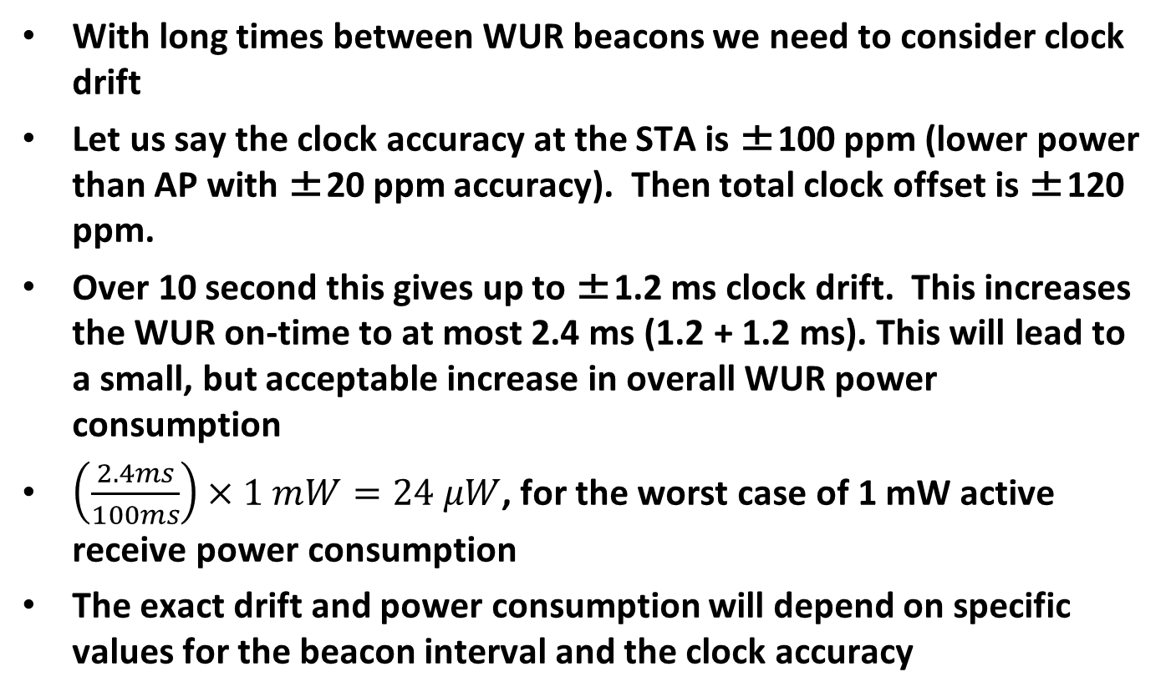
Clock Drift
With long times between WUR beacons we need to consider clock drift
Let us say the clock accuracy at the STA is ±100 ppm (lower power than AP with ±20 ppm accuracy). Then total clock offset is ±120 ppm.
Over 10 second this gives up to ±1.2 ms clock drift. This increases the WUR on-time to at most 2.4 ms (1.2 + 1.2 ms). This will lead to a small, but acceptable increase in overall WUR power consumption
$\left(\frac{2.4ms}{100ms}\right)×1 mW=24 μW$, for the worst case of 1 mW active receive power consumption
The exact drift and power consumption will depend on specific values for the beacon interval and the clock accuracy

Slide 7
Conclusions
By having the WUR receiver “listen frequently” and the WUR transmitter “transmit infrequently” we can meet the dual requirements of low latency and low medium utilization, at the cost of a small increase in average power consumption

