Slide 1
A Narrow-Band Bipolar OOK Signal
Date: March 13-17 2017
Authors:
Name | Affiliations | Address | Phone | Email
Shouxing Simon Qu | BlackBerry, Ltd. | 1001 Farrar Rd., Ottawa, ON, Canada | 1-613-595-4205 | squ@blackberry.com
Stephen McCann | BlackBerry, Ltd. |  |  | smccann@blackberry.com
James Lepp | BlackBerry, Ltd |  |  | jlepp@blackberry.com

Slide 2
Abstract
A narrow-band bipolar OOK (NBB OOK) signal is proposed in this contribution.
On-off keying (OOK) is a potential candidate modulation scheme for WUR [1].
The spectrum efficiency of regular non-return-to-zero (NRZ) OOK signal is analyzed.
The spectrum efficiency of NBB OOK signal is higher compared to the regular OOK signal.

Slide 3
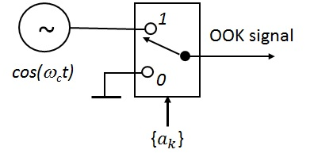
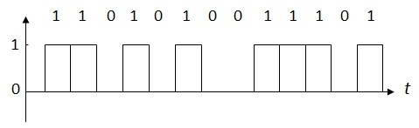
NRZ OOK Baseband Waveform:
NRZ OOK Signal (1)
Conceptual NRZ OOK Signal Generator:

Slide 4
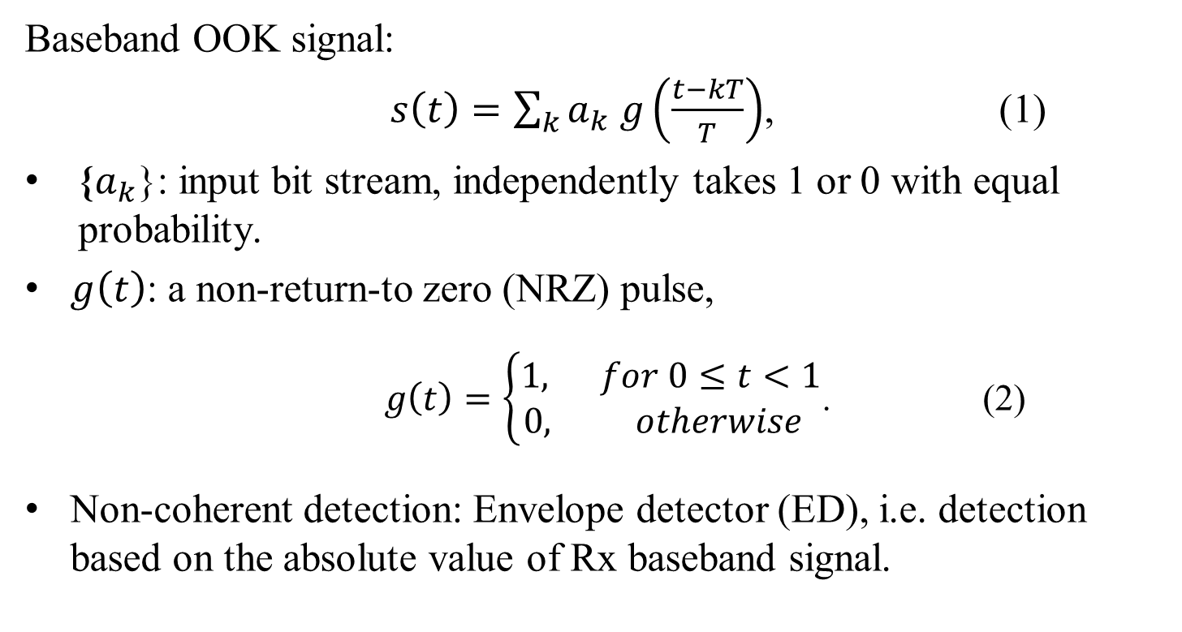
NRZ OOK Signal (2)
Baseband OOK signal:
$s\left(t\right)=\sum_{k}{a_{k} g\left(\frac{t−kT}{T}\right)}$, (1)
{$a_{k}$}: input bit stream, independently takes 1 or 0 with equal probability.
$g\left(t\right)$: a non-return-to zero (NRZ) pulse,
$g\left(t\right)=\left\{\begin{aligned}1, for 0≤t<1 \\ 0, otherwise \end{aligned}\right.$. (2)
Non-coherent detection: Envelope detector (ED), i.e. detection based on the absolute value of Rx baseband signal.

Slide 5
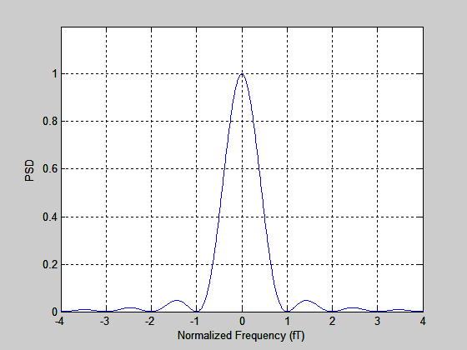
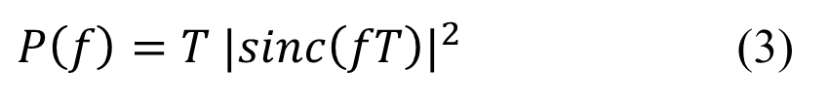
Normalized PSD of NRZ OOK Signal
$P\left(f\right)=T {|sinc\left(fT\right)|}^{2}$ (3)
  null-to-null bandwidth: W = 2/T.
  has non-zero discrete DC component (not shown).

Slide 6
Motivation for Narrow-Band Bipolar OOK
Proposing a new signal suitable for WUR.
Providing higher spectrum efficiency.
Slightly increasing transmitter complexity.
Do not increase receiver complexity:
  The new signal can be demodulated with the same envelope detector (ED) used as for the above OOK.
  Same error rate performance in AWGN channel.

Slide 7
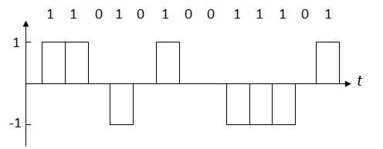
NBB OOK Baseband Waveform:
Narrow-Band Bipolar (NBB) OOK (1)
Bipolar: with three levels: {+1, 0 -1}.
  Adjacent pulses have same polarity;
  Non-adjacent pulses have alternate polarities.
Level varies cyclically: +1 → 0 → -1 → 0 → +1…

Slide 8
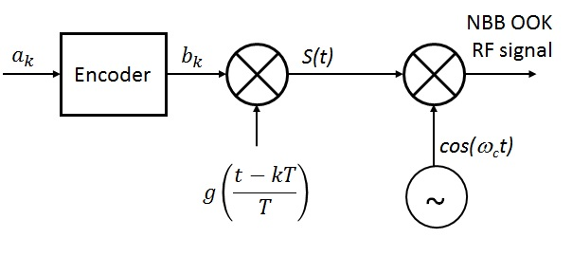
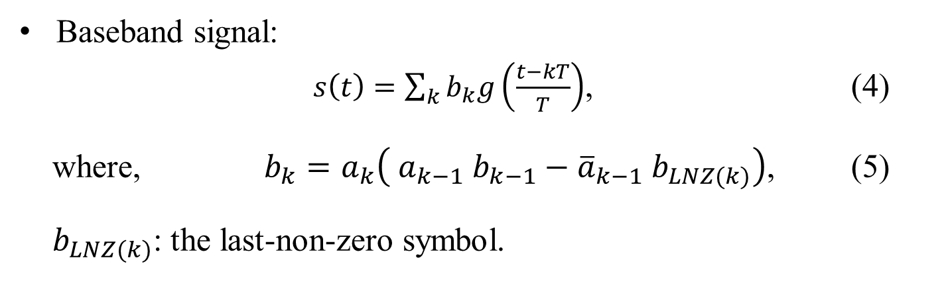
Narrow-Band Bipolar OOK (2)
Baseband signal:
$s\left(t\right)=\sum_{k}{b_{k}g\left(\frac{t−kT}{T}\right)}$, (4)
where, $b_{k}=a_{k}\left( a_{k−1} b_{k−1}−{\overline{a}}_{k−1} b_{LNZ(k)}\right)$, (5)
$b_{LNZ(k)}$: the last-non-zero symbol.

Slide 9
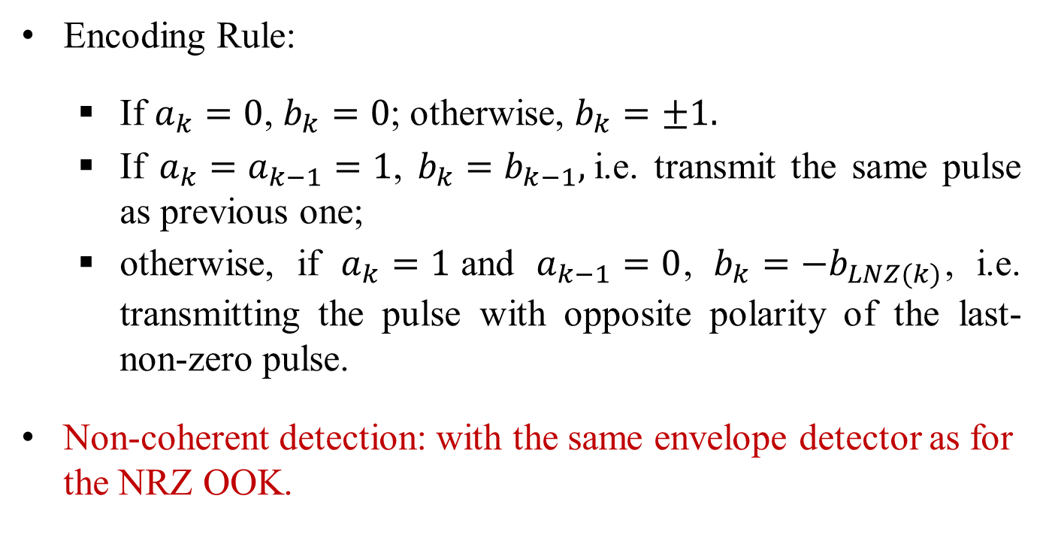
Narrow-Band Bipolar OOK (3)
Encoding Rule:
  If $a_{k}=0$, $b_{k}=0$; otherwise, $b_{k}=±1.$
  If $a_{k}=a_{k−1}=1$, $b_{k}=b_{k−1},$i.e. transmit the same pulse as previous one;
  otherwise, if $a_{k}=1$and $a_{k−1}=0$, $b_{k}=−b_{LNZ(k)}$, i.e. transmitting the pulse with opposite polarity of the last-non-zero pulse.
Non-coherent detection: with the same envelope detector as for the NRZ OOK.

Slide 10
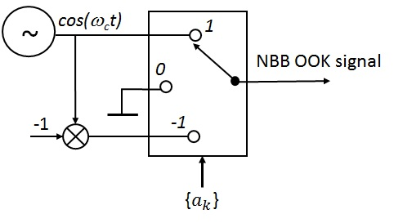
Narrow-Band Bipolar OOK (4)
NBB OOK Signal Generator: the switch moves as
1→ 0→ -1→ 0

Slide 11
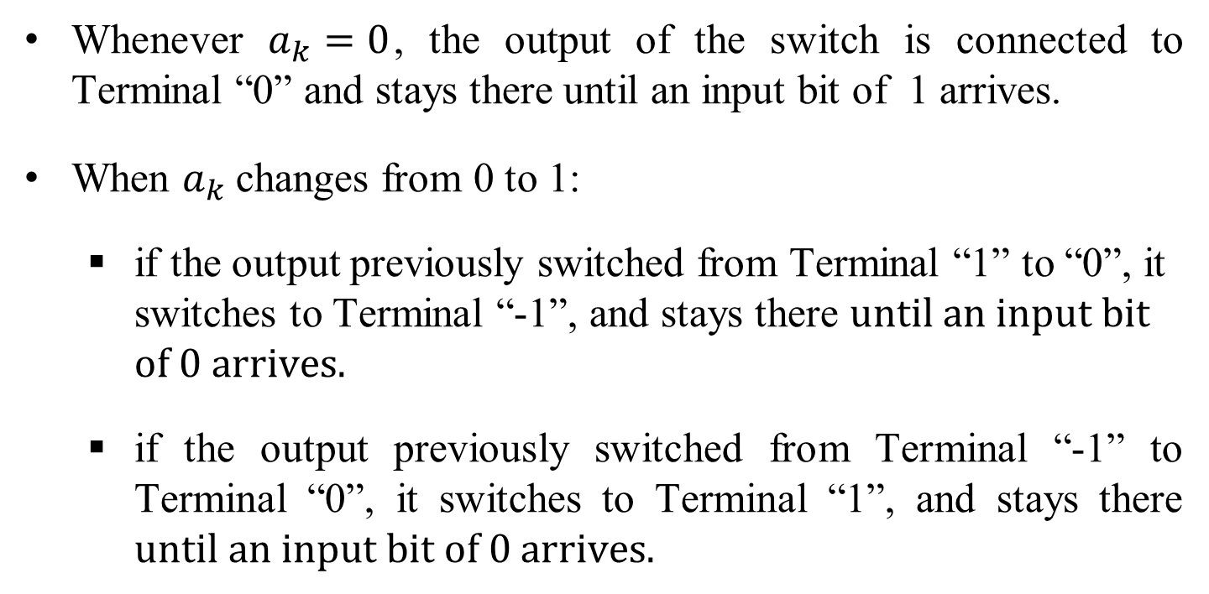
Switch Connection
Whenever $a_{k}=0$, the output of the switch is connected to Terminal “0” and stays there until an input bit of 1 arrives.
When $a_{k}$changes from 0 to 1:
  if the output previously switched from Terminal “1” to “0”, it switches to Terminal “-1”, and stays there $until an input bit$ $of 0 arrives.$
  if the output previously switched from Terminal “-1” to Terminal “0”, it switches to Terminal “1”, and stays there $until an input bit of 0 arrives.$

Slide 12
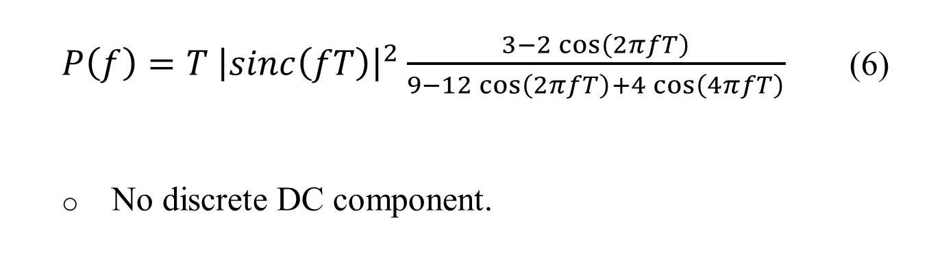
Normalized PSD of NBB OOK
$P\left(f\right)=T {\left|sinc\left(fT\right)\right|}^{2}\frac{3−2\cos\left(2πfT\right)}{9−12\cos\left(2πfT\right)+4\cos\left(4πfT\right)}$ (6)
  No discrete DC component.

Slide 13
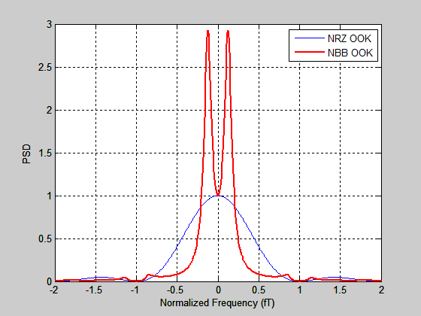
PSD of OOK Signals (theoretical, Eq.(6))

Slide 14
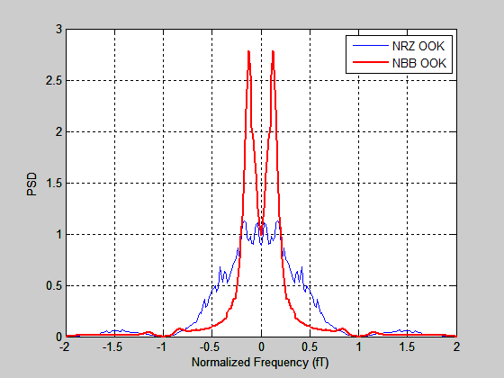
PSD of NBB OOK Signal (simulation results)

Slide 15
Bandwidth Efficiency Comparison
Double-Sided Bandwidth (f T) | Energy Ratio within Given Bandwidth (%)
 | NRZ OOK | NBB OOK
0.5 | 46.7 | 80.4
0.6 | 54.5 | 84.1
0.8 | 67.6 | 87.9
1.0 | 77.4 | 90.0
1.2 | 83.9 | 91.4
1.4 | 87.8 | 92.5
1.6 | 89.6 | 93.6
1.8 | 90.2 | 94.8
2.0 | 90.3 | 95.0

Slide 16
Conclusions
By introducing proper correlation among symbols, the proposed narrow-band bipolar OOK signal provides improved spectrum/bandwidth efficiency.
The bandwidth needed to transmit the NBB OOK signal is significantly narrower than to transmit the NRZ OOK signal.
The out-of-band energy leakage is reduced.
No increase of Rx complexity:
  Demodulation with the same ED for the NRZ OOK; yielding same error rate performance in AWGN channel.
Transmitter complexity increases slightly.
The principle is applicable to other unipolar binary signals.

Slide 17
REFERENCES
:
[1] ] Minyoung Park at.al, “LP-WUR (Low-Power Wake-Up
Receiver) Follow-Up”, IEEE 802.11-16/0341r0, Mar. 14, 2016.
[2] S. Benedetto, E. Biglieri and V. Castellani, Digital Transmission
Theory, Prentice-Hall, 1988.

