Slide 1
Current topics in 802.11: overview, high efficiency and reduced power consumption
Date: 2017-03-13
Authors:

Slide 2
Abstract
This document contains slides prepared for a tutorial to the IEEE 802 March 2017 plenary session
It contains the following:
  Scope of the 802.11 project
  Summary of current activities
  Summary of completed projects
  And then, drilling down into selected current activities:
    P802.11ax – “High efficiency wireless LAN”
    P802.11ba – “Wake up radio”
    LC – “Light communications”

Slide 3
Before We Share our Opinions……
“At lectures, symposia, seminars, or educational courses, an individual presenting information on IEEE standards shall make it clear that his or her views should be considered the personal views of that individual rather than the formal position, explanation, or interpretation of the IEEE.”
IEEE-SA Standards Board Operation Manual (subclause 5.9.3)
Notes:
3
3/8/2017

Slide 4
Contributors
This presentation contains material provided/reused from multiple authors:
  Bruce Kraemer
  Stephen McCann
  Jon Rosdahl
  Dorothy Stanley
  + most of the 802.11 task group chairs

Slide 5
IEEE 802 Wireless

Slide 6
IEEE 802.11 “Scope”
Wireless local area networks
Typical range up to 100m, can be much higher with directional antennas
Generally uses unlicensed or license-exempt spectrum, with the following exceptions:
  802.11p: DSRC band for vehicular applications
  802.11y: “lightly licensed”
  802.11af: TV whitespace bands
Ubiquitous Deployments: Broadband network access, public venue access, sensor networks, mesh networks, automotive.
Present in many different classes of device: laptops, phones, tablets, network infrastructure, home appliances, consumer electronics, healthcare devices
Notes:
What’s the scope of IEEE 802.11?

Slide 7
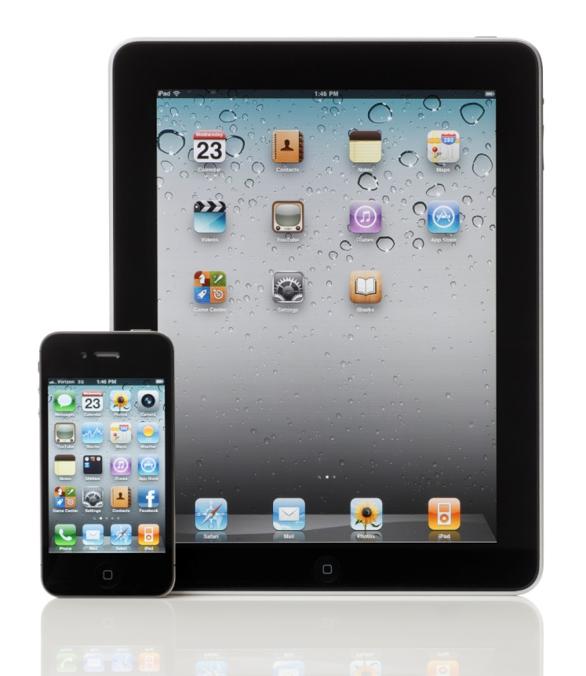

A Standard with unexpected impact
IEEE 802.11 originally conceived for linking wireless cash registers.
Today, underpins revolutionary mobile devices and a growing range of applications
Notes:
IEEE 802.11 was originally was conceived to interconnect wireless cash registers, but it has evolved into a contribution which benefits society with revolutionary new mobile devices that we couldn't’t have even imagined a decade ago. And the scope of things that are connected wirelessly today continues to expand at furious pace.

Slide 8
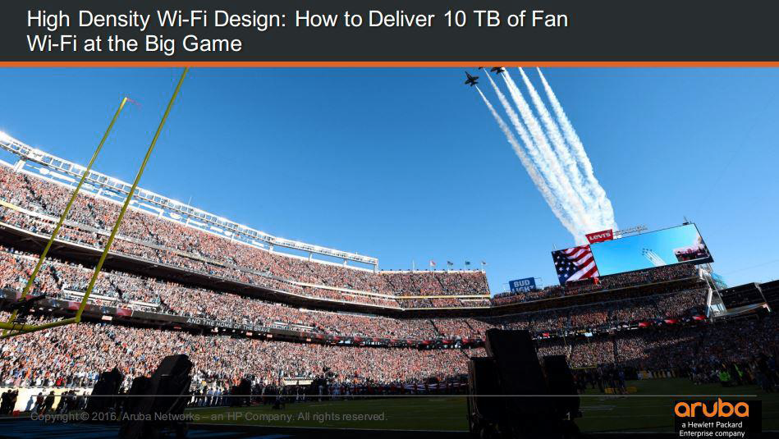
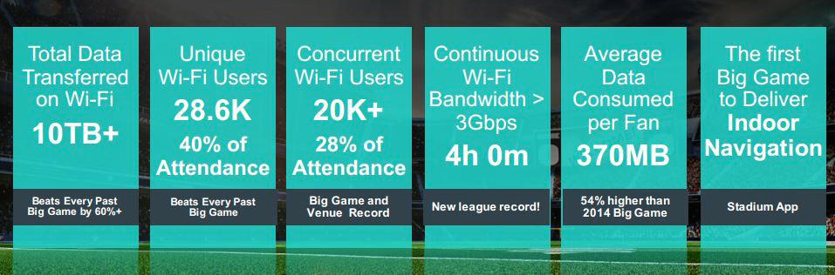
802.11 technology is serving high density applications today
Source: Aruba/HPE, used with their permission

Slide 9
In 2014 Wi-Fi traffic was 16 times cellular one
(2) Spectrum trends below 6GHz
UK Data carried in PB per month
538.5 MHz
available
538.5 MHz
available
602 MHz
available
602 MHz
available
Cisco VNI, 2014 average
Source: Andy Gowans (UK regulator) presentation: https://mentor.ieee.org/802.18/dcn/16/18-16-0016-01-0000-ofcom-future-spectrum-requirements.pptx
Notes:
According to Cisco VNI, 3% of all IP traffic is carried by mobile, compared to 49% over Wi-Fi and 48% wired. This is despite Wi-Fi having access to less spectrum (538.5 MHz) compared to mobile (602 MHz).
Source: Cisco VNI, Office of National Statistics, Ofcom CMR 2014 and Ofcom Infrastructure Report 2014
Notes: Infrastructure Report data is based on June 2014 only and assumes 93% use wireless routers (CMR 2014).

Slide 10


Wi-Fi Alliance
Founded in 1999 - http://www.wi-fi.org
600+ member companies
The Wi-Fi Alliance provides:
  Interoperability certification programs
    Over 30,000 products certified
    Over 7 billion Wi-Fi devices deployed
  Specifications that extend 802.11 (e.g. security)
  Market messaging
  Includes WiGig certified 60 GHz products (2016)
First called the “Wireless Ethernet Compatibility
Alliance”, early alliance slogan was
“The standard for Wireless Fidelity”
Over 7,000,000 hot spots world wide

Slide 11
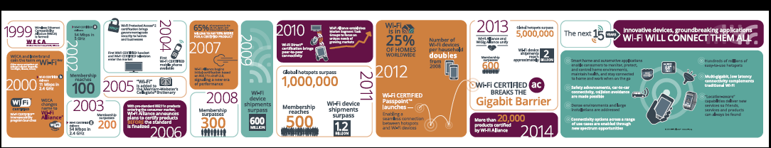
http://www.wi-fi.org/discover-wi-fi/15-years-of-wi-fi

Slide 12
Summary of Current Activities

Slide 13
Type of Groups
Type of Group | Description
WG | Working Group
SC | Standing Committee
TG | Task Group
SG | Study Group
TIG | Topic Interest Group

Slide 14
Recent New Activities
Wake-up Radio Task Group (TGba)
  Amendment project approved in December 2016
  Wake-up Radio project grew out of the Long Range Low Power (LRLP) Topic Interest Group work
Light Communications Topic Interest Group (LC TIG)
  Topic Interest Group formed to assess interest and scope of potential work
  See https://mentor.ieee.org/802.11/dcn/16/11-16-1499-00-0wng-lifi-light-communication-for-802-11.pptx
Advanced Access Networking Interface (AANI) Standing Committee
  Advance interactions with 3GPP re: 802.11 technology inclusion in IMT-2020, 5G, additional topics

Slide 15
IEEE 802.11 Groups
Type | Group | Description
WG | WG11 | The IEEE 802.11 Working Group
SC | AANI | Advanced Access Networking Interface (AANI)
SC | ARC | Architecture
SC | PAR | PAR review
SC | WNG | Wireless Next Generation
802 SC | JTC1 | ISO/IEC JTC1/SC6
TG | AJ | China Milli-Meter Wave (CMMW)
TG | AQ | Pre-association Discovery (PAD)
TG | AK | General Link (GLK)
TG | AX | High Efficiency Wireless LAN (HEW)
TG | AY | Next Generation 60 GHz (NG60)
TG | AZ | Next Generation Positioning (NGP)
TG | BA | Wake-up Radio
TIG | LC | Light Communication TIG

Slide 16
IEEE 802.11 Standards Pipeline
MAC
802.11
-2016
802.11aq
PAD
802.11az
NGP
802.11ak
GLK
802.11ba
WUR
802.11ai
FILS
WNG
Light Comms
(LC) TIG
802.11ax
HEW
802.11ah
< 1 GHz
802.11ay
NG60
802.11aj
CMMW
MAC & PHY
Discussion Topics
TIG/Study
groups
TG without
Approved draft
WG
Letter Ballot
Sponsor
Ballot
Published
Amendment
Published
Standard
Notes:
doc.: IEEE 802.11-11/0483r0
May 2011
Bruce Kraemer (Marvell)
Page 16

Slide 17
Completed Projects

Slide 18
Recently Completed Projects
These projects were approved in the December 2016 IEEE-SA Standards Board meeting
TGah, Sub 1GHz
  expect publication early 2017
TGai, Fast Initial Link Setup
  Published in December 2016
TGmc, the revision project
  Rolls up 5 amendments
  Improved support for Location/Positioning
  Published in December 2016 as IEEE 802.11-2016

Slide 19
Summary of Completed Projects - 1
Date | Name | Type | Description
1997 | 802.11 | Standard | Original standard for 802.11 with 3 PHYs
1997 | 802.11c | Amendment | Support for MAC bridges
1999 | 802.11 | Revision | Rolls in 802.11c and maintenance fixes
1999 | 802.11f | Recommended Practice | Inter Access Point protocol. Withdrawn in 2006.
1999 | 802.11a | Amendment | Higher Speed PHY Extension in the 5 GHz Band
1999 | 802.11b | Amendment | Higher Speed PHY Extension in the 2.4 GHz Band
2001 | 802.11d | Amendment | Operation in Additional Regulatory Domains
2003 | 802.11g | Amendment | Further Higher Data Rate Extension in the 2.4 GHz Band
2003 | 802.11h | Amendment | Spectrum and Transmit Power Management Extensions in the 5 GHz Band in Europe (DFS & TPC)
2004 | 802.11i | Amendment | MAC Security Enhancements

Slide 20
Summary of Completed Projects - 2
Date | Name | Type | Description
2004 | 802.11j | Amendment | 4.9 GHz-5 GHz Operation in Japan
2005 | 802.11e | Amendment | MAC Enhancements for QoS
2007 | 802.11 | Revision | Rolls in previous amendments and maintenance update
2008 | 802.11k | Amendment | Radio Resource Measurement
2008 | 802.11r | Amendment | Fast Roaming
2008 | 802.11y | Amendment | 3650-3700 MHz Operation in USA
2009 | 802.11n | Amendment | High Throughput
2009 | 802.11w | Amendment | Protected Management Frames
2010 | 802.11p | Amendment | Wireless Access for the Vehicular Environment
2010 | 802.11z | Amendment | Extensions to Direct Link Setup
2011 | 802.11v | Amendment | Wireless Network Management

Slide 21
Summary of Completed Projects - 3
Date | Name | Type | Description
2011 | 802.11u | Amendment | Inter-Working with External Networks
2011 | 802.11s | Amendment | Mesh Networking
2012 | 802.11 | Revision | Roll in of amendments and maintenance update
2012 | 802.11ae | Amendment | Prioritization of Management Frames
2012 | 802.11aa | Amendment | Video Transport Streams
2012 | 802.11ad | Amendment | Very High Throughput in the 60 GHz band
2013 | 802.11ac | Amendment | Very High Throughput in < 6 GHz bands
2013 | 802.11af | Amendment | TV White Spaces
2016 | 802.11 | Revision | Roll in of amendments and maintenance update
2016 | 802.11ai | Amendment | Fast Initial Link Setup
2017 | 802.11ah | Amendment | Sub 1 GHz operation

Slide 22
Detail on some current 802.11 Activities

Slide 23
High Efficiency WLAN 802.11ax

Slide 24


Purpose
Improve performance of WLAN deployments in dense scenarios
  Targeting at least 4x improvement in the per-STA throughput compared to 802.11n and 802.11ac.
  Improved efficiency through spatial (MU MIMO) and frequency (OFDMA) multiplexing.
Dense scenarios are characterized by large number of access points and large number of associated STAs deployed in geographical limited region, e.g. a stadium or an airport.
Access to Internet, latest airlines’ announcements, and digital media such as movies and sport events

Slide 25
Progress
Draft D1.0 was approved by the TG in November 2016.
WG Letter ballot ended on January 08, 2017
The draft failed to achieve the necessary 75% approval ratio
Approximately 7000 comments were received
The TG main task is to resolve comments received on draft D1.0
Draft 2.0 and WG LB is expected in September or November 2017
Task Group Documents
  11-14-0165-01 PAR and 11-14-0169-01 CSD
  11-14-0938-04 TGax Selection Procedure
  11-14-0980-14 TGax Simulation Scenarios
  11-14-0571-10 TGax Evaluation Methodology
  11-14-0882-04 TGax Channel Models
  11-14-1009-02 TGax Functional Requirements
  11-15-0132-16 TGax Specification Framework

Slide 26
Technical Highlights
Increase network efficiency by multiplexing users in both frequency and space
  UL and DL OFDMA
  UL and DL MU-MIMO
Increase spatial reuse through dynamic clear channel assessment (CCA)
Increase link efficiency with a longer OFDM symbol and high order modulation (1024-QAM)
Improved support for outdoor operation

Slide 27
OFDMA and MU-MIMO
Frequency
STA
STA-1
STA-2
PHY
Header
STA-3
STA
AP
STA-4
STA-5
Time
STA
OFDMA resource allocation based on buffer status at the STA for better user experience.
MU MIMO allows a high capability device to simultaneously transmit or receive from a multiple of low capability devices.

Slide 28
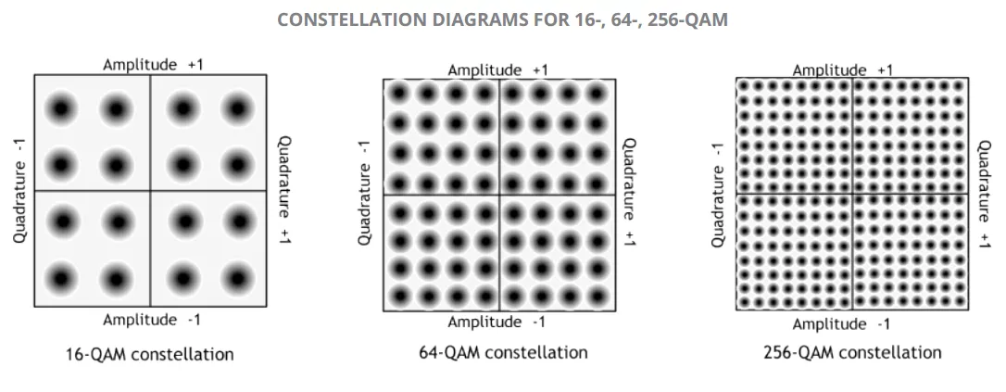
Increased link efficiency
Increased tone density
Squeeze more tones in around DC and edge
Frequency domain
(~5% gain)
VHT
HE
FFT window
VHT
GI
DATA
GI
DATA
GI
DATA
GI
DATA
GI
DATA
…
Guard interval (GI) overhead reduced
Time domain
(~15% gain)
4 times
HE
GI
DATA
GI
DATA
…
Modulation
(~25% gain)
+ 1024-QAM

Slide 29
Improved outdoor operation
Operates in higher delay spread channels than 11ac:
  11ac GI options: 0.4 µs and 0.8 µs
  11ax GI options: 0.8 µs, 1.6 µs and 3.2 µs
  GI overhead mitigated with longer OFDM symbol
Preamble includes repeated L-SIG
Extended range preamble includes repeated HE-SIG-A
Dual carrier modulation improves robustness in Data field

Slide 30
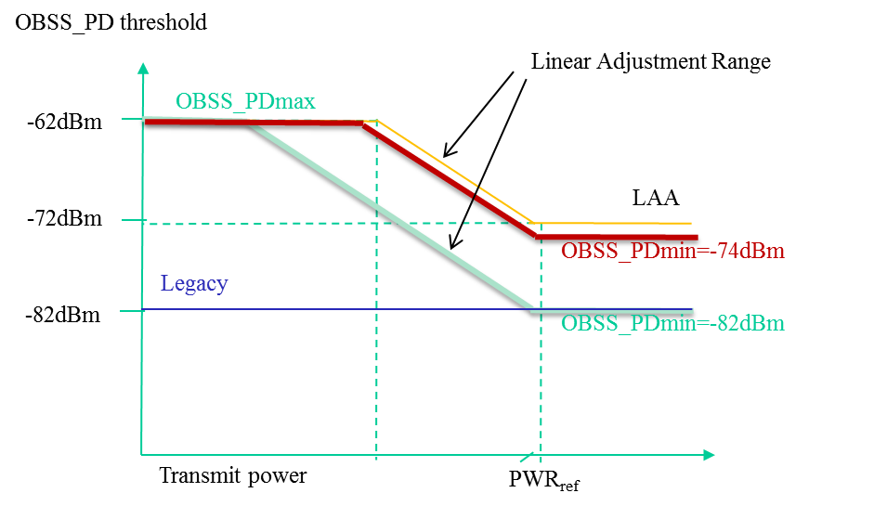

Increase spatial reuse
Adjust CCA threshold based on transmit power of device
  A device with low transmit power causes less interference than a device with high transmit power
  CCA threshold is for OBSS traffic
  BSS Color in the PHY header allows the identification of intra-BSS and Inter-BSS PPDUs

Slide 31
Data exchange sequences:
Multi-user downlink
Preamble
DL Data (STA 1)
BAR
BAR
:
VHT
DL Data (STA 4)
BA STA #1
BA STA #2
BA STA #4
Preamble
DL Data (STA 1)
:
HE
DL Data (STA 4)
BA STA #1
BA STA #2
: :
BA STA #n
In a VHT DL MU sequence acknowledgements are serialized
In an HE DL MU sequence acknowledgements are allocated UL resources and transmitted simultaneously

Slide 32
Data exchange sequences:
Multi-user uplink
DL BA (STA 1)
DL BA (STA 2)
DL BA (STA n)
VHT
UL Data (STA 1)
UL Data (STA 2)
UL Data (STA n)
Trigger
Multi-STA BA
(STA 1-n)
HE
Preamble
UL Data (STA 1)
:
Data (STA n)
In a VHT UL sequence, STAs compete for medium access and send sequentially
In an HE UL sequence, the AP triggers simultaneous transmissions in multiple STAs

Slide 33
Wake up Radio
802.11ba

Slide 34


Purpose
IEEE 802.11ba improves energy efficiency of IEEE 802.11 stations while maintaining low latency
IEEE 802.11ba solves the following problems
Internet
Internet
AP buffers data until the 802.11 station wakes up
→ Long latency
data
Buffer
data
Do you have data for me?
Buffer
Do you have data for me?
No
Do you have data for me?
802.11 radio needs to wake up periodically to receive data within a latency requirement → high power consumption of 802.11 station
No
No
Awake
Awake
802.11 station
802.11 station
Sleep
Sleep
Short sleep interval
Long sleep interval

Slide 35

Wake-up Radio Operation
Transmission range
or
Data
Packet
802.11 = LP-WUR
Transmitter
Receiver
802.11
802.11
802.11
802.11
OFF
ON
OFF
+
ON
802.11
Wake-up
Packet
Wake-up signal
LP-WUR
ON
Extremely low power
receiver design
- Small and simple demodulator
(e.g. On-off keying)

Slide 36
Scope Defined in the PAR
This amendment defines a physical (PHY) layer specification and defines modifications to the medium access control (MAC) layer specification that enables operation of a wake-up radio (WUR)
The wake-up frames carry only control information
The reception of the wake-up frame by the WUR can trigger a transition of the primary connectivity radio out of sleep
The WUR is a companion radio to the primary connectivity radio and meets the same range requirement as the primary connectivity radio
The WUR devices coexist with legacy IEEE 802.11 devices in the same band
The WUR has an expected active receiver power consumption of less than one milliwatt

Slide 37
Timeline
2017
  January: TGba formation meeting
  November: TGba Draft 0.1 (initial draft spec)
2018
  March: TGba Draft 1.0
  (first draft spec)
  September: TGba Draft 2.0
2019
  March: MDR (mandatory document review)
  July: formation of sponsor ballot pool
  September: Sponsor ballot
2020
  July: RevCom
2017
2018
2019
2020
10 mo.
4 mo.
6 mo.
Jan.‘17
- TGba formation
We are here
Nov.‘17
- TGba D0.1
Mar.‘18
- TGba D1.0
Sep.‘18
- TGba D2.0
Mar.‘19
- MDR
Jul.‘19
SB pool
formation
Sep.‘19
SB
Jul.‘20
RevCom

Slide 38
Light Communications
LC TIG

Slide 39
The LC Topic Interest Group (TIG) aims to create a draft report that will outline the technical and economic feasibility
  IEEE 802.11 created a “topic interest group” to determine the technical and economic feasibility of using Light Communications.
  This part of the tutorial is a “taster” for a full-length tutorial in July 2017, which should align with when the LC TIG has completed its work.
  The first sessions of the LC TIG were attended by over 45 participants
  A draft report outline was adopted and some of the initial technical components were added.
  The TIG decided that a liaison statement should be drafted for consideration by the 802.11 WG that can be sent to the relevant stakeholders in the LC space, including lighting industry associations and others.

Slide 40
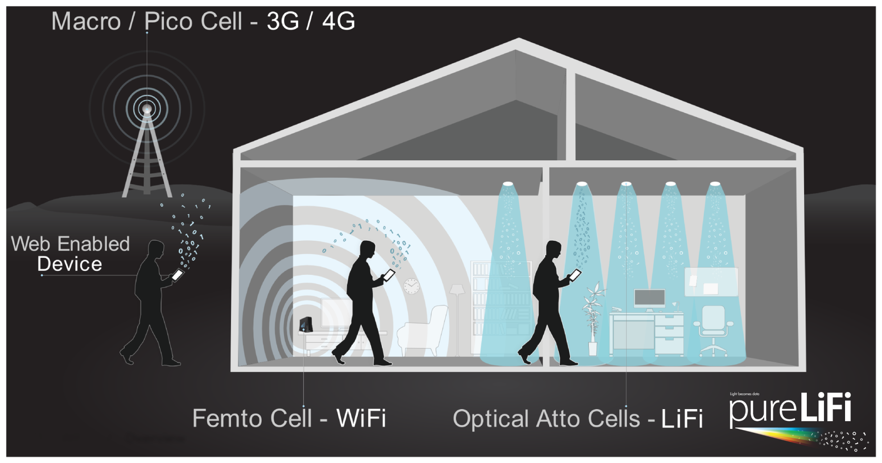
LC (Light Communications) is high speed, bidirectional and networked wireless communications using light

Slide 41
Light Communications (LC) may expand the reach of IEEE 802.11 into new applications and markets
  LC is high speed, bidirectional and networked wireless communications using light. It provides users with similar functionality as other 802.11 solutions, including multiple access and handover, except that it uses the light spectrum.
  Application areas include:
    Enterprise and home wireless deployments to provide increased security, data rates and complementary capacity,
    IoT exploitation due to improved security and localized communications.
  Market research indicates that LC will become a $75 billion industry by 2023. What is hoped to be minimal changes to the existing 802.11 protocols will increase their reach into this new market.
  Over 1 Billion LED lights sold annually with 13% CAGR
  LC has comparable computational energy efficiency to existing 802.11. For “downlink”, the energy already required for illumination is used for LC communications.

Slide 42
Useful Links
802.11 home page: http://ieee802.org/11/
Help if you want to contribute: http://www.ieee802.org/11/help.html
802.11 document server: https://mentor.ieee.org/802.11/documents
Wi-Fi Alliance http://www.wi-fi.org/
Get 802.11 standards:
  http://standards.ieee.org/about/get/802/802.11.html
  http://www.techstreet.com/ieee

Slide 43
Backup
The intention is to keep useful material not relevant to this specific presentation here so that the deck can be restructured for different audiences.

Slide 44
Fast facts about 802.11 / Wi-Fi
2 Mbps to >1 Gbps in 15 years
5 M chipsets per day
38 Billion connected devices by 2020
Average of 8 connected devices per household
$222 B in economic value / yr
60% of mobile traffic uses Wi-Fi
70% of all internet traffic uses Wi-Fi
Source: Wi-Fi Alliance & various

Slide 45
IEEE 802.11 Organization
IEEE 802.11 is a working group, responsible for writing Wireless Local Area Network (LAN) standards
802.11 operates under
  The “Sponsor”: IEEE LMSC “LAN / MAN Standards Committee” – aka “802”
  IEEE Computer Society
  IEEE-SA Standards Board
Work in 802.11 is divided into various activities
  Task groups – one per approved standard or amendment to be developed
  Study groups or topic interest groups – the precursor to a task group that investigates marketability, feasibility and determines initial requirements
  Various standing committee's responsible for ongoing work, such as “Architecture”

Slide 46
PHY Project Sequence
100 Gbps
10 year
yardstick
10 Gbps
1 Gbps
100 Mbps
802.3
10 Mbps
1 Mbps
802.11
100 Kbps
80
85
90
95
00
05
10
15

Slide 47
802.11 Architecture Overview
Multiple Over the Air PHY options
One common MAC based on CSMA/CA + PHY-specific derivatives
a
b
g
n
ac
ad
af
ah
ax
ay
802.11 MAC + derivatives

Slide 48
STANDARDS PROCESS

Slide 49
IEEE-SA Individual and Corporate Standards Development
Open, consensus-based process
Open – anybody can participate (payment of meeting fees may be needed)
Individual standards development
  Each individual has one vote
Corporate standards development
  One company/one vote
Results frequently adopted by national, regional, and international standards bodies
IEEE 802 uses the “individual membership” process for all of its working groups.

Slide 50

IEEE Standards Development: Develop Draft Standard
A standard is written by a working group
  The working group consists of participants interested in creating the standard
The working group chooses a way to create the first draft document
  The group writes initial draft, or
  The draft developed from existing documents and specifications
Draft document are refined in the working group through multiple iterations and review
Notes:
Some tips for starting the development of your draft include the following:
• Develop an outline that will be used as key clauses.
• Divide up each topic or clause among working group members, preferably according to their experience.
• It is to your advantage to assign a working group member as a technical editor. During the development process, the technical editor will ensure consistency and can gather and incorporate all contributions and comments.
• The working group meetings should only be used for reviewing important points in the draft and resolving areas of disagreement.
• Working with an IEEE Project Editor will expedite the project since the editor can flag items that could otherwise be slowed down by the IEEE-SA Standards Board during the approval process.
• Use the IEEE Standards Style Manual as the reference for document structure.

Slide 51
IEEE Standards Development: Consensus process
Consensus is determined through a ballot
Interested individuals or organizations are invited to ballot on draft standards (IEEE 802 uses the “individual membership” process)
A ballot group receives document, reviews it, and votes/comments on it
  Vote yes (approve), no (disapprove), abstain
  Can offer comments on document as well
Ultimate approval of standard is granted by the IEEE-SA Standards Board
Notes:
• The sponsor forms the balloting group. In some cases, this may involve using the membership of an active committee or committees; in other cases, this may involve inviting a wide variety of interested parties to participate.
• The sponsor also approves the balance of the group. No one interest group can be more than 33%.
• Once the balloting group is formed, the composition of that balloting group cannot change until the close of the ballot.
• The IEEE-SA now allows three types of ballot groups: one made up of individuals, one made up of Entities (persons who are representing an Entity), and one made up of both of these types of ballots. See the IEEE-SA Standards Board Operations Manual for details of these balloting processes.

Slide 52
IEEE Standards Development: Project Authorization
A project may be started by any individual or company
Each project must be supported by a technical group in the IEEE
  Referred to as a “Sponsor”
  Official developer of standard
Projects approved through document called Project Authorization Request (PAR)
  Summarizes details of project
Notes:
Approval of a PAR means that the work is authorized by the IEEE-SA Standards Board
The PAR is the means by which IEEE can extend the umbrella of indemnification (or protection) to its standards developers

Slide 53
IEEE Standards Development: Process Flow
Decide / Choose Technology
Write / update a Draft
Ballot Draft
Idea!
Resolve Comments
Done?
Typical project lifetime: 4 years
Project Approval Process
Develop Draft Standard
(in Working Group)
Sponsor Ballot
IEEE-SA Standards Board Approval Process
Publish Standard
Revise or Withdraw Standards
Maximum of 10 years
Notes:
This chart illustrates the whole standards process in simplified form.
Idea: The idea for a standard is usually developed by a group of people, and the responsibility for the idea is assumed by the sponsor. The sponsor is usually a society or an existing standards committee.
Project Approval Process: This idea is then transferred onto a form called the Project Authorization Request (PAR) and submitted to the New Standards Committee (NesCom) for approval.
Develop draft standard: The draft is then developed and revised by the working group.
Ballot draft: When the draft work is finalized, the sponsor forms the balloting group and ballots the standard.
Standards Board Approval: After your ballot has achieved consensus, the draft then goes to the Review Committee (RevCom) and the Standards Board for approval. The amount of time from PAR to Board approval is 4 years (an extension can be made if absolutely necessary).
Publish Standard: The draft is then edited and formatted by an IEEE Project Editor and published.
The standard is valid for 10 years before it must be revised or withdrawn.

Slide 54
IEEE Standards Development: Publication & Maintenance
Standard published after approval
Standard is valid for 10 years after approval
  After 10 years, must be revised or withdrawn
Notes:
Once your standard has been approved, it will receive a thorough, detailed edit from an IEEE Standards editor. The editor does not make any technical changes, thereby ensuring the technical integrity of the document.
It is also the role to the editor to format the text in accordance with IEEE Standards Style. A draft copy is then provided to the committee for final review. Appropriate editorial corrections are then made and the standard is published.
Complimentary copies are then issued to the working group and awards are given to the Chair of the working group in recognition of the work done.

Slide 55
Other activities
Status of other activities not presented in detail

Slide 56
Other subgroups of 802.11
WNG – wireless next generation. Talking shop and incubator of what we do next. Anybody attending the meeting can request agenda time to present their idea.
JTC1 – Standing Committee of 802. Manages interactions with ISO/IEC JTC1/SC6.
PAR – Standing Committee to review IEEE 802 PARS and provide 802.11 working group feedback.

Slide 57
Architecture Standing Committee (ARC) Overview
Models for STA architecture and related concepts, and overall system architecture, included in the Standard in clauses 4 and 5, generally.
Evolution of the models, either to consider amendments to the Standard, or as clarification is needed
Define how 802.11 technologies fit into 802, 802.1 use cases.
Define MIB and management conventions

Slide 58
TGaj Purpose
  This amendment defines modifications to the IEEE P802.11ad Physical (PHY) layer and the Medium Access Control (MAC) layer to enable operation in the Chinese 59-64 GHz frequency band.
  The amendment maintains backward compatibility with 802.11ad when it operates in the 59-64 GHz frequency band.
  The amendment also defines modifications to the PHY and MAC layers to enable the operation in the Chinese 45 GHz frequency band. The amendment maintains the 802.11 user experience.

Slide 59
TGaj Progress
Started as a study group in January 2012
Has a stable draft, near the end of its Working Group ballot phase.

Slide 60
TGak Purpose
This amendment enables an 802.11 connection to be used as a through link in a general network, not just as a connection to an end station at the edge of a network.
Fully general mixed 802.11 and wired plug and play in the home.
Data Center top-of-rack to top-of-rack connections for overflow traffic.
Industrial and Enterprise network use.

Slide 61
TGak Progress
General Link study group started in September 2012
Task group is near the end of its Working Group letter ballot with a stable draft.
This amendment changes 802.11’s architectural view of the rest of the network, and vice versa. It has involved collaboration with 802.1 and 802.11’s architecture standing committee.

Slide 62
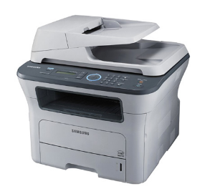



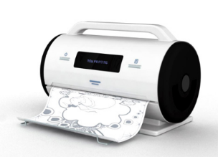
TGaq Purpose
This amendment enables delivery of pre-association Service Discovery information by IEEE 802.11 stations (STAs).
Printer discovery in a hotel
Pre-association protocol designed to discover services on a WLAN
Started November 2012
TGaq has a stable draft, and passed initial sponsor ballot in November 2016.

Slide 63
TGaq Technical Highlights
Container MAC protocol to carry upper layer service discovery protocols (e.g. UPnP, Bonjour)
Provisioning and configuration of services in the access point
  Service Transaction Proxy is a logical element connected to the access point
Universal identification of services
  Using a hash name
  Provide service attributes (e.g. 3D printer capability or point of sale service)
Currently considering request/response or broadcast concept

Slide 64
TGay Purpose
Expected to develop mode of operation capable of supporting a maximum throughput of at least 20 gigabits per second (measured at the MAC data service access point), while maintaining or improving the power efficiency per station.
Project Authorization Request (PAR) | 11-14/1151r8
Critera for Standards Development (CSD) | 11-14/1152r8

Slide 65
TGay use cases and requirements
Use cases fall under the following categories
  Access: tri-band Wi-Fi, high-speed cellular offload, roaming
  Cable replacement: ultra-short range comms, office docking, wireless AV (4K and 8K displays), etc.
  Backhaul/fronthaul
Two types of environments
  Indoor: access and cable replacement
  Outdoor: access and backhaul/fronthaul
Both LOS and NLOS channels

Slide 66
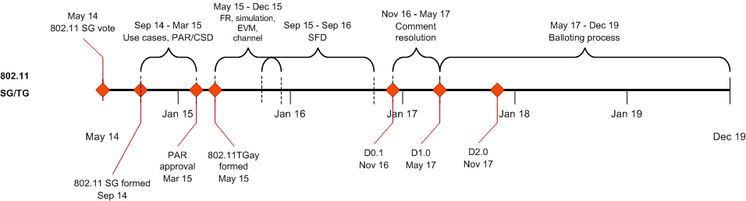
TGay Progress
The task group is part way through writing a specification framework document and is seeking agreement on channel models.

Slide 67
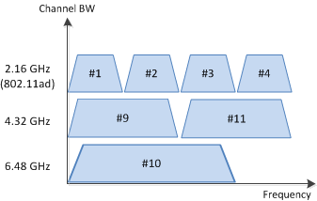
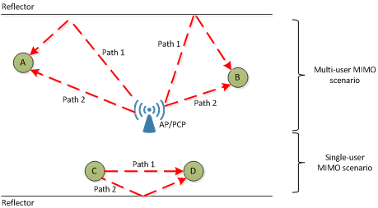
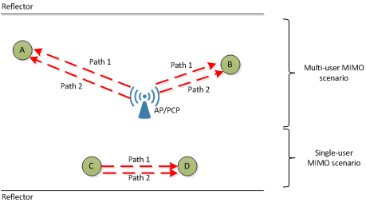
TGay Key technological enhancements
Channel bonding requires new:
  Channelization
  Packet format
  Channel access
SU and downlink MU MIMO
  Distribute capacity across users
  Unique requirements given directionality
  Exploit antenna polarization
  Changes to the beamforming protocol
Example without polarization
Example with polarization

Slide 68
TGay Progress
Initial Task Group Meeting May 2015
A partial draft (D0.1) exists. Task group is working to fill in the holes before performing an internal review.

Slide 69
TGay Technical highlights
Current generation 60 GHz (802.11ad) achieves 7Gbps
Next Generation 60 GHz increases throughput, range and reliability
Technical approaches include channel bonding and MIMO

Slide 70
TGaz
IEEE Std 802.11-2007 includes support for timing measurement.
IEEE Std 802.11-2016 includes “fine timing measurement” that allows location to determined to ~3m using 802.11n/802.11ac.
The Next Generation Positioning study group will improve location accuracy and scalability and will consider new usages such as directionality and ranging
Project Authorization Request (PAR) | 11-15/30r8
Critera for Standards Development (CSD) | 11-15/262r4

