Slide 1
Coexistence Analysis of ED Threshold Levels
- Overview of Discussion in PDED Adhoc -
Date: 2017-03-13
Authors:
Name | Affiliation | Address | Email
Kosuke Aio | Sony |  | Kosuke.Aio@sony.com
Ryuichi Hirata
Yusuke Tanaka
Yuichi Morioka

Slide 2
Introduction
IEEE 802.11 WG established the “PDED adhoc” to consider potential response to 3GPP RAN1’s request to change WLAN’s ED threshold from
-62dBm to -72dBm
IEEE802.11-16/1291r0 [1] suggests three experiments (by simulation and/or testing) to provide the basis to respond to the 3GPP RAN1 request;
(1) What happens if all Wi-Fi uses ED of -72dBm
(2) What happens if some Wi-Fi uses ED of -72dBm
(3) What happens if both LAA and Wi-Fi operate at ED of -72dBm but with no PD communication
So far, we provided some simulation data to analyze the impact of the change in ED threshold
  In case of (2) at the November 2016 meeting
  In case of (3) at the January 2017 meeting

Slide 3
Recap
Summary of our contribution at the November 2016 meeting
  IEEE802.11-16/1451r0 : Simulation Analysis of ED Threshold Levels [2]
  Difference of ED thresholds makes performance of Ax WLAN worse in case of coexistence of Ax WLAN with ED threshold of -72dBm and legacy WLAN with ED threshold of -62dBm
Summary of our contribution at the January 2017 meeting
  IEEE802.11-17/0062r0 : Simulation Analysis of ED Threshold Levels in WLAN and LAA coexistence scenario [3]
  Some advantages in LAA medium access protocol makes performance of Ax WLAN worse in case of coexistence of LAA and Ax WLAN with ED threshold of -72dBm (but this was not sufficient and additional analyses are shown in this contribution)
Both simulation results showed that changing the ED threshold of future WLAN will degrade its performance

Slide 4
Feedback Summary
We received some feedback during and after the meetings as follows;
  (A) Why do the results show unequal performance of inner/outer BSSs?
    It may be caused by the initialization process of the simulation
    It may be caused by the too few Monte Carlo drops. 20 is not sufficient
    It may be caused by the asymmetric position of the BSSs
  (B) Why are throughput of WLAN and LAA different in spite of same ED?
    The value of 802.11 APs CWmax should be 63 (same as LAA)
    Are there differences in the channel access mechanism that cause difference?
    Are there differences in PD mechanism that cause difference?
In this presentation, we provide updated simulation results incorporating these feedback, and summarize technical analysis of ED threshold

Slide 5
Simulation 1
Confirmation of Feedback

Slide 6
Default Simulation Scenario
Simulation scenario is based on 3GPP TR 36.889 [3]
  Indoor scenario for LAA coexistence evaluations within unlicensed band
From next slide, we reviewed the parameters in red
 | LAA | Ax WLAN
Active Nodes | BS x 4, MS x 20 | BS x 4, MS x 20
Traffic Model | DL : FTP model 1 UDP (Appendix.1) / UL : No Traffic
Channel Access Parameter (Appendix.2) | CW_{min}=15, CW_{max}=63, m=3 | CW_{min}=15, CW_{max}=[63, 1023] AIFSN=3
MCS | 4 (Fixed)
Freq. /BW [MHz] | 5,180 / 20
Max TX Power [dBm] | BS:+18, MS:+18 | BS:+18, MS:+18
Antenna Gain [dBi] | BS:+5, MS:0 | BS:+5, MS:0
Detect Th [dBm] | (PD,ED) = (NA, -72) | Default Setup (PD,ED) = (-82, -62) (2) 3GPP Requested Setup (PD,ED) = (-82, -72)
<Layout of Nodes>
120m
5m
30m
50m
Blue is LAA BS (eNB).
Green is Ax WLAN BS (AP).
WLAN and LAA Mobile Stations (MS) are dropped randomly in this area. ([20, 100] drops)
Note : 11ax and LAA features such as OFDMA /Multi-user /HARQ are not enabled in this simulation to see the pure performance of channel access.

Slide 7
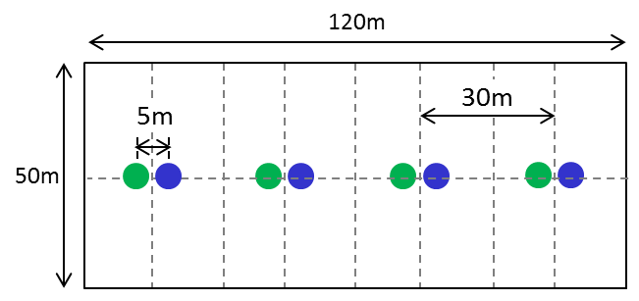
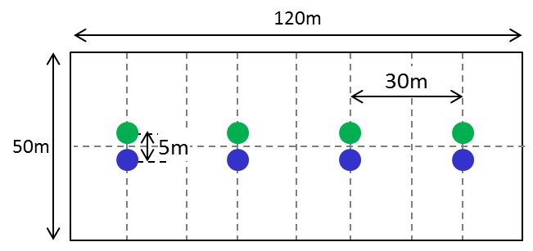
(A) Review of the Simulation Scenario
  We reviewed the simulation scenario to get equal performance of the inner/outer BSSs
  Considering some feedback, we compared simulation results in these two scenarios (Other parameters are as described in Slide 6)
Scenario | Traffic Start Time | Num. of Drops | Layout | Note
(A1) | fixed | 20 | Asymmetric | Same setup as Jan. meeting
(A2) | random | 100 | Symmetric
(Asymmetric)
(Symmetric)
Blue is LAA BS (eNB).
Green is Ax WLAN BS (AP).

Slide 8
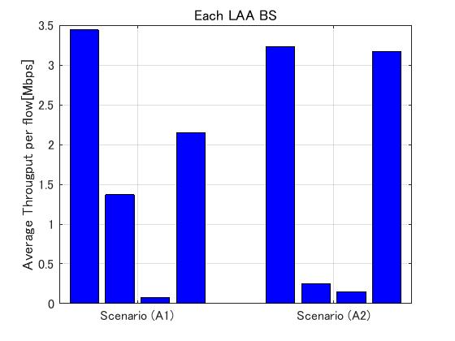
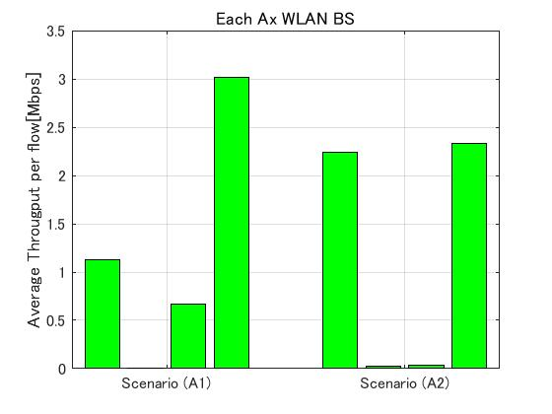
(A) Review of the Simulation Scenario
Each BS Ave. DL Throughput per flow [Mbps]
By incorporating all feedback, throughputs of the inner/outer BSSs became almost comparable
Therefore, we use “Scenario (A2)” for the following simulation

Slide 9
(B) Analysis of difference between LAA & WLAN
  We analyze the reason why throughput of WLAN and LAA are different when WLAN changes ED to -72dBm same as LAA
  Considering some feedback, we compared simulation results in these four setups
Setup | WLAN AP CWmax value | LAA Channel Access Model (*1) | WLAN PD [dBm] | Note
(B1) | 63 | LAA | -82 | Default setup
(B2) | 1023 | LAA | -82 | For identifying the effect of different CW max value (same as Jan. meeting)
(B3) | 63 | WLAN | -82 | For identifying the effect of different channel access model
(B4) | 63 | LAA | -72 | For identifying the effect of different detection rule for the same system signal (PD)
(*1) In this column,
・“LAA” means LAA Channel Access Model described in 3GPP TS 36.213 V14.0.0 [7] (Appendix.2)
・“WLAN” means that LAA Channel Access Model is the same as WLAN

Slide 10
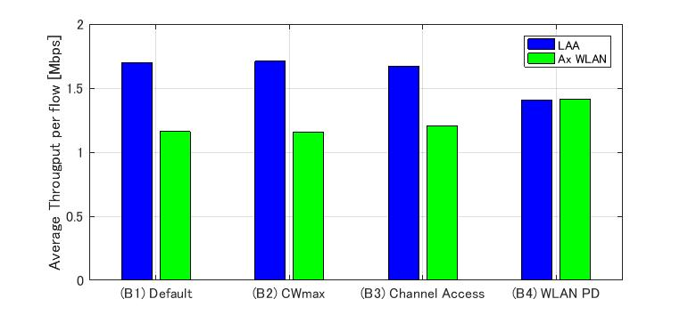
(B) Analysis of difference between LAA & WLAN
Each BS Ave. DL Throughput per flow [Mbps]
Only “Setup (B4)” showed throughput of LAA & WLAN become comparable
The different detection rule for the same system signal (i.e. how LAA detects other LAA signals) causes this different performance between LAA & WLAN, not channel access model

Slide 11
Simulation 2
Updated simulation results on
“What happens if some Wi-Fi uses ED of -72dBm ”

Slide 12
Simulation Scenario
In this simulation, we set 802.11 devices : Legacy WLAN and Ax WLAN
  Simulation scenario is based on 3GPP TR 36.889 [4] : Indoor scenario for LAA coexistence evaluations within unlicensed band
<Layout of nodes>
 | Legacy WLAN | Ax WLAN
Active Nodes | BS x 4, MS x 20
Traffic Model | DL : FTP model 1 UDP (Appendix.1) / UL : No Traffic
Channel Access Parameter | CW_{min}=15, CW_{max}=63, AIFSN=3
MCS | 4 (Fixed)
Freq. /BW [MHz] | 5,180 / 20
Max TX Power [dBm] | BS:+18, MS:+18
Antenna Gain [dBi] | BS:+5, MS:0
Detect Th [dBm] | (PD,ED) = (-82, -62) | Default Setup (PD,ED) = (-82, -62) (2) 3GPP Requested Setup (PD,ED) = (-82, -72)
120m
30m
50m
5m
Orange is Legacy WLAN BS (AP).
Green is Ax WLAN BS (AP).
Each WLAN Mobile Stations (MS) are dropped randomly in this area. (100 drops)
Note : 11ax features such as OFDMA /Multi-user are not enabled in this simulation to see the pure performance of channel access.

Slide 13
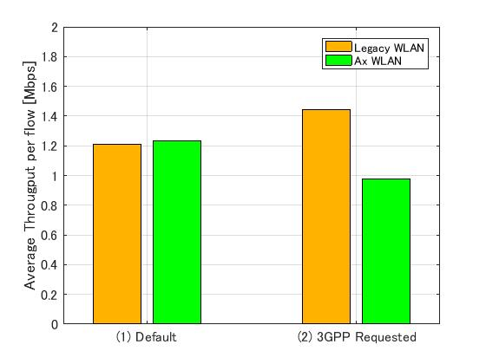
Simulation Result
Ave. DL Throughput per flow [Mbps]
Setup | Legacy WLAN | Ax WLAN
(1) | 1.21 Mbps | 1.23Mbps
(2) | 1.45 Mbps | 0.98Mbps
Default Setup
Ax WLAN : (PD,ED) = (-82, -62)
(2) 3GPP Requested Setup
Ax WLAN : (PD,ED) = (-82, -72)
If Ax WLAN changes ED to -72dBm, performance of Ax WLAN degrade and become lower than that of legacy WLAN due to different ED threshold

Slide 14
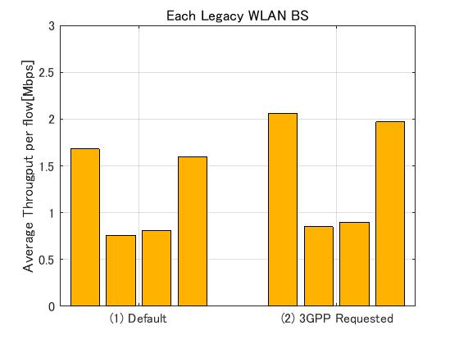
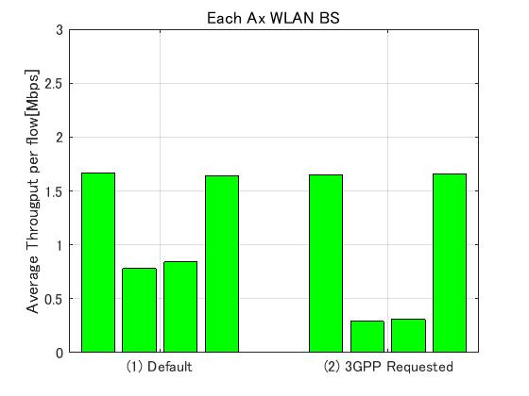
Simulation Result
Each BS Ave. DL Throughput per flow [Mbps]
If Ax WLAN changes ED to -72dBm, performance of inner Ax WLAN BSSs degrade due to improving performance of outer legacy WLAN BSSs
Ave. DL throughput of the inner/outer BSSs are almost equal

Slide 15
Simulation 3
Updated Simulation results on
“What happens if both LAA and Wi-Fi operate at ED of -72dBm but with no PD communication”

Slide 16
Simulation Scenario
In this simulation, we set LAA and Ax WLAN
  Simulation scenario is based on 3GPP TR 36.889 [4] : Indoor scenario for LAA coexistence evaluations within unlicensed band.(Same as previous)
<Layout of nodes>
 | LAA | Ax WLAN
Active Nodes | BS x 4, MS x 20 | BS x 4, MS x 20
Traffic Model | DL : FTP model 1 UDP (Appendix.1) / UL : No Traffic
Channel Access Parameter (Appendix.2) | CW_{min}=15, CW_{max}=63, m=3 | CW_{min}=15, CW_{max}=63, AIFSN=3
MCS | 4 (Fixed)
Freq. /BW [MHz] | 5,180 / 20
Max TX Power [dBm] | BS:+18, MS:+18 | BS:+18, MS:+18
Antenna Gain [dBi] | BS:+5, MS:0 | BS:+5, MS:0
Detect Th [dBm] | (PD,ED) = (NA, -72) | Default Setup (PD,ED) = (-82, -62) (2) 3GPP Requested Setup (PD,ED) = (-82, -72)
120m
30m
50m
5m
Blue is LAA BS (eNB).
Green is Ax WLAN BS (AP).
WLAN and LAA Mobile Stations (MS) are dropped randomly in this area. (100 drops)
Note : 11ax and LAA features such as OFDMA /Multi-user /HARQ are not enabled in this simulation to see the pure performance of channel access.

Slide 17
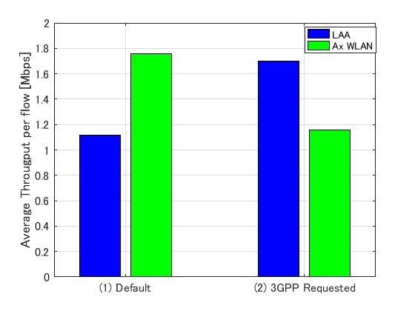
Simulation Result
Ave. DL Throughput per flow [Mbps]
Setup | LAA | Ax WLAN
(1) | 1.12Mbps | 1.76Mbps
(2) | 1.70Mbps | 1.16Mbps
Default Setup
Ax WLAN : (PD,ED) = (-82, -62)
(2) 3GPP Requested Setup
Ax WLAN : (PD,ED) = (-82, -72)
If Ax WLAN changes ED to -72dBm, performance of Ax WLAN degrade and become lower than that of LAA due to different detection rule for the same system signal (PD) as I mentioned in Slide 10

Slide 18
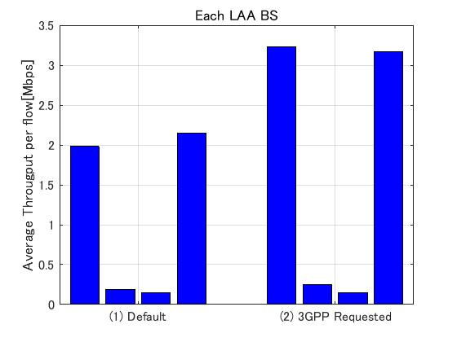
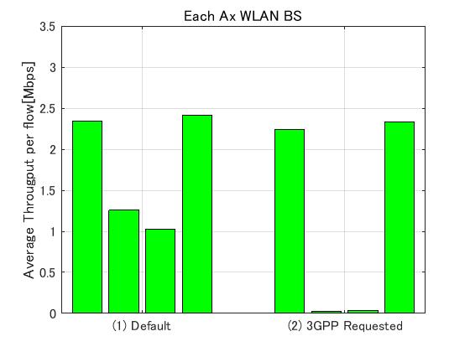
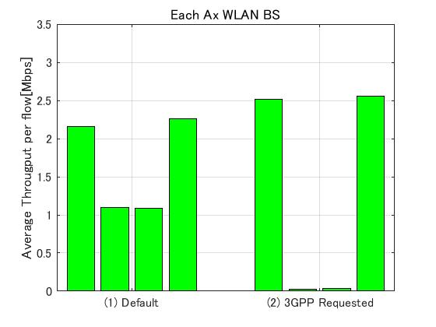
Simulation Result
Each BS Ave. DL Throughput per flow [Mbps]
If Ax WLAN changes ED to -72dBm, performance of inner Ax WLAN BSs degrade due to improving performance of outer LAA BSs
Ave. DL throughput of the inner/outer BSSs are almost equal

Slide 19
Conclusion
We confirmed the simulation results incorporating feedbacks and updated simulation scenario and parameters
  By reviewing initial parameters, number of drops and layout of nodes, we observed equal performance of the inner/outer BSSs
  We identified that different detection rule for the same system signal (i.e. how LAA detects other LAA signals) causes different performance between LAA and WLAN
We updated simulation results that confirm that changing the ED threshold to -72dBm makes Ax WLAN performance worse
  Different ED threshold makes Ax WLAN performance worse in the case of coexistence of Ax WLAN and Legacy WLAN
  Different detection rule for the same system signal makes Ax WLAN performance worse in the case of coexistence of Ax WLAN and LAA

Slide 20
Future Works
We concluded that if future WLAN changes the ED threshold to -72dBm it could have detrimental effect on its performance
However, we should consider the possibility for future WLAN be excluded from the exceptional treatment in EN 301 893, where the ED threshold of -62dBm may not be maintained
  If LAA adopts WLAN Preamble Detection as IEEE requested, it may balance out the performance of the two systems, but we should also consider the case if 3GPP does not accept our request
We should continue our investigation on the effects of intersystem coexistence and develop techniques to mitigate any negative impact

Slide 21
References
[1] 11-16-1291-00-0000-pded-ad-hoc-agenda-27-sept-2016
[2] 11-16-1451-00-0000-Simulation-Analysis-of-ED-Threshold-
Levels
[3] 11-17-0062-00-0000-Simulation Analysis of ED Threshold Levels in WLAN and LAA coexistence scenario
[4] 3GPP TR 36.889 V13.0.0
[5] R1-156621(Coexistence Simulation Results for DL-only LAA)
  [6] 3GPP TR 36.814.
[7] 3GPP TS 36.213 V14.0.0 (2016-09)

Slide 22
Appendix

Slide 23
Appendix 1. Traffic Model
We compare between difference ED threshold under the traffic model.
(A) FTP model 1 UDP
  This is default traffic model following 3GPP indoor scenario corresponding to TR36.889 [4].
  file size : 0.5Mbyte, lambda : 2.5
  This traffic model is used in the simulation on R1-156621 (Coexistence Simulation Results for DL-only LAA) [5].
  This FTP model is described in 3GPP TR 36.814 [6].
  This is regarded as heavy traffic, but isn’t as full buffer.

Slide 24
Appendix 2. LAA channel access model [7]
Need to TX?
Initial CCA
Yes
Channel idle for T_{d}?
Yes
Transmit
No
Generate random number
N out of [0,CW]
Update CW
based on
HARQ-ACK
Extended CCA
Channel idle for T_{d}?
No
Yes
N=0?
Yes
T_{d}=16 μs+m_{p}*T_{sl}
T_{sl}=9 μs
No
N=N-1
No
Channel idle for T_{sl}?
Yes

Slide 25
Appendix 3. LAA ED rule
Excerpt from 3GPP TS 36.213[7]/15.2.3.1 “Default maximum energy detection threshold computation procedure”
If the higher layer parameter ‘absenceOfAnyOtherTechnology-r14’ indicates TRUE:
Eq(1)
otherwise
Eq(2)

Slide 26
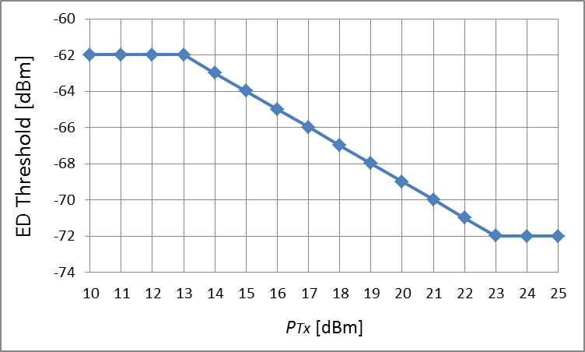
Appendix 3. LAA ED rule
In that case of WLAN and LAA coexistence, LAA’s ED threshold is calculated by Eq(2).
If BW = 20MHz, LAA’s ED threshold is as follows.

Slide 27
Appendix 3. LAA ED rule
According to LAA’s ED rule in 3GPP TS 36.213 [7], LAA can control ED threshold by maximum output power. (Appendix.2)
However, the ED threshold is static once maximum output power is selected
  Maximum output power is determined by rated output power declared by the manufacturer, and it can not change during operation
Therefore, LAA’s and WLAN’s ED threshold in this simulation is as follows.
  LAA’s ED is set to -72dBm (fixed) because LAA BS’s maximum output power is 23dBm including antenna gain.
  In (1) Default Setup, WLAN’s ED threshold is set to -62dBm (fixed).
  In (2) 3GPP Requested Setup, WLAN’s ED threshold is set to -72dBm (fixed) for the same reason as LAA’s BS.

Slide 28
Appendix.4 Detection rule for the same system
WLAN have PD (-82dBm/20MHz) detecting the other WLAN signal to prevent collision and achieve high SINR.
LAA don’t have PD, but have only ED (-72dBm/20MHz) detecting the other LAA signal in 3GPP TR 36.889 V13.0.0 [4].
  LAA BS don’t need to receive unlicensed band signal because LAA MS can’t transmit any signal in unlicensed band.
  LAA MS don’t need to receive unscheduled signal because LAA MS always receive schedule information BS transmitting in licensed band before LAA BS transmit downlink signal.
This different detection rule for the same system makes different performance between LAA & Ax WLAN when Ax WLAN change ED threshold to -72dBm.

Slide 29
Appendix.4 Detection rule for the same system
For example, what happens when AP1 starts to transmit in this scenario?
There is unfairness between LAA and WLAN because Only eNB4 can get opportunity to transmit.
  All of other WLAN BSs change “BUSY” because received power is over PD threshold : -82dBm/20MHz.
  LAA BSs without eNB4 change “BUSY” because received power is over ED threshold : -72dBm/20MHz.
There is no advantage of high sensitivity of PD because STA1’s SINR degrade due to collision with eNB4’s signal.
RSSI of AP1’s signal = -72dBm
STA1
RSSI of AP1’s signal = -82dBm
AP1
AP3
AP2
AP4
eNB1
eNB2
eNB3
Blue is LAA BS (eNB)
Green is Ax WLAN BS (AP).
means BUSY.
eNB4

Slide 30
Appendix.5 Additional Simulation
In this simulation, we set LAA & Ax WLAN & Legacy WLAN .
  Simulation scenario is based on 3GPP TR 36.889 [4] : Indoor scenario for LAA coexistence evaluations within unlicensed band.
 | LAA | Ax WLAN | Legacy WLAN
Active Nodes | BS x 4, MS x 20 | BS x 4, MS x 20
Traffic Model & Load | DL : FTP model 1 UDP (Appendix.1) / UL : No Traffic
Channel Access Parameter (Appendix.2) | CW_{min}=15, CW_{max}=63, m=3 | CW_{min}=15, CW_{max}=63, AIFSN=3
MCS | 4 (Fixed)
Freq. /Bandwidth [MHz] | 5,180 / 20
Max TX Power [dBm] | BS:+18, MS:+18 | BS:+18, MS:+18
Antenna Gain [dBi] | BS:+5, MS:0 | BS:+5, MS:0
Detect Th [dBm] | (PD,ED) = (NA, -72) | Ax : (1)&(2), Legacy : (1)only Default Setup (PD,ED) = (-82, -62) (2) 3GPP Requested Setup (PD,ED) = (-82, -72)
<Layout of nodes>
120m
30m
2.5m
50m
Blue is LAA BS (eNB).
Green is Ax WLAN BS (AP).
Orange is Legacy WLAN BS (AP).
WLAN and LAA Mobile Stations (MS) are dropped randomly in this area. (100 drops)

Slide 31
Appendix.5 Additional Simulation
Average Throughput [Mbps]

