Slide 1
WUR Phase Noise Model
Follow-Up
Date: 2017-3-6
Authors:

Slide 2
Abstract
This is a follow-up presentation on the phase noise model of a wake-up receiver [1]
This presentation proposes a phase noise model for 802.11ba that takes into account the power consumption of a wake-up receiver

Slide 3
Re-cap of [1]
The power consumption target for a wake-up receiver is much lower than a legacy 802.11 STA
  WUR SG PAR [802.11-16/1045r9]:
  “The WUR has an expected active receiver power consumption of less than one milliwatt”
In 802.11, a simple phase noise model proposed in [802.11-04/224r1] has been used for a legacy 802.11 STA but without any constraint on power consumption
  With this model, the power consumption of a local oscillator (LO) may consume more than 1 mW
  This model should be used for the transmitter of a wake-up packet (e.g. AP)
We believe TGba should use a new phase noise model that takes into account the power consumption of LO of a wake-up receiver

Slide 4
Re-cap: Minimum Phase Noise of a Ring Oscillator
Minimum phase noise of a ring oscillator with the minimum power consumption is shown in [3]:
  Definitions
    PN_{min}: minimum phase noise; P_{min}: minimum power dissipation
    f₀: oscillation frequency; Δf: offset frequency
    k: Boltzmann constant, T: temperature
  [3] Navid, T. H. Lee, R. W. Dutton, “Minimum Achievable Phase Noise of RC Oscillators”, JSSC 2005
(1)

Slide 5
Re-cap: Single-Sideband Phase Noise Spectrum in dBc/Hz
The single-sideband phase noise L(f_{m}) (in dBc/Hz) is expressed as follows for small values of c and for 0 <= f_{m}<< f₀ in [4]
where f_{m}= Δf: offset frequency and L(f_{m})=PN(Δf).
[4] A. Demir, A. Mehrotra, and J. Roychowdhury., "Phase noise in oscillators: a unifying theory and numerical methods for characterization," Transactions on Circuits and Systems I: Fundamental Theory and Applications, vol. 47, no. 5, pp. 655-674, May 2000.
(2)

Slide 6
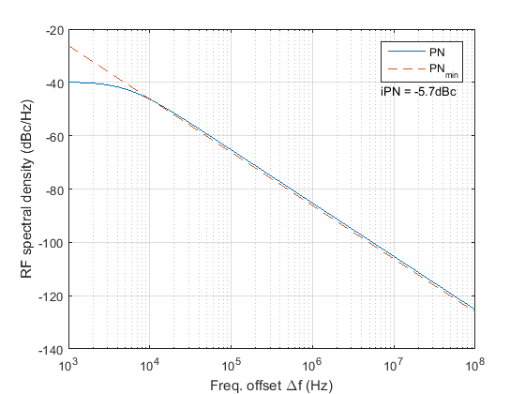
Re-cap: Finding the Constant c for a Given LO Power Consumption
Step 1: Choose power consumption P_{min}
Step 2: Find constant c that makes PN overlap with PN_{min}
Example 1:
  f₀ = 2.437GHz
  PNmin(Δf ) at Pmin=75µW
  PN(Δf ) with c = 0.5e-15
  Integrated PN (iPN) =-5.7dBc
    10 KHz ~ 2 MHz

Slide 7
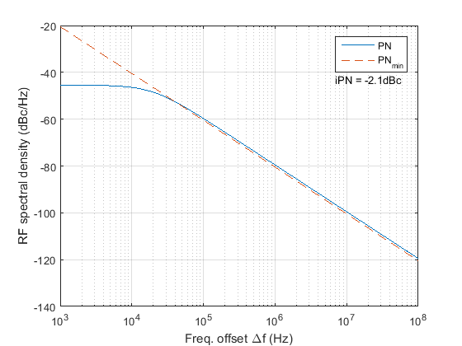
Re-cap
Example 2: P_{min}=20 µW
Parameters
  f₀ = 2.437 GHz
  PN_{min}(Δf ) at P_{min}=20 µW
  PN(Δf ) with c = 1.875e-15
  Integrated PN (iPN) =-2.1dBc
    10 KHz ~ 2 MHz

Slide 8
Discrete Time Phase Noise Model of White Frequency Noise [2]
Ref. [2] describes how to generate phase noise due to the white frequency noise for a discrete time based simulation based on [3,6]:
Definitions
  is the phase noise at index k
  f₀ is the nominal oscillator frequency (i.e. center frequency)
  c is the constant that determines the rate at which the variance of an oscillator increases with time due to the white frequency noise [4]
  is the simulation time-step
  is the independent standard Gaussian random variable
Eq. (3) only considers white frequency noise (i.e. white Gaussian noise)
For the evaluation of 802.11ba receiver performance, add the phase noise generated by eq. (3) to a received WUR signal
Ref. [5] provides a MATLAB code that generates phase noise using eq. (3)
(3)

Slide 9
Proposed 802.11ba Phase Noise Model
Consider the white frequency noise as the source of the phase noise
Choose a power consumption (P_{min}) of LO (i.e. Ring oscillator) of a wake-up receiver (e.g. P_{min}= 20 µW)
Use the minimum phase noise model [eq. (1) in Slide 4] shown in [3] to estimate the phase noise performance (PN_{min}) of a Ring oscillator at P_{min}
Use the phase noise model [eq. (2) in Slide 5] shown in [2,4] and find a constant c that overlaps the phase noise performance (PN) estimated from eq. (2) and PN_{min}
Use eq. (3) in Slide 8 to generate the phase noise and add the phase noise to a received wake-up signal for the evaluation of 802.11ba

Slide 10
References
[1] Minyoung Park, et.al., “WUR phase noise model study,” IEEE 802.11-17/0026r0
[2] O. Khan; B. Wheeler; F. Maksimovic; D. Burnett; A. M. Niknejad; K. Pister, "Modeling the Impact of Phase Noise on the Performance of Crystal-Free Radios," in IEEE Transactions on Circuits and Systems II: Express Briefs , vol.PP, no.99, pp.1-1
[3] Navid, T. H. Lee, R. W. Dutton, “Minimum Achievable Phase Noise of RC Oscillators”, JSSC 2005
[4] A. Demir, A. Mehrotra, and J. Roychowdhury., "Phase noise in oscillators: a unifying theory and numerical methods for characterization," Transactions on Circuits and Systems I: Fundamental Theory and Applications, vol. 47, no. 5, pp. 655-674, May 2000.
[5] Osama Khan. Free Running Oscillator. [Online]. https://github.com/openwsn-berkeley/free-running-oscillator/blob/master/free-running-oscillator.m
[6] David C. Lee, "Modeling Timing Jitter in Oscillators," , 2001.

Slide 11
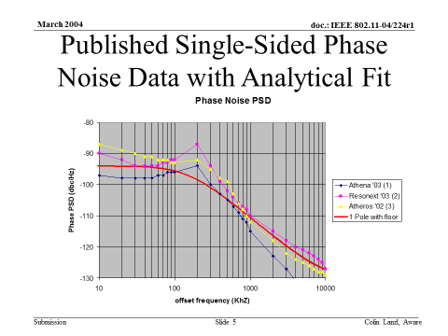
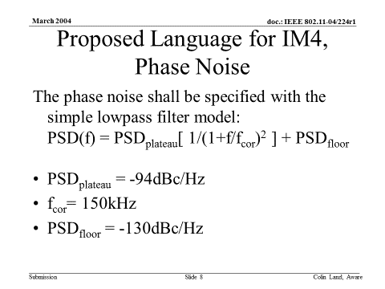
TGn Phase Noise Model [11-04/224r1]

Slide 12
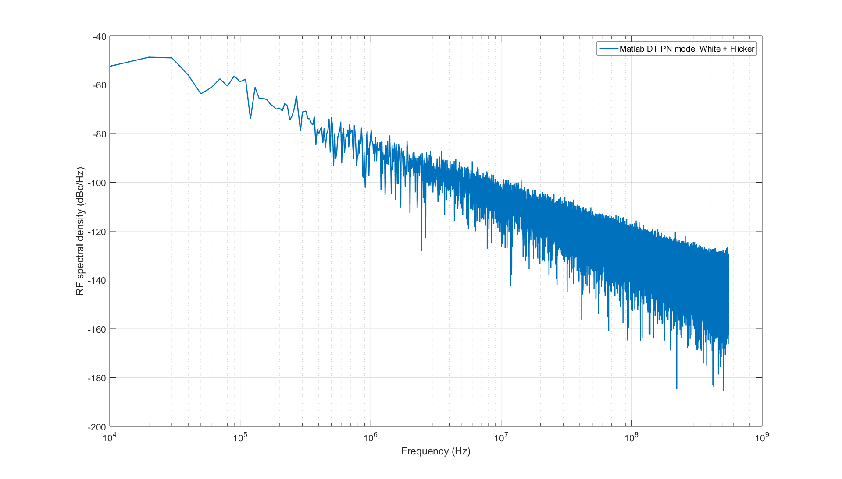
Phase Noise Profile of a Ring Oscillator [2]
Example: 65 nm, 75 µW power consumption
[2] O. Khan; B. Wheeler; F. Maksimovic; D. Burnett; A. M. Niknejad; K. Pister, "Modeling the Impact of Phase Noise on the Performance of Crystal-Free Radios," in IEEE Transactions on Circuits and Systems II: Express Briefs , vol.PP, no.99, pp.1-1

Slide 13
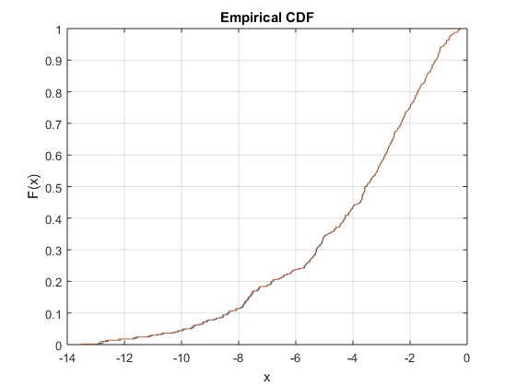
CDF of Integrated Phase Noise [2]
500 iterations
Fc=2.447 GHz
Integration bandwidth
  10 KHz – 2 MHz and 10 MHz
  10 KHz resolution
Statistics
  Min: -13.5dBc
  Max: -0.25dBc
  Mean: -4.24dBc
  Median: -3.6dBc
  Std: 2.87dBc

