Slide 1
Introduction to RPW system
Date: 2017-03-14
Authors:
Name | Affiliations | Address | Phone | email
Ken Takei | Hitachi Ltd. | 1-1, Omika-cho 7-chome, Hitachi-shi Ibaraki-ken 319-1292 Japan | +81-294-52-5111 | ken.takei.cb@hitachi.com

Slide 2
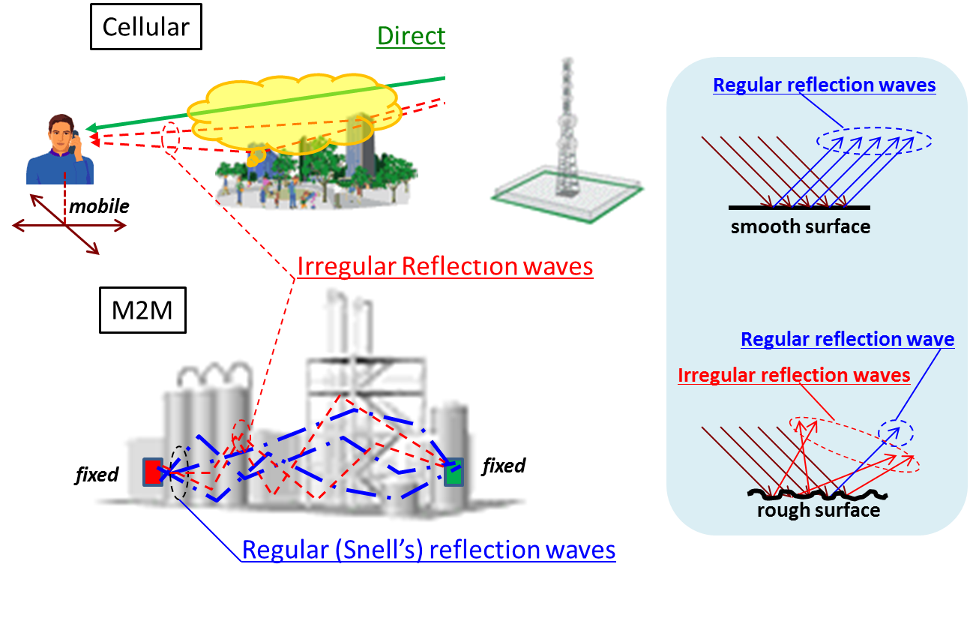
Cellular communication v.s. M2M

Slide 3
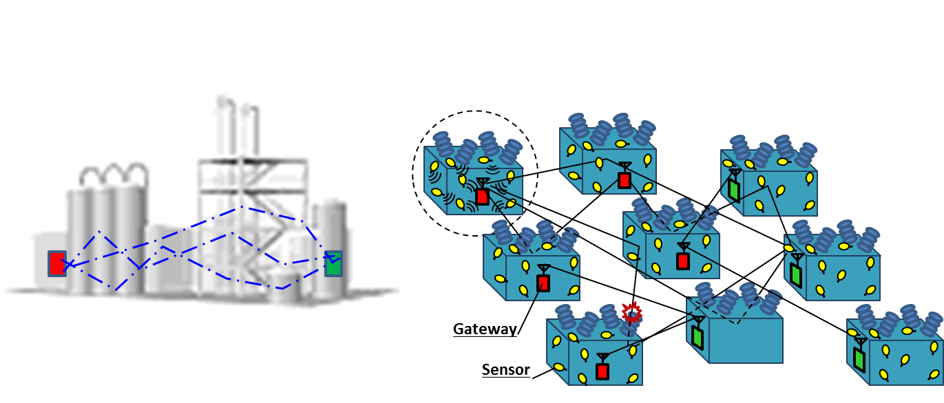
Wireless link between numerous sensors to a gateway and between gateways
Wireless link to connect numerous sensors to a gateway
Non-Line-of-Sight communication among gateways
Highly scattering and no time variation waves are useful

Slide 4
IoT O&M for Industrial System
Purpose
Improve system performance by monitoring and controlling its equipment
With numerous sensors and actuators onto that, respectively
Features
・Wireless link between numerous devices to a gateway and between gateways
・Non-line-of-sight communication among devices fixed onto scatting surfaces
・Data of low rate less than 1 Mbps leach beyond long distance more than 1 km
・Low-cost devices operated in un-license band
Challenges
・Conventional cellular technologies (ex. CDMA and OFDM) are mostly developed
for high data rates communication.
・M2M achieves an ultra-reliable and secure communication over large distances
focusing on low rate data transfer.

Slide 5
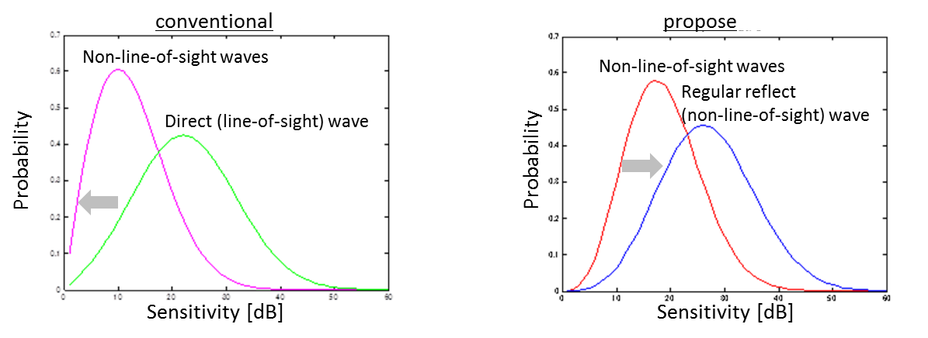
Solution with Polarization
Motivation
Overcome severe attenuation of a non-line-of-sight wave with polarization that
the conventional mobile systems do not essentially use.
Propose
When positions of devices are fixed and propagation path is static, signal on the
path that consists of regular reflection waves is deterministic as a line-of-sight wave.
A wireless system which measures path quality and uses it statistically with
polarization achieves good signal quality as if uses a line-of-sight wave.

Slide 6
Polarization Detecting Communication
Regular reflection waves satisfying Snell’s law can be deterministic.
Fixed radio achieves non-line-of-sight communication by using regular
reflection (RR) waves satisfying Snell’s law.
・RR wave uniquely changes polarization in reflection.
・Receiver detecting polarization change deterministically
uses RR wave by compensating this change.

Slide 7
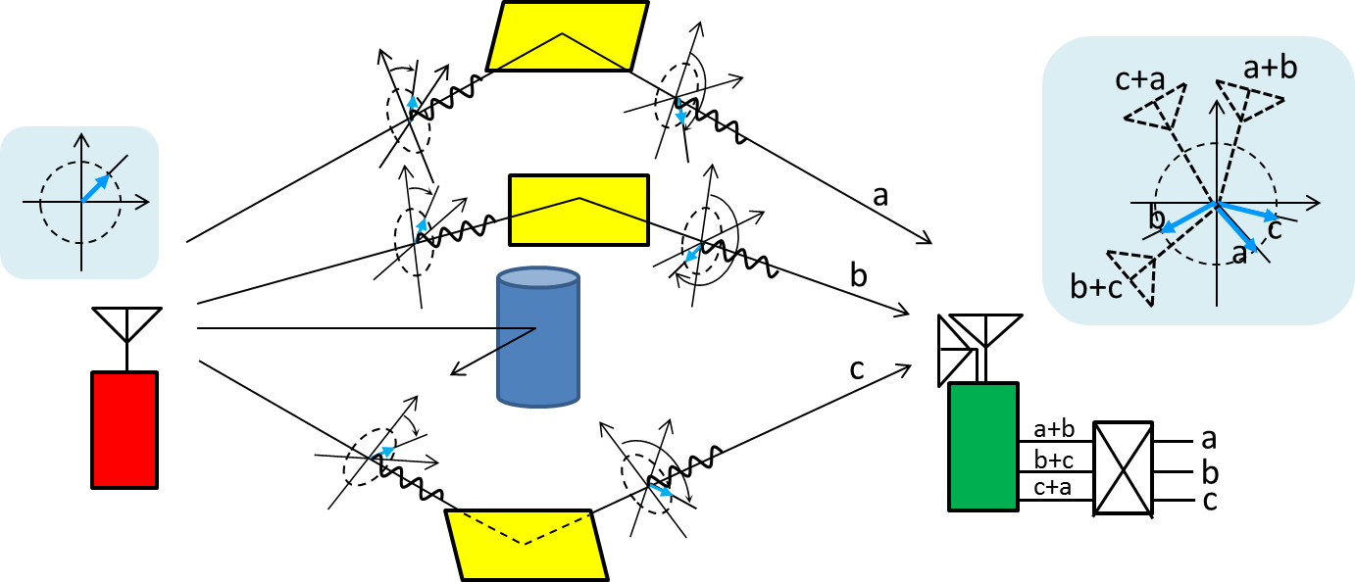
Polarization Selection with Antennas
Waves carrying the same signal arrive on different paths with different polarizations.
Different combinations of the waves obtained by different antennas provide every signal on each path.

Slide 8
Rotation Polarization Wave System
RPW’s slowly rotating polarization let receiver measure the polarization with arbitrary two antennas by using digital signal processing technologies.

Slide 9
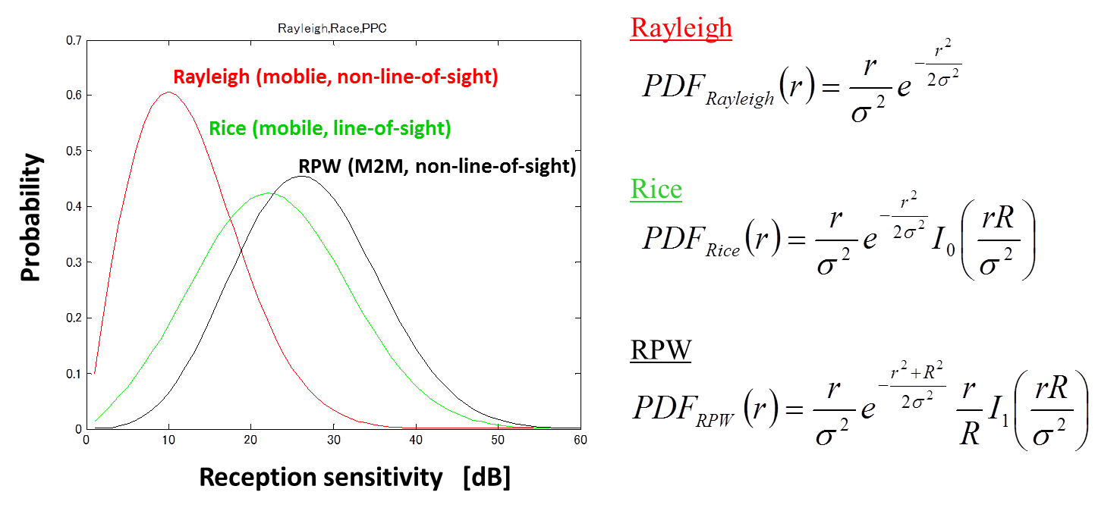
Stochastic analysis of RPW system
RPW has higher receiver sensitivity statistically as it can capture energy from all possible polarizations arising from the polarization changes that were induced by the channel.

Slide 10
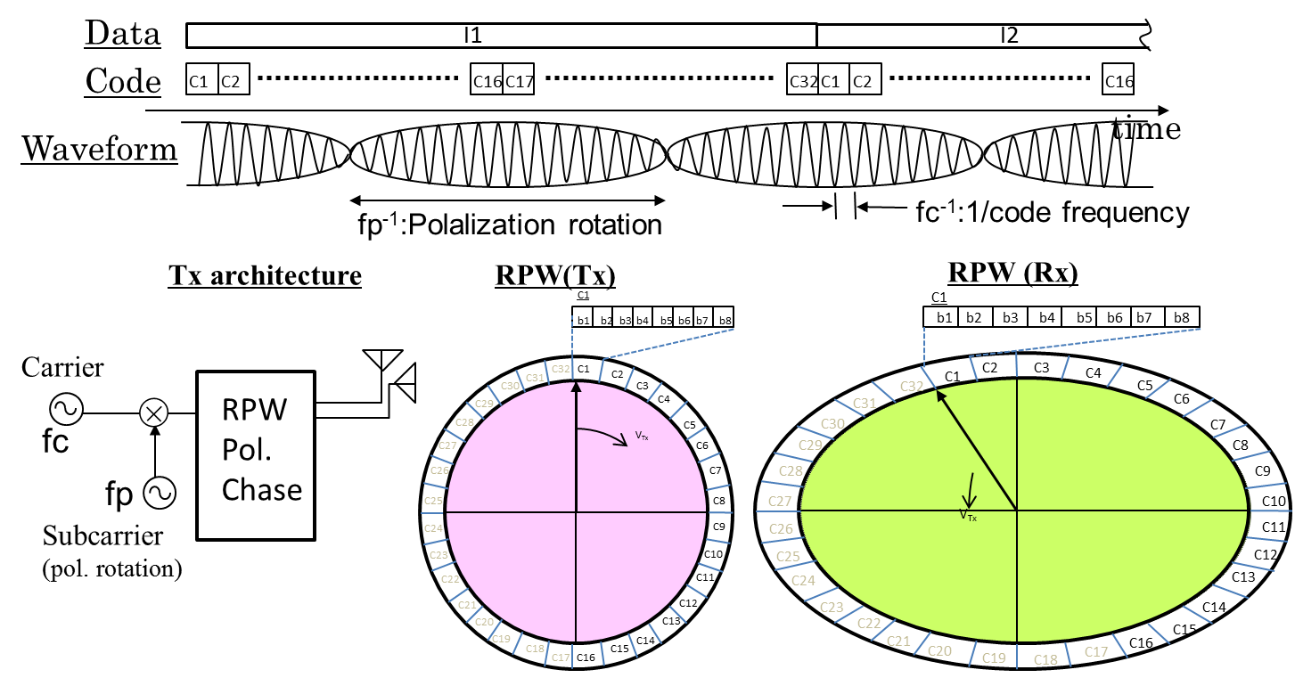
Code to measure Polarization
Receiver measures path fluctuation with polarization and compensates this by using code to be the path deterministic.

Slide 11
Prototype of RPW System†
†experiments was performed in the un-echoic chamber of Hitachi Research Laboratory

Slide 12
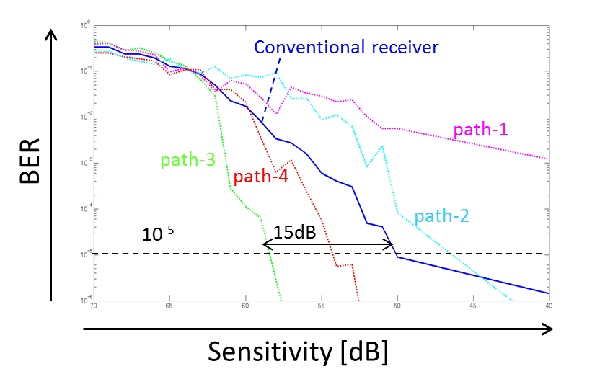
Measured BER Performance
BPSK signal is transferred on multiple polarizations by RPW.
The proposed receiver can capture 15 dB higher receiving power at BER of 10⁻⁵ on the polarization of path-3 than conventional one that is force to use the powers on all paths.

Slide 13
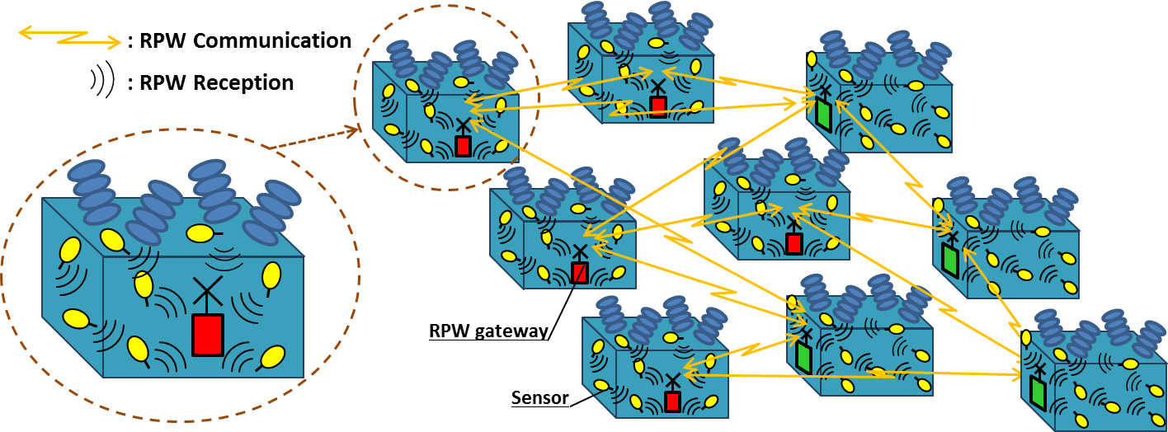
RPW of WLAN for Substation System
Gateway receive sensor signal with optimum polarization
RPW achieve good non-line-of-sight communication
RPW mesh network provides robust wireless hops

Slide 14
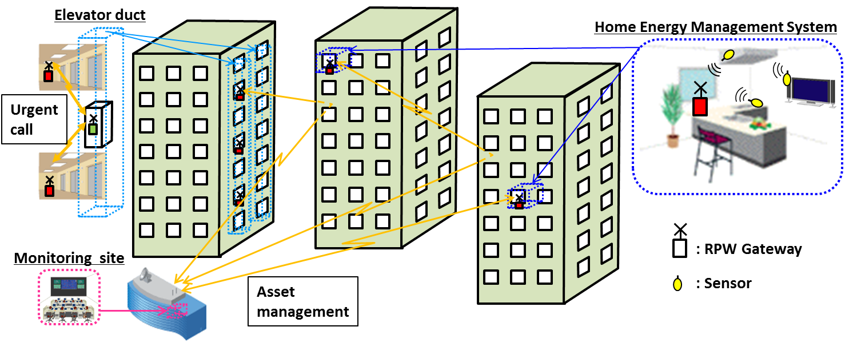
RPW of WLAN for Urban System
Gateway captures asset information from sensors
RPW achieves good non-line-of-sight G-w communication

Slide 15
Summary
Regular reflection waves is useful for non-line-of-sight M2M communication in industrial O&M system.
Deterministic reflection waves exploits the polarization dimension by transmitting the same data over multiple pol.s
RPW system that rotates polarization at frequency low enough to differentiate polarizations by DSP technologies.
RPW receiver captured 15 dB higher receiving power at BER of 10⁻⁵ on the polarization of an optimum path than conventional one that has to use the powers on all paths.

Slide 16
Straw Poll
Do you think that IEEE 802.11 wireless LAN should further discuss polarization diversity based transmission technologies such as Rotating Polarization as a candidate physical layer technology to improve the reliability of industrial M2M systems?
Y:
N:
A:

Slide 17
References
[1] K. Takei, “Polarization angle diversity for highly-reliable machine-to-machine radio,“ in Proc. 2013 IEEE ICCPCT., pp. 825-828.
[2] K. Takei, “Stochastic Analysis for Rotating Polarization Communication with Multi-reflective Waves in Multipath Environment,“ in Proc. 2014 IEEE PES Transmission and Distribution Conf., TD2014-236
[3] M. Aono, K. Takei, “Polarization angle diversity and quick decodable block code for M2M wireless communication,“ in Proc. 2014 APMC.
[4] K. Takei, “Orthogonal code for polarization angle division diversity,“ in Proc. 2015 IEEE ICCPCT, paper-ID 94．
[5] M. Aono, “Polarization angle diversity and new digital software radio architecture,“ in Proc. 2015 IEEE ICCPCT, paper-ID 545.

