Slide 1
802.11 Working Group Opening Report
March 2017
Date: 2017-03-08
Authors:

Slide 2
Introduction
This presentation, together with the reports cited on the next slide, forms the opening report of the IEEE 802.11 Working Group for March 2017.
Subgroup status is reported in the “Snapshots” submission (see documents slide for link). This is incorporated by reference into this opening report.
“Mx.y.z” terminology indicates that the item was on the tentative agenda for the Monday 802.11 plenary, and was agenda item x.y.z.

Slide 3
M1.3 Meeting Decorum
%
Photography or recording by permission only (December 2014 IEEE-SA Standards Board Ops Manual 5.3.3.2)
Press (i.e., anyone reporting publicly on this meeting) are to announce their presence (December 2015 IEEE-SA Standards Board Ops Manual 5.3.3.3)
Laptop speakers, cell phone / tablet ringers off
Wear your badges at all times in meeting areas
  Help the hotel security staff improve the general security of the meeting rooms
  Laptops HAVE BEEN STOLEN at previous meetings
  DO NOT assume that meeting areas are secure
Please observe proper decorum in meetings

Slide 4

M1.7 - Shusaku Shimada (1951-2017)
1974-2012 Yokogawa Electric Corporation
Wireless Standardization Scientist, International Standardization Group Manager, Corporate R&D Center.
2012-2017 Schubiquist Technologies Guild
Founder & C.E.O.
IEEE802.11 (2003-2017）
IEEE802.11n,ac,ah
IEEE802.15 (2004-2017）
IEEE802.15.4d Technical co-editor
15.4g , 15.4e, 15.4s
IEEE1394
IEEE802.16

Slide 5
M2.3.1 Summary of Liaisons
Outgoing from last session:
  To 3GPP RAN2: 11-16/1510r3 (Estimated throughput)
  To 3GPP RAN: 11-16/1573r4 (Radio-level integration)
Incoming from 3GPP RAN2 – doc 11-17/315r0
  https://mentor.ieee.org/802.11/dcn/17/11-17-0315-00-0000-liaison-statement-from-3gpp-ran2-on-estimated-wlan-throughput.doc
  “Reply LS on Estimated WLAN Throughput”
  Actions:
    … consider whether accuracy requirements can be defined for the throughput metric.
    … consider whether additional metrics are beneficial …
    … provide definition of such metric(s) …

Slide 6
M 2.4 Other project of interest – P1930.1
Title: Recommended Practice for Software Defined Networking (SDN) based Middleware for Control and Management of Wireless Networks
Scope: This Recommended Practice specifies a middleware for vendor independent management and control of Wireless Networks, specifically, management & control of Access Points (APs) for IEEE 802.11 based Wireless Local Area Networks (WLAN) and BaseStations for IEEE 802.22 based Wireless Regional Area Networks (WRAN), in accordance with the Software Defined Networking (SDN) paradigm.
802.11 Chair has invited P1930.1 chair to come to an 802.11 meeting and brief us on what they are doing.

Slide 7
M 2.4 Other project of interest – P1912
Title: Standard for Privacy and Security Architecture for Consumer Wireless Devices
Scope: This standard describes a common communication architecture for diverse wireless communication devices such as, but not limited to, devices equipped with near field communication (NFC), home area network (HAN), wireless area network (WAN) wireless personal area network (WPAN) technologies or radio frequency identification technology (RFID) considering proximity; and specifies approaches for end user security through device discovery/recognition, simplification of user authentication, tracking items/people under user control/responsibility, and supports alerting; while supporting privacy through user controlled sharing of information independent of the underlying wireless networking technology used by the devices
802.11 Chair has invited P1912 to brief the WG on what they are doing

Slide 8
M3.1 802.11 Working Group Session Documents
WG Session Reports
WG Agenda | https://mentor.ieee.org/802.11/dcn/11-17-0196
Opening report | https://mentor.ieee.org/802.11/dcn/11-17-0197
Snapshots | https://mentor.ieee.org/802.11/dcn/11-17-0256
1st vice chair | https://mentor.ieee.org/802.11/dcn/11-17-0254
2nd vice chair | https://mentor.ieee.org/802.11/dcn/11-17-0257
Treasurer | https://mentor.ieee.org/802.11/dcn/11-17-
Supplementary Material | https://mentor.ieee.org/802.11/dcn/11-17-0198
Motions | https://mentor.ieee.org/802.11/dcn/11-17-0258
Closing report | https://mentor.ieee.org/802.11/dcn/11-17-0259
Previous Session Minutes | https://mentor.ieee.org/802.11/dcn/11-17-0014

Slide 9
M3.2 Joint meetings and Reciprocal Credit
Joint meeting 802.1, 802.11, 802.15 – hosted by 802.1
  Tuesday 6:30pm-7:30pm
  "Highly-dense and highly-reliable heterogeneous wireless networks for industry“ - KOTO Hajime (NICT)
  Room “Saturna Island - Discovery Floor, Fairmont”
Reciprocal credit is provided to 802.11 voters for attendance at: 802.18, 802.19, 802.24, 802.1**
  Reciprocal credit for 802.1 is for 801.1Qbz, 802.1CF, 802E, 802c
** When meeting

Slide 10
M3.10 802 EC and IEEE-SA Standards Board decisions
The IEEE standards board received an appeal related to the TGax dominance complaint – see: http://www.ieee802.org/secmail/msg20808.html
The appeal was rejected – see: http://www.ieee802.org/secmail/msg20838.html
2017-02-07 EC telecon:
  Approved sending 802.11-2016, 802.11ah-206 and 802.11ai to ISO IEC/JTCI
  Approved sending P802.11aq D8 to ISO IEC

Slide 11
M 3.11 – IEEE-SA enquiry into effectiveness of TGax remedy
See: http://www.ieee802.org/secmail/msg20985.html
From the IEEE-SA SB chair:
“Dear Paul, Chairman, IEEE 802 LAN/MAN Standards Committee Sponsor,
At the SASB March meeting I would like to follow up on the Dec. SASB ratification of the actions taken by the IEEE 802 LMSC Sponsor in connection with the 802 TGax complaint and check if actions were effective and sufficient. Can you please prepare inputs for the SASB discussion?
Best regards,
Jean-Philippe Faure, 2017 SASB Chair”

Slide 12
M3.11 - IEEE-SA enquiry into effectiveness of TGax remedy
The IEEE 802 chair consulted with members of the EC to respond to this query and compiled a draft response.
See: http://www.ieee802.org/secmail/docjDBWdzooEd.doc
The response has been delayed to allow any additional observations from the March meeting to be included.
The EC will debate and approve the response some time after this meeting.

Slide 13
M4.1.1 Type of Groups
Type of Group | Description
WG | Working Group
SC | Standing Committee
TG | Task Group
SG | Study Group
TIG | Topic Interest Group

Slide 14
M4.1.1 Groups
Type | Group | Description
WG | WG11 | The IEEE 802.11 Working Group
SC | AANI | Advanced Access Networking Interface (AANI)
SC | ARC | Architecture
SC | PAR | PAR review
SC | WNG | Wireless Next Generation
802 SC | JTC1 | ISO/IEC JTC1/SC6
TG | AJ | China Milli-Meter Wave (CMMW)
TG | AQ | Pre-association Discovery (PAD)
TG | AK | General Link (GLK)
TG | AX | High Efficiency Wireless LAN (HEW)
TG | AY | Next Generation 60 GHz (NG60)
TG | AZ | Next Generation Positioning (NGP)
TG | BA | Wake-up Radio
TIG | LC | Light Communication TIG

Slide 15
M4.1.2 PAR Expiration/Renewal Schedule
Project | PAR Expiration Date
AJ | 31-DEC-2018
AK | 31-DEC-2018
AQ | 31-DEC-2018
AX | 31-DEC-2018
AY | 31-DEC-2019
AZ | 31-DEC-2019
BA | 31-DEC-2020
http://www.ieee802.org/11/PARs/index.html

Slide 16
M4.1.3 802.11 WG Appointed positions
WG Secretary – Stephen McCann
Treasurer – Jon Rosdahl
ANA Authority – Robert Stacey
WG Technical Editors – Robert Stacey, Peter Ecclesine

Slide 17
M4.1.3 Officers
Cat | Group | Chair | Vice Chair | Technical Editor | Secretary
WG |  | Adrian STEPHENS | Jon ROSDAHL Dorothy STANLEY | Robert STACEY Peter ECCLESINE | Stephen MCCANN
SC | AANI | Joseph LEVY | Roger Marks
SC | ARC | Mark HAMILTON | Joseph LEVY |  | Joseph LEVY
SC | PAR | Jon ROSDAHL | Michael MONTEMURRO
SC | WNG | Jim LANSFORD | Lei WANG
TG | AJ | Jiamin CHEN | Haiming WANG | Jiamin CHEN Shiwen HE (subeditor) | Open
TG | AK | Donald EASTLAKE | Mark HAMILTON | Donald EASTLAKE Norm FINN | Open
TG | AQ | Stephen MCCANN | Yunsong YANG | Lee ARMSTRONG | Open
TG | AX | Osama ABOUL-MAGD | Simone MERLIN Ron PORAT | Robert STACEY | Yasuhiko INOUE
TG | AY | Edward AU | Sang Kim | Carlos CORDEIRO | Jeorge HURTARTE
TG | AZ | Jonathan SEGEV | Carlos ALDANA | CC WANG | Open
TG | BA | Minyoung PARK
TIG | LC | Nikola Serafimovski
Changed since last session

Slide 18
IEEE 802.11 Revisions
802.11
-2016
802.11
-2012
802.11
-2007
802.11
-2003
11aa
Video Transport
11k
RRM
11s
Mesh
11e
QoS
MAC
11u
WIEN
11v
Network
Management
11h
DFS & TPC
IEEE
Std
802.11
-1997
11ae
QoS Mgt Frames
11z
TDLS
11i
Security
11d
Intl roaming
11w
Management
Frame
Security
11r
Fast Roam
11f
Inter AP
11af
TV Whitespace
11n
High
Throughput
(>100 Mbps)
11j
JP bands
11a
54 Mbps
5GHz
PHY & MAC
11ac -VHT
>1 Gbps @ 5GHz
11p
WAVE
11y
Contention
Based
Protocol
11g
54 Mbps
2.4GHz
11b
11 Mbps
2.4GHz
11ad - VHT
>1 Gbps @ 60GHz
Notes:
doc.: IEEE 802.11-11/0483r0
May 2011
Bruce Kraemer (Marvell)
Page 18

Slide 19
IEEE 802.11 Standards Pipeline
MAC
802.11
-2016
802.11aq
PAD
802.11az
NGP
802.11ak
GLK
802.11ba
WUR
802.11ai
FILS
WNG
Light Comms
(LC) TIG
802.11ax
HEW
802.11ah
< 1Ghz
802.11ay
NG60
802.11aj
CMMW
MAC & PHY
Discussion Topics
TIG/Study
groups
TG without
Approved draft
WG
Letter Ballot
Sponsor
Ballot
Published
Amendment
Published
Standard
19
Notes:
doc.: IEEE 802.11-11/0483r0
May 2011
Bruce Kraemer (Marvell)
Page 19

Slide 20
M4.1.5 Summary of ballots and comment collections
Type | Label | Group | Opened (mm-dd) | Dur (d) | # Comments | Ballot Group | Approve | Disapprove + invalid | Abstain | Return % | Approve % | Result
WR | 228 | TGai | 02-17 | 15 | 1 | 377 | 247 | 14+3 | 51 | 83 | 95 | P

Slide 21
M4.1.6 Current Membership Status
Status | Number
Aspirant | 125
Potential Voter | 38
Voter | 341
Ex Officio Voter | 12
Definitions:
  Aspirant: a member who has attended 1 qualifying meeting
  Potential Voter: a member who has attended 2 qualifying meetings and will become a voter at the start of the next plenary they attend
  Ex Officio Voter: a voter who has voting rights by virtue of their membership of the 802 EC and has requested to be recorded as an ex officio voter in 802.11
Data as of 2017-01-12

Slide 22
M4.1.6 Recent voting member history

Slide 23
background data

Slide 24
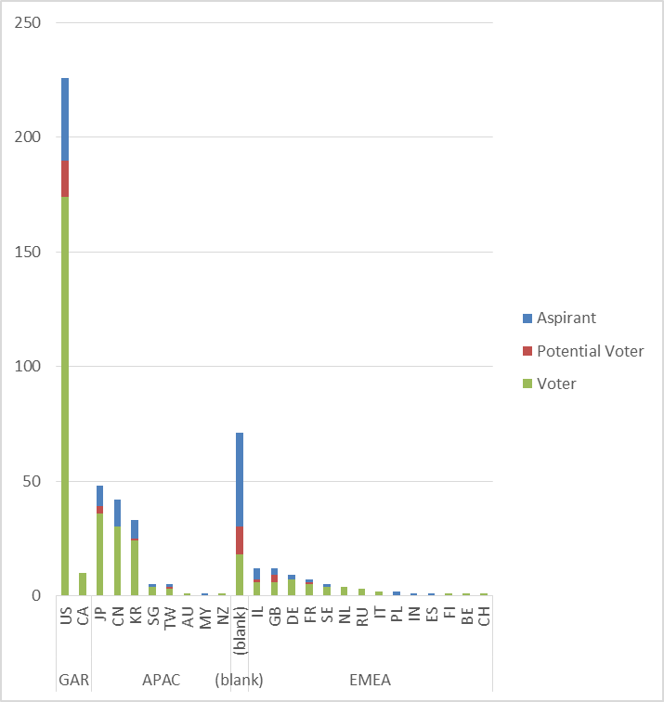
Membership by Country and Region

Slide 25
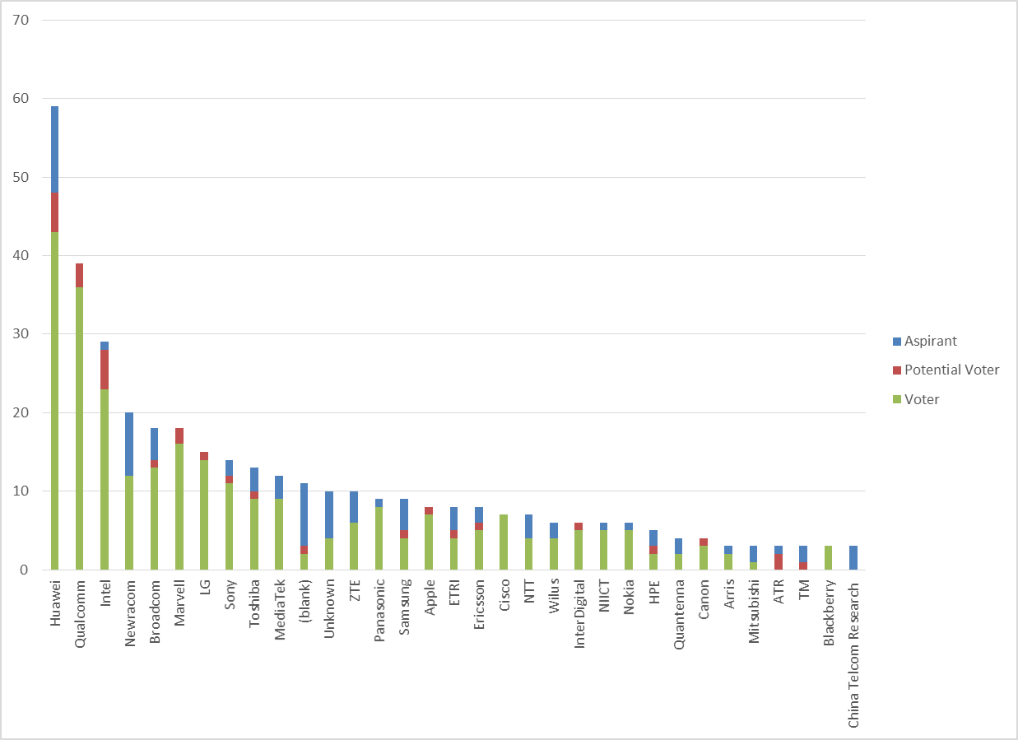
Members by Affiliation

Slide 26
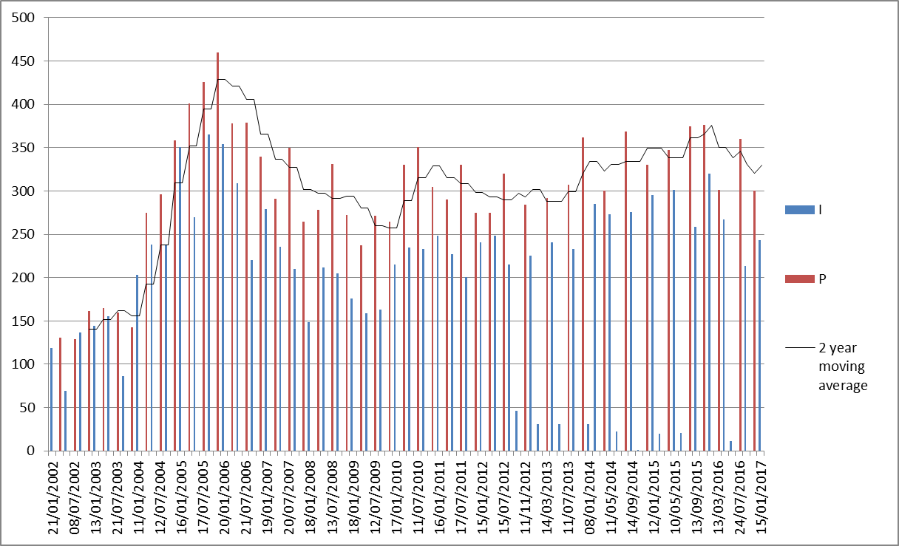
Meeting Attendance – Historic Data

Slide 27
Membership – Historic Data

