Slide 1
Intel Secured Location Threat Model
Date: 2017-01-16
Authors:

Slide 2
Abstract
This submission describes a set of attacks & identifies REVmc FTM protocol vulnerabilities. It also presents a threat model proposal that identifies adversary capabilities and the derived protocol functional requirements.

Slide 3
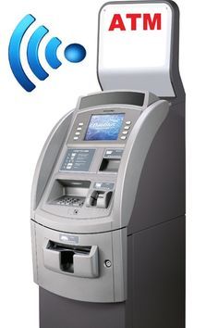


What is Protocol Security?
Protocl Security definition:
  Authentication - Authenticates user identity.
  Encryption Algorithm - The cryptographic cipher combined with various methods for encrypting the text.
  Key Management - Create, distribute and maintain the keys.
  Message Integrity - Ensures that the encrypted message* has not been tampered with.
  * - message refers to frame and/or field(s) within the frame.

Slide 4
Protocol Vulnerability (1): Eavesdropping
Adversary Goal:
  Detect ISTA location
Adversary Setup:
  FTM capable Wi-Fi NIC
  Laptop
Method of Attack:
  Eavesdrop the ongoing FTM and estimate ISTA location based on measurement results (t1,t4), the RSTA’s location and own location.
Motivation:
  Commercial intelligence
  Criminal activity

Slide 5
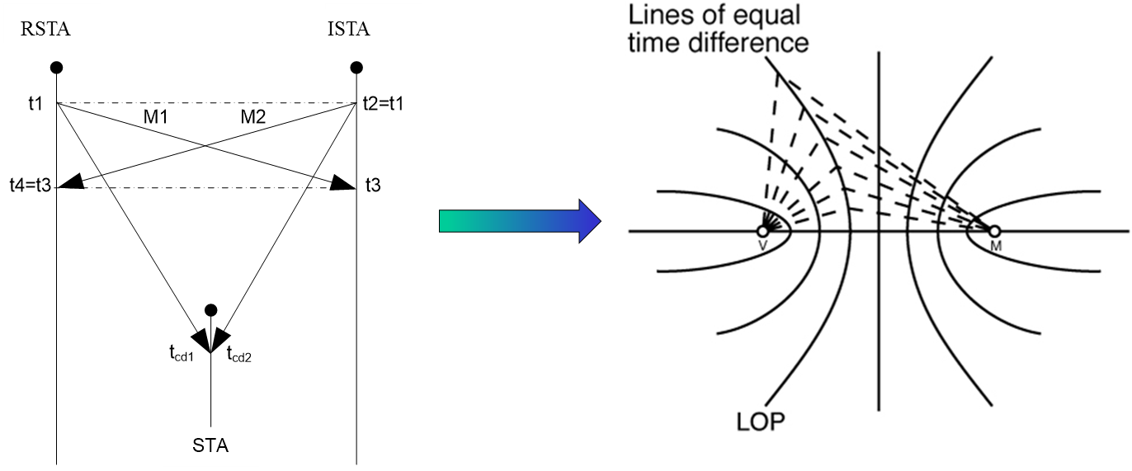
REVmc FTM Vulnerabilities – Recap: Hyperbolic Navigation using FTM

Slide 6
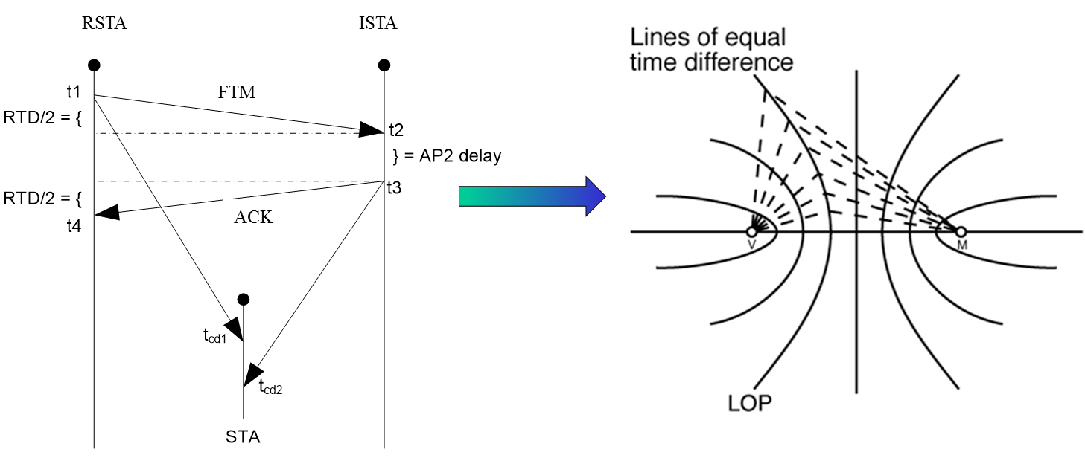
REVmc FTM Vulnerabilities – Recap: Hyperbolic Navigation using FTM – cont’d

Slide 7
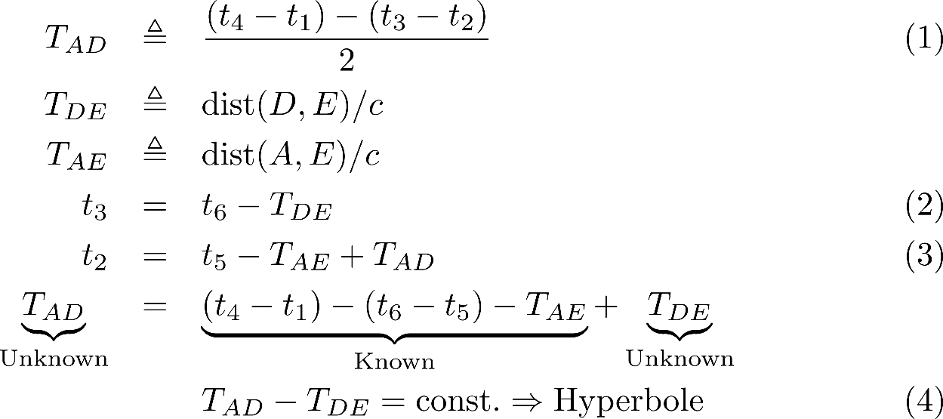
Protocol Vulnerability (1): Eavesdropping – cont’d
The adversary can passively estimate the ISTA’s LOP.

Slide 8
Protocol Vulnerability (1): Eavesdropping – Analysis
The adversary is logging the medium and processes it offline. This results in the ISTA’s LOP
By eavesdropping multiple FTM sessions, interception of LOPs yields ISTA location.
ISTA identity (MAC addr.) combined with its location is exposed.

Slide 9
Protocol Vulnerability (2.1):
SW Impersonation - Data Integrity
Adversary Goal:
  To spoof the ISTA true location to a random/false location.
Adversary Setup:
  FTM sniffer
  Wi-Fi jammer (can use cheap SDR) – optional
Method of Attack
  Use FTM NIC to imitate several RSTA
    Provide STA false LCI IE
    Provide STA false (t1,t4) values
    Optional: Jam ISTA from discovering beacons of true RSTA
Motivation:
  Criminal activity
Open:
  Could a complete ‘fixed location’ be spoofed or only range by using (t1,t4)?
Notes:
Is unsecured location configuration information (LCI) query consa security issue?
location configuration information (LCI): As defined in IETF RFC 6225: includes latitude, longitude, and altitude, with uncertainty indicators for each.

Slide 10
Protocol Vulnerability (2.2):
HW Impersonation - Data Integrity
Adversary Goal:
  To spoof the ISTA true location to a false location.
Adversary Setup:
  FTM sniffer
  Commercial, off-the-shelve (COTS) SDR equipment
Method of Attack
  Send ACK to affect t₄ calculation for desired false geolocation
  Variations:
    MAC level – earlier ACK
    PLCP– send only STF/LTF part.
    STF/LTF are unprotected so measurement could be easily modified.
Motivation:
  Criminal activity

Slide 11
HW Impersonation/Data Integrity –
How to Spoof Legacy Sounding
L-STF & L-LTF give the timing reference to the VHT-LTF, which could be spoofed by the adversary
RSTA (AP) Transmission

Slide 12
Summary
We have demonstrated two types of security vulnerabilities of the FTM protocol, using COTS low-cost components.
  A SW-based attack (msec level response time) for both spoofing (active) and eavesdropping (passive)
  An HW-based attack (SIFS-level response time) modifying the VHT LTF and by that affecting the TOA measurement.
The FRD should reflect protection against these types of adversaries.
The following slides compile these types of adversaries and attacks into proposed functional requirements.

Slide 13
Straw poll 1
We support the following FRD requirements:
  The 11az positioning protocol shall have at least one secured mode that meets all of the following security requirements in associated state:
  Authentication - Authenticates user identity.
  Encryption Algorithm - The cryptographic cipher combined with various methods for encrypting the text.
  Key Management - Create, distribute and maintain the keys.
  Message Integrity - Ensures that the encrypted message* has not been tampered with.
  * - message refers to frame and/or field(s) within the frame.
Y: 19 N: 0 A: 5

Slide 14
Motion 1
Move to agree that the FRD of the 11az positioning protocol shall have at least one secured mode that meets all of the following security requirements in the associated state:
  Authentication - Authenticates user identity.
  Encryption Algorithm - The cryptographic cipher combined with various methods for encrypting the text.
  Key Management - Create, distribute and maintain the keys.
  Message Integrity - Ensures that the encrypted message* has not been tampered with.
  * - message refers to frame and/or field(s) within the frame.
Moved by: Chris Hartman
Seconded By: Chao Chun Wang

Slide 15
Motion to Amend
Move to amend the motion in Slide 14 to read:
Move to agree that the FRD of the 11az positioning protocol shall have at least one secured mode that meets all of the following security requirements in the associated state:
  Authentication – Mutual authentication of initiator and responder
  Encryption Algorithm - The cryptographic cipher combined with various methods for encrypting the text.
  Key Management - Create, distribute and maintain the keys.
  Message Integrity - Ensures that the protected message* has not been tampered with.
  * - message refers to frame and/or field(s) within the frame.
Moved by: Nehru Bhandaru
Seconded: Jouni Malinen
Y: 17 N: 0 A: 0

Slide 16
Motion 1
Move to agree that the FRD of the 11az positioning protocol shall have at least one secured mode that meets all of the following security requirements in the associated state:
  Authentication – Mutual authentication of initiator and responder
  Encryption Algorithm - The cryptographic cipher combined with various methods for encrypting the text.
  Key Management - Create, distribute and maintain the keys.
  Message Integrity - Ensures that the protected message* has not been tampered with.
  * - message refers to frame and/or field(s) within the frame.
Moved by: Chris Hartman
Seconded By: Chao Chun Wang
Y: 16 N: 2 A: 1
Motion passes

Slide 17
Straw poll 2
We support the following FRD requirements:
  The 11az positioning protocol shall have at least one secured mode that meets all of the following security requirements in the unassociated state:
  Authentication - Mutual authentication of initiator and responder (provided there is a prior security context established).
  Encryption Algorithm - The cryptographic cipher combined with various methods for encrypting the message* used in 11az-positing protocol.
  Key Management - Create, distribute and maintain the keys.
  Message Integrity - Ensures that the protected message* has not been tampered with
  * - message refers to frame and/or field(s) within the frame.
  Y: 16, N: 0; A: 3

Slide 18
Motion 2
Move to agree that the FRD of the 11az positioning protocol shall have at least one secured mode that meets all of the following security requirements in the unassociated state:
  Authentication - Mutual authentication of initiator and responder (provided there is a prior security context established).
  Encryption Algorithm - The cryptographic cipher combined with various methods for encrypting the message* used in 11az-positing protocol.
  Key Management - Create, distribute and maintain the keys.
  Message Integrity - Ensures that the encrypted message* has not been tampered with.
  * - message refers to frame and/or field(s) within the frame.
Moved: S K Yong
Seconded by: Assaf Kasher
Y: 16; N: 1; A: 1
Motion passes

Slide 19
Straw poll 3 – Attacker Capabilities
We agree that an adversary may have at least one or more of the following capabilities and limitations:
[R1] An adversary that uses commercial NIC/Sniffer
[R2] At most, the adversary may deploy/use two non-co-located Tx and Rx chains.
[R3] The adversary shall be TOA and TOD capable on all received/transmitted frames.
[R4] The adversary shall be able to compose and transmit any 802.11 packet or part of it.
Y: 13; N: 1; A: 9

Slide 20
Motion 3
Move to agree that an adversary may have at least one or more of the following capabilities and limitations:
[R1] An adversary that uses commercial NIC/Sniffer
[R2] At most, the adversary may deploy/use two non-co-located Tx and Rx chains.
[R3] The adversary shall be TOA and TOD capable on all received/transmitted frames.
[R4] The adversary shall be able to compose and transmit any 802.11 packet or part of it.
Moved: S K Yong
Seconded by: A Kasher
Y: 14; N: 2; A: 5
Motion passes

Slide 21
Straw poll 4 – Protocol Requirements
The 11az protocol shall have at least one secured mode that supports privacy, authenticity and integrity against adversaries with the following response time.
  Type A Adversary is assumed to have response time to standard-specified OTA events or scenario dependent fields of 1 msec or longer.
  Type B Adversary is assumed to have response time to known OTA events or known pre-defined fields of 1usec or longer (up to 1msec).
Note: the STA capabilities is TBD (for both types of adversaries).
Y: 18; N: 0; A: 4

Slide 22
Motion 4
Move to agree that the 11az protocol shall have at least one secured mode that protects against adversaries with capabilities mentioned in Slide 20 and with the following response time.
  Type A Adversary is assumed to have response time to standard-specified OTA events or scenario dependent fields of 1 msec or longer.
  Type B Adversary is assumed to have response time to known OTA events or known pre-defined fields of 1usec or longer (up to 1msec).
Note: the STA capabilities is TBD (for both types of adversaries).
and grant editorial rights to the FRD Editor
Moved: Chittabrata Ghosh
Seconded by: S K Yong
Y: 15 N: 1 A: 2
Motion passes

