Slide 1
Discussion on CR for CID 5066
Date: 2017-1-16
Authors:
Name | Affiliations | Address | Phone | email
Dengyu Qiao | Huawei Technologies Co., Ltd. |  |  | qiaodengyu@huawei.com
Zhigang Rong
Yunsong Yang

Slide 2
CID 5066
CID | Clause | Page | Line | Comment | Proposed Change
5066 | 9.3.1.23 | 45 | 36 | In TWT SP, if AP want to use random access RU to collect buffer status information from TWT scheduled STAs, AP can send a Trigger frame to indicate an RU with AID12=0. But a STA that has no TWT capability also can use the RU to do OFDMA random access. This is inefficient way. | Define a mechanism to solve this issue.

Slide 3
Abstract
This proposal can improve transmission efficiency and power saving of TWT mechanism, especially when network congestion increases
For random access RU that is allocated during TWT service period, TWT scheduled STA needs to contend with other STAs that support random access
When many STAs unscheduled by TWT contend for random access RU, TWT scheduled STA will frequently fail to send UL frame by random access RU.
One AID value is assigned to indicate random access RU dedicated to TWT STA

Slide 4
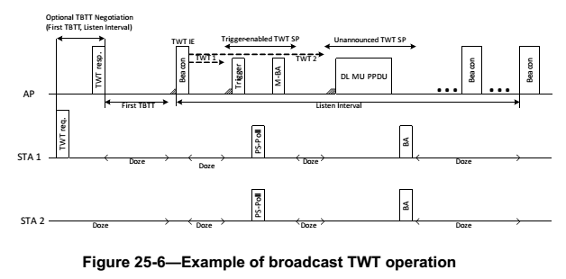
Background: TWT Procedure
As TWT negotiation is optional for broadcast TWT, TWT scheduled STA may not wake up for every TWT SP. AP needs to know which TWT scheduled STA has waked up.
As not every TWT scheduled STA has UL data to transmit, TWT scheduling STA needs to collect buffer report from TWT scheduled STA

Slide 5
Background: Random Access in TWT Service Period
OFDMA random access is an efficient way to collect buffer report or PS-Poll from TWT STA.
AID=0 in trigger frame identifies an RU for random access. Any STA can send frame in the RU after OFDMA backoff procedure
AID12=0 indicates RU for random access

Slide 6
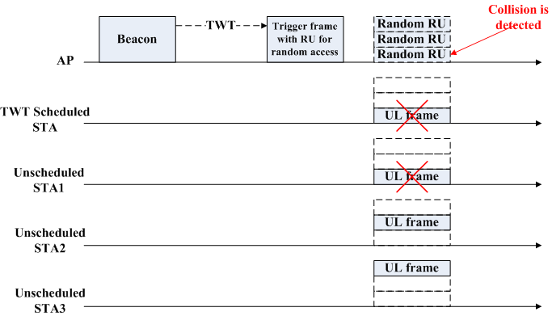
Motivation (1/2)
Any STA can perform OFDMA random access as long as it receives a Trigger frame containing a RU with AID = 0, even during TWT service period.
TWT STA may collide with non-TWT STA at random access RU.

Slide 7
Motivation (2/2)
When network congest increases, TWT scheduled STA will hard to send UL frame by random access RU during TWT SP, and may be also hard to send outside TWT SP, especially for those STAs that have no negotiation with TWT scheduling.
Even though severe collision is detected by AP, AP can do nothing for helping TWT STA to contend for random access RU, during TWT service period.

Slide 8
Proposed scheme
An AID value indicates a random access RU dedicated to TWT scheduled STAs
TWT scheduling STA can choose one available AID value and indicate it in TWT IE
Different AID values are allocated for Broadcast TWT IDs
A bit in Control field to indicate AID for Random Access field is present or not
Element ID | Length | Control | Request Type | Target Wake Time | TWT Group Assignment | Nominal Minimum TWT Wake Duration | TWT Wake Interval Mantissa | Broadcast TWT ID | TWT Channel | NDP Paging | AID for Random Access
B1 | B2 | B3 | B4 | B5 B8
NDP Paging Indicator | Responder PM Mode | Broadcast | Indicator for AID for Random Access | Reserved

Slide 9
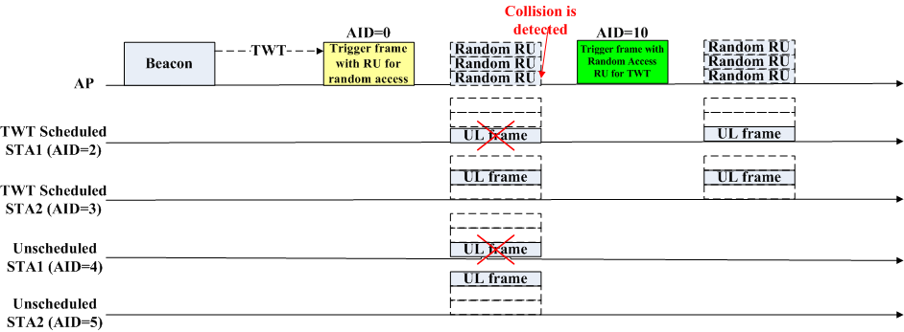
Proposed Procedure
When AP detects collision, AP may send Trigger frame to indicate an Random Access RU dedicated to TWT Scheduled STA

Slide 10
Benefit
TWT mechanism can be more efficient
Power consumption of TWT scheduled STA can be reduced.

Slide 11
Straw Poll 1
Do you support that an AID value is allocated to identify an random access RU dedicated to TWT scheduled STA?
Y/N/A

