Slide 1
Additional background for CID 8908
Date: 2017-01-16
Authors:

Slide 2
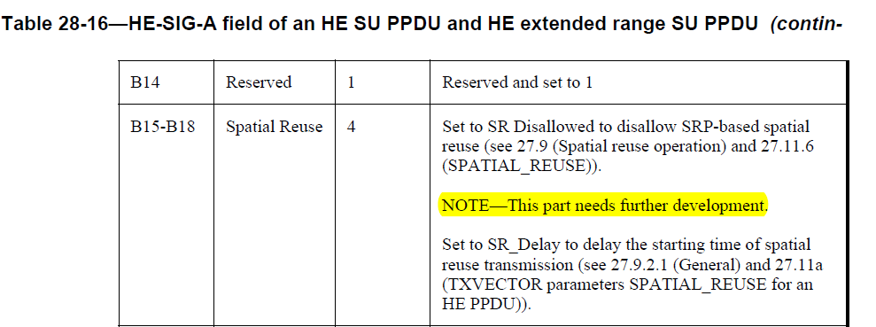
CID 8908
CID 8908 raises concerns about the state of SR
This submission further elaborates on the specific concerns and possible mitigation

Slide 3
Concerns with SR
Impression from review of 802.11ac/D1.0 is that SR is less mature than other parts of the document
  SR had a later start than other parts of the draft
    First recorded agreements: OBSS_PD - September 2015, SRP - May 2016
  Significant new material needed to enhance definition failed to get approval (repeatedly)
    See contributions 947 & 1476
  As acknowledged in the draft (“This part needs further development”)
SRP-based SR seems to rely on Trigger frame preceding SR PPDU
  How will this work for SU and DL-MU
No consideration for DSC
  DSC has advantage of simplicity – e.g. no OBSS detection needed
  Can be implemented for pre-11ax protocols

Slide 4
Risks for 11ax
SR is a risk to 11ax schedule
  If no significant progress is made soon
11ax schedule is a risk to SR
  “that’s all the time we have” may leave SR incomplete
Spatial re-use is a new feature with significant risk for disruption when not done right
  Very different class of feature
SR does not have the same wide consensus as other parts of the draft
  Incidentally, 57% approval for 802.11ax D1.0 is lowest for any D1.0 in the last 10 years

Slide 5
Proposal: Consider Decoupling 11ax and SR if progress remains elusive
Make 11ax “SR ready”
  E.g. keep reserved bits for SR in the preamble
Remove all other SR-related material from the draft
Start SG/TG dedicated to SR
  Continue further development and discussion in this dedicated group
  Publish SR as a separate amendment, applicable to both 11ax and older protocols
Procedural hurdles (SG/TG formation …) should be minimal, given the preliminary work that has already been done on SR

Slide 6
Advantages
Reduce risk to 11ax MAC/PHY development and timeline
  Risk caused by technical and procedural issues with SR
More comprehensive definition of SR
  SR is a new concept that deserves proper consideration on its own terms
  Possible inclusion of features that have not been properly considered so far
SR development not limited by 11ax timeline and vice versa

Slide 7
Conclusion
CID 8908 highlights lack of maturity of SR definition
This submission explains the concerns with SR in more detail
This submission provides additional clarification on the proposed resolution
  Alternative ways to keep 11ax on track

