Slide 1
High Level PHY Design
Date: 2017-01-16
Authors:

Slide 2
Introduction
This contribution proposes a high level PHY design for WUR
It reiterates the proposal outlined in [1], which was further studied both analytically and through simulations in [2-4].
In [2], selecting an optimum threshold for non-coherent OOK was discussed, and performance of an envelop detector was given.
In [3,4], OOK Modulation with Manchester Code and symbol repetition were studied. Additionally, simulation results comparing their performance to the L-SIG performance were provided using both coherent and non-coherent detectors.

Slide 3
Wake-up Packet Design
Wake-up Packet
The WUR packet consists of two portions:
First, a Legacy Preamble to enable coexistence with other Wi-Fi devices (L-STF, L-LTF, L-SIG)
Use L-SIG to protect the packet
It is for the 3rd party legacy stations
The Legacy portion of the packet is not decoded (or detected) by the WUR
Next, a Wake-up portion, which is subdivided into to parts
Wake-up preamble
Payload of the wake-up packet
Payload can include receiver address, body (control information) and FCS
Legacy
WUR Portion
Legacy
preamble
wake-up portion

Slide 4
WUR Waveform Portion of Packet
We propose to use On-Off Keying (OOK) modulation for the payload portion
This simple modulation scheme enables very low power consumption through the use of a simple receiver architecture [5 and references there in]
Allows non-coherent detection
OOK modulation can be done using the existing OFDM transmitter with simple modification (see the next slide)
One OFDM symbol period (4usec) is used to transmit 1 bit
This results in 250kbps
Simple channel coding can be utilized to further improve SNR performance
For example, repetition or Manchester coding as discussed in [3,4]

Slide 5
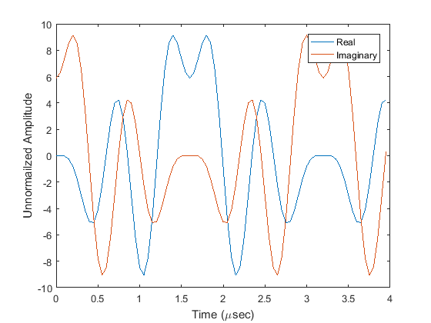
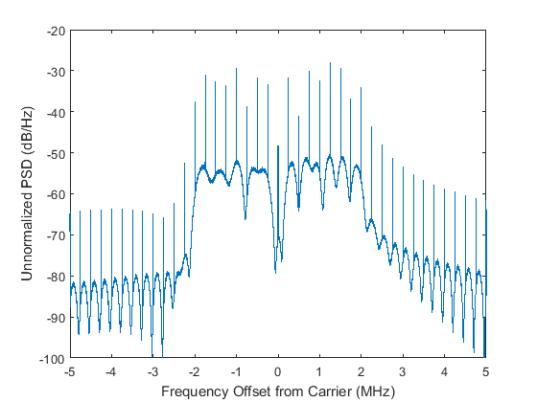
Waveform Generation Using OFDM Transmitter
OOK waveform:
Reuse 802.11 OFDM transmitter for OOK waveform generation
Still, a single carrier OOK signal that uses a sequence of complex numbers assigned in the frequency domain for the “on” state of the OOK.
Example: OOK symbol is constructed by
Populating 13 subcarriers (for example, can use the non-null L-STF sequence with 312.5 kHz spacing) to obtain:
Approximately 4 MHz of bandwidth
4 µsec symbol period; with the inclusion of 0.8 µsec cyclic prefix

Slide 6
Conclusion
We proposed to use the existing WLAN OFDM transmitter to generate the wake-up waveform.
This wake-up waveform is used to modulate the payload in an OOK scheme.
The OOK modulation scheme provides
A very low power receiver design
Simple non-coherent envelop detector where the complexity of demodulation is with setting a correct threshold

Slide 7
Straw Poll 1
Do you support the use of OOK for modulation of the payload portion of the wake-up packet?
Yes
No
Abstain

Slide 8
Straw Poll 2
Do you support to generate wake-up waveform by populating a certain number of the OFDM subcarriers?
Yes
No
Abstain

Slide 9
References
[1] Minyoung Park et al., “LP-WUR (Low-Power Wake-Up Receiver) Follow-Up”, IEEE 802.11-16/0341r0, Mar. 14, 2016.
[2] Shouxing Simon Qu et al., , “On Error Rate Performance of OOK in AWGN”, IEEE 802.11-16/1144r0, Sept. 12, 2016.
[3] Eunsung Park et al., , “Performance Investigation on Wake-Up Receiver”, IEEE 802.11-16/0865r1, July 26, 2016.
[4] Eunsung Park et al., , “Further Investigation on WUR
Performance”, IEEE 802.11-16/1144r0, Sept. 12, 2016.
[5] C. Salazar, A. Kaiser, A. Cathelin, J. Rabaey, “A −97dBm-sensitivity interferer-resilient 2.4GHz wake-up receiver using dual-IF multi-N-Path architecture in 65nm CMOS”, IEEE Int. Solid-State Circuits Conf. Dig. Tech. Papers, pp. 242-244, 2015

