Slide 1
Usage Model for Power Saving AP
Date: 2017-01-16
Authors:

Slide 2
Abstract
A home usage where an AP is the receiver side of the Wake Up Radio is proposed to enable the AP to be in power saving mode.

Slide 3
Home Usage
Currently most of the APs are stayed power-on even when all the household members are out.
  Most of the users are lazy to power-on and off their APs.
Especially in apartments, a lot of APs can be observed. These APs in different households are interferer to each other. If the APs can have their main radio turned off when not used, interference at apartments may be reduced.

Slide 4
With WUR function…
APs can be in power saving mode
  By the LP-WUR unit equipped at the APs.
  Ideally, it will be good if no action is required to the users.
Main module
(802.11)
LP-WUR

Slide 5
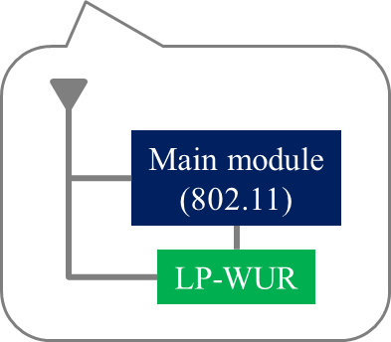
Usage Model: Home with Power Saving AP
When all the user-held STAs leave home, the AP turns off its main radio.
When one of the user-held STAs is back home, the AP will receive the WUR signal and turns on the main radio.

Slide 6
Usage Model: Home with Power Saving AP
Requirements:
  The STA side will have the functionality to transmit wake up signals
    STAs may be such as smartphones carried by household members
  The AP side will have the main radio + LP-WUR and functionality
    to receive wake up signals by LP-WUR
    when such signal is received, to turn on the main radio
    and to turn off the main radio automatically based on timeout or manually

Slide 7
Issues that may be needed to consider
How the STA side can determine to start sending the wake up signals?
  A STA has no idea whether its user came back home…
    Let the user to trigger the STA? – Then adding such SAP primitives will be a solution.
    But again, ideally, it will be good if no action is required to the users.
    Add a mechanism to start sending wake up signals in combination with the Probe Request timeout?

Slide 8
Straw Poll
Do you agree to add a usage model that is described in p.5-6?
  Y/N/A=

