Slide 1
UL Training Protocol for DL MU-MIMO in 802.11ay
Date:
Authors:

Slide 2
Introduction
DL MU-MIMO is included in 11ay
An essential part of DL MU-MIMO operation is the obtaining of channel information (at the AP) for proper user pairing and precoding
Depending on the scenario, UL training may be more efficient (lower overhead etc.) than explicit (DL) training
And vice versa
Other 5G communities are adopting UL training for mmWave

Slide 3
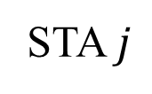
Hardware Model
…
…
$N_{RF}^{AP}$ RF chains
AP
$N^{AP}$antennas
…
…
$N_{RF}^{STA}$ RF chains
STA $j$
$N^{STA}$antennas
We consider a hybrid scenario (not fully digital)
Due to this, we need to find good analog beams (SLS, BRP, etc.) before doing any digital precoding
The proposed UL training mechanism is useful for both

Slide 4
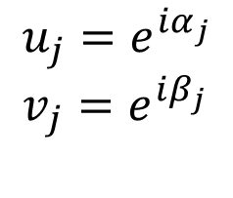
Generating Transmit Beams in Hybrid Mode
Transmitting a beam $w$ (a.k.a. sector):
$$w={\left[w_{1} w_{2} w_{3} w_{4}\right]}^{T}=p_{1}u+p_{2}v={p_{1}\left[u_{1} u_{2} u_{3} u_{4}\right]}^{T}+p_{2}{\left[v_{1} v_{2} v_{3} v_{4}\right]}^{T}, \\ where p_{1},p_{2}∈ℂ$$
$$u_{1}$$
+
$$w_{1}$$
$$v_{1}$$
$$u_{2}$$
+
$$w_{2}$$
$$v_{2}$$
$$u_{3}$$
+
$$w_{3}$$
$$v_{3}$$
$$u_{4}$$
+
$$w_{4}$$
$$v_{4}$$
$$p_{1}$$
$$p_{2}$$
$$u_{j}=e^{iα_{j}} \\ v_{j}=e^{iβ_{j}}$$
Typically
RF
RF

Slide 5
Example: Classic Hybrid Structure Transmission
Transmit beams/sectors corresponding to classic hybrid structure
$$w_{1}$$
$$w_{2}$$
RF
RF
…
…
$$w_{N}$$
$$w_{N+1}$$
RF
RF
$$w_{N+2}$$
…
…
$$w_{2N}$$
$$w_{1}={\left[w_{1}…w_{N} 0…0\right]}^{T}$$
$$w_{2}={\left[0…0 w_{N+1}…w_{2N}\right]}^{T}$$

Slide 6
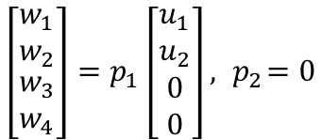
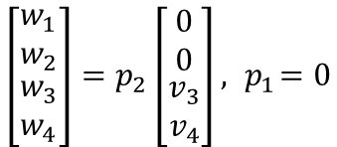
Example: Classic Hybrid Structure Transmission Implementation
A way to implement the classic hybrid transmission
$$u_{1}$$
+
$$w_{1}$$
$$u_{1}$$
+
$$w_{1}$$
$$u_{2}$$
+
$$w_{2}$$
$$u_{2}$$
+
$$w_{2}$$
$$v_{3}$$
+
$$w_{3}$$
$$v_{3}$$
+
$$w_{3}$$
$$v_{4}$$
+
$$w_{4}$$
$$v_{4}$$
+
$$w_{4}$$
$$p_{1}$$
$$p_{2}$$
$$p_{1}$$
$$p_{2}$$
$$\left[\begin{matrix}w_{1} \\ w_{2} \\ \begin{matrix}w_{3} \\ w_{4}\end{matrix}\end{matrix}\right]=p_{1}\left[\begin{matrix}u_{1} \\ u_{2} \\ \begin{matrix}0 \\ 0\end{matrix}\end{matrix}\right], { p}_{2}=0$$
$$\left[\begin{matrix}w_{1} \\ w_{2} \\ \begin{matrix}w_{3} \\ w_{4}\end{matrix}\end{matrix}\right]=p_{2}\left[\begin{matrix}0 \\ 0 \\ \begin{matrix}v_{3} \\ v_{4}\end{matrix}\end{matrix}\right], { p}_{1}=0$$
RF
RF
RF
RF

Slide 7
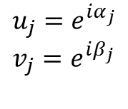
Generating Receive Beams in Hybrid Mode
Receiving simultaneously with beams/sectors $u,v$
$$y_{1}$$
$$y_{2}$$
$$y_{3}$$
$$y_{4}$$
$$u_{1}$$
$$u_{2}$$
$$u_{3}$$
$$u_{4}$$
$$v_{1}$$
$$v_{2}$$
$$v_{3}$$
$$v_{4}$$
$$u_{j}=e^{iα_{j}} \\ v_{j}=e^{iβ_{j}}$$
+
+
$$u=\left[u_{1} u_{2} u_{3} u_{4}\right] \\ v=\left[v_{1} v_{2} v_{3} v_{4}\right]$$
RF
RF
$$r_{1}$$
$$r_{2}$$
$$r=\left[\begin{matrix}u \\ v\end{matrix}\right]y$$

Slide 8
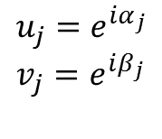
Example: Hybrid Structure Reception
$$y_{1}$$
$$y_{2}$$
$$y_{3}$$
$$y_{4}$$
$$u_{1}$$
$$u_{2}$$
$$v_{3}$$
$$v_{4}$$
$$u=[u_{1} u_{2} 0 0]$$
$$u_{j}=e^{iα_{j}} \\ v_{j}=e^{iβ_{j}}$$
$$v=[0 0 v_{3} v_{4}]$$
+
+
RF
RF
$$r_{1}$$
$$r_{2}$$
$$r=\left[\begin{matrix}u \\ v\end{matrix}\right]y$$

Slide 9
Main Observations: Enhanced SLS Example
Consider an AP (2 RF chains) that transmits 4 sectors to a single STA (1 RF chain) with 2 receive sectors during enhanced SLS [1]
RF
RF
TRN-R
TRN-R
TRN-R
TRN-R
AP
RF
STA
It takes in total 4×2 = 8 TRN-R subfield slots

Slide 10
Main Observations: Enhanced SLS Example in UL
By reversing the previous procedure, the AP can listen to 2 sectors simultaneously (since it has 2 RF chains)
RF
RF
AP
RF
TRN-R
TRN-R
STA
It takes in total 2×4/2 = 4 TNR-R subfield slots (half the overhead compared to DL)

Slide 11
BRP DL
The previous reversal to UL training can as well be applied to the BRP procedure
RF
RF
BRP
BRP
BRP
BRP
AP
RF
STA
It takes in total 4×4 = 16 BRP subfield slots

Slide 12
BRP UL
We now reverse the DL BRP, so that it becomes UL BRP
RF
RF
AP
RF
BRP
BRP
BRP
BRP
STA
It takes in total 4×4/2 = 8 BRP subfield slots (half the overhead compared to BRP DL)

Slide 13
DL/UL Overhead Comparison

Slide 14
DL/UL Overhead Comparison (Detailed)
Hardware & scenario
dependent (shaded boxes)
Previous presentation showed: $\frac{\#DL Training Slots}{\#UL Training Slots}=\left(\frac{N_{RF}^{AP}}{KN_{RF}^{STA}}\right)+\frac{N_{RF}^{AP}T_{f}}{S^{AP}S^{STA}}$
Implementation
dependent
Clearly, if $KN_{RF}^{STA}<N_{RF}^{AP}$, DL training overhead is larger
Independent of the feedback packet duration $T_{f}$
In general, the larger the $N_{RF}^{AP}$, the larger the DL training overhead

Slide 15
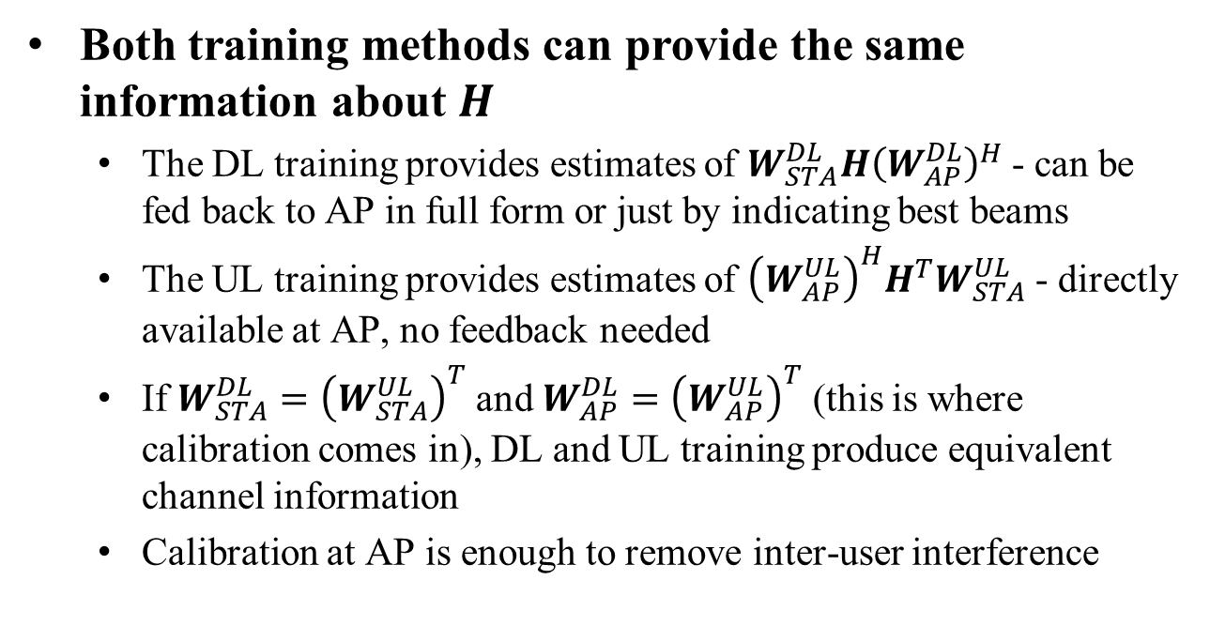
DL/UL Training Duality
Both training methods can provide the same information about $H$
The DL training provides estimates of $W_{STA}^{DL}H{\left(W_{AP}^{DL}\right)}^{H}$ - can be fed back to AP in full form or just by indicating best beams
The UL training provides estimates of ${\left(W_{AP}^{UL}\right)}^{H}H^{T}W_{STA}^{UL}$ - directly available at AP, no feedback needed
If $W_{STA}^{DL}={\left(W_{STA}^{UL}\right)}^{T}$ and $W_{AP}^{DL}={\left(W_{AP}^{UL}\right)}^{T}$ (this is where calibration comes in), DL and UL training produce equivalent channel information
Calibration at AP is enough to remove inter-user interference

Slide 16
Impact of Channel Characteristics
If complete (or almost complete) channel estimate is required, the overhead can be reduced significantly with UL training
There are indoor mmWave (58.7 GHz) channels that contain significant multipaths [2] – might require more than LOS estimate

Slide 17
UL Training Protocol
AP sends out a trigger frame for UL training
STA 1
AP
Trigger frame
STA 2
STAs transmit (directional or omni) in UL (simultaneous or sequential) and AP listens to different sectors
Pilot packet
STA 1
AP
is orthogonal to
Pilot packet
STA 2

Slide 18
Benefits of UL Training
Significantly less training overhead (for same channel information) in many scenarios
Requires no feedback
The AP can estimate the best analog Tx-Rx beam configuration itself
The AP also obtains digital CEF for the best analog Tx-Rx beam configuration (no STA feedback needed)
The AP only informs STAs (during DL packet) which analog beams that they transmitted were best (so these are used as receiving beams at STAs)

Slide 19
References
[1] IEEE 802.11-17/0067r1
[2] J. Medbo, N. Seifi, H. Asplund, ”Frequency Dependency of Measured Highly Resolved Directional Propagation Channel Characteristics”, European Wireless 2016 (invited paper)

Slide 20
Straw Poll
Do you support including the principles of Uplink training (as outlined on page 17 of this presentation) into the 802.11ay draft?
Note: Inclusion into the draft is subject to the availability of normative text
Yes
No
Further studies wanted

