Slide 1
UL Training Protocol for DL MU-MIMO in 802.11ay
Date:
Authors:

Slide 2
Introduction
DL MU-MIMO is included in 11ay
An essential part of DL MU-MIMO operation is the obtaining of channel information for proper precoding and user pairing
With massive antenna arrays in 11ay, it is unclear if explicit training (DL training) is always to prefer, or if sometimes UL training could be more effective
  Cellular community will adopt UL training in 5G for mmWave scenarios

Slide 3





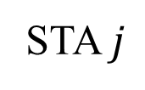





General Scenario
AP transmit beam codebook
…
…
$$U_{Tx}^{AP}=\left\{u_{Tx,1}^{AP},u_{Tx,2}^{AP},…,u_{Tx,S^{AP}}^{AP}\right\}$$
$N_{RF}^{AP}$ RF chains
AP
$N^{AP}$antennas
AP receive beam codebook
$$U_{Rx}^{AP}=\left\{u_{Rx,1}^{AP},u_{Rx,2}^{AP},…,u_{Rx,S^{AP}}^{AP}\right\}$$
STA $j$ transmit beam codebook
…
$$U_{Tx}^{STA_{j}}=\left\{u_{Tx,1}^{STA_{j}},u_{Tx,2}^{STA_{j}},…,u_{Tx,S^{STA} }^{STA_{j}}\right\}$$
$N_{RF}^{STA}$ RF chains
STA $j$
…
$N^{STA}$antennas
STA $j$ receive beam codebook
$$U_{Rx}^{STA_{j}}=\left\{u_{Rx,1}^{STA_{j}},u_{Rx,2}^{STA_{j}},…,u_{Rx,S^{STA}}^{STA_{j}}\right\}$$

Slide 4





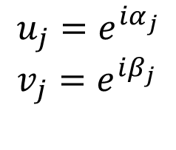
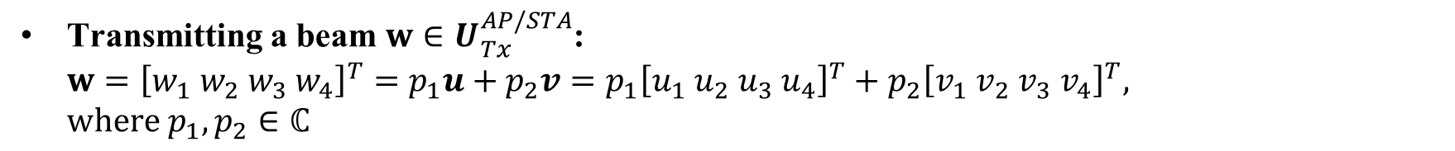









Generating Transmit Beams
Transmitting a beam $w∈U_{Tx}^{AP/STA}$:
$w={\left[w_{1} w_{2} w_{3} w_{4}\right]}^{T}=p_{1}u+p_{2}v={p_{1}\left[u_{1} u_{2} u_{3} u_{4}\right]}^{T}+p_{2}{\left[v_{1} v_{2} v_{3} v_{4}\right]}^{T},$
$where p_{1},p_{2}∈ℂ$
$$u_{1}$$
+
$$w_{1}$$
$$v_{1}$$
$$u_{2}$$
+
$$w_{2}$$
$$v_{2}$$
$$u_{3}$$
+
$$w_{3}$$
$$v_{3}$$
$$u_{4}$$
+
$$w_{4}$$
$$v_{4}$$
$$p_{1}$$
$$p_{2}$$
$$u_{j}=e^{iα_{j}} \\ v_{j}=e^{iβ_{j}}$$
Typically
RF
RF

Slide 5








Example: Hybrid Structure Transmission
Transmit codebook beams corresponding to classic hybrid structure
$$w_{1}$$
$$w_{2}$$
RF
RF
…
…
$$w_{N}$$
$$w_{N+1}$$
RF
RF
$$w_{N+2}$$
…
…
$$w_{2N}$$
$$w={\left[w_{1}…w_{N} 0…0\right]}^{T}∈U_{Tx}^{AP/STA}$$
$$w={\left[0…0 w_{N+1}…w_{2N}\right]}^{T}∈U_{Tx}^{AP/STA}$$

Slide 6

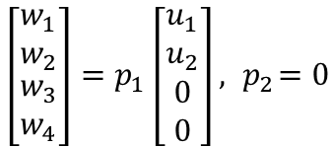

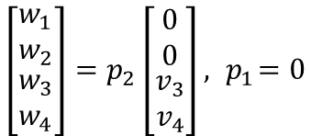










Example: Hybrid Structure Transmission
Transmit codebook beams corresponding to classic hybrid structure
$$u_{1}$$
+
$$w_{1}$$
$$u_{1}$$
+
$$w_{1}$$
$$u_{2}$$
+
$$w_{2}$$
$$u_{2}$$
+
$$w_{2}$$
$$v_{3}$$
+
$$w_{3}$$
$$v_{3}$$
+
$$w_{3}$$
$$v_{4}$$
+
$$w_{4}$$
$$v_{4}$$
+
$$w_{4}$$
$$p_{1}$$
$$p_{2}$$
$$p_{1}$$
$$p_{2}$$
$$\left[\begin{matrix}w_{1} \\ w_{2} \\ \begin{matrix}w_{3} \\ w_{4}\end{matrix}\end{matrix}\right]=p_{1}\left[\begin{matrix}u_{1} \\ u_{2} \\ \begin{matrix}0 \\ 0\end{matrix}\end{matrix}\right], { p}_{2}=0$$
$$\left[\begin{matrix}w_{1} \\ w_{2} \\ \begin{matrix}w_{3} \\ w_{4}\end{matrix}\end{matrix}\right]=p_{2}\left[\begin{matrix}0 \\ 0 \\ \begin{matrix}v_{3} \\ v_{4}\end{matrix}\end{matrix}\right], { p}_{1}=0$$
RF
RF
RF
RF

Slide 7

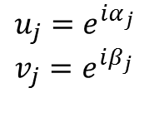









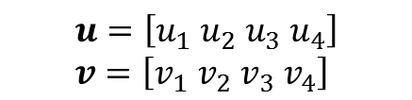



Generating Receive Beams
Receiving simultaneously with beams $u,v∈U_{Rx}^{AP/STA}$
$$y_{1}$$
$$y_{2}$$
$$y_{3}$$
$$y_{4}$$
$$u_{1}$$
$$u_{2}$$
$$u_{3}$$
$$u_{4}$$
$$v_{1}$$
$$v_{2}$$
$$v_{3}$$
$$v_{4}$$
$$u_{j}=e^{iα_{j}} \\ v_{j}=e^{iβ_{j}}$$
+
+
$$u=\left[u_{1} u_{2} u_{3} u_{4}\right] \\ v=\left[v_{1} v_{2} v_{3} v_{4}\right]$$
RF
RF
$$r_{1}$$
$$r_{2}$$
$$r=\left[\begin{matrix}u \\ v\end{matrix}\right]y$$

Slide 8










Example: Hybrid Structure Reception
$$y_{1}$$
$$y_{2}$$
$$y_{3}$$
$$y_{4}$$
$$u_{1}$$
$$u_{2}$$
$$v_{3}$$
$$v_{4}$$
$$u=[u_{1} u_{2} 0 0]$$
$$v=[0 0 v_{3} v_{4}]$$
+
+
RF
RF
$$r_{1}$$
$$r=\left[\begin{matrix}u \\ v\end{matrix}\right]y$$
$$r_{2}$$

Slide 9

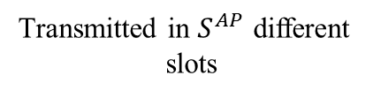
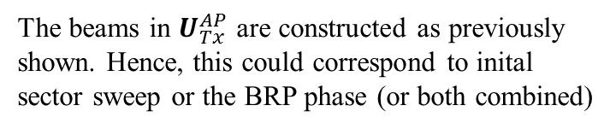



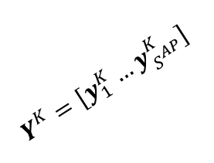

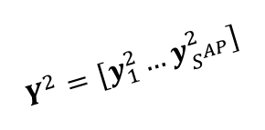

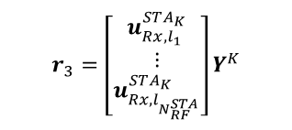


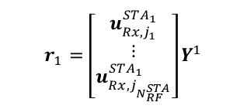

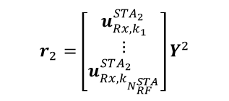

DL Training
Listening to $N_{RF}^{STA}$ beams simultaneously
$$U_{Tx}^{STA}=\left\{u_{Tx,1}^{STA},u_{Tx,2}^{STA},…,u_{}^{STA}\right\}$$
Transmitted in $S^{AP}$ different
slots
$$U_{Rx}^{STA_{1}}=\left\{u_{Rx,1}^{STA_{1}},u_{Rx,2}^{STA_{1}},…,u_{Rx,S^{STA} }^{STA_{1}}\right\}$$
$$r_{1}=\left[\begin{matrix}u_{Rx,j_{1}}^{STA_{1}} \\ ⋮ \\ u_{Rx,j_{N_{RF}^{STA}}}^{STA_{1}}\end{matrix}\right]Y^{1}$$
$$Y^{1}=[y_{1}^{1}…y_{S^{AP}}^{1}]$$
STA 1
$$ds$$
$$H=\left[\begin{matrix}H_{1} \\ H_{2} \\ \begin{aligned}⋮ \\ H_{K}\end{aligned}\end{matrix}\right]$$
$$u_{Tx,1}^{AP}, u_{Tx,2}^{AP},…,u_{Tx,S^{AP} }^{AP}$$
$$U_{Rx}^{STA_{2}}=\left\{u_{Rx,1}^{STA_{2}},u_{Rx,2}^{STA_{2}},…,u_{Rx,S^{STA}}^{STA_{2}}\right\}$$
AP
$$r_{2}=\left[\begin{matrix}u_{Rx,k_{1}}^{STA_{2}} \\ ⋮ \\ u_{Rx,k_{N_{RF}^{STA}}}^{STA_{2}}\end{matrix}\right]Y^{2}$$
$$Y^{2}=[y_{1}^{2}…y_{S^{AP}}^{2}]$$
STA 2
$$U_{Tx}^{AP}=\left\{u_{Tx,1}^{AP},u_{Tx,2}^{AP},…,u_{Tx,S^{AP} }^{AP}\right\}$$
$Y^{K}$ $=[y_{1}^{K}…y_{S^{AP}}^{K}]$
$$U_{Rx}^{STA_{K}}=\left\{u_{Rx,1}^{STA_{K}},u_{Rx,2}^{STA_{K}},…,u_{Rx,S^{STA}}^{STA_{K}}\right\}$$
The beams in $U_{Tx}^{AP}$ are constructed as previously
shown. Hence, this could correspond to inital
sector sweep or the BRP phase (or both combined)
$$r_{3}=\left[\begin{matrix}u_{Rx,l_{1}}^{STA_{K}} \\ ⋮ \\ u_{Rx,l_{N_{RF}^{STA}}}^{STA_{K}}\end{matrix}\right]Y^{K}$$
STA K

Slide 10

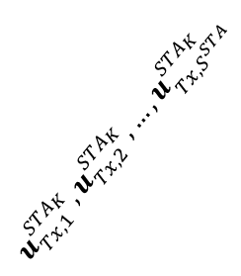
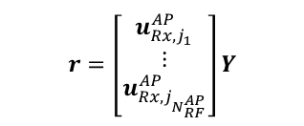
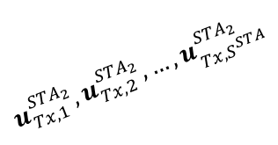



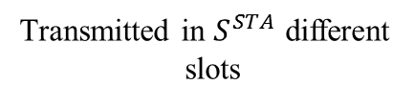




UL Training
Transmitted in $S^{STA}$ different
slots
$$U_{Tx}^{STA}=\left\{u_{Tx,1}^{STA},u_{Tx,2}^{STA},…,u_{}^{STA}\right\}$$
Listening to $N_{RF}^{AP}$
beams simultaneously
$$U_{Tx}^{STA_{1}}=\left\{u_{Tx,1}^{STA_{1}},u_{Tx,2}^{STA_{1}},…,u_{Tx,S^{STA}}^{STA_{1}}\right\}$$
STA1
$$u_{Tx,1}^{STA_{1}}, u_{Tx,2}^{STA_{1}},…,u_{Tx,S^{STA}}^{STA_{1}}$$
$$r=\left[\begin{matrix}u_{Rx,j_{1}}^{AP} \\ ⋮ \\ u_{Rx,j_{N_{RF}^{AP}}}^{AP}\end{matrix}\right]Y$$
$$ds$$
$$H^{T}=\left[\begin{matrix}H_{1}^{T} \\ H_{2}^{T} \\ \begin{aligned}⋮ \\ H_{K}^{T}\end{aligned}\end{matrix}\right]$$
$$U_{Tx}^{STA_{2}}=\left\{u_{Tx,1}^{STA_{2}},u_{Tx,2}^{STA_{2}},…,u_{Tx,S^{STA}}^{STA_{2}}\right\}$$
$$Y$$
AP
$$u_{Tx,1}^{STA_{2}}, u_{Tx,2}^{STA_{2}},…,u_{Tx,S^{STA}}^{STA_{2}}$$
STA2
$$U_{Rx}^{AP}=\left\{u_{Rx,1}^{AP},u_{Rx,2}^{AP},…,u_{Rx,S^{AP} }^{AP}\right\}$$
$$u_{Tx,1}^{STA_{K}}, u_{Tx,2}^{STA_{K}},…,u_{Tx,S^{STA}}^{STA_{K}}$$
$$U_{Tx}^{STA_{K}}=\left\{u_{Tx,1}^{STA_{K}},u_{Tx,2}^{STA_{K}},…,u_{Tx,S^{STA}}^{STA_{K}}\right\}$$
is orthogonal to
STA K
is orthogonal to

Slide 11
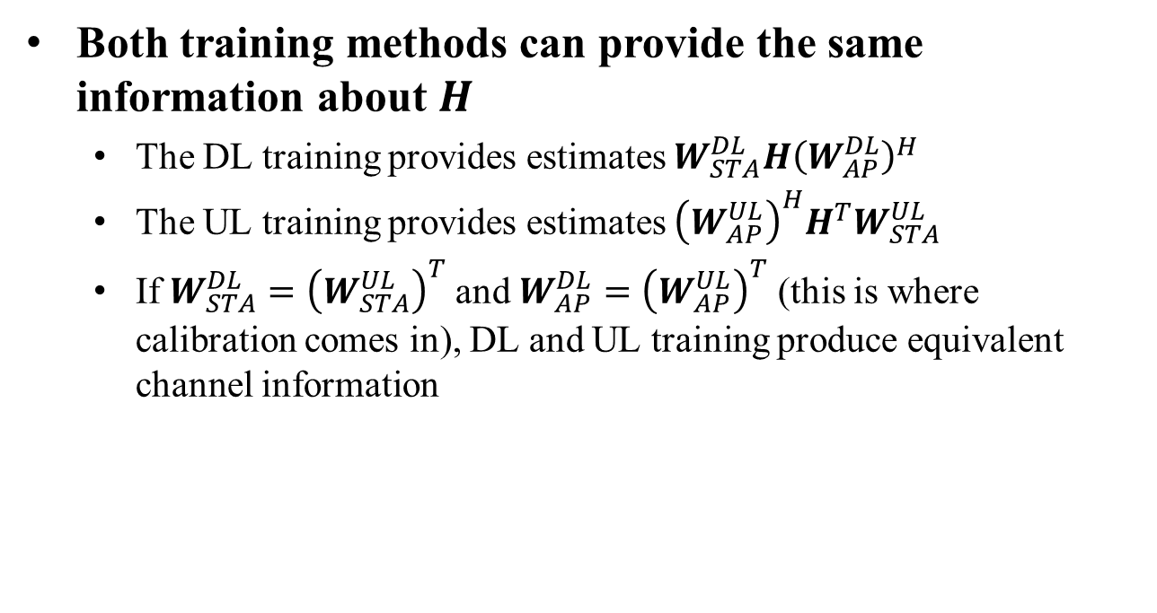
DL/UL Training Duality
Both training methods can provide the same information about $H$
  The DL training provides estimates $W_{STA}^{DL}H{\left(W_{AP}^{DL}\right)}^{H}$
  The UL training provides estimates ${\left(W_{AP}^{UL}\right)}^{H}H^{T}W_{STA}^{UL}$
  If $W_{STA}^{DL}={\left(W_{STA}^{UL}\right)}^{T}$ and $W_{AP}^{DL}={\left(W_{AP}^{UL}\right)}^{T}$ (this is where calibration comes in), DL and UL training produce equivalent channel information

Slide 12
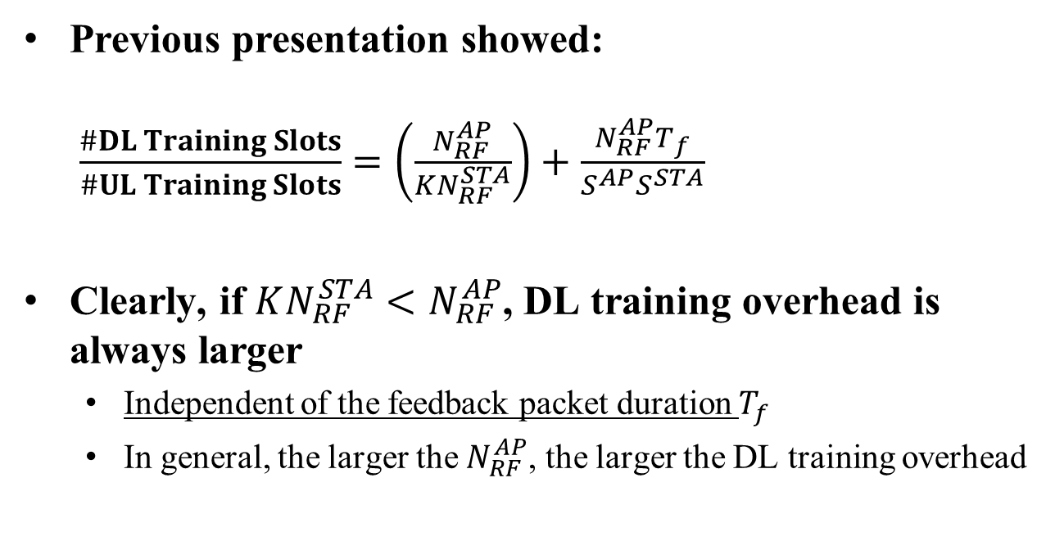
DL/UL Overhead Comparison
Hardware & scenario
dependent
Previous presentation showed:
$\frac{\#DL Training Slots}{\#UL Training Slots}=\left(\frac{N_{RF}^{AP}}{KN_{RF}^{STA}}\right)+\frac{N_{RF}^{AP}T_{f}}{S^{AP}S^{STA}}$
Clearly, if $KN_{RF}^{STA}<N_{RF}^{AP}$, DL training overhead is always larger
  Independent of the feedback packet duration $T_{f}$
  In general, the larger the $N_{RF}^{AP}$, the larger the DL training overhead
Implementation
dependent

Slide 13
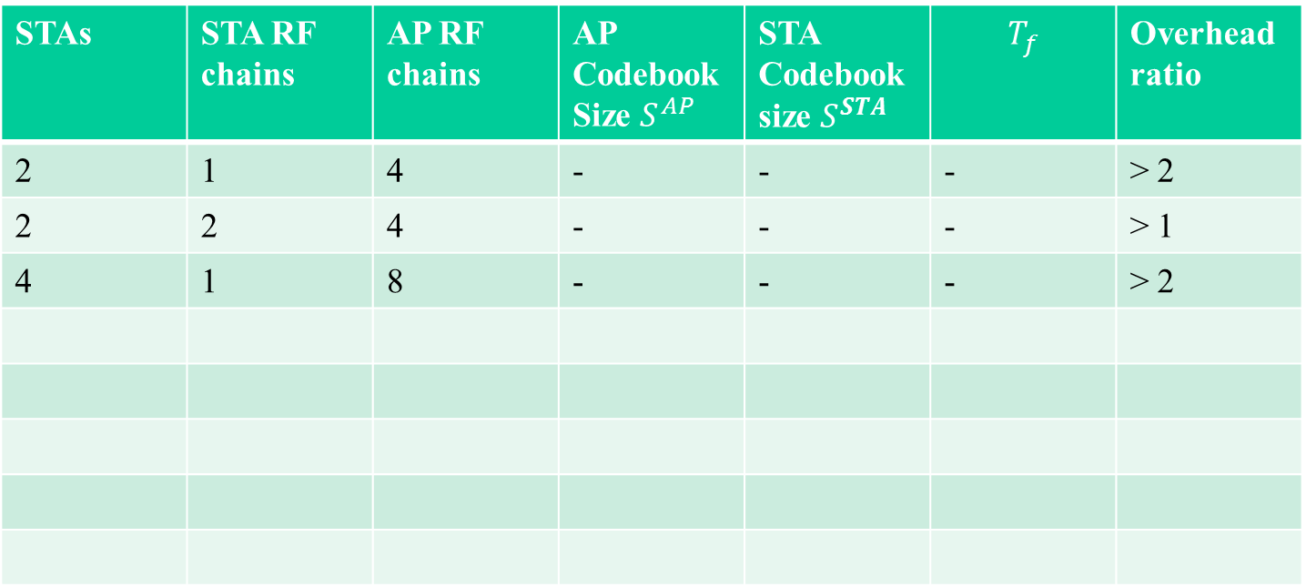
Overhead Comparison
STAs | STA RF chains | AP RF chains | AP Codebook Size $S^{AP}$ | STA Codebook size $S^{STA}$ | $$T_{f}$$ | Overhead ratio
2 | 1 | 4 | - | - | - | > 2
2 | 2 | 4 | - | - | - | > 1
4 | 1 | 8 | - | - | - | > 2

Slide 14
UL Training Protocol
AP sends out a trigger frame
STA 1
AP
Trigger frame
STA 2
STAs transmit training (pilot) packets in UL (via orthogonal matrices)
Pilot packet
STA 1
AP
is orthogonal to
Pilot packet
STA 2

Slide 15
Relation to BRP
The proposed scheme is the dual of BRP in 11ad
  11ad BRP: AP transmits different beams in DL and receives feedback on best beams
  UL training BRP: STAs transmit in UL and AP projects the incoming signal on the BRP vectors. No AP feedback
The ”initial sector sweep” and BRP codebooks are instead used to project the UL signal at the AP
  In the end, the same amount of information is obtained about the channel as with 11ad BRP
One could, e.g., use UL training for initial sweep and perform BRP in DL

Slide 16
Benefits of UL Training
Significantly less training overhead (for same channel information) in many scenarios
Much faster ”full channel” estimation for advanced DL MU-MIMO transmission schemes
  Suitable for scenarios with STA movement and NLOS channels (such as the virtual reality use-case)
Requires no AP polling nor feedback from STAs

Slide 17
Straw Poll
Do you support that the 802.11ay SFD includes the UL training mechanism for DL MU-MIMO transmissions?
Yes
No
Abstain

