Slide 1
TRN sub-fields cyclic extension
Date: 2017-January-15
Authors:
Name | Company | Email
Alecsander Eitan | Qualcomm | eitana@qti.qualcomm.com
Assaf Kasher | Qualcomm | akasher@qti.qualcomm.com
Amichai Sanderovich | Qualcomm | amichais@qti.qualcomm.com

Slide 2
Agenda
Current TRN subfields do not have a cyclic suffix at the end of the sequence.
This means that when time domain processing is used for “channel estimation” on the TRN sequences have inaccuracies.
Usages for channel estimate in TRN subfields:
  Selection of sector according to channel quality (capacity) rather than RSSI
  Selection of MIMO pair according to capacity.

Slide 3
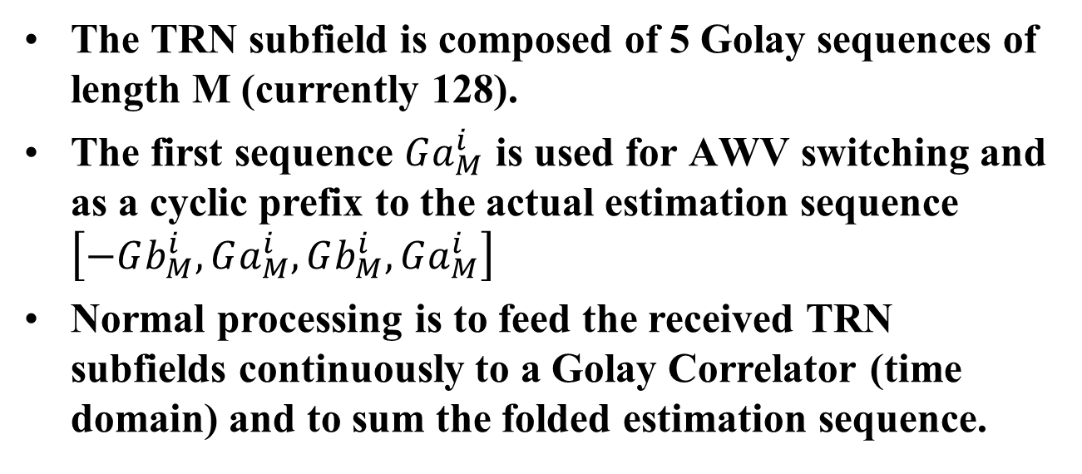
Current Structure
The TRN subfield is composed of 5 Golay sequences of length M (currently 128).
The first sequence $Ga_{M}^{i}$ is used for AWV switching and as a cyclic prefix to the actual estimation sequence $\left[−Gb_{M}^{i},Ga_{M}^{i},Gb_{M}^{i},Ga_{M}^{i}\right]$
Normal processing is to feed the received TRN subfields continuously to a Golay Correlator (time domain) and to sum the folded estimation sequence.

Slide 4
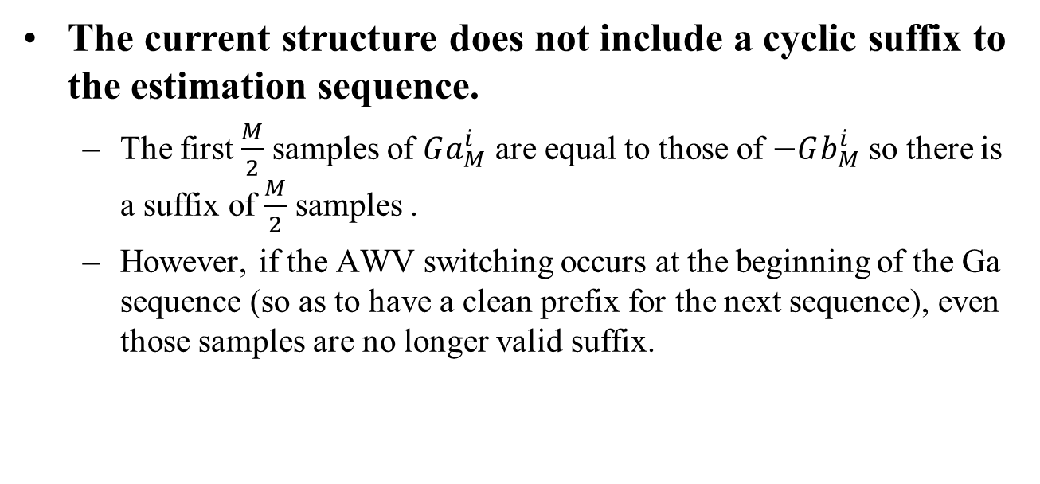
Problem
The current structure does not include a cyclic suffix to the estimation sequence.
  The first $\frac{M}{2}$ samples of $Ga_{M}^{i}$ are equal to those of $−Gb_{M}^{i}$ so there is a suffix of $\frac{M}{2}$ samples .
  However, if the AWV switching occurs at the beginning of the Ga sequence (so as to have a clean prefix for the next sequence), even those samples are no longer valid suffix.

Slide 5
Result
We see that we get an incorrect impulse response when estimating with a Golay Correlator directly on the received signal.

Slide 6
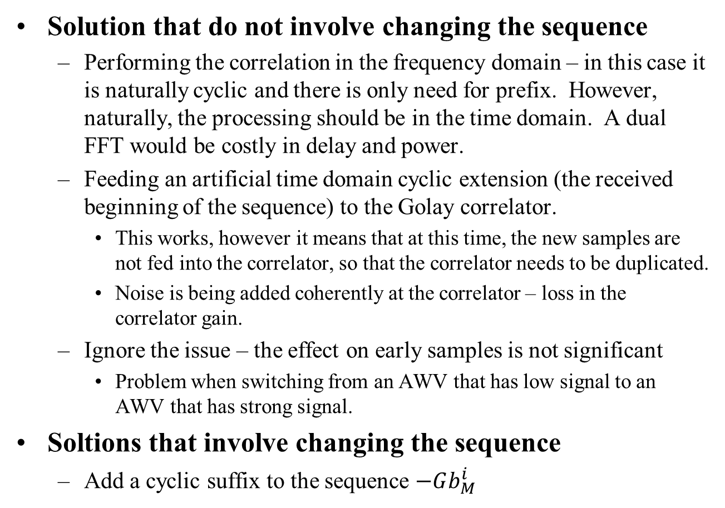
Possible Solutions
Solution that do not involve changing the sequence
  Performing the correlation in the frequency domain – in this case it is naturally cyclic and there is only need for prefix. However, naturally, the processing should be in the time domain. A dual FFT would be costly in delay and power.
  Feeding an artificial time domain cyclic extension (the received beginning of the sequence) to the Golay correlator.
    This works, however it means that at this time, the new samples are not fed into the correlator, so that the correlator needs to be duplicated.
    Noise is being added coherently at the correlator – loss in the correlator gain.
  Ignore the issue – the effect on early samples is not significant
    Problem when switching from an AWV that has low signal to an AWV that has strong signal.
Soltions that involve changing the sequence
  Add a cyclic suffix to the sequence $−Gb_{M}^{i}$

Slide 7
Proposed Solution
Add a cyclic suffix to the TRN-subfield and sequences constructed from it.

Slide 8

Straw Poll
Do you support adding to the SFD:
“The basic TRN field has the structure: $\left[Ga_{M}^{i},−Gb_{M}^{i},Ga_{M}^{i},Gb_{M}^{i},Ga_{M}^{i},−Gb_{M}^{i}\right]$ where M is 128, 192, 256, 512 for Channel bonding 1,2,3,4 respectively and i is the spatial stream number

Slide 9
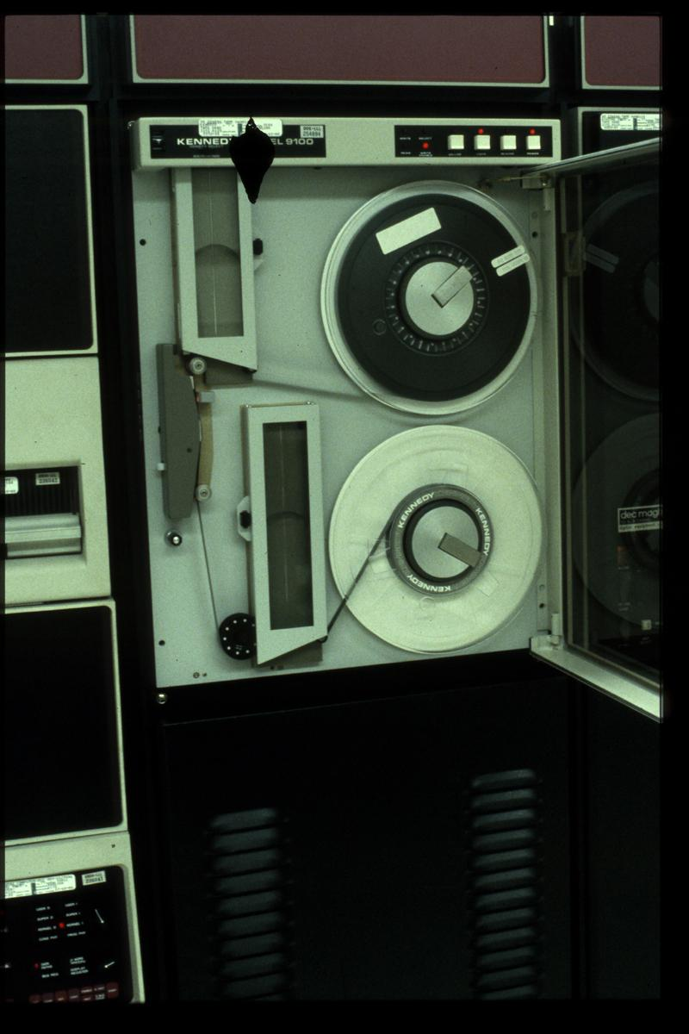
Backup

