Slide 1
Simulation Analysis of ED Threshold Levels in WLAN and LAA coexistence scenario
Date: 2017-1-17
Authors:
Name | Affiliation | Address | Email
Kosuke Aio | Sony |  | Kosuke.Aio@sony.com
Yuichi Morioka
Yusuke Tanaka

Slide 2
Introduction (1)
IEEE 802.11 WG established the “PDED ad hoc” to consider potential response to 3GPP RAN1’s request to change WLAN’s ED threshold from -62dBm to -72dBm
IEEE802.11-16/1291r0 [1] mentions that at least three experiments (by simulation and/or testing) are suggested to provide the basis to respond to the 3GPP RAN1 request
In November 2016 meeting at San Antonio, we analyzed case B) “some 802.11 STA uses ED of -72dBm”, where 802.11ax STAs use the new threshold” in IEEE802.11-16/1451r0 [2]

Slide 3
Introduction (2)
In this presentation, we further analyze using simulation scenario defined in 3GPP
  indoor scenario corresponding to TR36.889 [3]
We analyze the performance of 802.11 in these two cases;
  (1) What happens if both LAA and Wi-Fi operate at ED of -72dBm but with no PD communication
  (2) What happens if Wi-Fi operates using “Dynamic TX power and ED threshold control method”

Slide 4
(1) Simulation results on “What happens if both LAA and Wi-Fi operate at ED of -72dBm but with no PD communication”

Slide 5
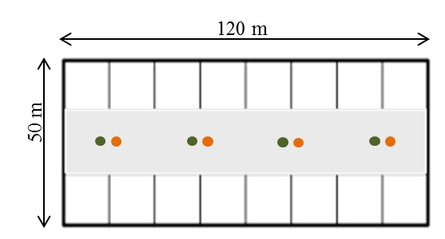
Simulation Scenario
Simulation scenario is based on 3GPP TR 36.889 [3]
  Indoor scenario for LAA coexistence evaluations within unlicensed band.
<Layout of nodes>
 | LAA | WLAN
Active Nodes | BS x 4, MS x 20 | BS x 4, MS x 20
Traffic Model & Load | Next slide
Channel Access Parameter (Appendix.1) | CW_{min}=15, CW_{max}=63, m=3, T_{m cot}=0 | CW_{min}=15, CW_{max}=1023, AIFSN=3, TXOP limit=0
MCS | 5 (Fixed)
Frequency | 5,180MHz
Bandwith | 20MHz
Max TX Power [dBm] | BS:+18, MS:+18 | BS:+18, MS:+18
Antenna Gain [dBi] | BS:+5, MS:0 | BS:+5, MS:0
Detect Th [dBm] | (PD,ED) = (NA, -72) | Next slide
Blue is LAA BS (eNB).
Green is WLAN BS (AP).
WLAN and LAA Mobile Stations (MS) are dropped randomly in this area. (20 drops)
Note : 11ax and LAA features such as OFDMA /Multi-user /HARQ are not enabled in this simulation to see the pure performance of channel access.

Slide 6
Simulation Setup
We set simulation setups as follows.
Traffic Model & Load |  | WLAN Detect Th [dBm]
(A) | Heavy Traffic Model FTP model 1 UDP (file size : 0.5Mbyte, lambda : 2.5) <DL> 20flows <UL> No traffic | (1) | Default Setup WLAN : (PD,ED) = (-82, -62)
 |  | (2) | 3GPP Requested Setup WLAN : (PD,ED) = (-82, -72)
(B) | Light Traffic Model CBR UDP (75kbps) <DL> 75kbps × 20flows <UL> No traffic | (1) | Default Setup WLAN : (PD,ED) = (-82, -62)
 |  | (2) | 3GPP Requested Setup WLAN : (PD,ED) = (-82, -72)
  * (A) FTP model 1 UDP is default traffic model defined for 3GPP indoor scenario corresponding to TR36.889 [3].
  This FTP model is described in 3GPP TR 36.814 [4].
  * (B) CBR UDP with 75kbps traffic load is used in the simulation for R1-156621[5].

Slide 7
What’s LAA’s ED rule?
According to LAA’s ED rule in 3GPP TS 36.213 [6], LAA can control ED threshold by maximum output power. (Appendix.2)
However, the ED threshold is static once maximum output power is selected
  Maximum output power is determined by rated output power declared by the manufacturer, and it can not change during operation
Therefore, LAA’s and WLAN’s ED threshold in this simulation is as follows.
  LAA’s ED is set to -72dBm (fixed) because LAA BS’s maximum output power is 23dBm including antenna gain.
  In (1) Default Setup, WLAN’s ED threshold is set to -62dBm (fixed).
  In (2) 3GPP Requested Setup, WLAN’s ED threshold is set to -72dBm (fixed) for the same reason as LAA’s BS.

Slide 8
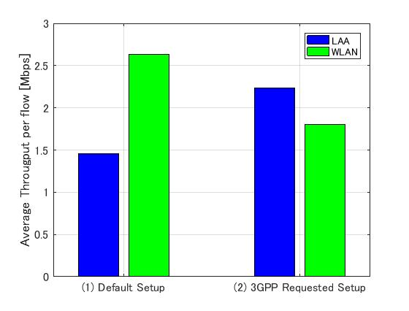
Simulation Result : (A) FTP model 1 UDP
・ Ave. DL Throughput per flow [Mbps]
Setup | LAA | WLAN
(1) | 1.46Mbps | 2.64 Mbps
(2) | 2.23Mbps | 1.80 Mbps
- If WLAN ED changes to -72dBm (fixed), Ave. DL throughput of LAA is higher than that of WLAN due to difference of channel access, such as CWmax.

Slide 9
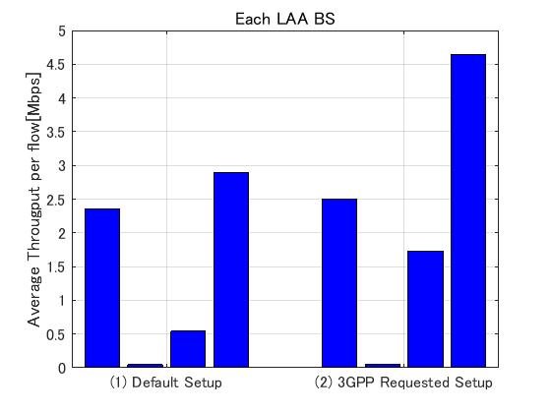
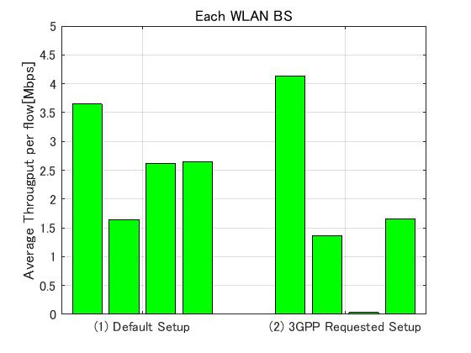
Simulation Result : (A) FTP model 1 UDP
・ Each BS Ave. DL Throughput per flow [Mbps]
- There is LAA BS that is muted in (1) Default Setup.
- Even if WLAN’s ED threshold changes to -72dBm, the performance of the muted BS is not improved

Slide 10
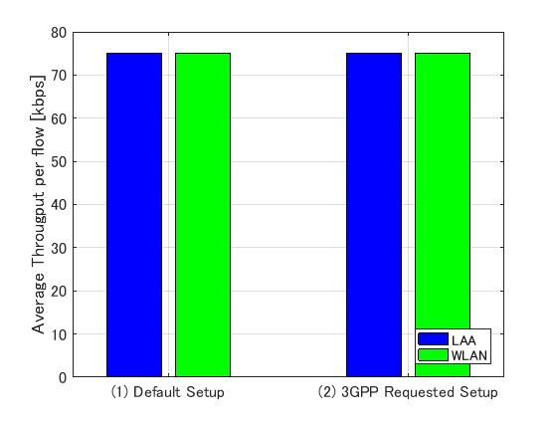
Simulation Result : (B) CBR UDP (75kbps)
・ Ave. DL Throughput per flow [Mbps]
Setup | LAA | WLAN
(1) | 75.0kbps | 75.0kbps
(2) | 75.0kbps | 75.0kbps
- LAA and WLAN average DL throughput is the same between two simulation setups (1) and (2) due to low traffic

Slide 11
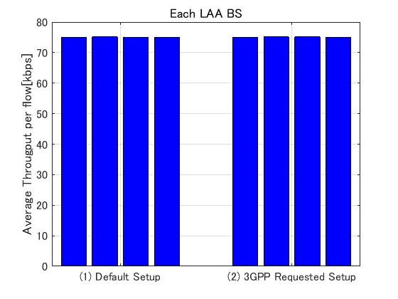
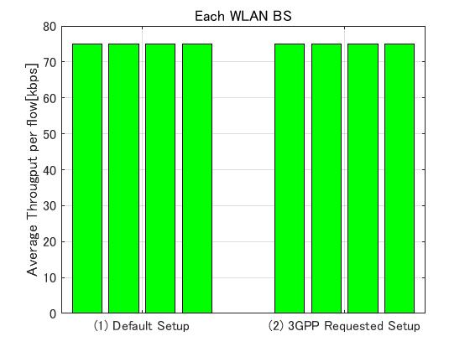
Simulation Result : (B) CBR UDP (75kbps)
・ Each BS Ave. DL Throughput per flow [Mbps]
- Average throughput of all BS is same at 75kbps.

Slide 12
Conclusion
From these simulation results, it can be observed that meeting 3GPP request is not a way to provide fair coexistence between LAA and WLAN especially in heavy networks, from the following two reasons;
  When WLAN uses the same ED threshold of -72dBm, throughput of LAA become higher than that of WLAN due to difference of channel access scheme.
  Furthermore, the lowest performance of LAA BS is not improved even if WALN changes ED threshold to -72dBm.
Therefore, we need to consider other method to provide fair coexistence
From next slide, we analyze dynamic TX power control and ED Threshold control to solve this problem

Slide 13
(2) Simulation results on “What happens if Wi-Fi operates using
Dynamic TX power and ED threshold control method”

Slide 14
Dynamic TX Power and ED Threshold Control
Current LAA’s ED Threshold is fixed by maximum output power
  Maximum output power can be lowered but that will result in smaller coverage
We analyze “Dynamic TX power and ED threshold control” for WLAN
  WLAN adjusts TX power according to anticipated recipient
  WLAN adjusts ED threshold by current TX power
WLAN BS
ED-th(dBm)
High TX power
Low ED threshold
Low TX power
High ED threshold
-62
WLAN MS_1
WLAN MS_2
-72
WLAN MS_2
(far from BS)
WLAN MS_1
(near from BS)
Current TX Pow(dBm)
13
23

Slide 15
Simulation Setup
Simulation setup is as follows
  (A)/(1)/(2) are the same as before
Traffic Model & Load |  | WLAN Detect Th [dBm]
(A) | FTP model 1 UDP (file size : 0.5Mbyte, lambda : 2.5) <DL> 20flows <UL> No traffic | (1) | Default Setup WLAN : (PD,ED) = (-82, -62)
 |  | (2) | 3GPP Requested Setup WLAN : (PD,ED) = (-82, -72)
 |  | (3) | Proposed Setup - WLAN : PD = -82 WLAN : ED = variable. (determined by current TX power) - Target RSSI = -52 (※)
* TX power [dBm] = Target RSSI [dBm] – Path Loss [dB]
(On the assumption that WLAN can get information about Path Loss between BS and MS)

Slide 16
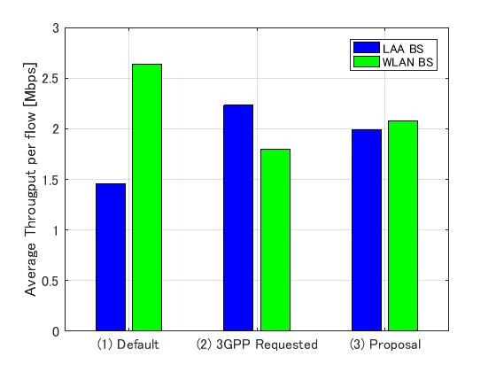
Simulation Result
・ Ave. DL Throughput per flow [Mbps]
Setup | LAA | WLAN
(1) | 1.46Mbps | 2.64 Mbps
(2) | 2.23Mbps | 1.80 Mbps
(3) | 2.00Mbps | 2.08Mbps
- If WLAN controls TX power and ED threshold, Ave. DL throughput of LAA and WLAN become comparable because WLAN can increase ED threshold

Slide 17
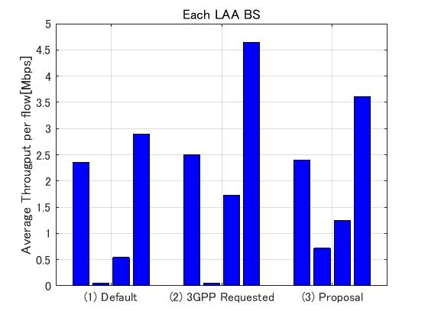
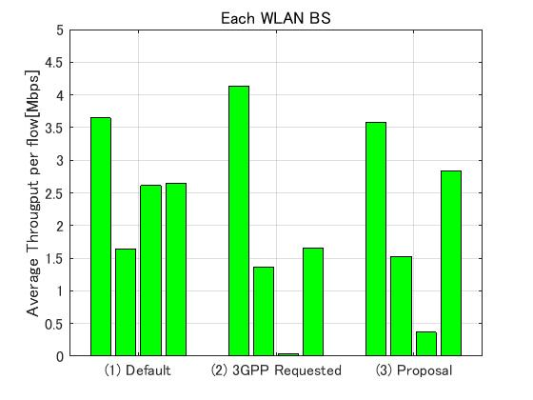
Simulation Result
・ Each BS Ave. DL Throughput per flow [Mbps]
- If WLAN controls TX power and, the lowest throughput of LAA BS is improved because WLAN BS reduces the TX power

Slide 18
Conclusion
By this simulation result, ”Dynamic TX power and ED threshold control” is the best solution to provide fairness between WLAN and LAA
If WLAN can control TX power and ED value, DL throughput of LAA BS and WLAN AP become comparable
  Furthermore, the lowest performance of LAA BS is improved by proposed method

Slide 19
References
[1] 11-16-1291-00-0000-pded-ad-hoc-agenda-27-sept-2016
[2] 11-16-1451-00-0000-Simulation-Analysis-of-ED-Threshold-
Levels
[3] 3GPP TR 36.889 V13.0.0
  [4] 3GPP TR 36.814.
[5] R1-156621(Coexistence Simulation Results for DL-only LAA)
[6] 3GPP TS 36.213 V14.0.0 (2016-09)

Slide 20
Appendix

Slide 21
Appendix 1. LAA channel access model [6]
Need to TX?
Initial CCA
Yes
Channel idle for T_{d}?
Yes
Transmit
No
Generate random number
N out of [0,CW]
Update CW
based on
HARQ-ACK
Extended CCA
Channel idle for T_{d}?
No
Yes
N=0?
Yes
T_{d}=16 μs+m_{p}*T_{sl}
T_{sl}=9 μs
No
N=N-1
No
Channel idle for T_{sl}?
Yes

Slide 22
Appendix 2. LAA ED rule
・ Excerpt from 3GPP TS 36.213[6]/15.2.3.1 “Default maximum energy detection threshold computation procedure”
If the higher layer parameter ‘absenceOfAnyOtherTechnology-r14’ indicates TRUE:
Eq(1)
otherwise
Eq(2)

Slide 23
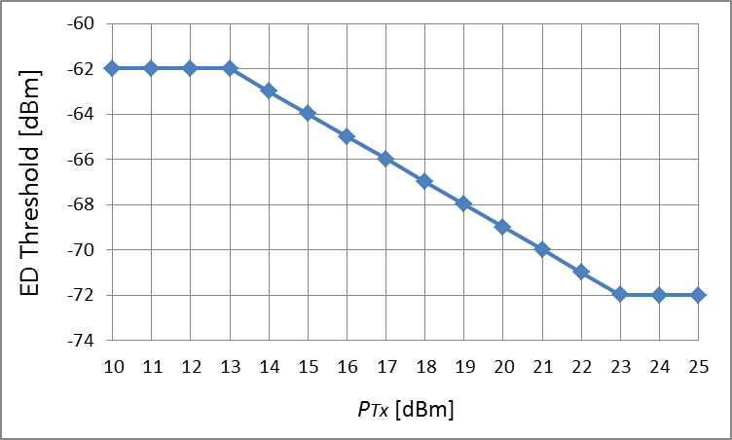
Appendix 2. LAA ED rule
・ In that case of WLAN and LAA coexistence, LAA’s ED threshold is calculated by Eq(2).
・If BW = 20MHz, LAA’s ED threshold is as follows.

Slide 24
Appendix 3. Traffic Model
We compare between difference ED threshold under two traffic model.
(A) FTP model 1 UDP
  This is default traffic model following 3GPP indoor scenario corresponding to TR36.889 [3].
  This traffic model is used in the simulation on R1-156621 (Coexistence Simulation Results for DL-only LAA) [4].
  This FTP model is described in 3GPP TR 36.814 [5].
  This is regarded as heavy traffic, but isn’t as full buffer.
(B) CBR UDP (75kbps)
  This traffic model is used in the simulation on R1-156621 (Coexistence Simulation Results for DL-only LAA) [4].
  This is regarded as very low traffic.

