Slide 1
Considerations on post wake-up sequences
Date: 2017-01-16
Authors:

Slide 2
Abstract
Discussing post wake-up sequences of WUR STAs
  Regarding transmission failure and recovery
Proposing to apply Wake-Up (WU) report exchange
  Avoiding excessive recovery delay
  Drawing a boundary between the Primary Connectivity Radio (PCR) and WUR MAC procedure
  Detecting false wake-up attack
Considerations on WU report on group addressed (multiple) wake-up scenario

Slide 3
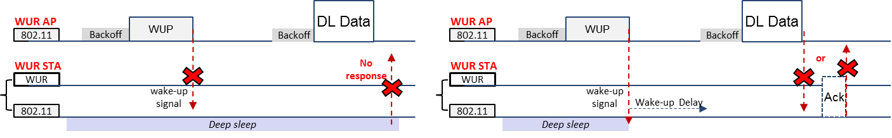
General post wake-up sequence
If a transmitted Wake-Up Packet (WUP) is delivered successfully to a WUR STA, the PCR of the STA starts to wake
After the STA wakes up, AP may initiate PCR transmission sequence
  AP must wait until the STA’s PCR is ready (Wake-Up Delay)
If the AP didn’t get any response, the reason could be one of:
  PCR Data or Ack transmission failure
  WUP transmission failure

Slide 4
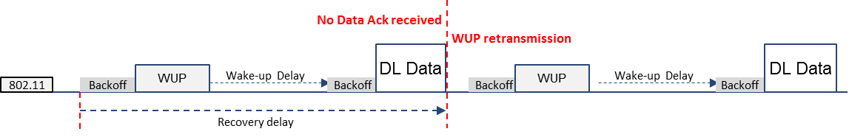
Recovery procedure of WUR AP
Since AP cannot find out what causes the lack of response, it should retry the whole procedure starting from WUP retransmission
  An excessive delay might occur
    including WUP, PCR transmission, WUD, and additional channel access delays
  The failure of PCR MAC procedure requires WUR MAC to invoke a retransmission of WUP
    WUR is expected to cooperate with many other different 802.11 MAC standards
    We need to minimize a requirement for changes between two different MAC specifications
It is necessary to finalize WUR wake-up procedure before the PCR data exchange
  In order to avoid such an excessive delay of WUP retransmission
  To separate wake-up sequence from PCR MAC procedure

Slide 5
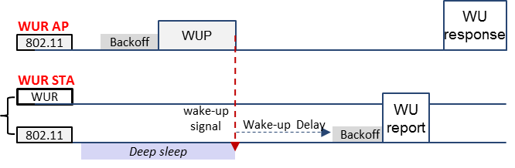
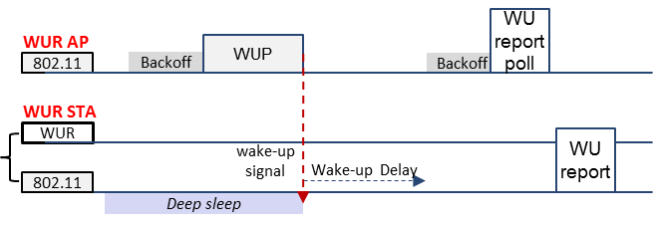
Wake-Up report exchange (1)
A 2-way handshake protocol using PCR can be considered
  A WUR STA reports its wake-up status
    WU report/response, if initiated by WUR STA
    WU report poll/report, if initiated by WUR AP
  Some useful information can also be included in the frame exchange
    Status information, following MAC sequence

Slide 6
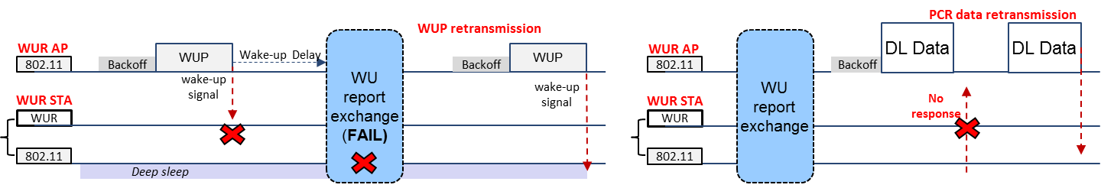
Wake-Up report exchange (2)
By applying WU report exchange,
  If there’s no WU report from the intended STA, AP retransmits WUP instead of initiating PCR transmission sequence which causes waste of resource
  In case of PCR transmission failure, AP doesn’t have to reinvoke WUR procedure
The PCR MAC procedure starts with the end of the WU report exchange (WUR MAC)

Slide 7
WU report and security
WU report procedure can be exploited to detect false wake-up
  Simply copying and repeating of any captured WUP might cause a STA’s power leakage
  If a WUR STA, not solicited by the WUR AP, sends a WU report, AP might be aware of an attack from the outside
    In which case, WU report initiated by the non-AP STA could be more appropriate
      The AP wouldn’t send WU report poll to which it haven’t sent a WUP
  After the detecting of false wake-up, WUR (re)association procedure might be invoked

Slide 8
Wake-up report in group addressed WUP
AP might wake-up multiple STA simultaneously with a single WUP
  To reduce overhead caused by the listing of WUR addresses
    e.g., modulated by OOK
  A group management procedure may exist using PCR
    Group assignment, group address for WUP
In Group Addressed (GA) WUR scenario, WU report exchange might incur overhead problem as well
  WU report might be sent both either contention or scheduling basis
  The more number of STAs assigned in a same group, the longer the delay caused by the WU reports exchange procedure

Slide 9
Considerations on WU report exchange scheme in group wake-up scenario (1)
One of the easiest ways is simply not to allow group wake-up STAs to send WU reports
  To avoid the latency caused by the WU report exchange
However, WU report is still important especially for group wake-up STAs
  The long duration of recovery, including both WUR and PCR MAC procedure, causes power consumption and latency of multiple STAs
  False wake-up attack with group addressed WUP could be fatal
It is necessary to find out a proper way to apply the WU report exchange in group wake-up situation

Slide 10
Considerations on WU report exchange scheme in group wake-up scenario (2)
One of the main usage scenarios of 11ba standard is IoT networks
  The variance of number of associated STAs could be much larger than the existing WLAN usage scenario
    10s to 100s
      E.g., Home automation vs. cargo scenario
  Priority differences
    A WUR group may be consist of heterogeneous devices
      E.g., an anchor node (data sink) with a lot of normal sensor nodes
    STAs may have different WUDs and latency requirements
More flexible WU reporting scheme might be necessary instead of a fixed reporting policy
  For example, letting AP to choose which STAs to send WU reports adaptively
  Need further discussions

Slide 11
Conclusion
In this contribution, we have discussed the necessity of WU report and corresponding issues
WU report exchange could be beneficial in terms of:
  Reducing the delay of recovery procedure
  Boundary between WUR and PCR MAC
  Detecting false wake-up attack
WU report exchange could also be applied to group wake-up scenario
  Further discussions are required for better application
    Considering the variety of usage model of 11ba

Slide 12
Strawpoll 1
Do you agree that the WU report procedure is necessary for WUR networks?
Y/N/A

Slide 13
Strawpoll 2
Do you agree that the WU report procedure is necessary for group wake-up STAs?
Y/N/A

